Slide 1
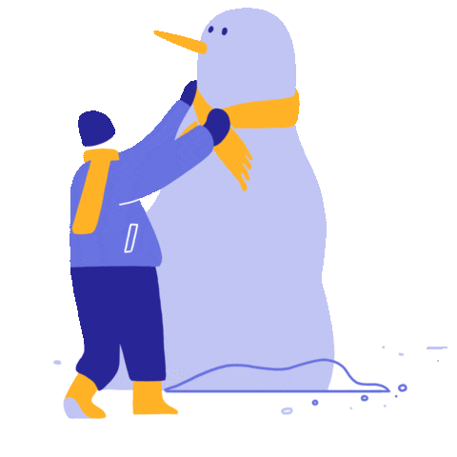

Play in the sand
Play in the snow

Slide 2


https://giphy.com/stickers/elexmedia-elex-elexmediakomputindo-media-IfmFnXSTBo8q8YlhH6
Wear Sandals Wear tennis shoes

Slide 3
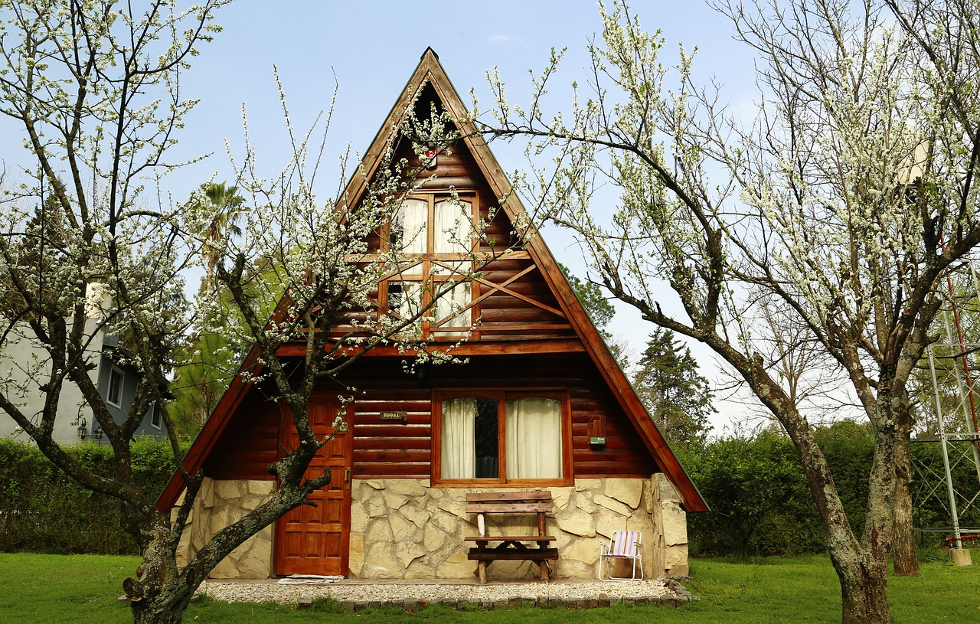
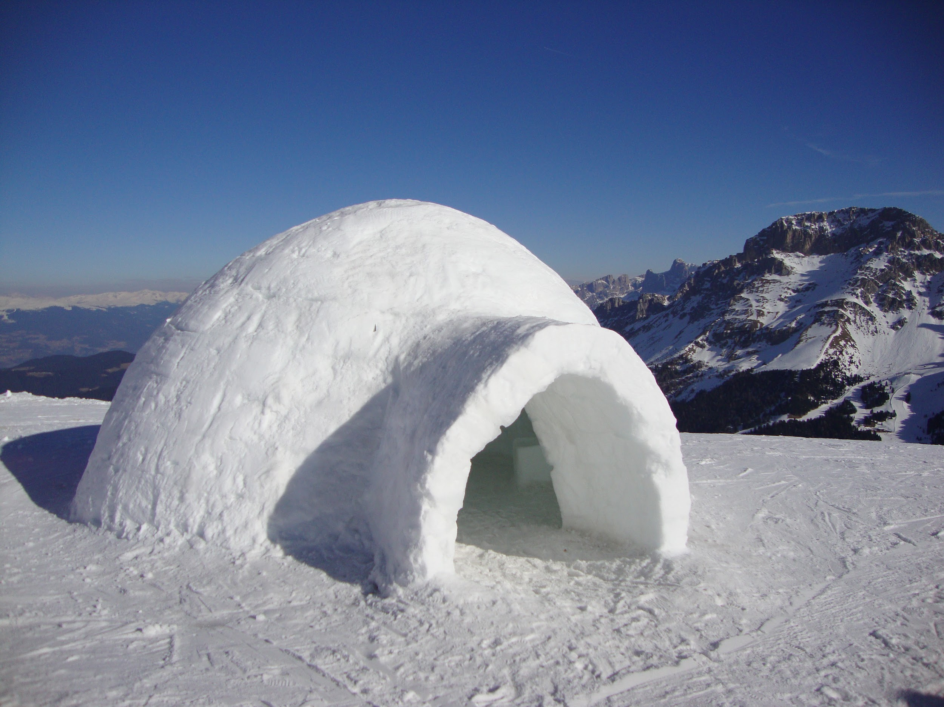
Sleep in a cabin in the woods Sleep in an igloo in the snow

Slide 4

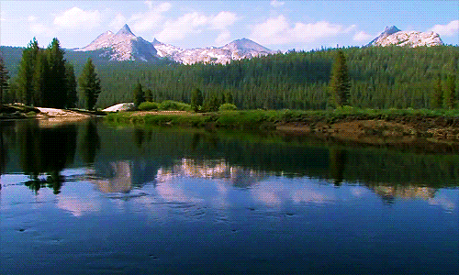
Live in a city Live in the country

Slide 5
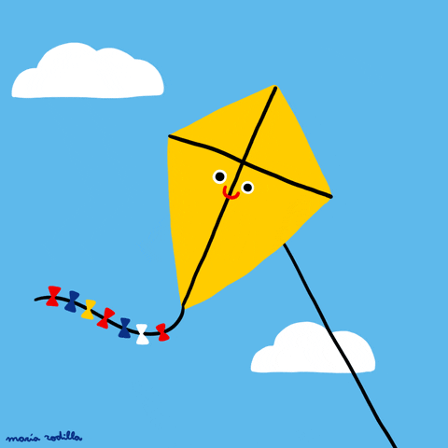
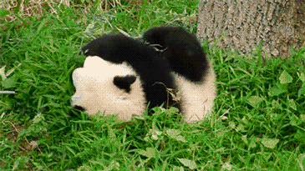
Fly a kite Roll down a hill

Slide 6


Live without music Live without books

Slide 7


Explore the oceans Explore Outer Space

Slide 8


Eat super spicy foods Eat super sour foods

Slide 9

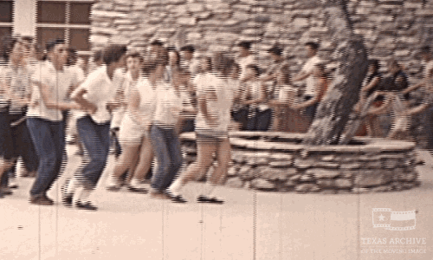
Do the Chicken Dance Do the Bunny Hop

Slide 10


Play HIde-and-Seek Play Tag

Slide 11


Try to catch a squirrel Try to catch a frog

