Slide 1



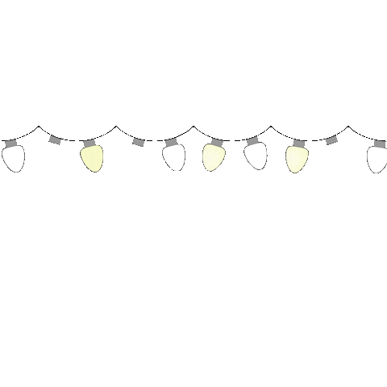








Mrs. Anand will be back in 5 minutes….
via Le

Slide 2






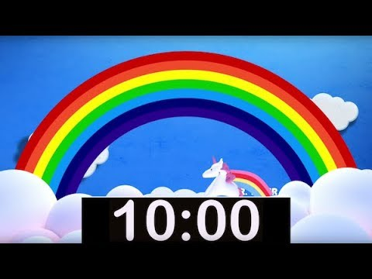

Mrs. Anand will be back in 10 minutes….

Slide 3

