Slide 1
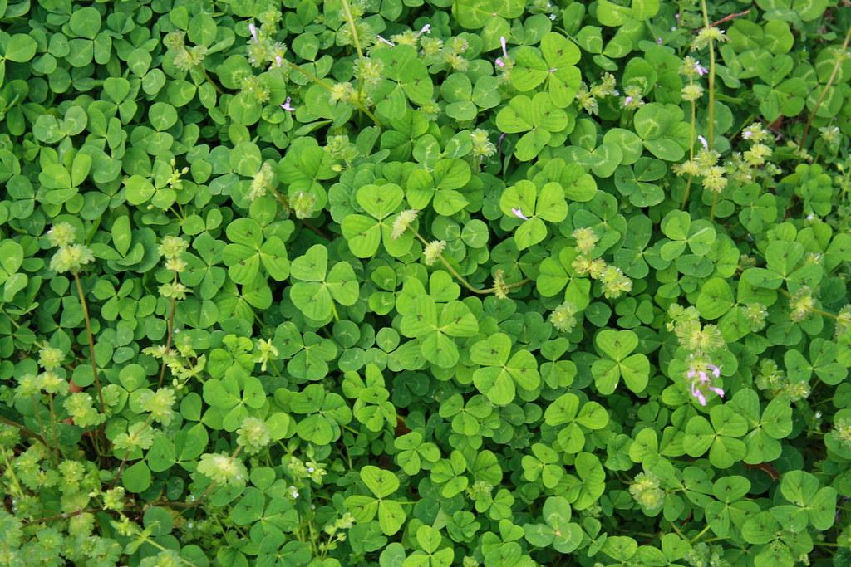

Play Tic Tac Toe with your class or have students challenge another student. They say the coordinates and I move the marker for them or I share the doc and assign them a slide.
March
Tic-Tac-Toe
Notes:
Created by Malee Her of Bitmoji Craze for Educators
Tic Tac Toe template credits goes to Clara Bernardo of Bitmoji Craze for Educators

Slide 2

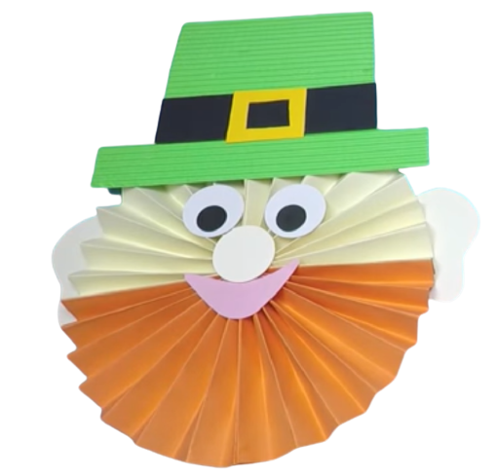
A
B
C
1
2
3

Slide 3
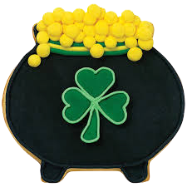
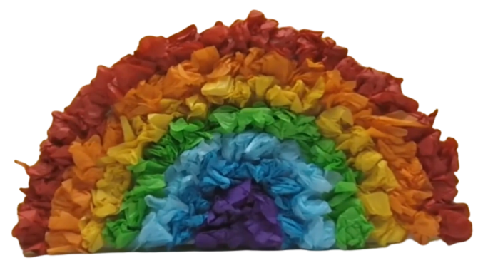
A
B
C
1
2
3

Slide 4


A
B
C
1
2
3

Slide 5
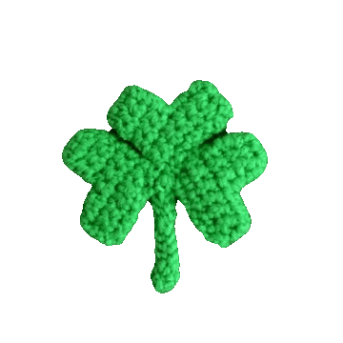

A
B
C
1
2
3

Slide 6
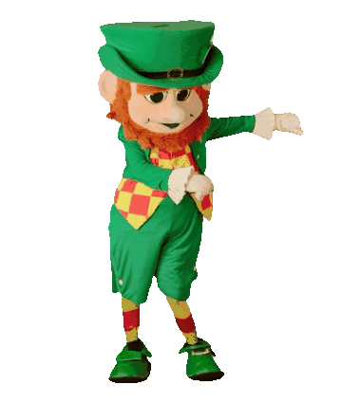
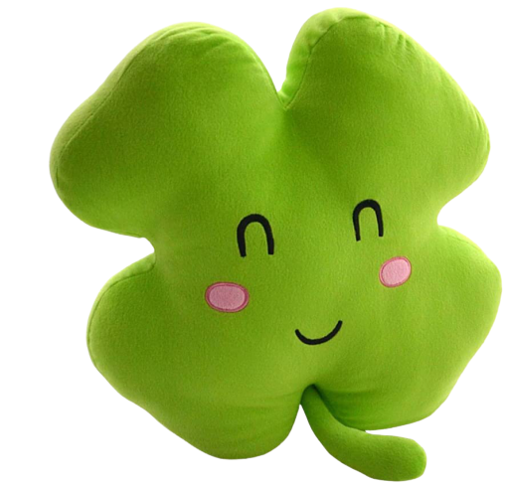
A
B
C
1
2
3

Slide 7


A
B
C
1
2
3

Slide 8

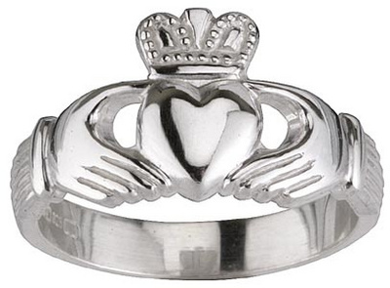
A
B
C
1
2
3

