Slide 1




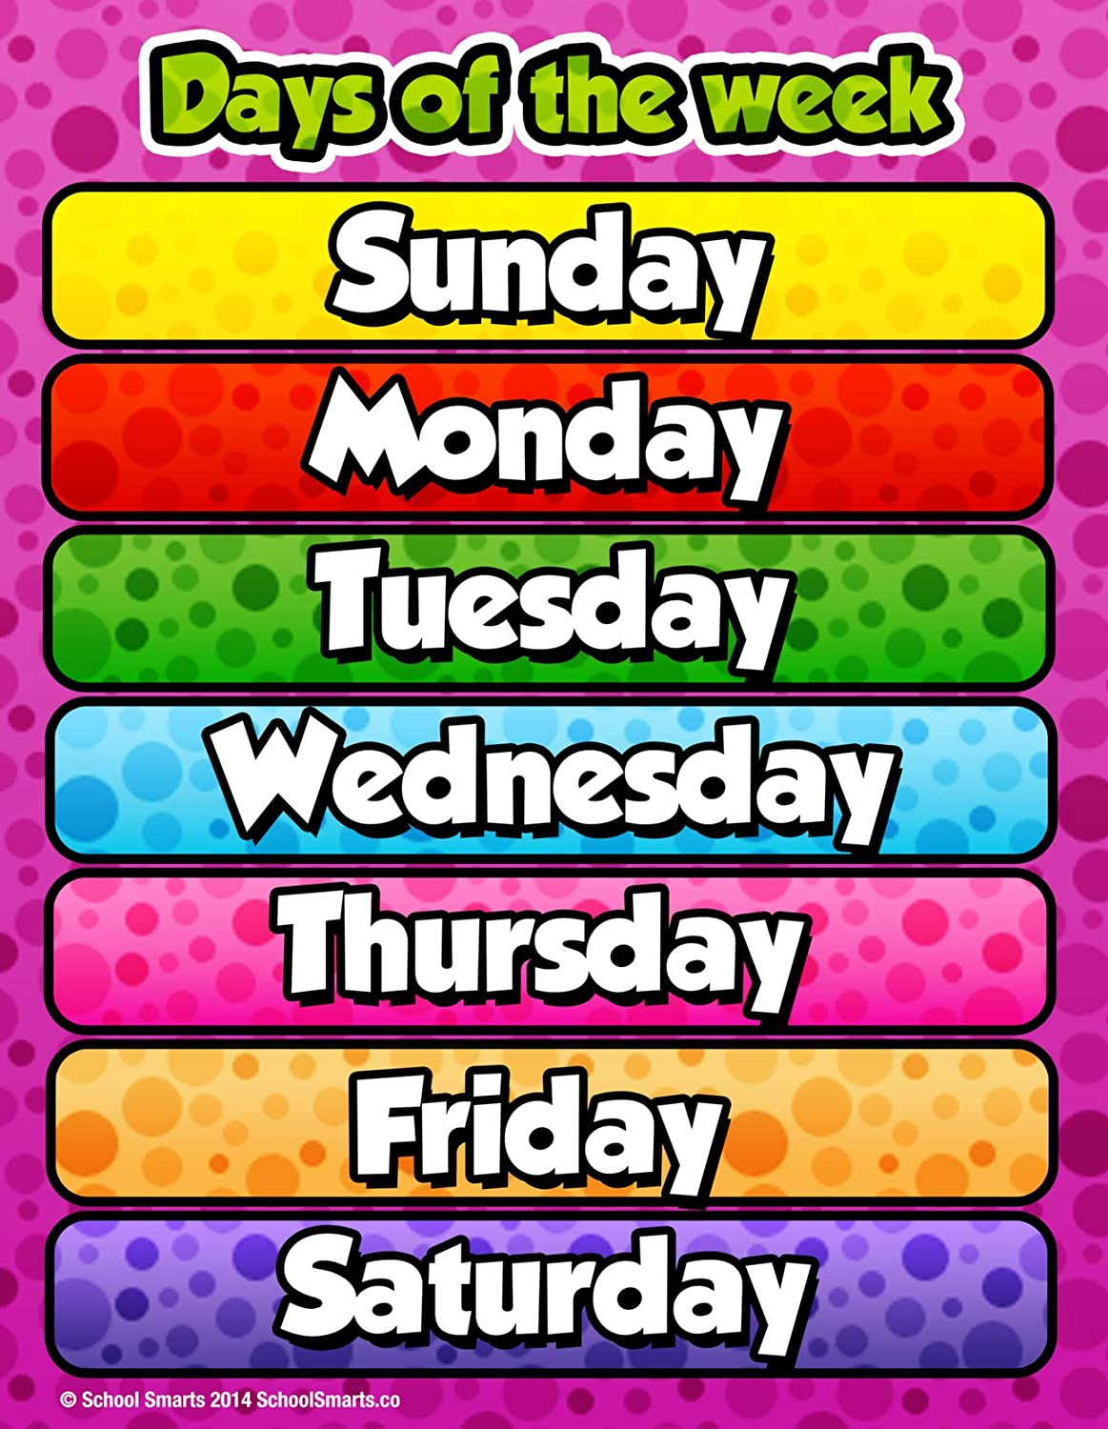



















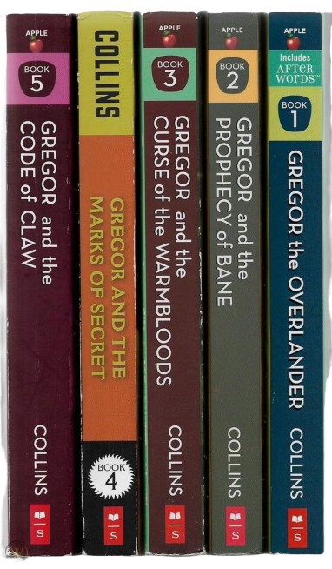

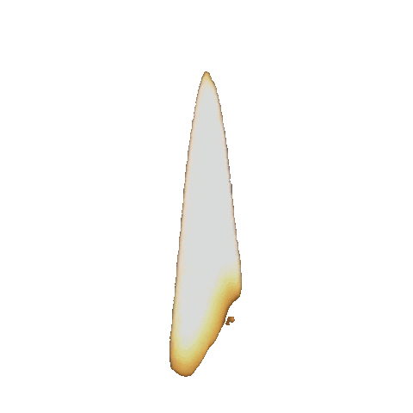

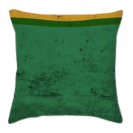



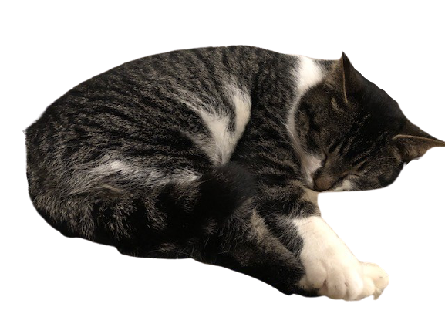



March 1, 2021
DID YOU KNOW?
"Arachibutyrophobia" is the fear of peanut butter sticking to the roof of your mouth..
To Do
Bridges Materials Out

Slide 2

March 2, 2021
DID YOU KNOW?
A crocodile cannot stick its tongue out.
To Do
Bridges Materials Out

Slide 3

March 3, 2021
DID YOU KNOW?
A shrimp's heart is in its head.
To Do
Bridges Materials Out

Slide 4

March 4, 2021
DID YOU KNOW?
If you sneeze too hard, you could fracture a rib.
To Do
Bridges Materials Out

Slide 5
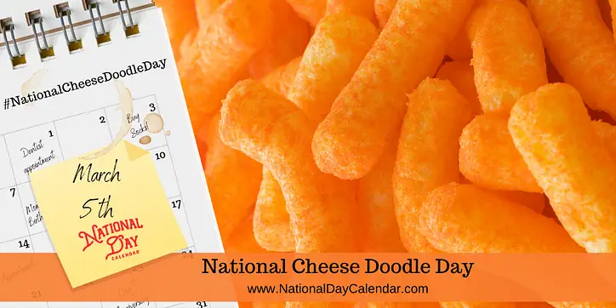
March 5, 2021
DID YOU KNOW?
There are 293 ways to make change for a dollar.
To Do
Bridges Materials Out

Slide 6

March 8, 2021
DID YOU KNOW?
A shark is the only known fish that can blink with both eyes.
To Do
Bridges Materials Out

Slide 7

March 9, 2021
DID YOU KNOW?
"Dreamt" is the only English word that ends in the letters "mt."
To Do
Bridges Materials Out

Slide 8

March 10, 2021
DID YOU KNOW?
Almonds are a member of the peach family.
To Do
Bridges Materials Out

Slide 9

March 11, 2021
DID YOU KNOW?
Maine is the only state that has a one-syllable name.
To Do
Bridges Materials Out

Slide 10

March 12, 2021
DID YOU KNOW?
DID YOU KNOW?
A cat has 32 muscles in each ear.
To Do
Bridges Materials Out

Slide 11

March 15, 2021
DID YOU KNOW?
An ostrich's eye is bigger than its brain.
To Do
Bridges Materials Out

Slide 12

March 16, 2021
DID YOU KNOW?
A dime has 118 ridges around the edge.
To Do
Bridges Materials Out

Slide 13
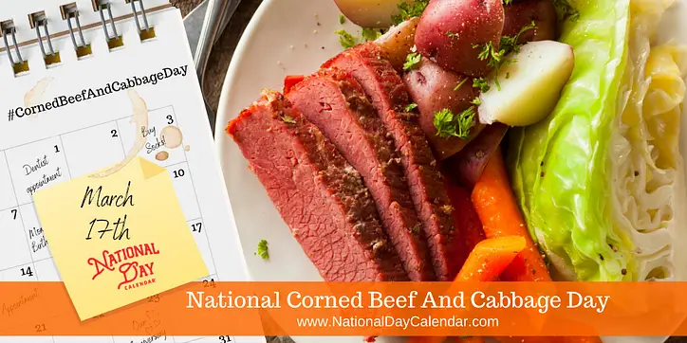
March 17, 2021
DID YOU KNOW?
Most people fall asleep in seven minutes.
To Do
Bridges Materials Out

Slide 14

March 18, 2021
DID YOU KNOW?
The average U.S. household has 300,000 things in it..
To Do
Bridges Materials Out

Slide 15

March 19, 2021
DID YOU KNOW?
The first item sold on eBay was a broken laser pointer.
To Do
Bridges Materials Out

Slide 16

March, 22 2021
DID YOU KNOW?
There was a prehistoric dragonfly that's wings spanned more than two feet.
To Do
Bridges Materials Out

Slide 17

March 23, 2021
DID YOU KNOW?
Shakespeare invented more than 1,700 words.
To Do
Bridges Materials Out

Slide 18

March 24, 2021
DID YOU KNOW?
It is impossible for most people to lick their own elbow.
To Do
Bridges Materials Out

Slide 19

March 25, 2021
DID YOU KNOW?
One of the largest pyramids in the world is a Bass Pro Shops in Memphis, Tennessee.
To Do
Bridges Materials Out

Slide 20

March 26, 2021
DID YOU KNOW?
Extreme ironing is an actual sport.
To Do
Bridges Materials Out

Slide 21

March 29, 2021
DID YOU KNOW?
It's illegal to own just one guinea pig in Switzerland, you must own two or more.
To Do
Bridges Materials Out

Slide 22

March 30, 2021
DID YOU KNOW?
"Q" is the only letter that doesn't appear in any U.S. state name.
To Do
Bridges Materials Out

