Slide 1
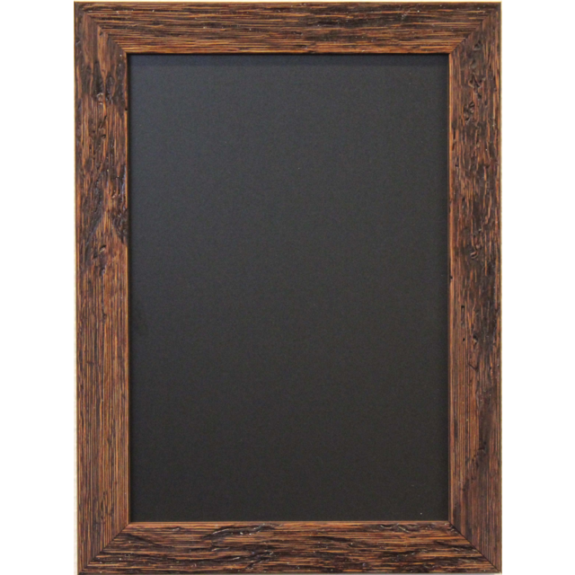

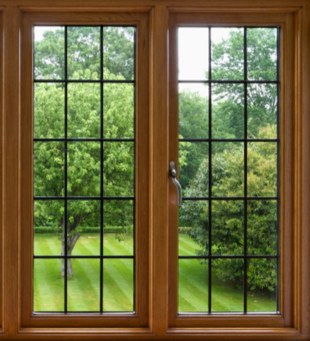


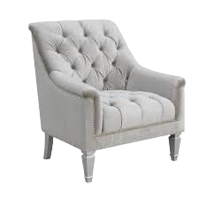
Language | Math | Other
9am Character | Math Facts | Science
9:15 Writing | PE | Relax
9:40 Reading | Today's Lesson | Worldly Study
10:35 Vocab | Groups | Weekly Artist

Slide 2

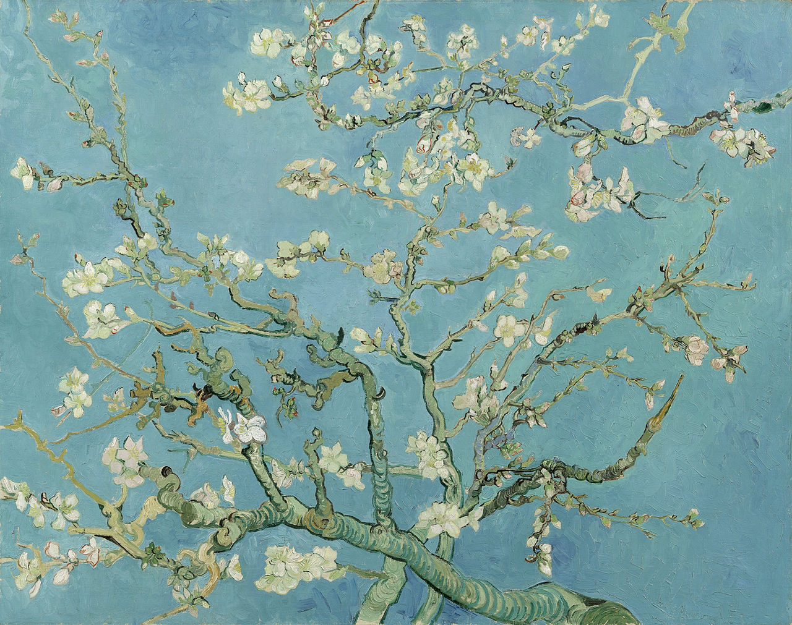
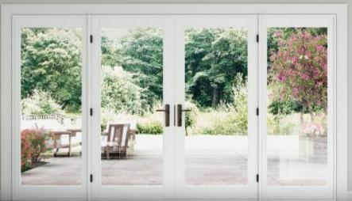
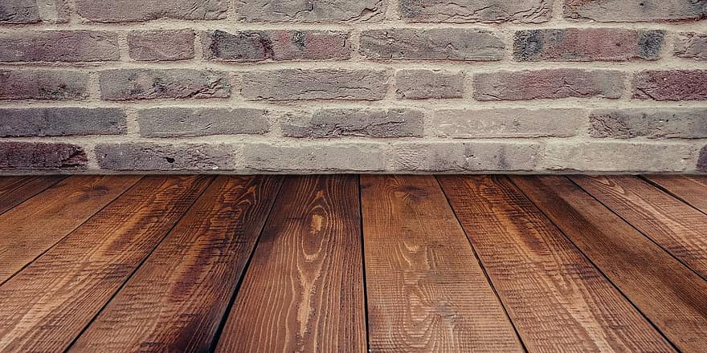
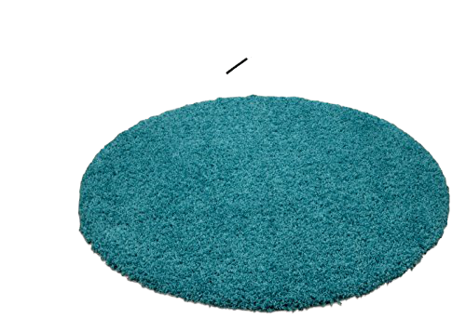
Language | Math | Other
9am Character | Math Facts | Science
9:15 Writing | PE | Relax
9:40 Reading | Today's Lesson | Worldly Study
10:35 Vocab | Groups | Weekly Artist

Slide 3
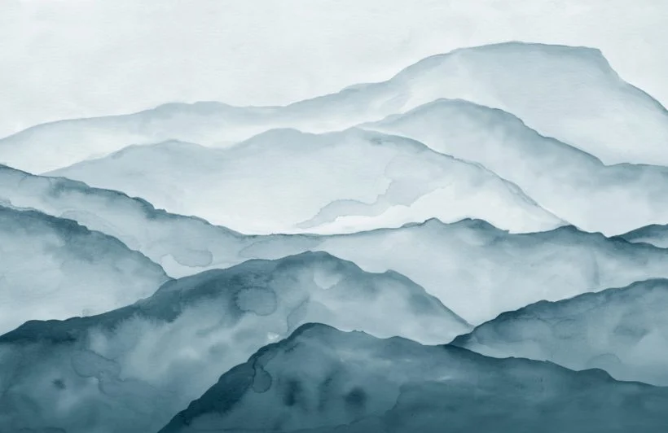

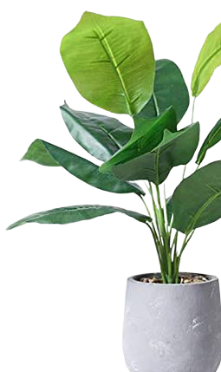
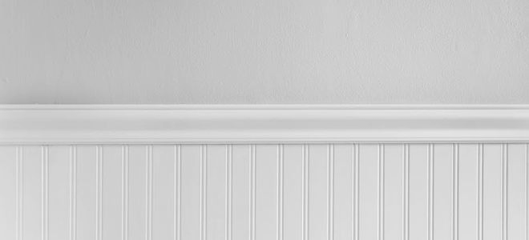


Language | Math | Other
9am Character | Math Facts | Science
9:15 Writing | PE | Relax
9:40 Reading | Today's Lesson | Worldly Study
10:35 Vocab | Groups | Weekly Artist

Slide 4

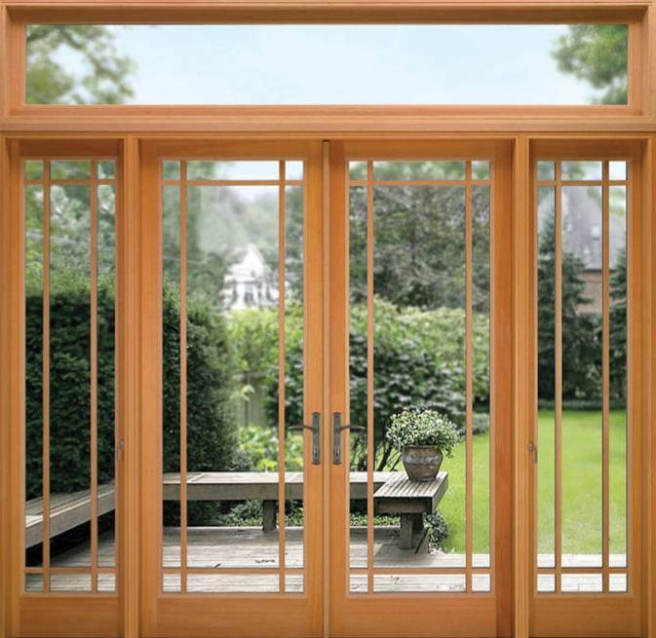

Language | Math | Other
9am Character | Math Facts | Science
9:15 Writing | PE | Relax
9:40 Reading | Today's Lesson | Worldly Study
10:35 Vocab | Groups | Weekly Artist

Slide 5


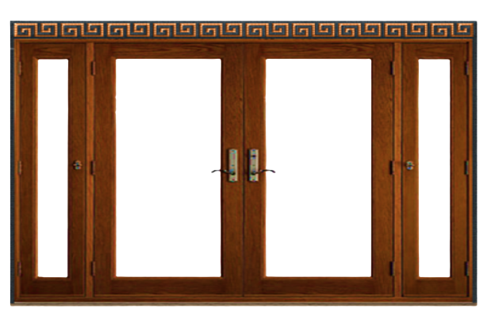
Language | Math | Other
9am Character | Math Facts | Science
9:15 Writing | PE | Relax
9:40 Reading | Today's Lesson | Worldly Study
10:35 Vocab | Groups | Weekly Artist

Slide 6

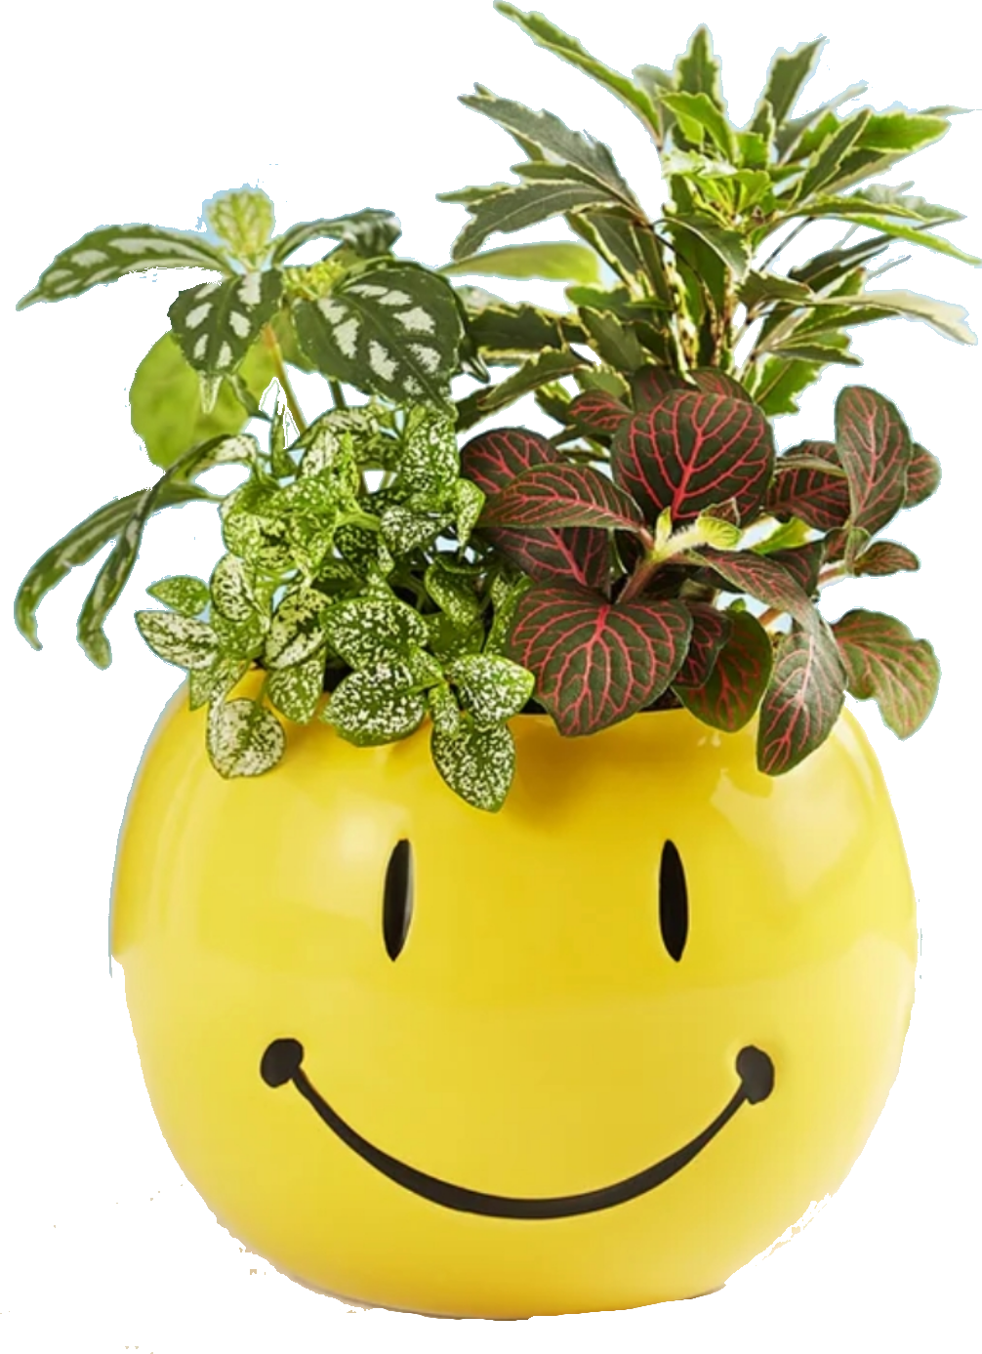
Language | Math | Other
9am Character | Math Facts | Science
9:15 Writing | PE | Relax
9:40 Reading | Today's Lesson | Worldly Study
10:35 Vocab | Groups | Weekly Artist

