Slide 1
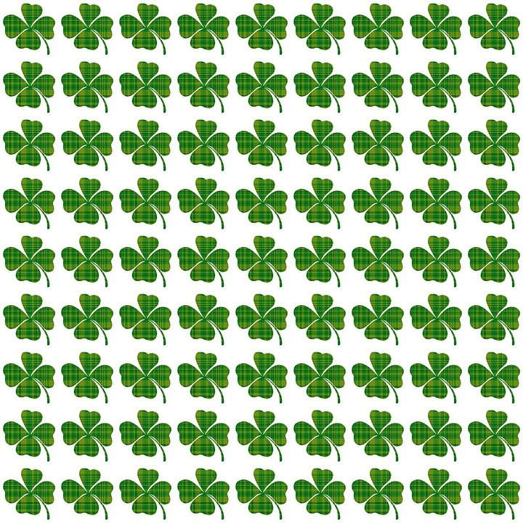
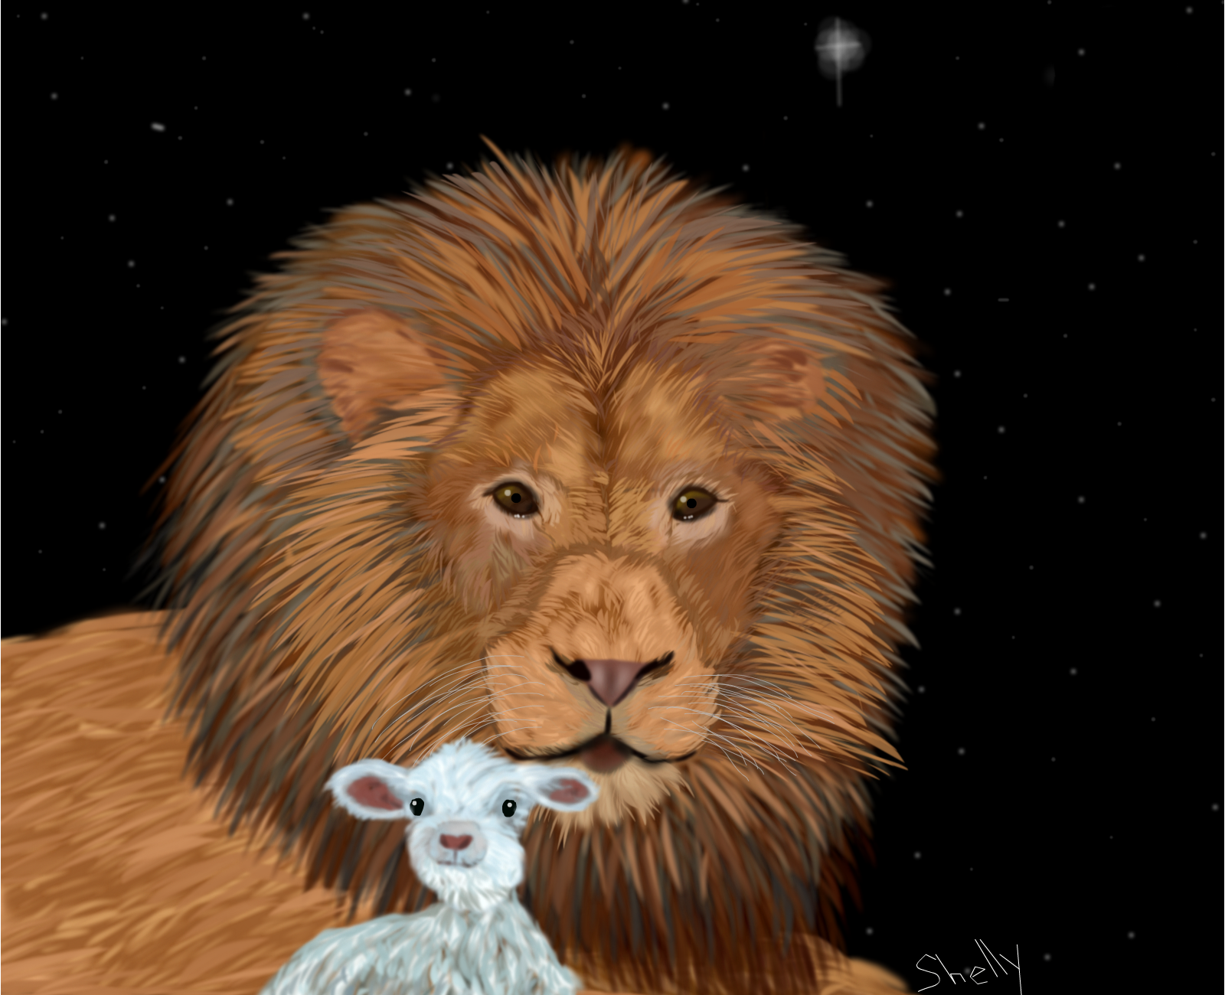


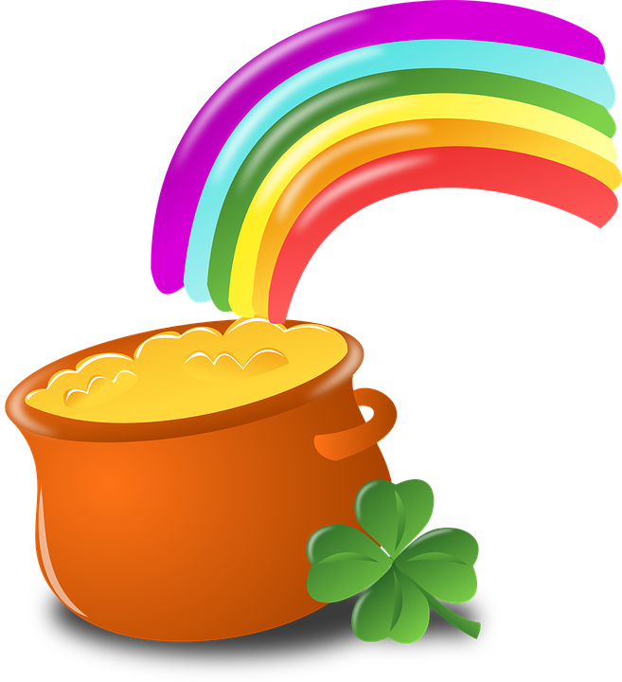
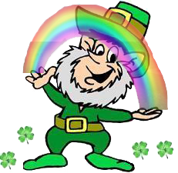
March Scavenger Hunt

Slide 2
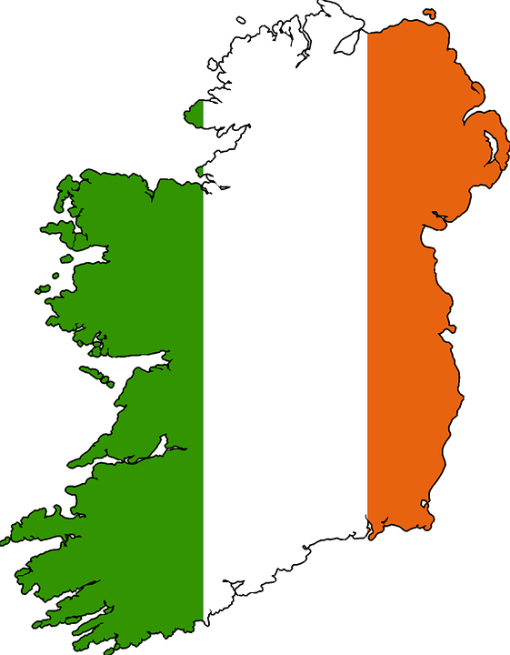

Find something that begins with the same letter as the first letter in IRELAND.

Slide 3

Find something the same color as a shamrock

Slide 4

Find something that you would serve at a St. Patrick’s Day Dinner

Slide 5

Find something the same color as any color in the rainbow

Slide 6
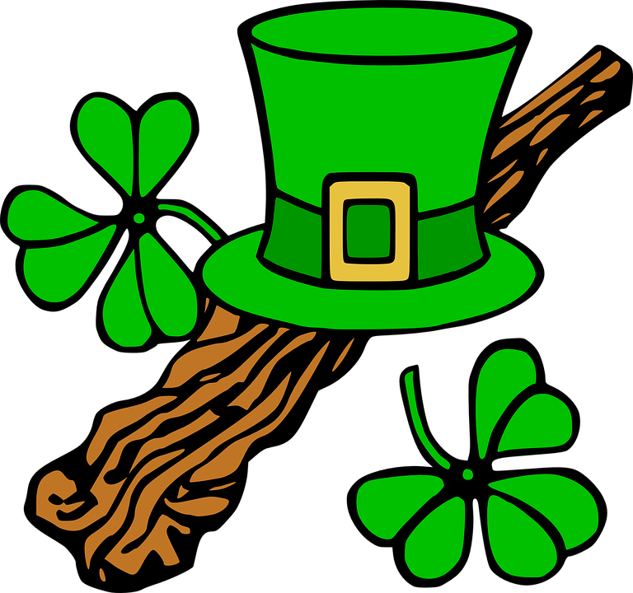
Find any kind of hat

Slide 7
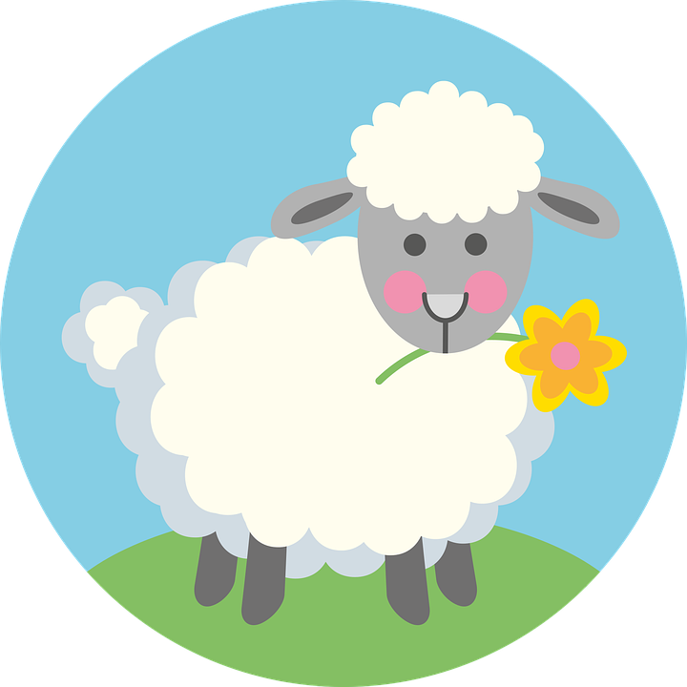
Find something as soft and cuddly as this lamb.

Slide 8

Find a Spring decoration

Slide 9

Find something that can move easily in the wind

