Slide 1
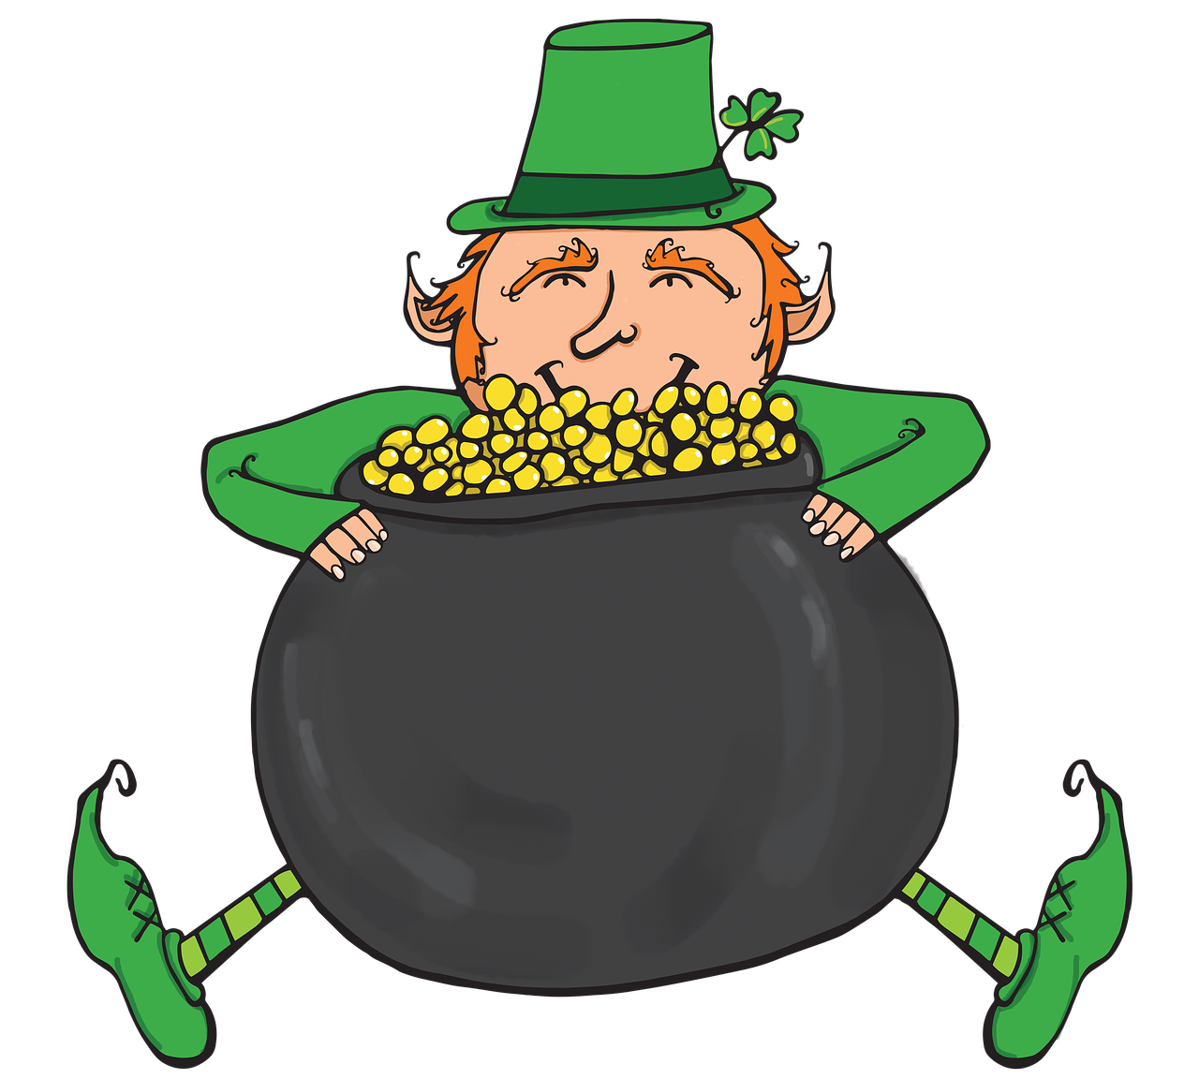

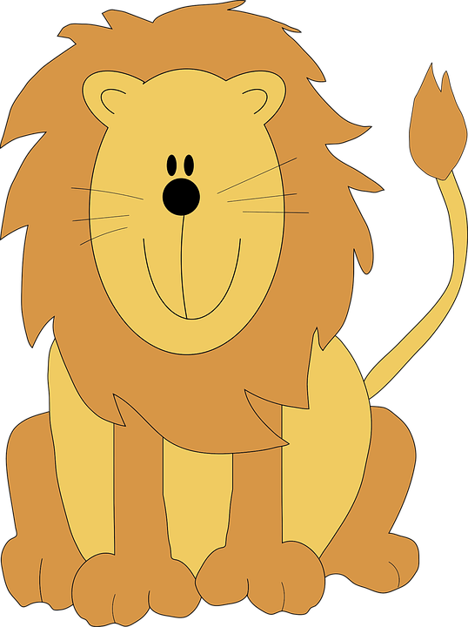
WELCOME TO MARCH!

Slide 2
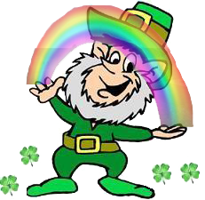
What’s your favorite flavor of ice-cream?

Slide 3
What’s your least favorite type of candy?

Slide 4
If you could visit anywhere in the world, where would you go?

Slide 5
What is your least favorite food?

Slide 6
What’s your favorite movie?

Slide 7
What’s your dream job?

Slide 8
If you could go to any point in history, where would you go?

Slide 9
If you could change one thing about yourself, what would it be?

Slide 10
What is your greatest accomplish-ment?

Slide 11
What are three things you do everyday?

Slide 12
Are you organized or messy?

Slide 13
If you were faced with a disaster, what 3 things (not people) would you save?

Slide 14
Happy St. Patrick’s Day! What makes you feel lucky?

Slide 15
What help can you offer a friend in need?

Slide 16
Tomorrow is the first day of Spring! What does that mean to you?

Slide 17
If you could change one thing in the world, what would it be?

Slide 18
If you were faced with a disaster, what 3 things (not people) would you save?

Slide 19
Which would you give up, your sight or your hearing?

Slide 20
What help can you offer a friend in need?

Slide 21
If an alien landed in your yard, what would you do?

Slide 22
Which would you give up, your sight or your hearing?

Slide 23
What makes you the most happy?

Slide 24
If an alien landed in your yard, what would you do?

