Slide 1
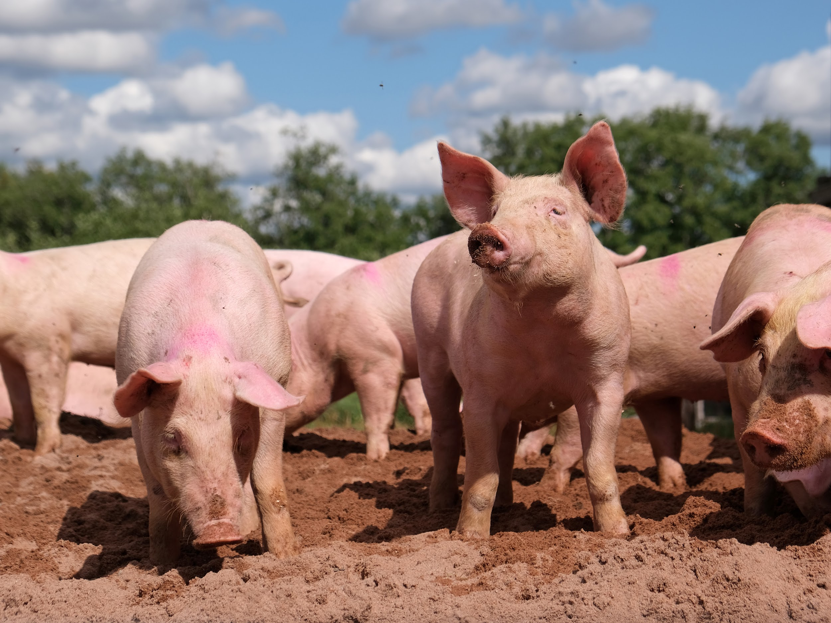
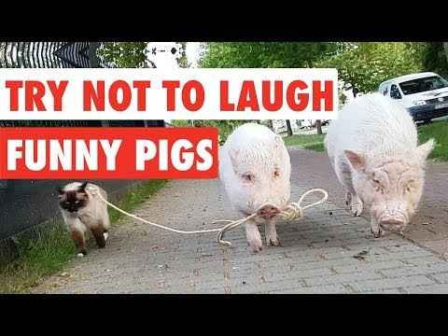
Today is…
National Pig Day!
Notes:
3/1

Slide 2

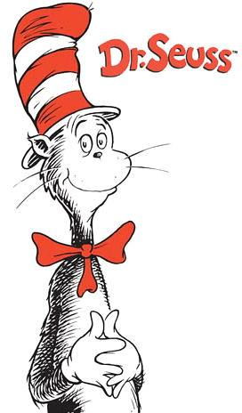
Today is Read Across America Day!
Notes:
3/02

Slide 3

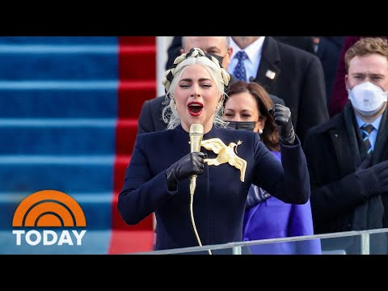
Today is National Anthem Day!
Notes:
3/3

Slide 4
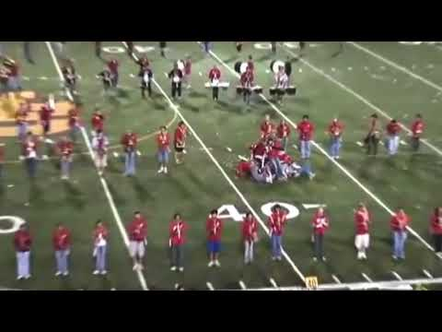
Today is national marching band day!
Notes:
3/4

Slide 5
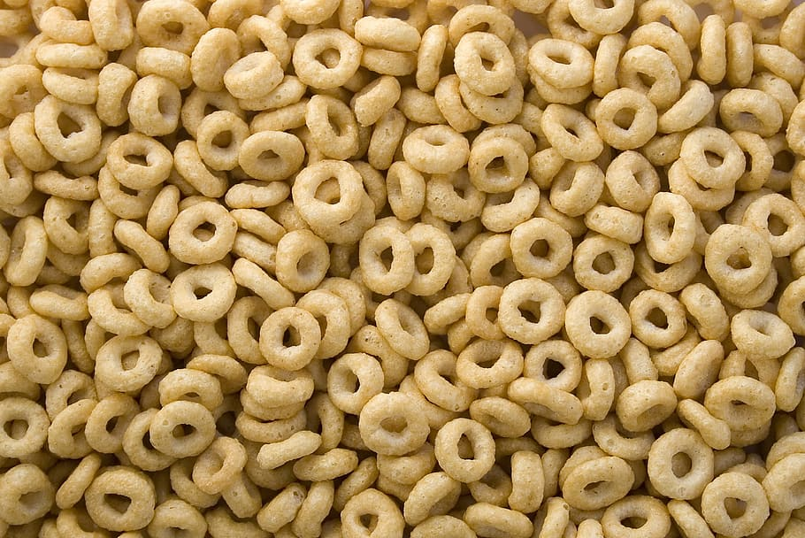
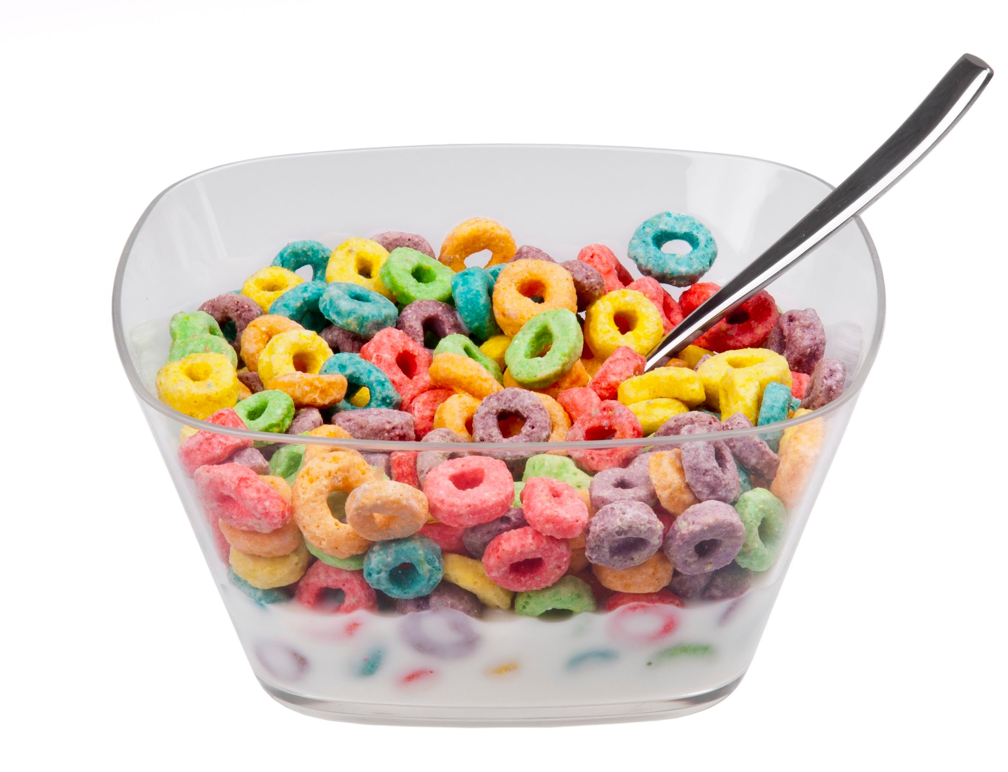
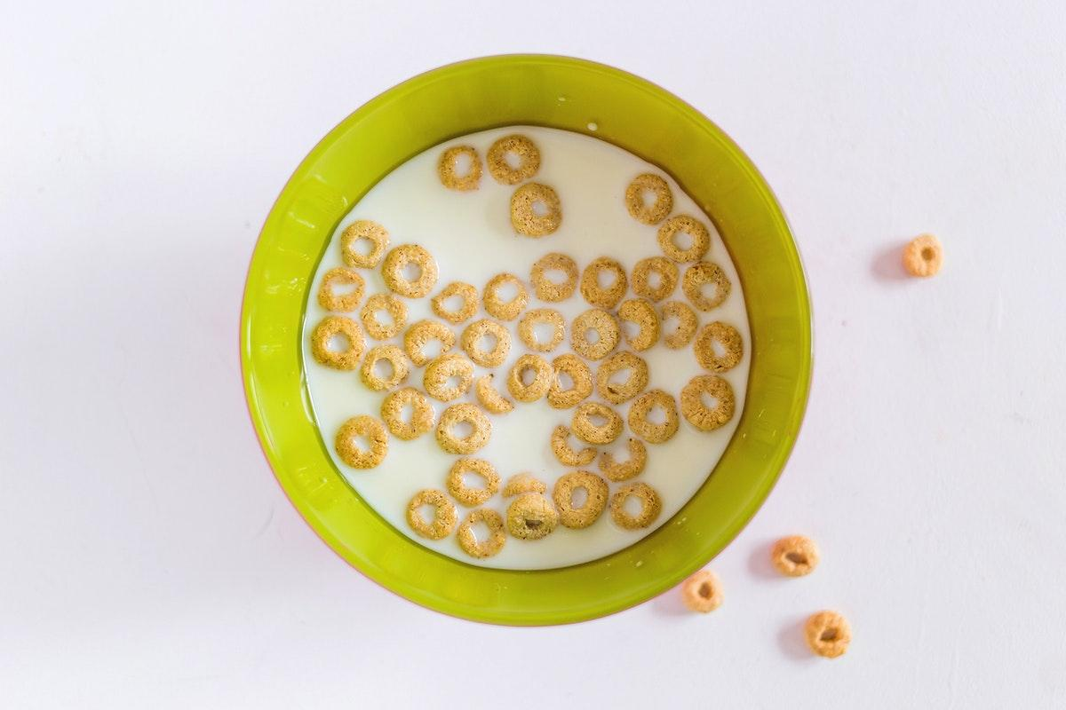
It is cereal day!
What is your favorite kind of cereal?
Notes:
3/7

Slide 6

It is international women’s day!!!
Notes:
3/8

Slide 7
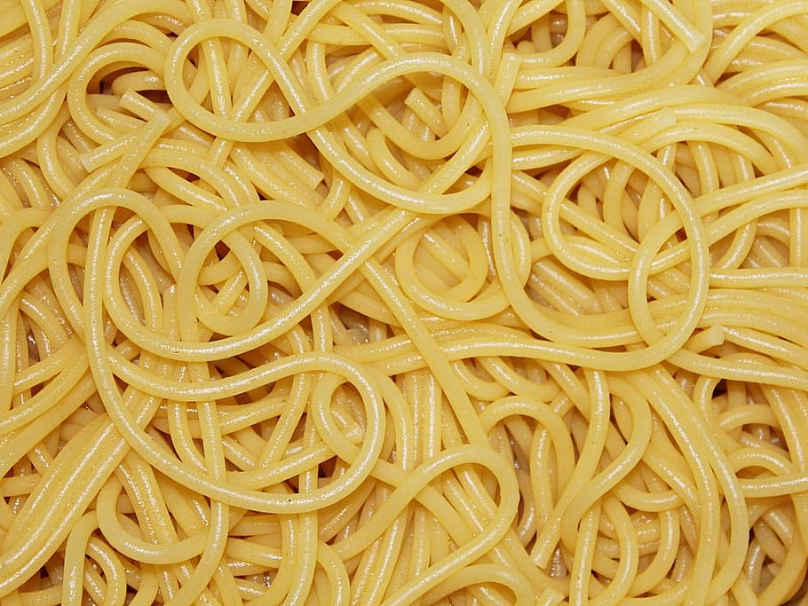
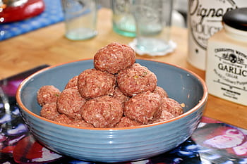
Today is national meatball day!
Notes:
3/9

Slide 8
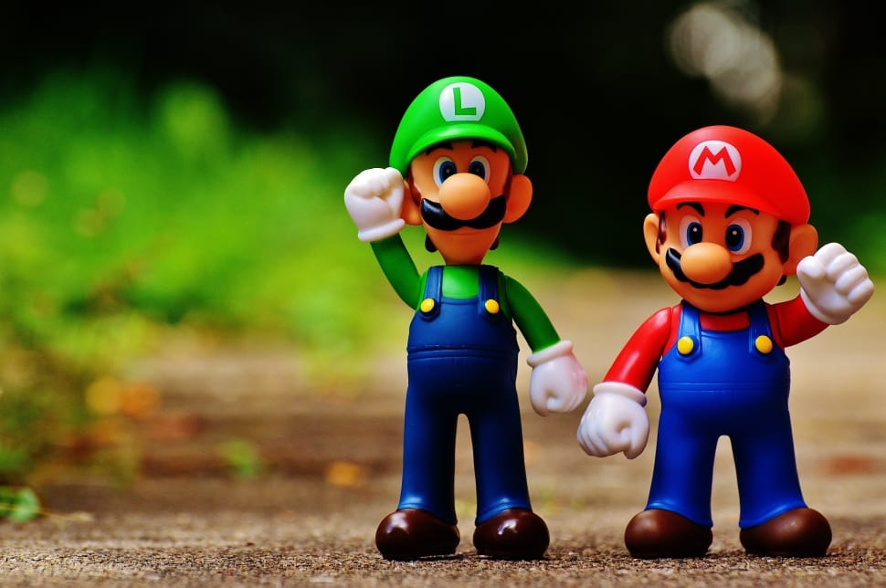
Today is Mario Day!
Notes:
3/10

Slide 9
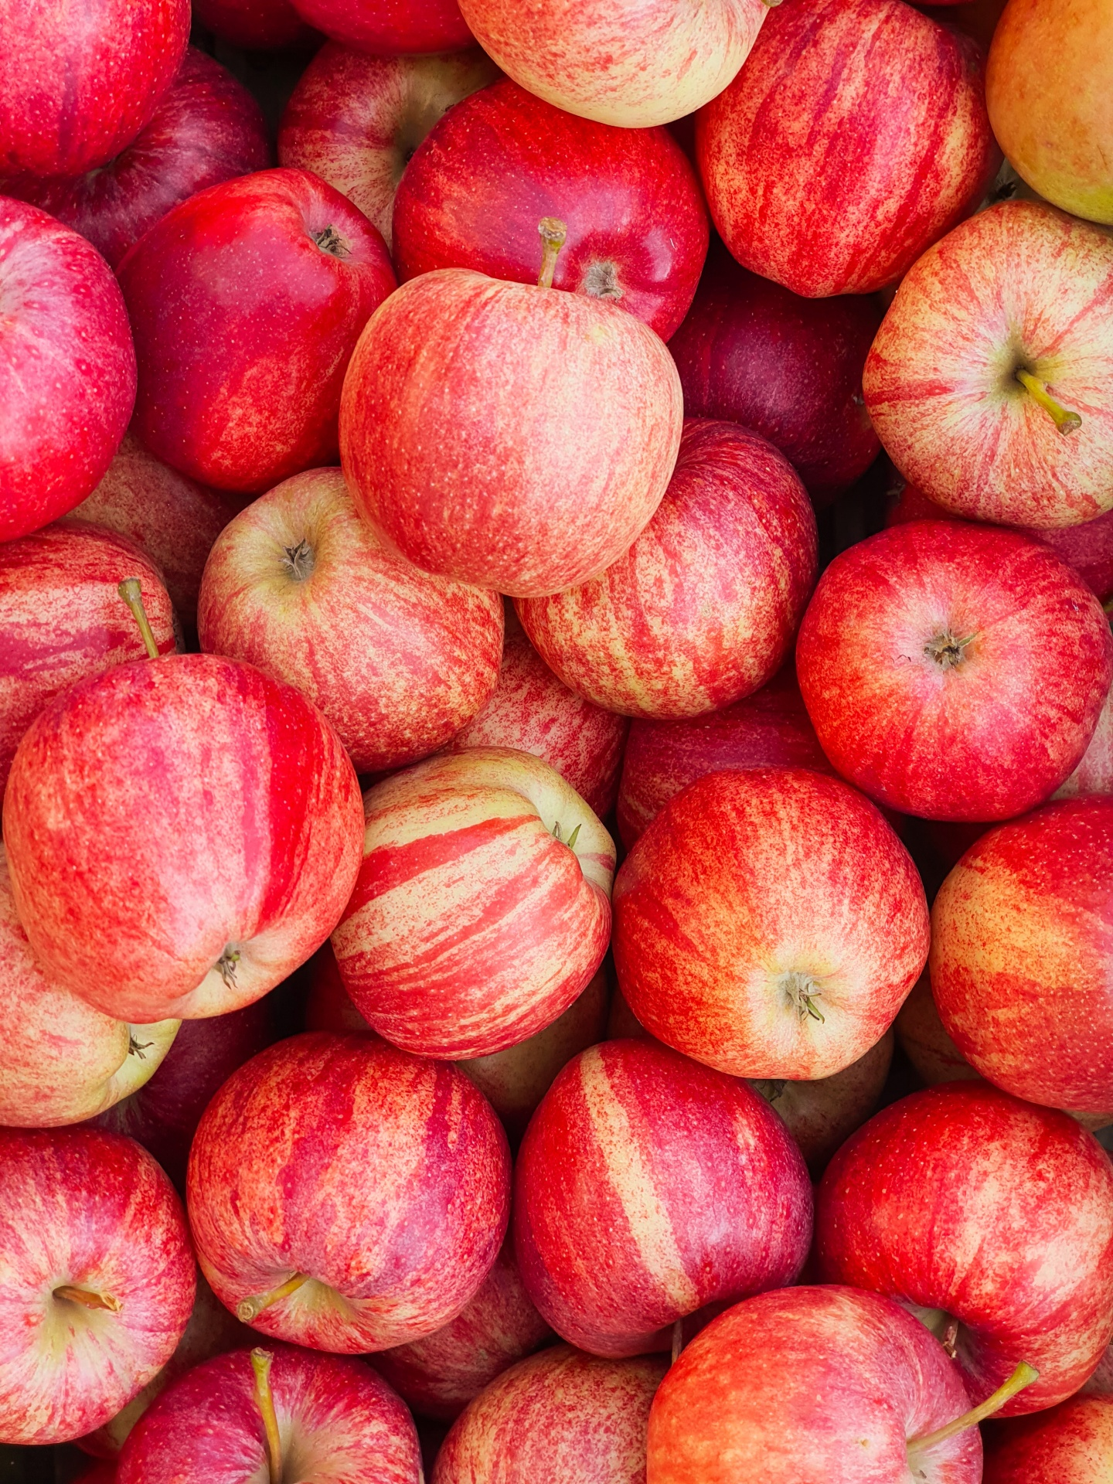

It is Johnny Appleseed day!
Notes:
3/11

Slide 10
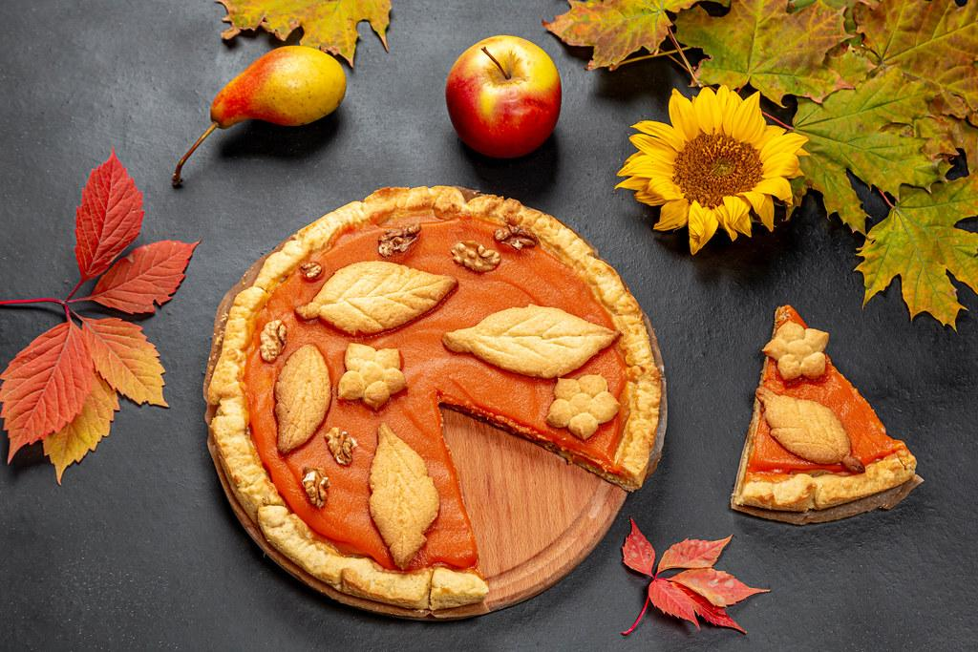
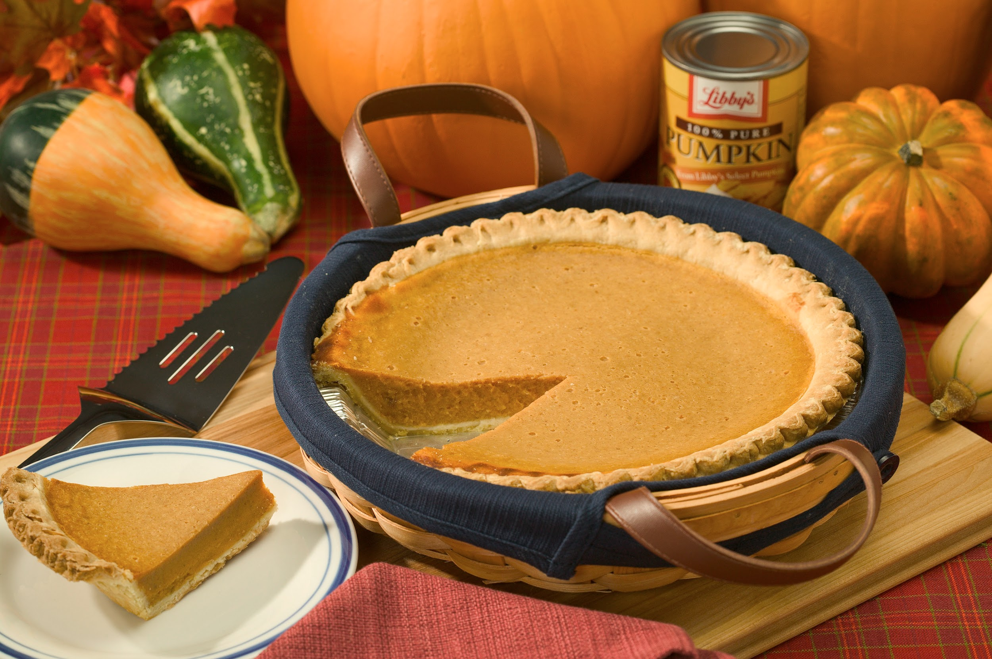
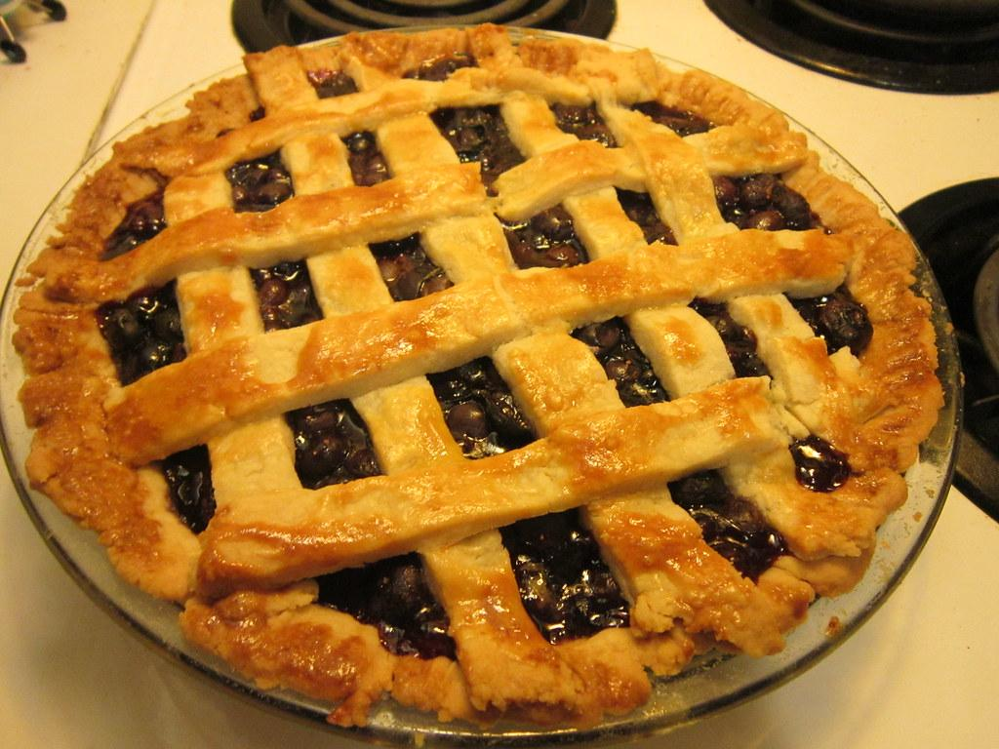
Today is Pi Day!
What is your favorite kind of pie?
Notes:
3/14

Slide 11
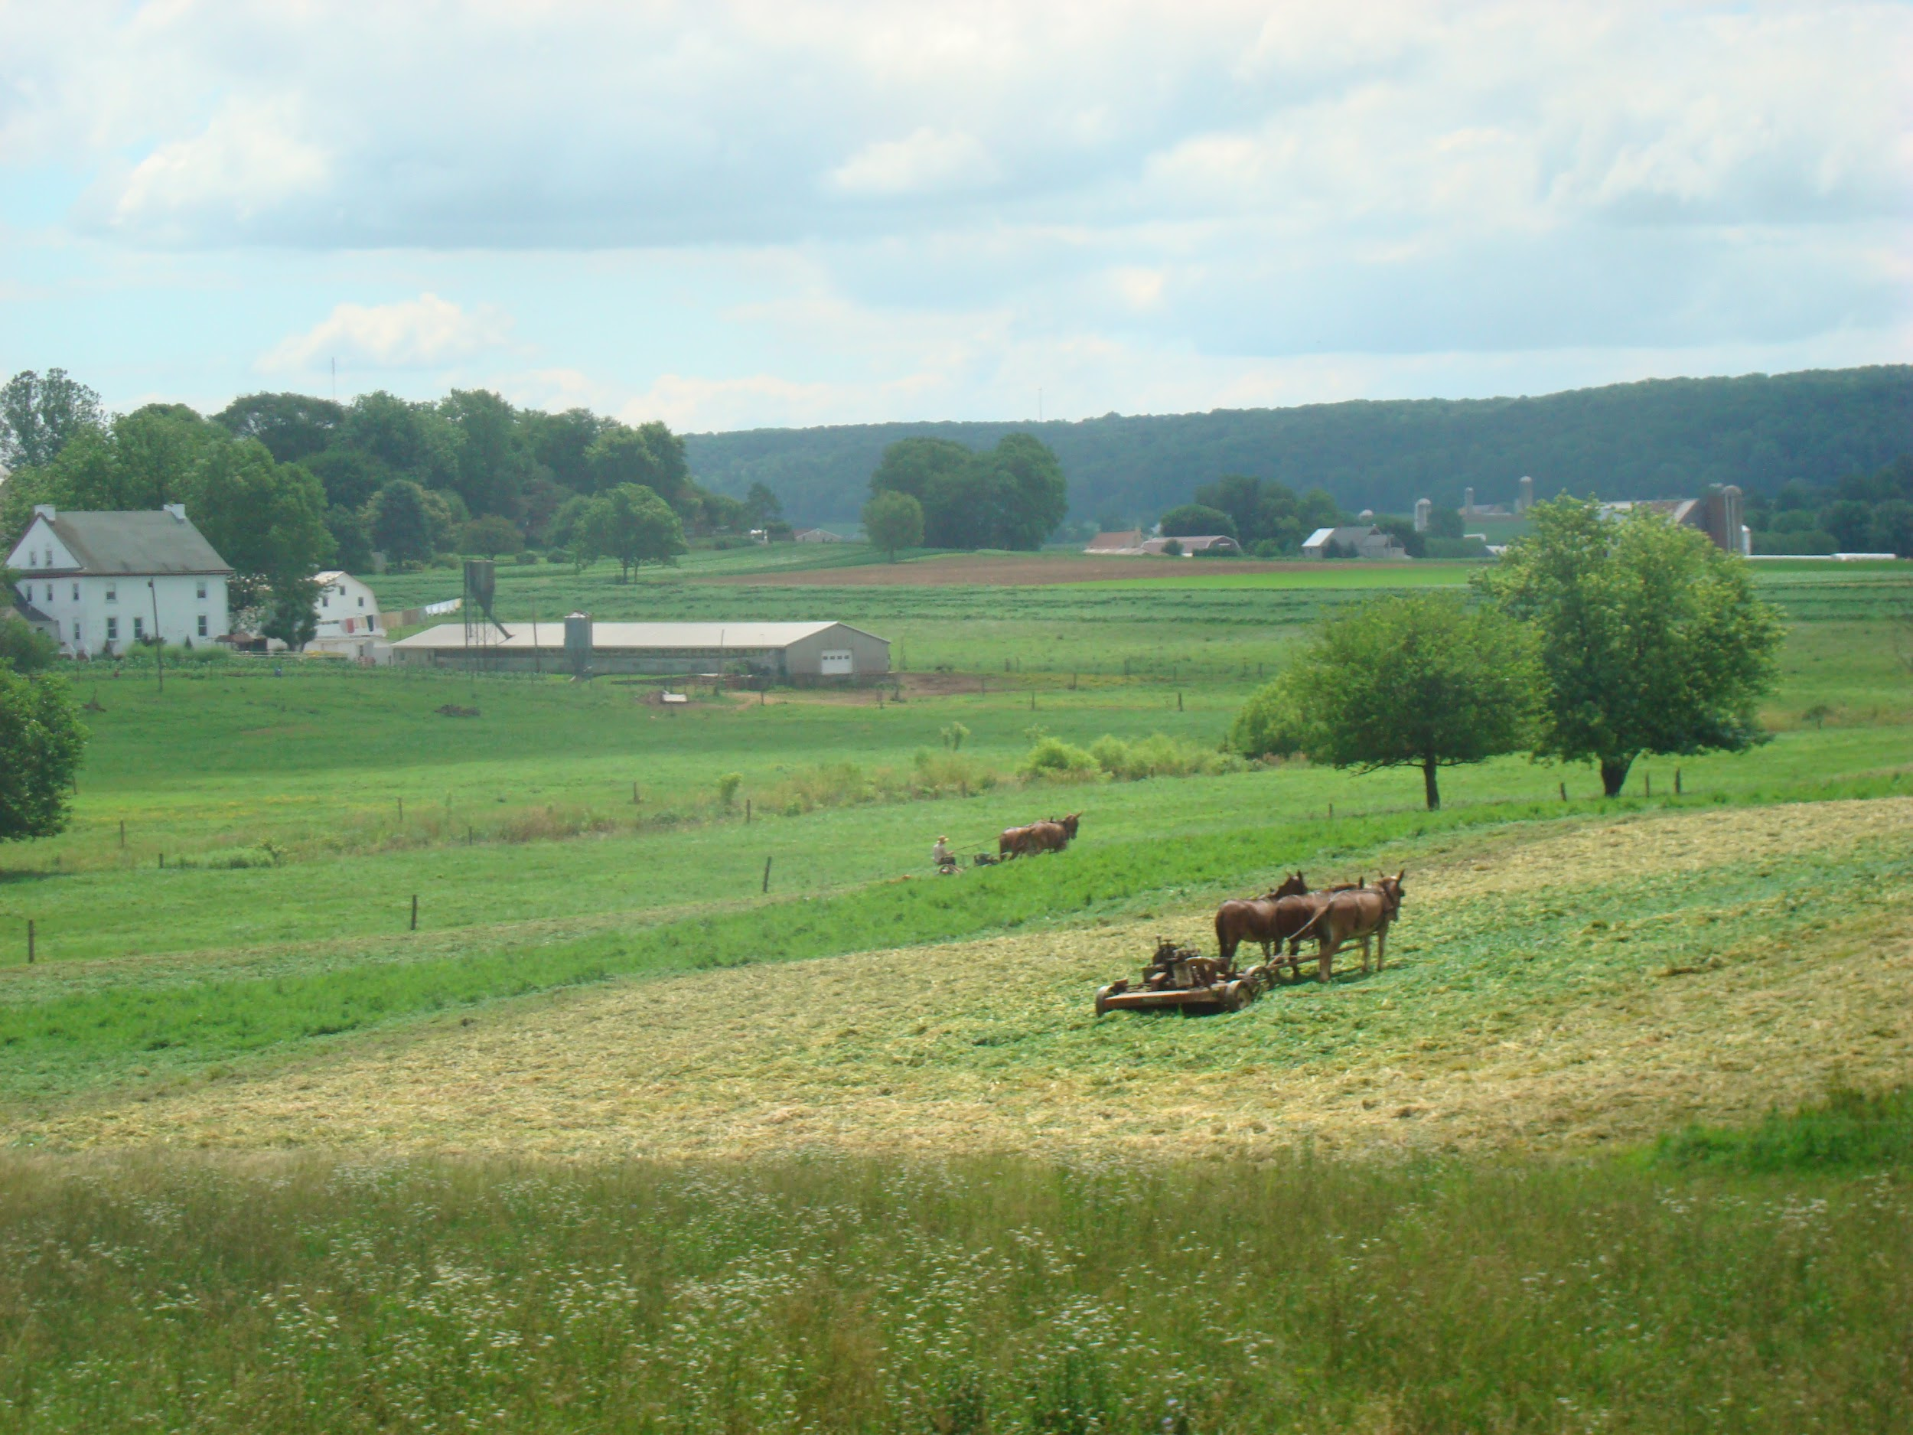

It is national Kansas day!
Notes:
3/15

Slide 12
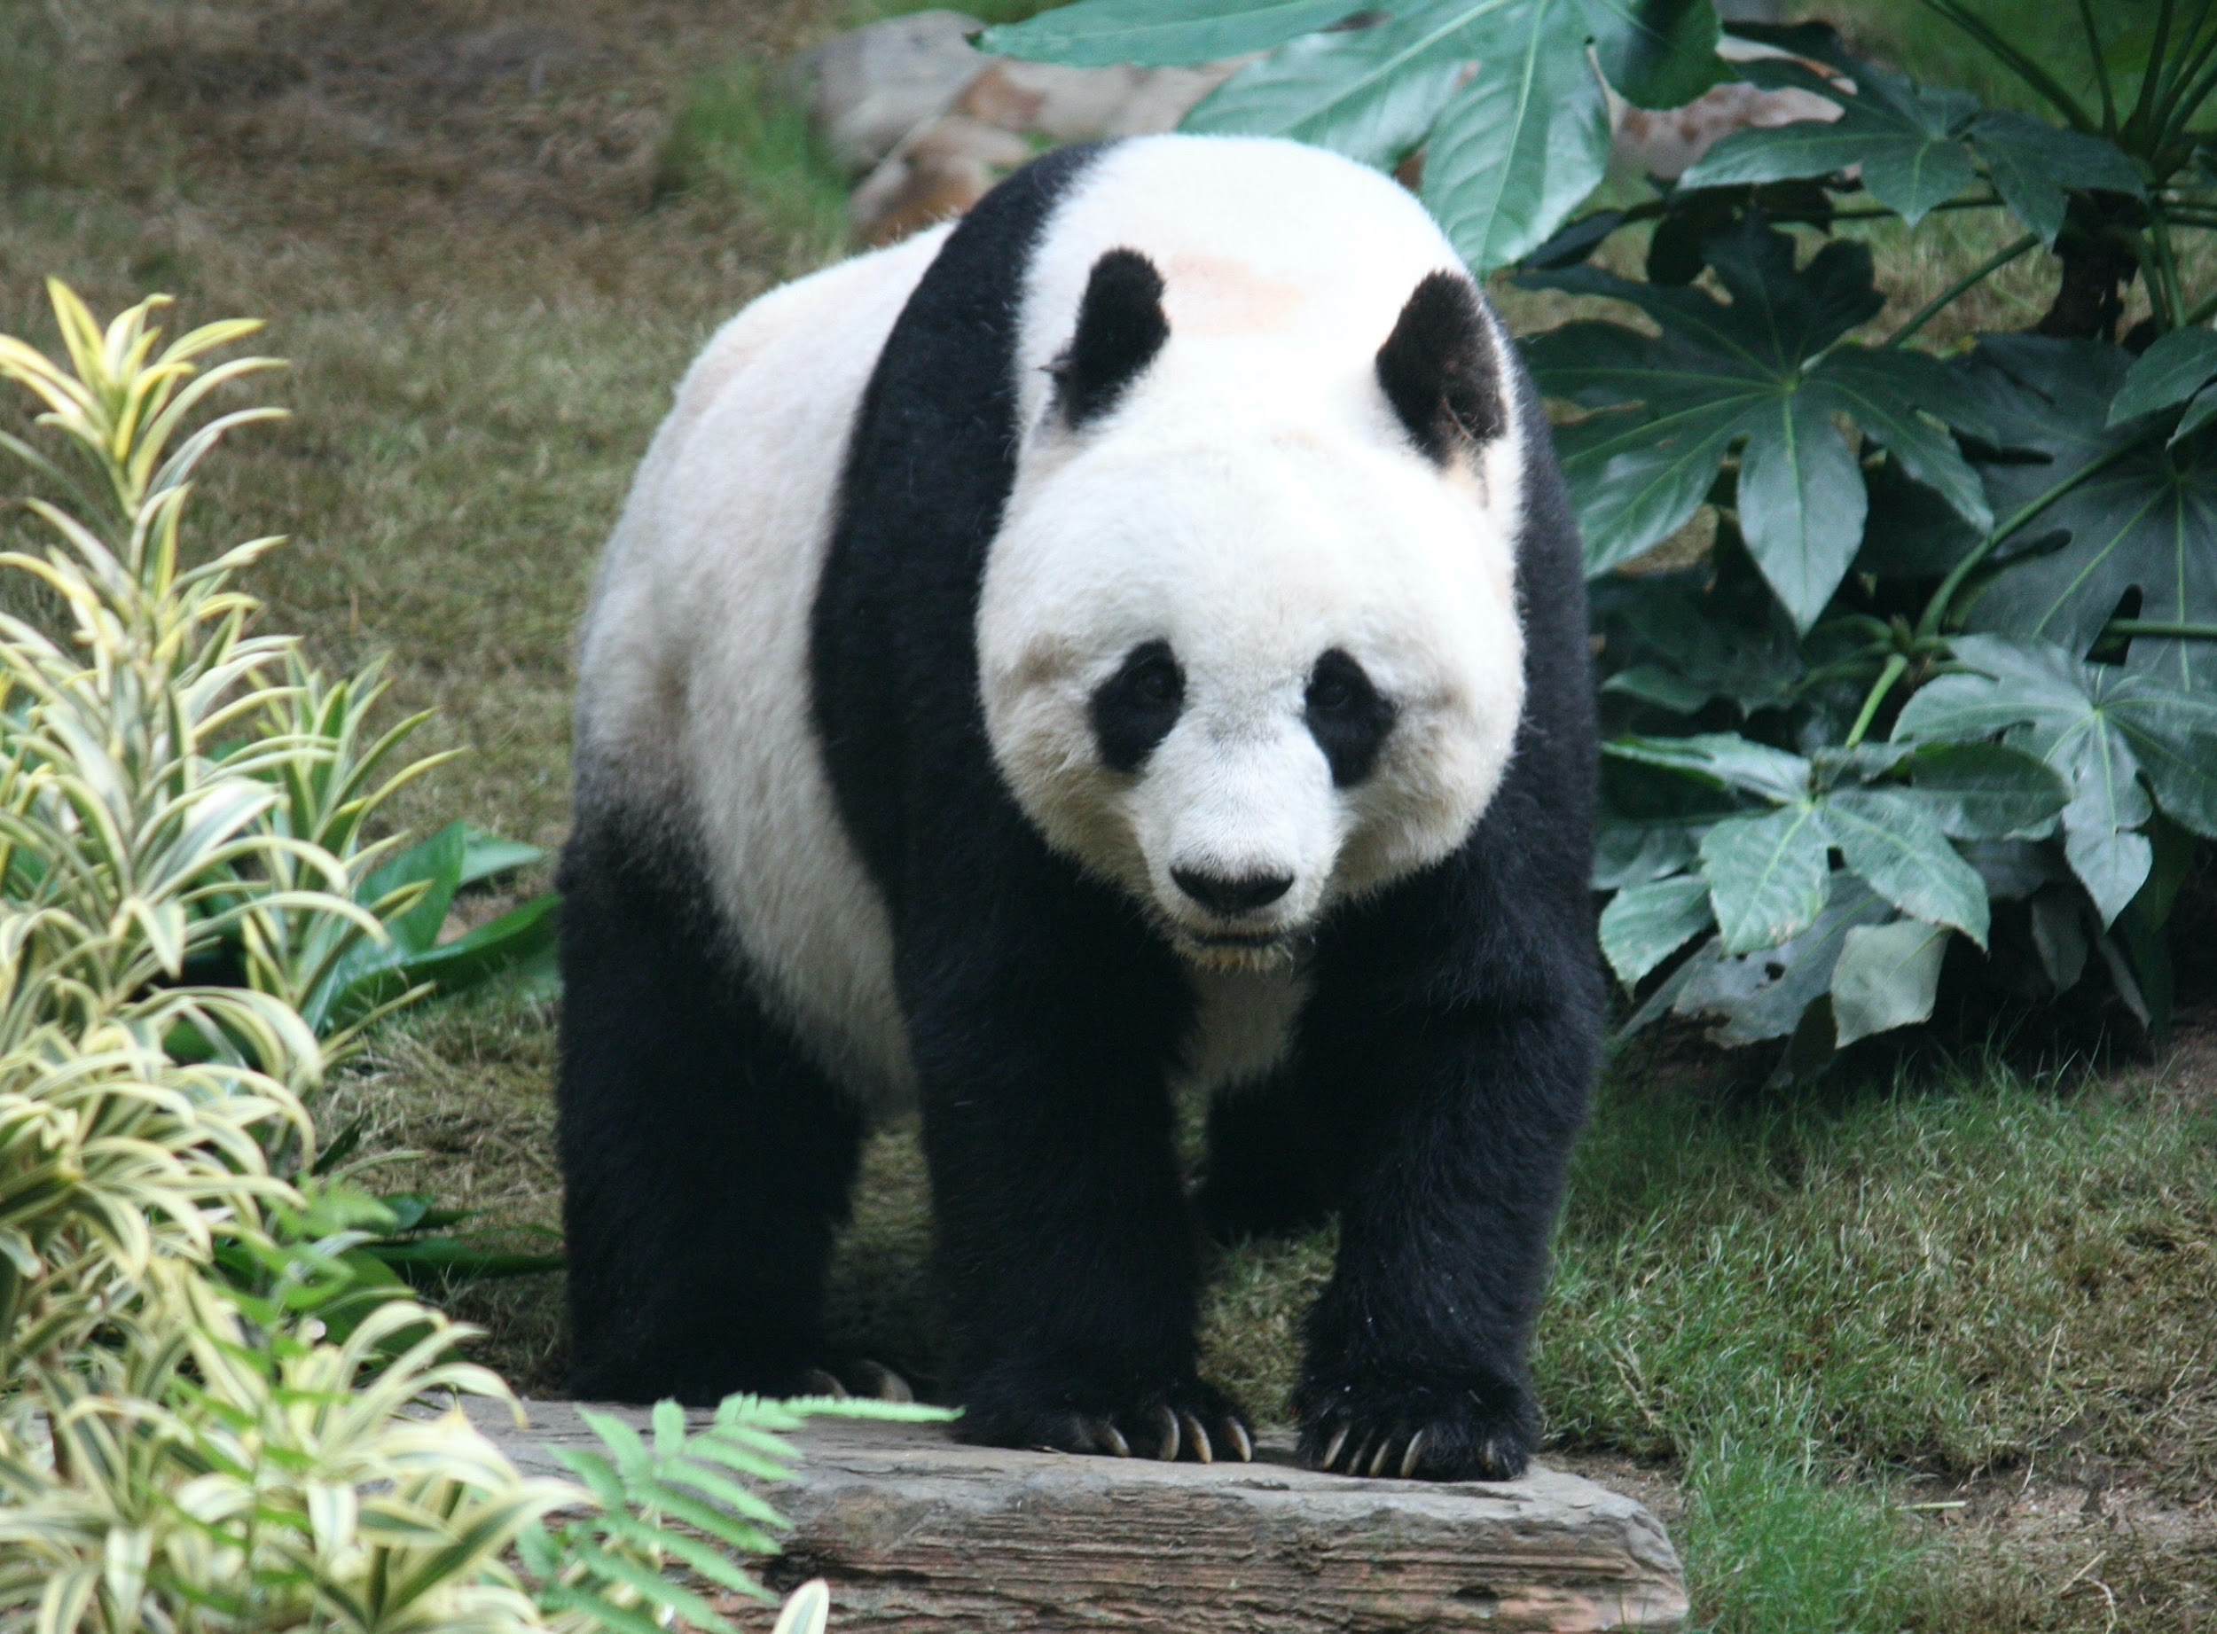
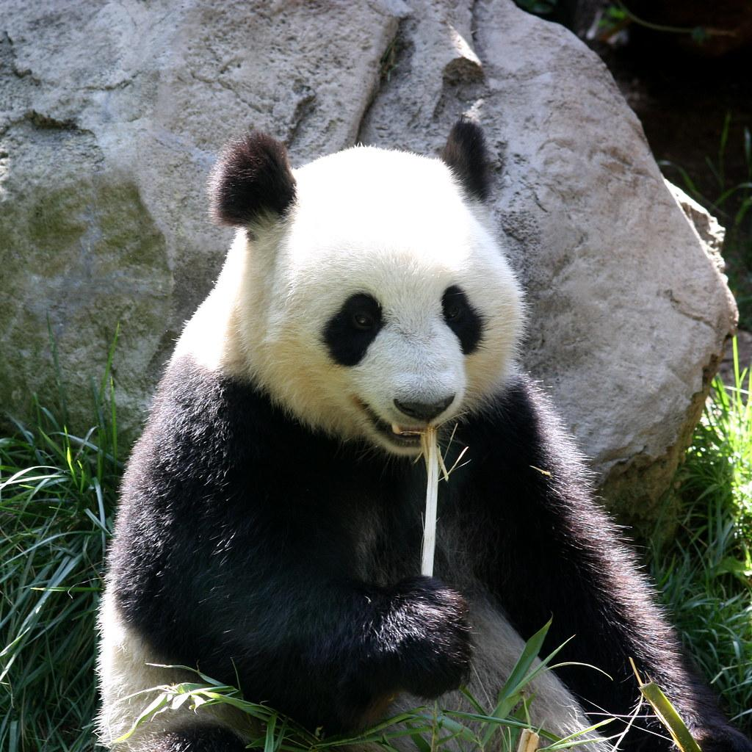
It is national Panda Day!
Notes:
3/16

Slide 13


It is Saint Patrick’s day!
Notes:
3/17

Slide 14


Today is National Down Syndrome Day!
Notes:
3/21

Slide 15

Today 3-D day!
Notes:
3/22

Slide 16
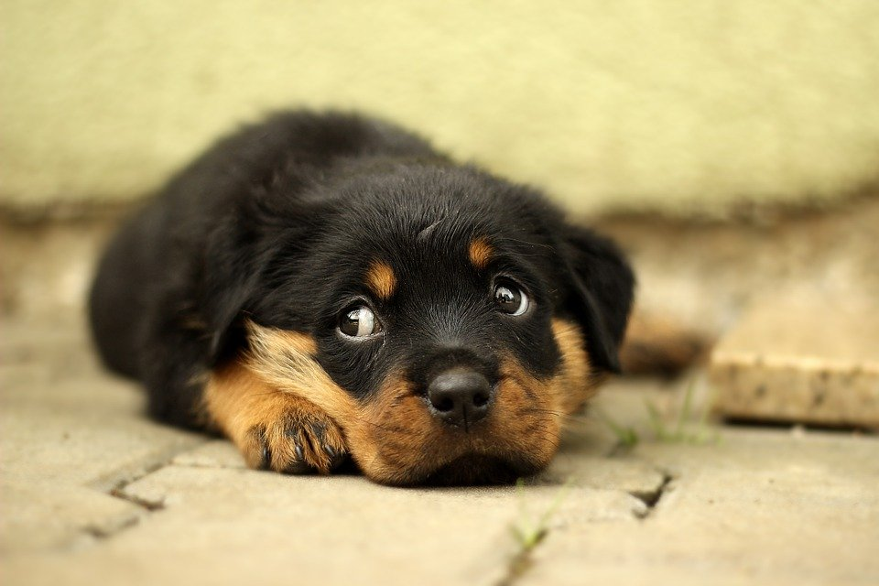
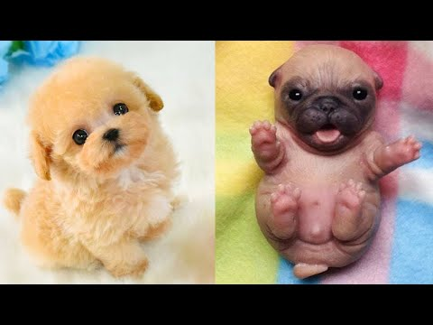
Today is national puppy day!
Notes:
3/23

Slide 17
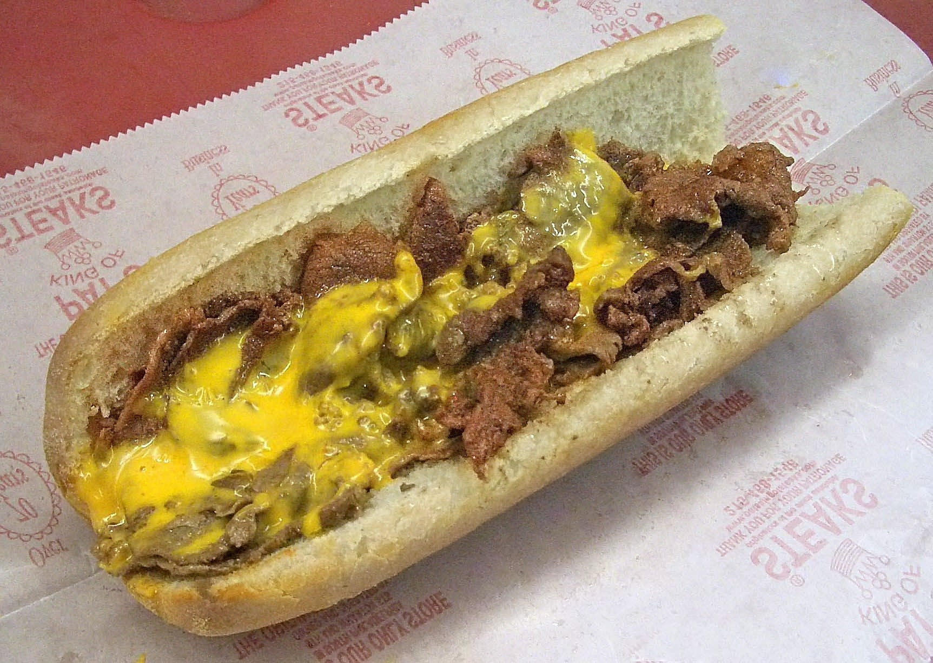
Today is National Cheesesteak day!
Notes:
3/24

Slide 18
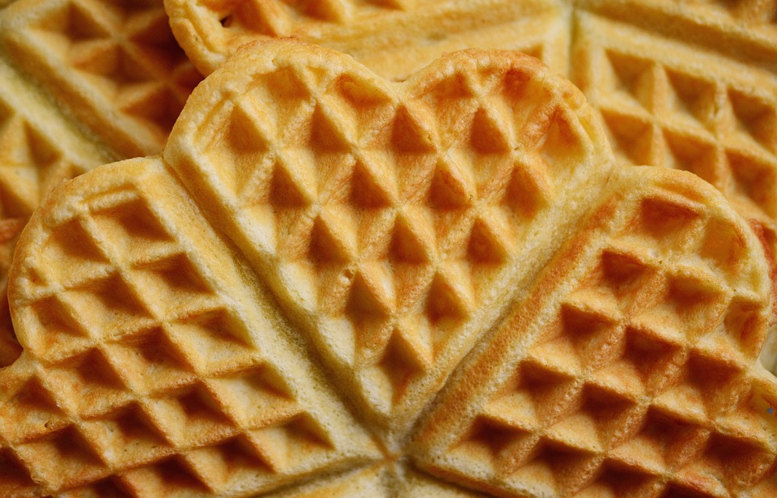
Today is international waffle day!!
Notes:
3/25

Slide 19

Today is National Piano day!
Notes:
3/28

Slide 20

It is national Nevada day.
Notes:
3/29

Slide 21
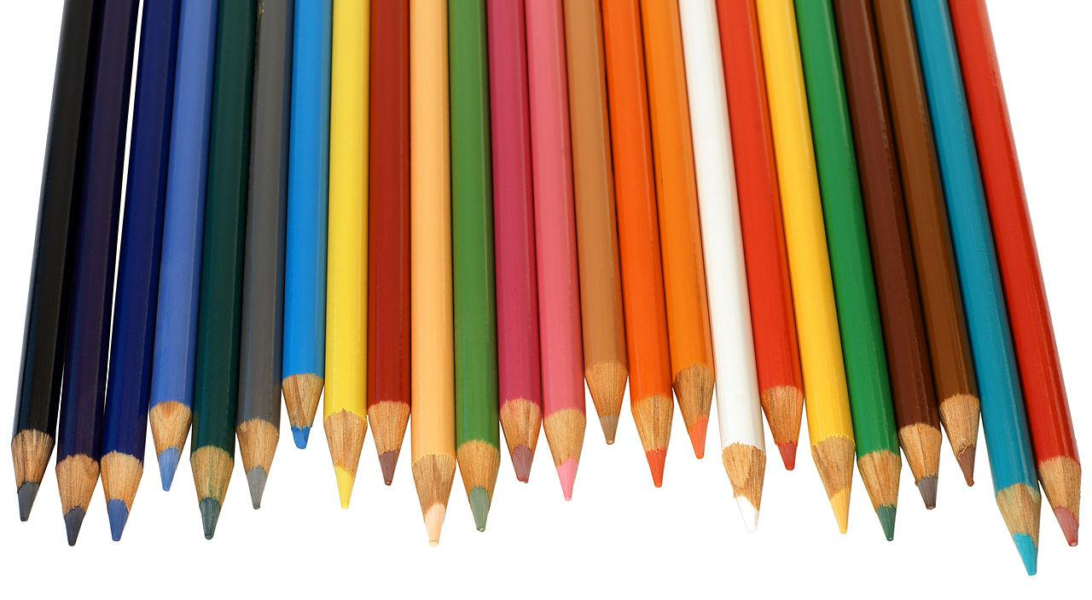
Today is national pencil day!
Notes:
3/30

Slide 22
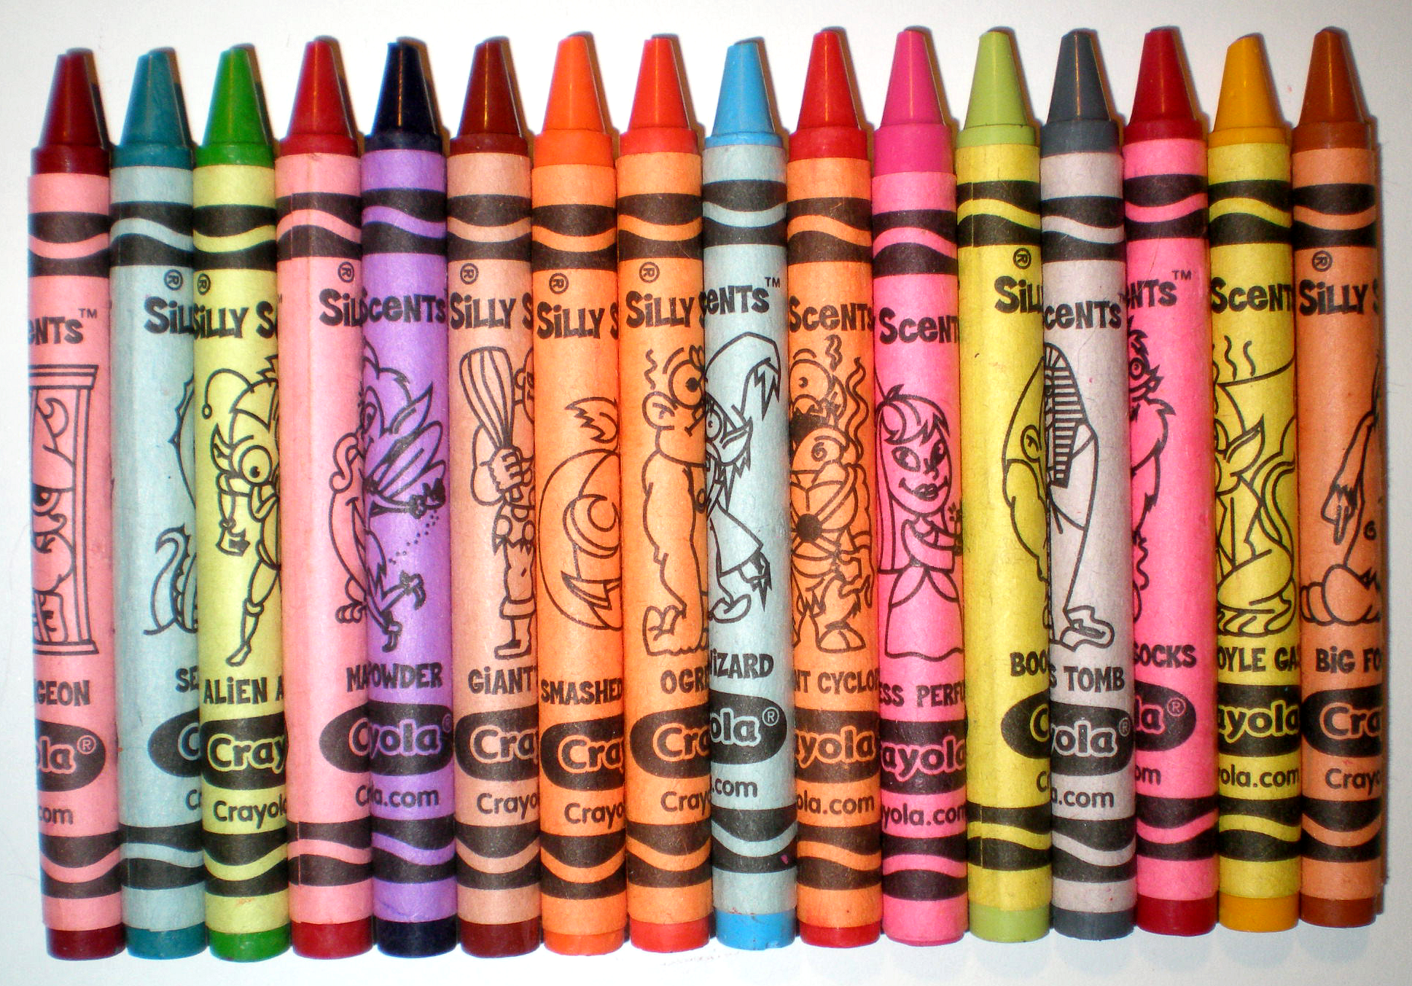
It is national crayon day!
Notes:
3/31

