Slide 1

March National Days!
2022

Slide 2

March 1st
National Pig Day
National Pig Day, observed annually on March 1st, recognizes the domesticated pig. This holiday includes events and celebrations at zoos, schools,and sporting events around the United States. Pigs have been popular storybook characters for generations. There are hundreds of different breeds, most of which descended from the Eurasian Wild Boar. From A.A. Milne’s Piglet to E.B. White’s Wilbur, pigs have an endearing and flavorful quality about them that makes us love them.

Slide 3
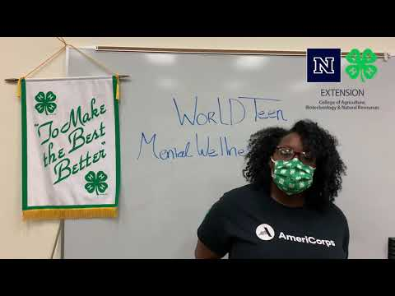
March 2nd- World Teen Mental Wellness Day
On March 2nd, World Teen Mental Wellness Day aims to normalize conversations and dismantle stigmas around teen mental health issues. According to the American Psychological Association, Gen Z has the worst mental health of any generation. However, teens are dedicated to making a difference. According to YPulse, 64 percent of Gen Z say they want to achieve a healthier lifestyle for overall happiness, including a stronger self-care routine. Also, 94 percent consider mental health very important to their well-being. Ultimately, raising awareness about mental health and the importance of self-care can help improve an entire generation’s mental wellness.

Slide 4


March 3rd- National Anthem Day
National Anthem Day commemorates the day the United States adopted “The Star Spangled Banner” as its National Anthem. Written by Francis Scott Key, the “Star Spangled Banner” became the National Anthem in 1931. Nearly 117 years passed after Key penned “Defence of Fort M’Henry” before it became the national anthem of the United States of America. “Hail Columbia” and “My Country’ Tis of Thee” held honorary places as patriotic songs. But, the United States didn’t have an officially declared anthem until a congressional resolution, signed by President Herbert Hoover, until “The Star Spangled Banner” became the national anthem of the United States of America on March 3rd, 1931.

Slide 5

March 4th- National Sons Day
National Sons Day on March 4th honors the sons of the world and those who raise them.Around the world, slightly more sons are born than daughters. Both bring joy to families.In 2018, Jill Nico created National Sons Day celebrating the importance and significations of sons and those who raise them. While there’s no single reason for selecting March 4th, the founder explains spring seemed ideal, and the date resounds with momentum when spoken. When it comes to our children, our rambunctious sons grow into adult men. Some are soft-spoken and gentle. Others with a spark of curiosity fill every hour with questions, some unanswerable.

Slide 6

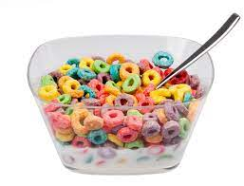
March 7th- National Cereal Day
March 7th urges us to get our bowl spoon ready for National Cereal Day each year! Since the end of the 19th century, cereal has become America’s most popular breakfast food. Ferdinand Schumacher, a German immigrant, began the cereal revolution in 1854 with a hand oats grinder in the back room of a small store in Akron, Ohio. His German Mills American Oatmeal Company was the nation’s first commercial oatmeal manufacturer. In 1877, Schumacher adopted the Quaker symbol, the first registered trademark for a breakfast cereal.What’s your favorite cereal?

Slide 7

March 8th- International Women’s Day
International Women’s Day on March 8th each year celebrates the social, economic, and political achievements of women around the world. The day also brings international awareness to gender parity. According to the World Economic Forum, global gender equality is estimated to be achieved by 2133. International Women’s Day origins can be traced back to the early 1900s when women became more politically active. They took an invested and vocal role in steering their course toward voting rights, fair pay, improved working conditions, and representation under the law.

Slide 8


March 9th- National Barbie Day
On March 9th, National Barbie Day celebrates an iconic toy that premiered on this day in 1959. Barbie debuted at the American International Toy Fair in New York. March 9th, 1959 also celebrates Barbie’s official birthday.In 1959, Ruth Handler created the Barbie doll and launched an American icon. Barbie’s full name is Barbara Millicent Roberts, and she came with a full array of accessories. National Barbie Day commemorates the day the Barbie doll made its debut in 1959. However, we have not identified the origins of the first celebrations.

Slide 9

March 10th- National Mario Day
National Mario Day on Mar 10 recognizes an iconic character from a popular video game. The character, known today as Mario, first appeared in 1981 in a game called Donkey Kong made by Nintendo. Dedicated fans knew Mario before his time as a plumber. At his creation, Donkey Kong portrays Mario as a carpenter named Jumpman. Whether you’re a Mario fan, a gamer, or just like to have a little fun, this day is for you. Celebrate by inviting friends and family to play.

Slide 10

March 14th- National Learn about Butterflies Day
On March 14th, National Learn About Butterflies Day encourages us to look for a blur of color as butterflies begin migrating across the country. Each year the celebration brings with it an awareness of the varieties of butterflies and their importance to our survival. Butterflies need our help to survive as they rely on flowers and other natural sources for survival. We can help them by planting more flowers. Read up on butterflies or find a good sunny spot to watch some.

Slide 11

March 15th- World Social Work Day
World Social Work Day on the third Tuesday in March recognizes the hard work and dedication of social workers. A global organization of social workers comes together for social justice, human rights, and social development all through the promotion of best practices in social work.Social workers serve many roles in their communities. They assess their client’s needs and challenges. As advocates, they speak for their clients, getting them access to the resources they need to improve their lives. World Social Work Day celebrates the achievements of social work globally and locally. It also recognizes the efforts of individuals who’ve chosen social work as a profession. Be sure to give a shout-out to social workers in your community.

Slide 12
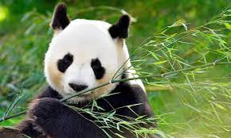

March 16th- National Panda Day
On March 16, National Panda Day draws attention to one of the world’s unique bears. Pandas are also one of the world’s most endangered and adored animals. Conservationists and animal lovers alike spread the word about increasing efforts of the international community dedicated to protecting and restoring habitat.Native to China, giant pandas are members of the Bear (Ursidae) family. They eat mostly plants and do not hibernate in the winter like many other bears.Share your love for pandas!

Slide 13
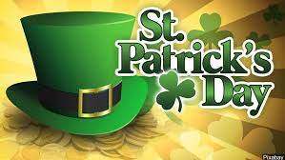

March 17th- St. Patrick’s Day
St. Patrick’s Day kicks off a worldwide celebration also known as the Feast of St. Patrick. On March 17th, many will wear green in honor of the Irish and decorate with shamrocks. According to lore, the wearing of the green tradition dates back to a story written about St. Patrick in 1726. St. Patrick (c. AD 385–461) used the shamrock to illustrate the Holy Trinity and worn green clothing. And while the story is unlikely to be true, many will revel in the Irish heritage and eat traditional Irish fare, too. Remember to wear green!!!!

Slide 14

March 18th- National Awkward Moments Day
On March 18th, we recognize National Awkward Moments Day. This is an annual day that every person can relate. We have all had our awkward moments from time to time. They are a part of life; they just happen. Awkwardness or embarrassment is defined as an emotional state of intense discomfort with oneself.Have you ever called someone by the wrong name, tripped over nothing, walked into a door, had the completely wrong words come out of your mouth or just forgot what you were doing? The list could go on and on.While it may be awkward to admit it, we have been unable to identify the origin of this awkward holiday.

Slide 15
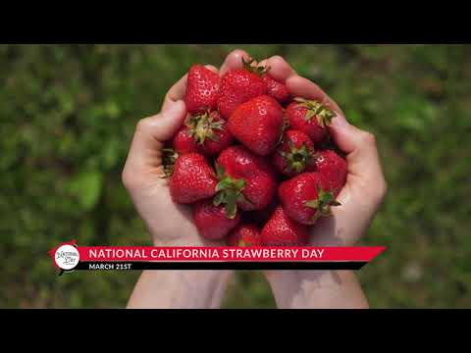
March 21st- National California Strawberry Day
As part of National Nutrition Month, National California Strawberry Day kicks off the strawberry season in California. The celebration takes place annually on March 21st which is typically the first full day of spring. It’s an ideal time to rejuvenate our senses and get excited about fresh fruit dishes, too. Strawberries are the flavor of paradise speckled with a bit of sunshine and whimsy. Their bright red dimpled fruit inspires picnics with double scoop strawberry ice cream cones. Make a parfait or strawberry shortcake and while you’re at it, make some memories, too. For another fun way to enjoy your strawberries, plan a trip to a pick-your-own strawberry farm.

Slide 16

March 22nd- National West Virginia Day
National West Virginia Day on March 22nd recognizes the last state to be created from one of the original thirteen colonies.When Virginia voted to secede from the Union, Western Virginians held firmly to their Union loyalties, created their own constitution and approached Congress for statehood. West Virginia, the 35th state, was admitted to the Union on June 20, 1863. It was the only state formed from another state and one of two created during the Civil War.Join National Day Calendar® as we explore the history, culture, and heritage of West Virginia.

Slide 17
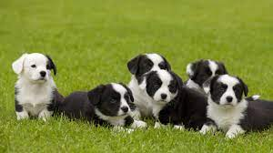

March 23rd- National Puppy Day
Observed each year on March 23rd, National Puppy Day celebrates the unconditional love and affection puppies bring to our lives. Their cuddles and wiggles make us smile and without a doubt, there are squeals of delight when there are puppies around!The day also brings awareness to the need for care of and homes for orphaned pups as well as to educate people about the horrors of puppy mills across the country. Puppies are a big responsibility. Be sure to consider everything involved and adopt from a shelter. According to the ASPCA, approximately 3.3 million dogs enter shelters every year. Some of these dogs come with litters of puppies.The day also brings awareness to the need for care of and homes for orphaned pups as well as to educate people about the horrors of puppy mills across the country. Puppies are a big responsibility. Be sure to consider everything involved and adopt from a shelter. The puppies there need love and a home just as much as any other and they grow into loyal pets, too!

Slide 18

March 24th- National Chocolate covered Raisin Day
When it comes to a National Day, a chocolate covered raisin or a box of them is worth celebrating. On March 24th, National Chocolate Covered Raisin Day celebrates raisins coated in a shell of either milk chocolate or dark chocolate.Moviegoers have been snacking on chocolate covered raisins for many, many years. Somehow, popcorn, a box of chocolate covered raisins go together perfectly. It doesn’t matter the kind of movie either. Chocolate covered raisins are also a conventional bulk vending item across the country. More than 1 million Raisinets are produced per hour.Enjoy your favorite brand of chocolate covered raisins. Or, make your own. We’ve even provided several different recipes using this delicious snack.

Slide 19

March 25th- National Tolkien Reading Day
Celebrated around the world on March 25th, Tolkien Reading Day is a favorite among fans of the renowned author. J.R.R. Tolkien (Jan. 3, 1892 – Sept. 2, 1973) was an English writer, poet, philologist, and university professor. He was best known as the author of the classic works The Hobbit, The Lord of the Rings and The Silmarrillion as well as Roverandom and Farmer Giles of Ham. However, he has published more than 30 books, several posthumously. The author has sold more than 150 million copies of The Lord of the Rings trilogy and that number continues to grow. With over 30 published works, he had a lot to say and not just about hobbits, though many are on medieval order.

Slide 20

March 28th- National Black Forest Cake Day
March 28th recognizes a decadent and delicious dessert on National Black Forest Cake Day. Black Forest cake is the English name for the German dessert Schwarzwalder Kirschtorte, meaning “Black Forest cherry torte.”Most often, bakers layer several layers of chocolate cake with whipped cream and cherries between each layer to make Black Forest cake.With cake holidays, we can celebrate in many ways. Visit your favorite bakery and order a delicious black forest cake to bring home.

Slide 21

March 29th- National Nevada Day
On March 29th, National Nevada Day celebrates The Battle Born State and the 36th state to join the Union.On October 31, 1864, Nevada joined West Virginia as the only other state to be granted statehood during the Civil War.The mostly desert landscape is nearly devoid of trees. With vast open spaces, dramatic gorges, majestic mountains, and windswept rock formations, the state transforms quickly.Most of the state is made up of National Parks providing some of the best opportunities for star-gazing anywhere. Perhaps that’s why Area 51 attracts so much attention and mystery. Well, who are we kidding?Join National Day Calendar as we recognize Nevada’s hidden treasures and natural beauty.

Slide 22

March 30th- National Take a Walk in The Park Day
National Take A Walk In The Park Day on March 30th each year encourages us to stretch our legs on our favorite trail or at our neighborhood park. After a long busy day, a calming and therapeutic way to relax would be a nice, leisurely walk in the park. Taking a walk at a local park is an excellent way to clear one’s mind from the stresses of the day, re-energize, and at the same time, improve health. During a walk, the opportunity to capture a beautiful photograph, compose an original poem, or have an uninterrupted conversation may arise. The chance to lose track of time and run into a familiar face could occur, too. When taking a walk in the park, all sorts of pleasant surprises could blossom.

Slide 23

March 31st- National Prom Day
On March 31st, National Prom Day honors friendship, cherished memories and celebrates the history, joy, and excitement this milestone event brings.
The day celebrates this special time in every teen’s life. It is a time filled with fashion, friendship and fun. But at times safety, peer pressure, and insecurity go along with it. too. That is why building a community that encourages confidence, empowerment, individuality and inner beauty is so important. It is also why we celebrate young adults all around the world. PromGirl founded National Prom Day in 2016 to celebrate generations of proms gone by, the fashion, fun, and friendship and to look forward to the proms ahead of us.

