Slide 1

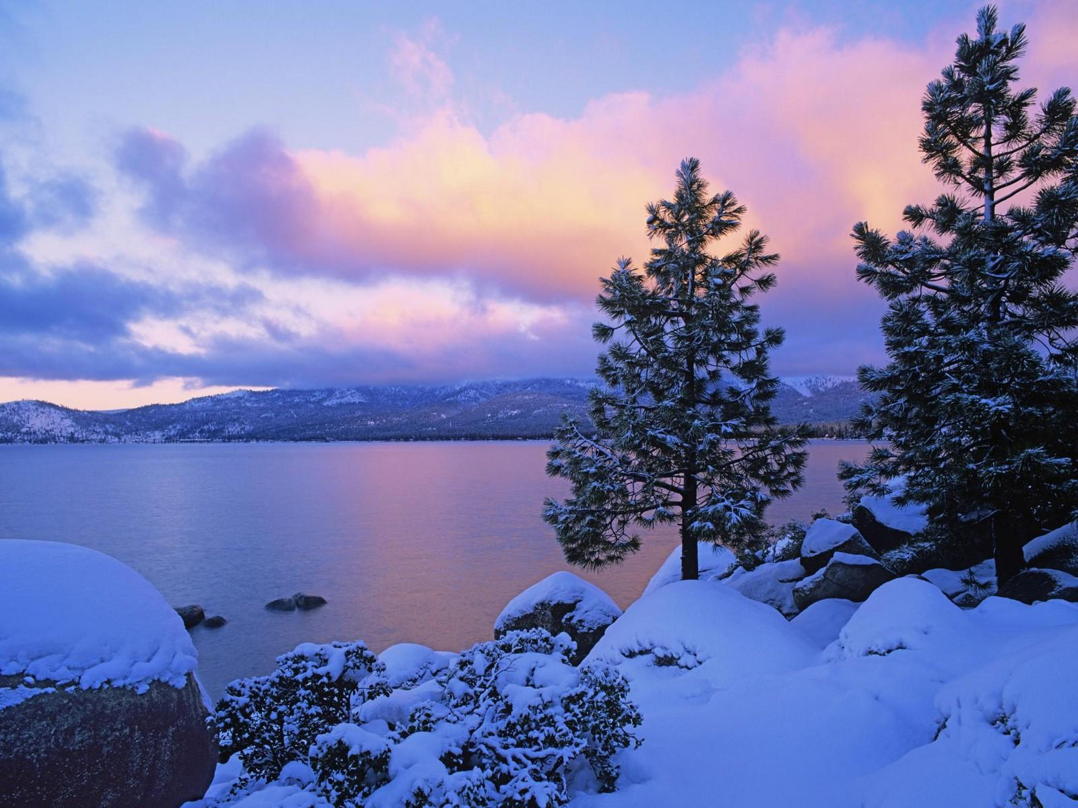




Good Morning! RISE and Shine!
Today is Monday, March 1, 2021.
Mindful Monday! Let’s get this week started!
DID YOU KNOW?!?
Today is World Compliment Day! Pay someone a nice compliment today!
Question of the Day!
What is one thing that you can teach ME about today?

Slide 2

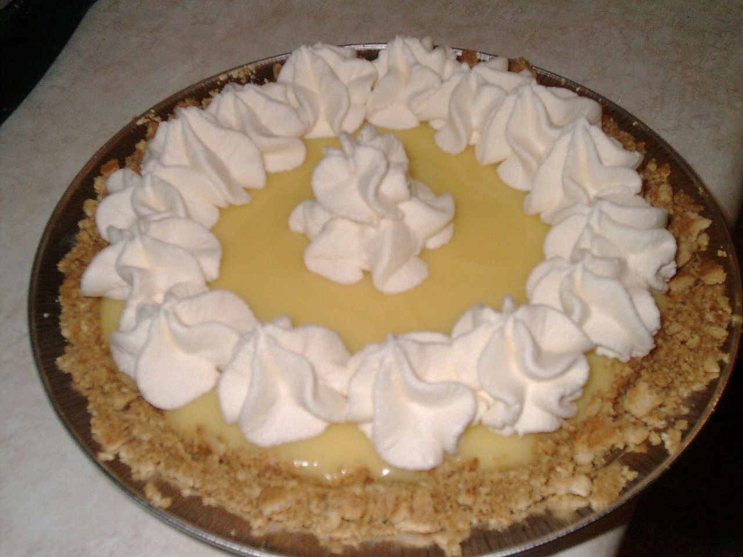
Good Morning! RISE and Shine!
Today is Tuesday, March 2, 2021.
Tune-in Tuesday! Let’s get focused!
DID YOU KNOW?!?
Today is National Banana Cream Pie Day! Enjoy a slice today!
Question of the Day:
What is one thing that has made you smile yesterday?
This Photo by Unknown Author is licensed under CC BY-SA

Slide 3

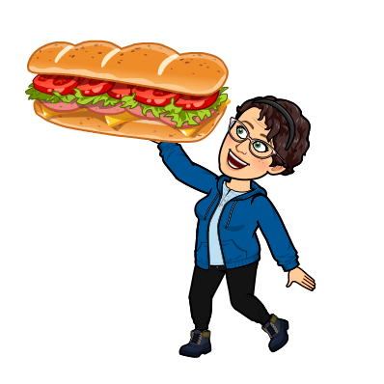
Good Morning! RISE and Shine!
Today is Wednesday, March 3, 2021.
Would You Rather Wednesday! Let’s get energized!
DID YOU KNOW?!?
Today is Cold Cuts Day! Make yourself a sandwich with some coldcuts!
Question of the Day:
How do you make a sandwich? What are all the steps?

Slide 4


Good Morning! RISE and Shine!
Today is Thursday, March 4, 2021.
Thoughtful Thursday! Let’s get thinking!
DID YOU KNOW?!?
Today is National Grammar Day! Make sure to use proper grammar with all of your work!
Question of the Day:
If you could travel anywhere, where would you go? Why?

Slide 5
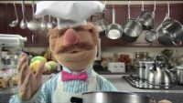

Good Morning! RISE and Shine!
Today is Friday, March 5, 2021.
Remember, it is FEAST FRIDAY! Let’s get cooking!
DID YOU KNOW?!?
Today is National Cheese Doodle Day! Maybe you can have a fun Cheesy snack today!
Question of the Day:
Would you like to travel back in time or to the future? Why?
This Photo by Unknown Author is licensed under CC BY-SA

Slide 6
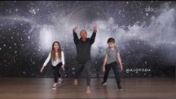
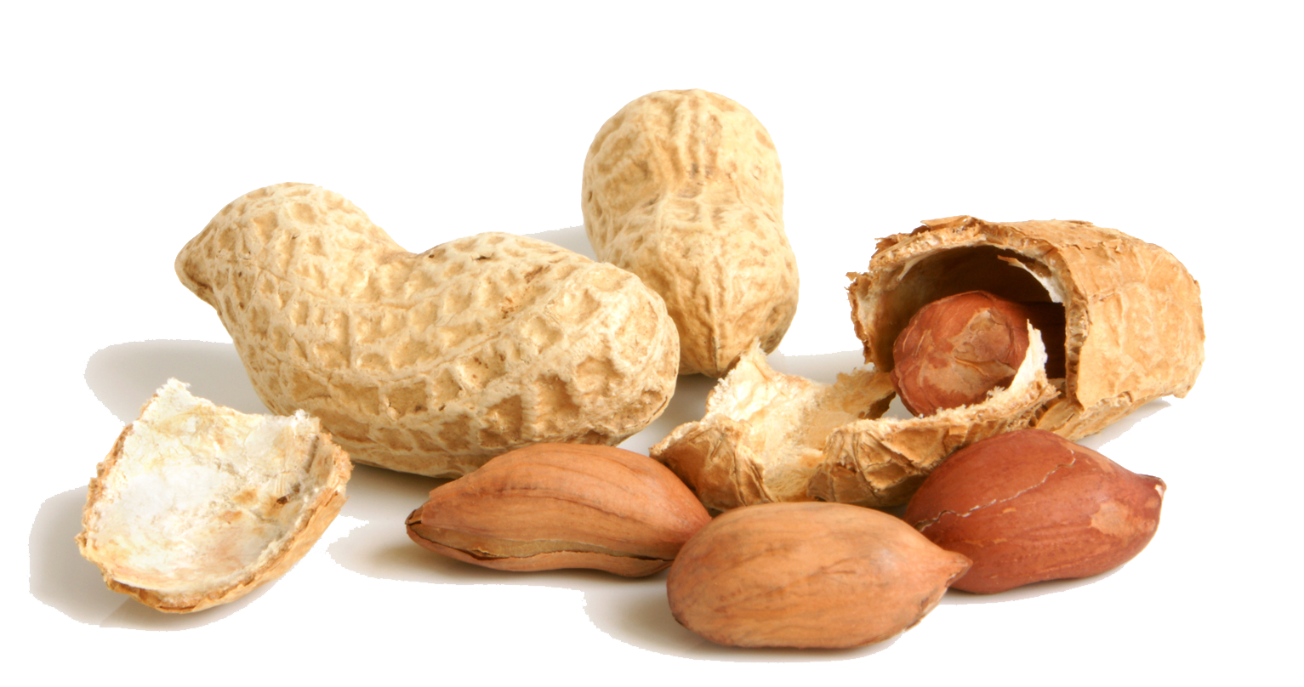
Good Morning! RISE and Shine!
Today is Monday, March 8, 2021.
Mindful Monday! Let’s get this week started!
DID YOU KNOW?!?
Today is International Peanut Cluster Day! Have you ever had a Peanut Cluster?
Question of the Day!
If you drew a picture of everything you thought of, what would you be drawing a picture of now?
This Photo by Unknown Author is licensed under CC BY-NC

Slide 7

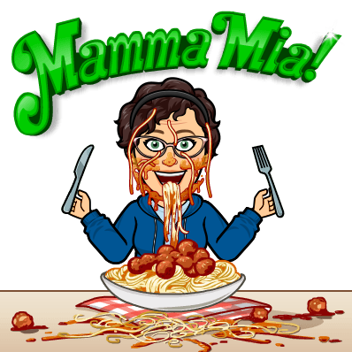
Good Morning! RISE and Shine!
Today is Tuesday, March 9, 2021.
Tune-in Tuesday! Let’s get focused!
DID YOU KNOW?!?
Today is National Meatball Day! Maybe you will have meatballs for dinner!
Question of the Day:
What are your favourite sounds to hear?

Slide 8


Good Morning! RISE and Shine!
Today is Wednesday, March 10, 2021.
Would You Rather Wednesday! Let’s get energized!
DID YOU KNOW?!?
Today is National Mario Day! What’s your favourite Mario game?
Question of the Day:
What objects would you use to build the best fort? Explain your choices!
This Photo by Unknown Author is licensed under CC BY-NC

Slide 9
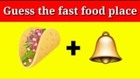

Good Morning! RISE and Shine!
Today is Thursday, March 11, 2021.
Thoughtful Thursday! Let’s get thinking!
DID YOU KNOW?!?
Today is National Worship of Tools Day! Which tool is your favourite to use?
Question of the Day:
If animals could drive, which one would be the best driver? Why?

Slide 10


Good Morning! RISE and Shine!
Today is Friday, March 12, 2021.
Remember, it is FEAST FRIDAY! Let’s get cooking!
DID YOU KNOW?!?
Today is National Plant a Flower Day! Maybe you can plant a seed indoors to put outside when it warms up!
Question of the Day:
If you could give your family members new names, what would they be?

Slide 11
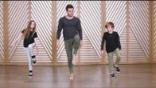

Good Morning! RISE and Shine!
Today is Monday, March 15, 2021.
Mindful Monday! Let’s get this week started!
DID YOU KNOW?!?
Today is National Nap Day! Get a little shut-eye during the break today!
Question of the Day!
If you could do anything right now, ,what would it be?

Slide 12
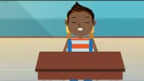

Good Morning! RISE and Shine!
Today is Tuesday, March 16, 2021.
Tune-in Tuesday! Let’s get focused!
DID YOU KNOW?!?
Today is National Panda Day! Try to learn one interesting fact about the Panda today!
Question of the Day:
If you had a pet dragon, what would you name it?

Slide 13


Good Morning! RISE and Shine!
Today is Wednesday, March 17, 2021.
Would You Rather Wednesday! Let’s get energized!
DID YOU KNOW?!?
Today is St Patrick’s Day! What do you know about this holiday?
Question of the Day:
What would you do if you found a pot of gold?

Slide 14

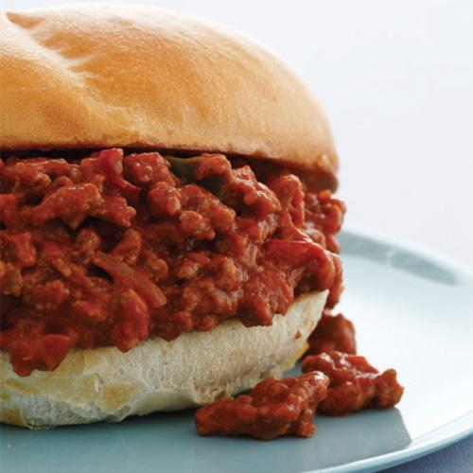
Good Morning! RISE and Shine!
Today is Thursday, March 18, 2021.
Thoughtful Thursday! Let’s get thinking!
DID YOU KNOW?!?
Today is National Sloppy Joe Day! Do you like Sloppy Joe?
Question of the Day:
If you opened a store, what would you sell?

Slide 15


Good Morning! RISE and Shine!
Today is Friday, March 19, 2021.
Remember, it is FEAST FRIDAY! Let’s get cooking!
DID YOU KNOW?!?
Today is National Let’s Laugh Day! Think of your best joke!
Question of the Day:
Would you like to travel back in time or to the future? Why?

Slide 16
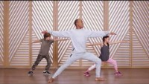
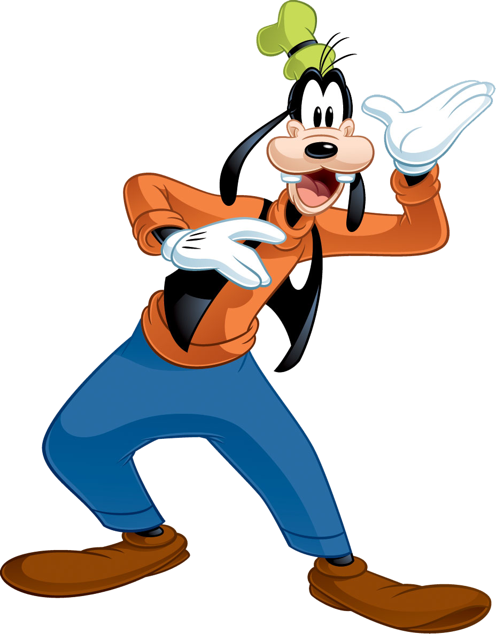
Good Morning! RISE and Shine!
Today is Monday, March 22, 2021.
Mindful Monday! Let’s get this week started!
DID YOU KNOW?!?
Today is National Goof Off Day! After school, do something goofy!
Question of the Day!
If you could spend a day inside one movie, which one would you choose?
This Photo by Unknown Author is licensed under CC BY-NC

Slide 17

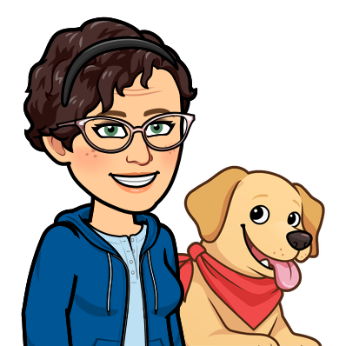
Good Morning! RISE and Shine!
Today is Tuesday, March 23, 2021.
Tune-in Tuesday! Let’s get focused!
DID YOU KNOW?!?
Today is National Puppy Day! Do you like puppies?
Question of the Day:
Are you a “dog person” or a “cat person”?

Slide 18

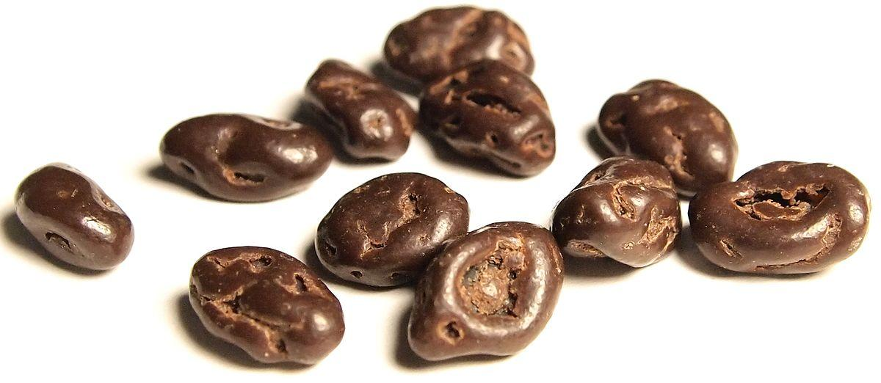
Good Morning! RISE and Shine!
Today is Wednesday, March 24, 2021.
Would You Rather Wednesday! Let’s get energized!
DID YOU KNOW?!?
Today is National Chocolate Covered Raisin Day! Do you like this strange treat?
Question of the Day:
How do you like to travel (what kind of transportation)?

Slide 19

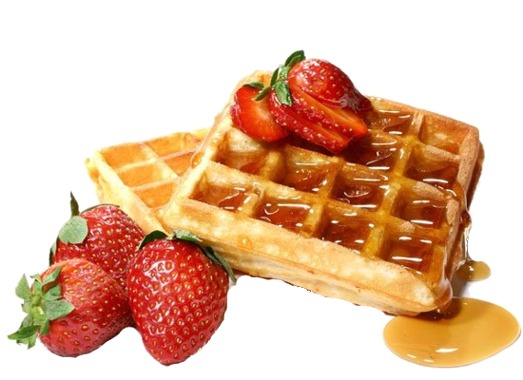
Good Morning! RISE and Shine!
Today is Thursday, March 25, 2021.
Thoughtful Thursday! Let’s get thinking!
DID YOU KNOW?!?
Today is National Waffle Day! Did you have a waffle for breakfast?
Question of the Day:
What is something that really bugs you?

Slide 20
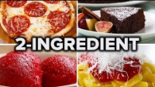

Good Morning! RISE and Shine!
Today is Friday, March 26, 2021.
Remember, it is FEAST FRIDAY! Let’s get cooking!
DID YOU KNOW?!?
Today is Epilepsy Awareness Day! Wear purple today!
Question of the Day:
If you were a professional photographer, what would you take pictures of?

Slide 21
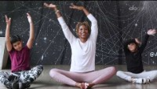

Good Morning! RISE and Shine!
Today is Monday, March 29, 2021.
Mindful Monday! Let’s get this week started!
DID YOU KNOW?!?
Today is National Lemon Chiffon Cake Day! Do you like lemon flavoured things?
Question of the Day!
What is the strangest thing you have ever eaten?

Slide 22


Good Morning! RISE and Shine!
Today is Tuesday, March 30, 2021.
Tune-in Tuesday! Let’s get focused!
DID YOU KNOW?!?
Today is National Pencil Day! Do you prefer to use pencils or pens?
Question of the Day:
If you could create a new class rule, what would it be?

Slide 23
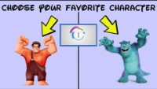
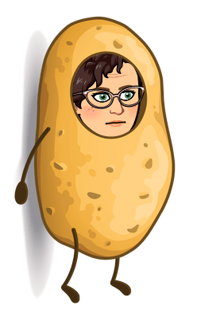
Good Morning! RISE and Shine!
Today is Wednesday, March 31, 2021.
Would You Rather Wednesday! Let’s get energized!
DID YOU KNOW?!?
Today is National Tater Day! Show those spuds some love!
Question of the Day:
If you could build a treehouse, what would you use? How would you make it special?

