Slide 1



Good Morning!
Class Jobs
Reminders
VIP:
Calendar Helper:
Time Keeper:
Meteorologist:
Substitute:
Attendance Clerk:
Expectations Monitor:
Morning Question
Share about a time when you were lucky.
3/1/20

Slide 2

Good Morning!
Class Jobs
Reminders
VIP:
Calendar Helper:
Time Keeper:
Meteorologist:
Substitute:
Attendance Clerk:
Expectations Monitor:
Morning Question
What is your favorite color in a rainbow?
3/2/20

Slide 3

Good Morning!
Class Jobs
Reminders
VIP:
Calendar Helper:
Time Keeper:
Meteorologist:
Substitute:
Attendance Clerk:
Expectations Monitor:
Morning Question
If you found a pot of gold, what would you do?
3/3/20

Slide 4

Good Morning!
Class Jobs
Reminders
VIP:
Calendar Helper:
Time Keeper:
Meteorologist:
Substitute:
Attendance Clerk:
Expectations Monitor:
Morning Question
What is one way you go “GO GREEN” in your home?
3/4/20

Slide 5

Good Morning!
Class Jobs
Reminders
VIP:
Calendar Helper:
Time Keeper:
Meteorologist:
Substitute:
Attendance Clerk:
Expectations Monitor:
Morning Question
If you were a leprechaun, what would your name be?
3/5/20

Slide 6

Good Morning!
Class Jobs
Reminders
VIP:
Calendar Helper:
Time Keeper:
Meteorologist:
Substitute:
Attendance Clerk:
Expectations Monitor:
Morning Question
Today is International Women’s Day. Who is an inspiring women in your life?
3/8/20

Slide 7

Good Morning!
Class Jobs
Reminders
VIP:
Calendar Helper:
Time Keeper:
Meteorologist:
Substitute:
Attendance Clerk:
Expectations Monitor:
Challenge!
Find my leprechaun-moji!
Morning Question
Would you rather find a pot of gold or a field of 4 leaf clovers?
3/9/20

Slide 8
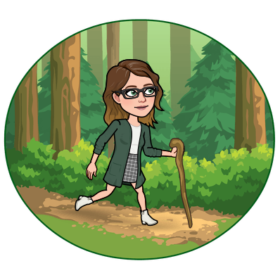
Good Morning!
Class Jobs
Reminders
VIP:
Calendar Helper:
Time Keeper:
Meteorologist:
Substitute:
Attendance Clerk:
Expectations Monitor:
Morning Question
What is something you really want to do in your lifetime?
3/10/20

Slide 9

Good Morning!
Class Jobs
Reminders
VIP:
Calendar Helper:
Time Keeper:
Meteorologist:
Substitute:
Attendance Clerk:
Expectations Monitor:
Morning Question
Would you rather be as fast or as small as a leprechaun?
3/11/20

Slide 10

Good Morning!
Class Jobs
Reminders
VIP:
Calendar Helper:
Time Keeper:
Meteorologist:
Substitute:
Attendance Clerk:
Expectations Monitor:
Challenge!
Find my leprechaun-moji!
Morning Question
Today is National Girl Scout Day. What is your favorite Girl Scout cookie?
3/12/20

Slide 11

Good Morning!
Class Jobs
Reminders
VIP:
Calendar Helper:
Time Keeper:
Meteorologist:
Substitute:
Attendance Clerk:
Expectations Monitor:
Morning Question
Today is National Napping Day. Do you like naps? Why or why not?
3/15/20

Slide 12

Good Morning!
Class Jobs
Reminders
VIP:
Calendar Helper:
Time Keeper:
Meteorologist:
Substitute:
Attendance Clerk:
Expectations Monitor:
Morning Question
Name something you have never done but would like to try and explain why.
3/16/20

Slide 13

Good Morning!
Class Jobs
Reminders
VIP:
Calendar Helper:
Time Keeper:
Meteorologist:
Substitute:
Attendance Clerk:
Expectations Monitor:
Morning Question
Happy Saint Patrick’s Day! Would you rather write a story about a leprechaun or invent a trap to catch one?
3/17/20

Slide 14

Good Morning!
Class Jobs
Reminders
VIP:
Calendar Helper:
Time Keeper:
Meteorologist:
Substitute:
Attendance Clerk:
Expectations Monitor:
Challenge!
Find my leprechaun-moji!
Morning Question
Share about something going on the world that concerns you.
3/18/20

Slide 15

Good Morning!
Class Jobs
Reminders
VIP:
Calendar Helper:
Time Keeper:
Meteorologist:
Substitute:
Attendance Clerk:
Expectations Monitor:
Morning Question
Would you rather have green skin OR have green hair and teeth?
3/19/20

Slide 16

Good Morning!
Class Jobs
Reminders
VIP:
Calendar Helper:
Time Keeper:
Meteorologist:
Substitute:
Attendance Clerk:
Expectations Monitor:
Morning Question
Who is most inspiring to you?
3/22/20

Slide 17

Good Morning!
Class Jobs
Reminders
VIP:
Calendar Helper:
Time Keeper:
Meteorologist:
Substitute:
Attendance Clerk:
Expectations Monitor:
Challenge!
Find my leprechaun-moji!
Morning Question
What is the hardest thing about being a kid?
3/23/20

Slide 18

Good Morning!
Class Jobs
Reminders
VIP:
Calendar Helper:
Time Keeper:
Meteorologist:
Substitute:
Attendance Clerk:
Expectations Monitor:
Morning Question
Would you rather have 20 chocolate gold coins or 1 real gold coin?
3/24/20

Slide 19

Good Morning!
Class Jobs
Reminders
VIP:
Calendar Helper:
Time Keeper:
Meteorologist:
Substitute:
Attendance Clerk:
Expectations Monitor:
Morning Question
If you were a leprechaun, what would you do?
3/25/20

Slide 20
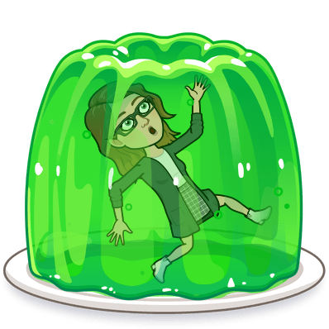
Good Morning!
Class Jobs
Reminders
VIP:
Calendar Helper:
Time Keeper:
Meteorologist:
Substitute:
Attendance Clerk:
Expectations Monitor:
Morning Question
Would you rather eat only green food for a week or wear only green clothes for a month?
3/26/20

Slide 21

Good Morning!
Class Jobs
Reminders
VIP:
Calendar Helper:
Time Keeper:
Meteorologist:
Substitute:
Attendance Clerk:
Expectations Monitor:
Morning Question
Would you rather find 5 pots of gold and share it with your classmates or find 1 pot of gold and keep it to yourself?
3/29/20

Slide 22

Good Morning!
Class Jobs
Reminders
VIP:
Calendar Helper:
Time Keeper:
Meteorologist:
Substitute:
Attendance Clerk:
Expectations Monitor:
Morning Question
If you could travel back in time 2 years, what advice would you give your younger self?
3/30/20

Slide 23

Good Morning!
Class Jobs
Reminders
VIP:
Calendar Helper:
Time Keeper:
Meteorologist:
Substitute:
Attendance Clerk:
Expectations Monitor:
Really hard Challenge!
Find my leprechaun-moji!
Morning Question
Today is Caesar Chavez Day. How can his actions inspire you?
3/31/20

