Slide 1

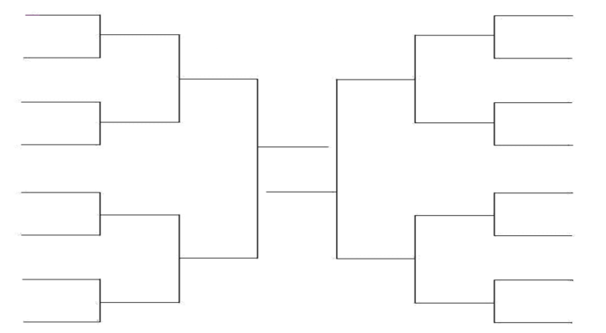
Learn a new dance
Vacuum the House
Set Up an Obstacle Course and Time Yourself
Help Cook a Meal
Go For a Long Walk/Jog
with your Family
Play Hallway Soccer
Play Balloon Volleyball
Jump Rope
Scavenger Hunt Created by your Family
Hula Hoop
Exercise Jenga
Bowling at Home
Indoor 3 Point Contest
Cup Stacking
10 Dynamic Stretches from Class
Do a Dance on GoNoodle
Mr. Tjaden’s Physical Education Bracket of Exercise

