Slide 1
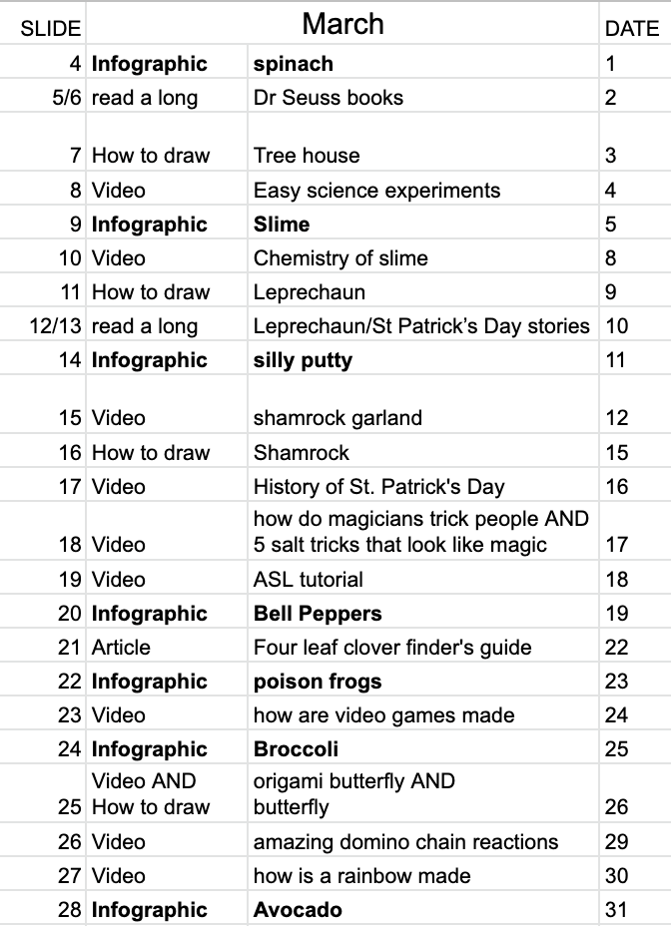
March Morning Board
Here is a synopsis of what is on each slide
Bonus video on Pi Day

Slide 2


March Morning Board
I am a Canvas LMS user. I embed this calendar onto my homepage. The past couple of months, I used it as a “fun” for the students. This month, I plan to hide a few links to some extra credit for the students. When I embed, I go into the html and add &rm=minimal to get rid of the black slideshow menu bar at the bottom.
PLEASE READ!
I have borrowed many of the activities from Kendra Emerson from the Bitmoji educators Facebook group. I have added links to all the slides. Most of these links take you to a website or a file in my google drive that should be linked so that “Anyone with a link can view.” If you want direct links to the web page with the infographics, you can go to https://www.compoundchem.com/infographics/ and choose any that suit your needs. That way, if you have troubles, you can download them and then you are the owner and your students can open it. :)
Notes:
Delete after reading :)

Slide 3


March
Click on today’s date.
Sunday | Monday | Tuesday | Wednesday | Thursday | Friday | Saturday
 | 1 | 2 | 3 | 4 | 5 | 6
7 | 8 | 9 | 10 | 11 | 12 | 13
14 National Pi Day | 15 | 16 | 17 | 18 | 19 | 20
21 | 22 | 23 | 24 | 25 | 26 | 27
28 | 29 | 30 | 31
National Peanut Butter Lover’s Day
Read Across America Day (Dr.Seuss Day)
National Cold Cuts Day
National Grammar Day
National Cheese Doodle Day
International Women’s Day
National Get
Over It Day
National Pack Your Lunch Day
National Promposal Day
National Plant a Flower Day
National Napping Day
National Panda Day
National Sloppy Joe Day
National Let’s Laugh Day
St. Patrick’s Day
National Bavarian Crepes Day
National Puppy Day
National Chocolate Covered Raisin Day
National Medal of Honor Day
National Spinach Day
National Vietnam War Veterans Day
National Pencil Day
National Bunsen Burner Day

Slide 4


March
Click on today’s date.
The first infographic for March. Let’s see if you can guess the theme.
Click here
Sunday | Monday | Tuesday | Wednesday | Thursday | Friday | Saturday
 | 1 | 2 | 3 | 4 | 5 | 6
7 | 8 | 9 | 10 | 11 | 12 | 13
14 | 15 | 16 | 17 | 18 | 19 | 20
21 | 22 | 23 | 24 | 25 | 26 | 27
28 | 29 | 30 | 31
St. Patrick’s Day
Notes:
Spinach infographic

Slide 5
March
Click on today’s date.
Get a pair of headphones before you continue to the next slide.
Sunday | Monday | Tuesday | Wednesday | Thursday | Friday | Saturday
 | 1 | 2 | 3 | 4 | 5 | 6
7 | 8 | 9 | 10 | 11 | 12 | 13
14 | 15 | 16 | 17 | 18 | 19 | 20
21 | 22 | 23 | 24 | 25 | 26 | 27
28 | 29 | 30 | 31
St. Patrick’s Day
Notes:
Dr Seuss library

Slide 6







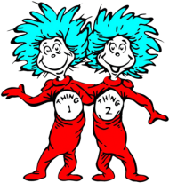














Slide 7
March
Click on today’s date.
Get a pair of headphones for today’s activity.
Sunday | Monday | Tuesday | Wednesday | Thursday | Friday | Saturday
 | 1 | 2 | 3 | 4 | 5 | 6
7 | 8 | 9 | 10 | 11 | 12 | 13
14 | 15 | 16 | 17 | 18 | 19 | 20
21 | 22 | 23 | 24 | 25 | 26 | 27
28 | 29 | 30 | 31
St. Patrick’s Day
Notes:
How to draw a Tree House

Slide 8
March
Click on today’s date.
Get some headphones and click here
For some colorful chemistry experiments.
Sunday | Monday | Tuesday | Wednesday | Thursday | Friday | Saturday
 | 1 | 2 | 3 | 4 | 5 | 6
7 | 8 | 9 | 10 | 11 | 12 | 13
14 | 15 | 16 | 17 | 18 | 19 | 20
21 | 22 | 23 | 24 | 25 | 26 | 27
28 | 29 | 30 | 31
St. Patrick’s Day
Notes:
Easy Science experiments

Slide 9
March
Click on today’s date.
Here is today’s infographic.
Click here!
Sunday | Monday | Tuesday | Wednesday | Thursday | Friday | Saturday
 | 1 | 2 | 3 | 4 | 5 | 6
7 | 8 | 9 | 10 | 11 | 12 | 13
14 | 15 | 16 | 17 | 18 | 19 | 20
21 | 22 | 23 | 24 | 25 | 26 | 27
28 | 29 | 30 | 31
St. Patrick’s Day
Notes:
Slime

Slide 10
March
Click on today’s date.
Can you get out of this sticky situation?
Click here!
Sunday | Monday | Tuesday | Wednesday | Thursday | Friday | Saturday
 | 1 | 2 | 3 | 4 | 5 | 6
7 | 8 | 9 | 10 | 11 | 12 | 13
14 | 15 | 16 | 17 | 18 | 19 | 20
21 | 22 | 23 | 24 | 25 | 26 | 27
28 | 29 | 30 | 31
St. Patrick’s Day
Notes:
Chemistry of slime video

Slide 11
March
Click on today’s date.
“How to” Drawing
Get out a piece of paper and pencil before you start.
Sunday | Monday | Tuesday | Wednesday | Thursday | Friday | Saturday
 | 1 | 2 | 3 | 4 | 5 | 6
7 | 8 | 9 | 10 | 11 | 12 | 13
14 | 15 | 16 | 17 | 18 | 19 | 20
21 | 22 | 23 | 24 | 25 | 26 | 27
28 | 29 | 30 | 31
St. Patrick’s Day
Notes:
Leprechaun

Slide 12
March
Click on today’s date.
Get a pair of headphones before continuing to the next slide.
Sunday | Monday | Tuesday | Wednesday | Thursday | Friday | Saturday
 | 1 | 2 | 3 | 4 | 5 | 6
7 | 8 | 9 | 10 | 11 | 12 | 13
14 | 15 | 16 | 17 | 18 | 19 | 20
21 | 22 | 23 | 24 | 25 | 26 | 27
28 | 29 | 30 | 31
St. Patrick’s Day
Notes:
Leprechaun/St Patrick’s Day stories

Slide 13


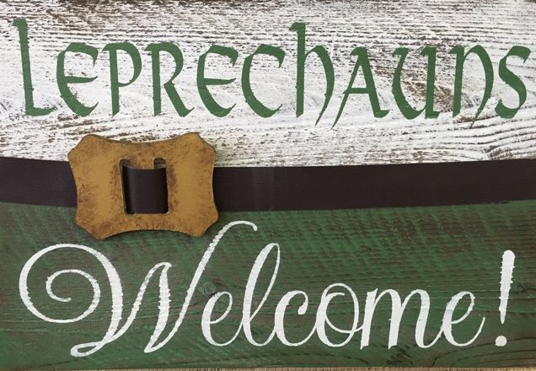

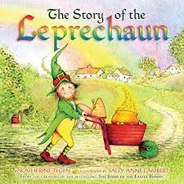
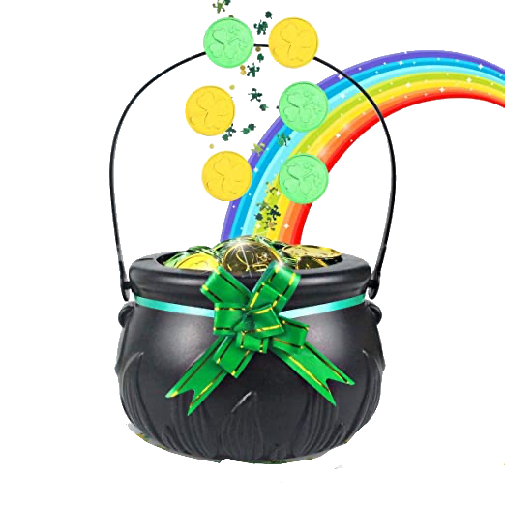


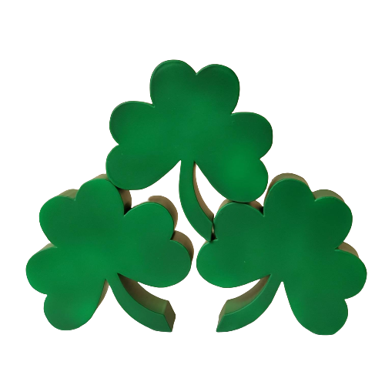
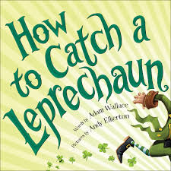

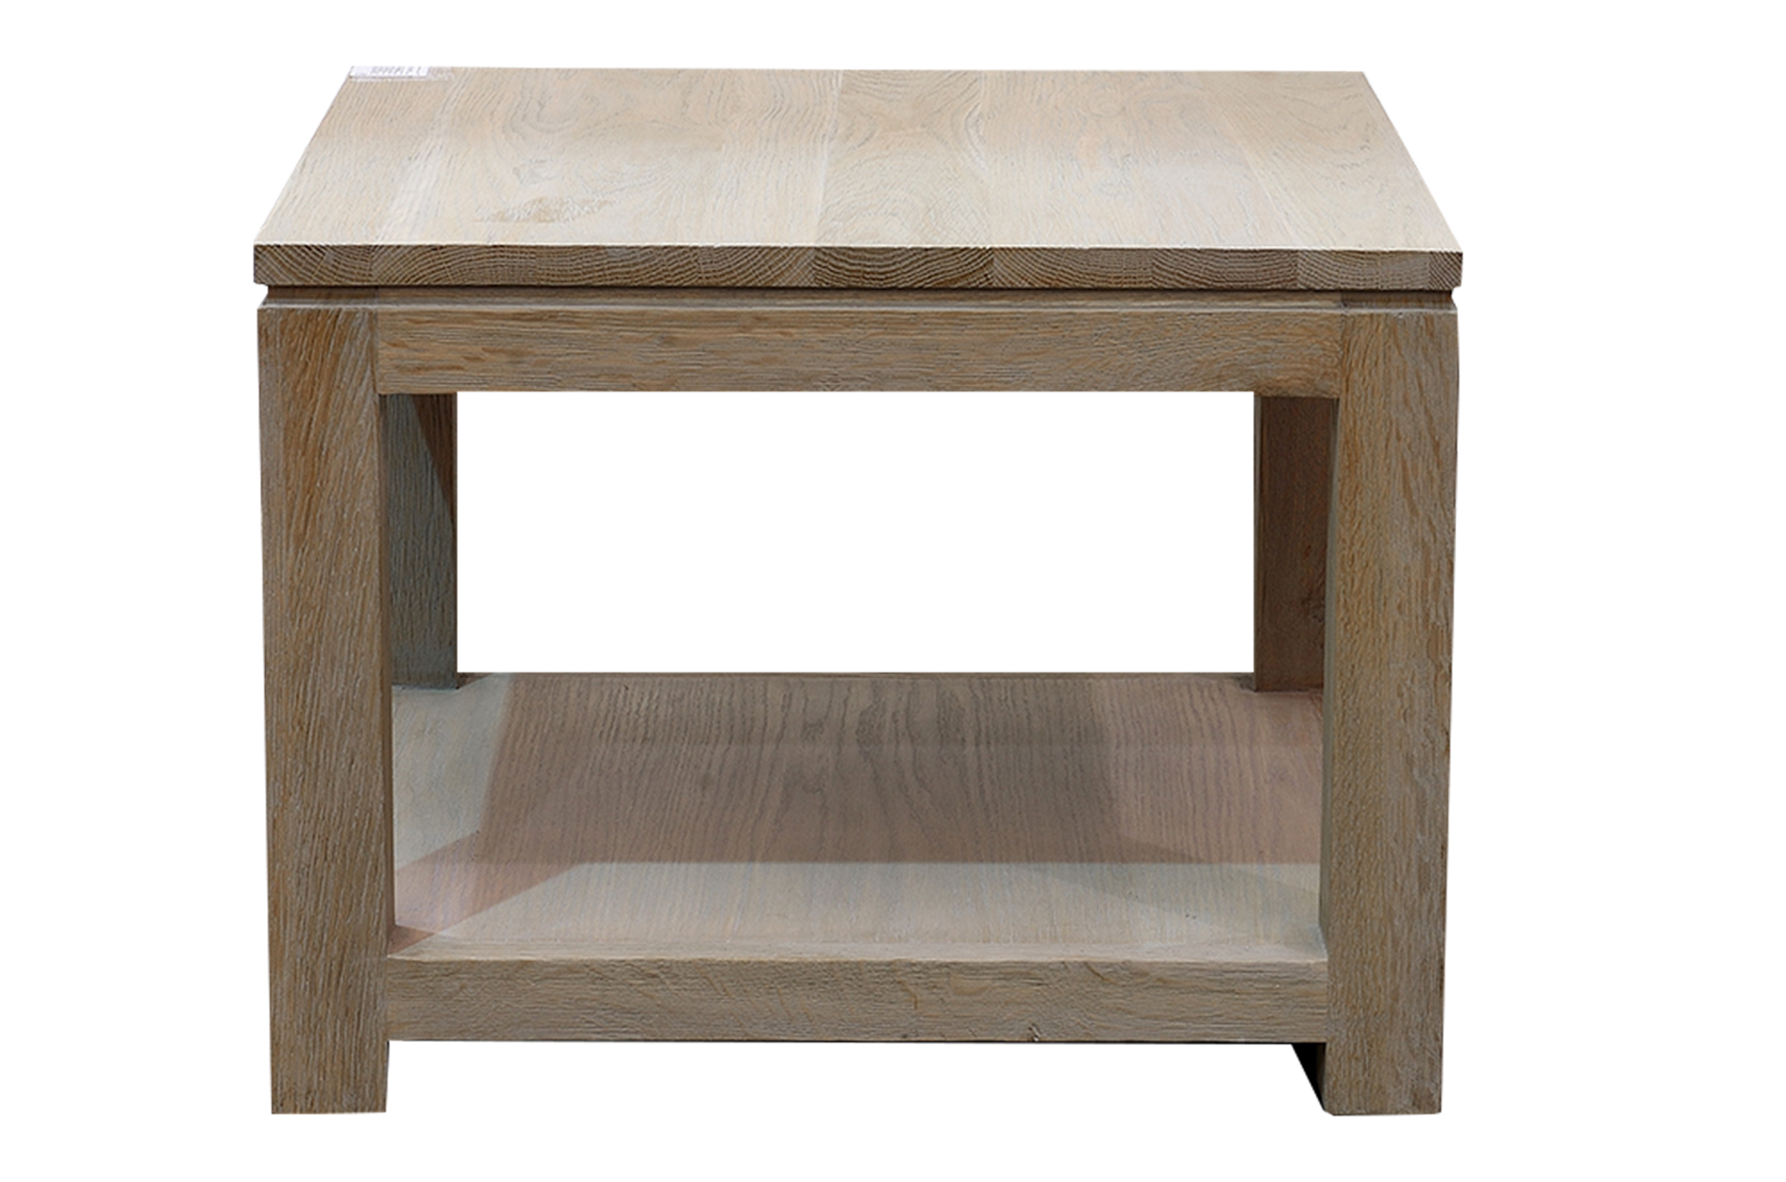


Slide 14
March
Click on today’s date.
Don’t be silly, this stuff isn’t boring!
Check this infographic out!
Sunday | Monday | Tuesday | Wednesday | Thursday | Friday | Saturday
 | 1 | 2 | 3 | 4 | 5 | 6
7 | 8 | 9 | 10 | 11 | 12 | 13
14 | 15 | 16 | 17 | 18 | 19 | 20
21 | 22 | 23 | 24 | 25 | 26 | 27
28 | 29 | 30 | 31
St. Patrick’s Day
Notes:
Silly Putty

Slide 15
March
Click on today’s date.
Get a pair of headphones & 2 colors of green paper.
Click here
for a craft project.
Sunday | Monday | Tuesday | Wednesday | Thursday | Friday | Saturday
 | 1 | 2 | 3 | 4 | 5 | 6
7 | 8 | 9 | 10 | 11 | 12 | 13
14 | 15 | 16 | 17 | 18 | 19 | 20
21 | 22 | 23 | 24 | 25 | 26 | 27
28 | 29 | 30 | 31
St. Patrick’s Day
Notes:
Shamrock garland

Slide 16
March
Click on today’s date.
“How to” Drawing
Get out a piece of paper and pencil before you start.
Sunday | Monday | Tuesday | Wednesday | Thursday | Friday | Saturday
 | 1 | 2 | 3 | 4 | 5 | 6
7 | 8 | 9 | 10 | 11 | 12 | 13
14 | 15 | 16 | 17 | 18 | 19 | 20
21 | 22 | 23 | 24 | 25 | 26 | 27
28 | 29 | 30 | 31
St. Patrick’s Day
Notes:
Shamrock

Slide 17
March
Click on today’s date.
Get out headphone’s before watching today’s video.
Sunday | Monday | Tuesday | Wednesday | Thursday | Friday | Saturday
 | 1 | 2 | 3 | 4 | 5 | 6
7 | 8 | 9 | 10 | 11 | 12 | 13
14 | 15 | 16 | 17 | 18 | 19 | 20
21 | 22 | 23 | 24 | 25 | 26 | 27
28 | 29 | 30 | 31
St. Patrick’s Day
Notes:
History of St Patrick’s Day

Slide 18
March
Click on today’s date.
Watch the video here
For the secrets
of magic & for some
Chemistry Magic
Click here
Sunday | Monday | Tuesday | Wednesday | Thursday | Friday | Saturday
 | 1 | 2 | 3 | 4 | 5 | 6
7 | 8 | 9 | 10 | 11 | 12 | 13
14 | 15 | 16 | 17 | 18 | 19 | 20
21 | 22 | 23 | 24 | 25 | 26 | 27
28 | 29 | 30 | 31
St. Patrick’s Day
Notes:
How Do Magicians Trick People? - Mystery Science

Slide 19
March
Click on today’s date.
Today’s activity.
Learn to talk with your hands.
Sunday | Monday | Tuesday | Wednesday | Thursday | Friday | Saturday
 | 1 | 2 | 3 | 4 | 5 | 6
7 | 8 | 9 | 10 | 11 | 12 | 13
14 | 15 | 16 | 17 | 18 | 19 | 20
21 | 22 | 23 | 24 | 25 | 26 | 27
28 | 29 | 30 | 31
St. Patrick’s Day
Notes:
Sign Language Tutorial

Slide 20
March
Click on today’s date.
What is today’s infographic?
Click here
Sunday | Monday | Tuesday | Wednesday | Thursday | Friday | Saturday
 | 1 | 2 | 3 | 4 | 5 | 6
7 | 8 | 9 | 10 | 11 | 12 | 13
14 | 15 | 16 | 17 | 18 | 19 | 20
21 | 22 | 23 | 24 | 25 | 26 | 27
28 | 29 | 30 | 31
St. Patrick’s Day
Notes:
Bell peppers

Slide 21
March
Click on today’s date.
Ever been lucky enough to find a four leaf clover? Here is the “How to”
guide
to do do just that!
Sunday | Monday | Tuesday | Wednesday | Thursday | Friday | Saturday
 | 1 | 2 | 3 | 4 | 5 | 6
7 | 8 | 9 | 10 | 11 | 12 | 13
14 | 15 | 16 | 17 | 18 | 19 | 20
21 | 22 | 23 | 24 | 25 | 26 | 27
28 | 29 | 30 | 31
St. Patrick’s Day
Notes:
4-leaf Clovers: a Finder's Guide

Slide 22
March
Click on today’s date.
Don’t be afraid, jump into this infographic.
Sunday | Monday | Tuesday | Wednesday | Thursday | Friday | Saturday
 | 1 | 2 | 3 | 4 | 5 | 6
7 | 8 | 9 | 10 | 11 | 12 | 13
14 | 15 | 16 | 17 | 18 | 19 | 20
21 | 22 | 23 | 24 | 25 | 26 | 27
28 | 29 | 30 | 31
St. Patrick’s Day
Notes:
Poison frogs

Slide 23
March
Click on today’s date.
No need for a controller here
to check out today’s video game adventure.
Sunday | Monday | Tuesday | Wednesday | Thursday | Friday | Saturday
 | 1 | 2 | 3 | 4 | 5 | 6
7 | 8 | 9 | 10 | 11 | 12 | 13
14 | 15 | 16 | 17 | 18 | 19 | 20
21 | 22 | 23 | 24 | 25 | 26 | 27
28 | 29 | 30 | 31
St. Patrick’s Day
Notes:
How are Video Games Made? - Mystery Science

Slide 24
March
Click on today’s date.
An infographic about my favorite tree to eat.
Sunday | Monday | Tuesday | Wednesday | Thursday | Friday | Saturday
 | 1 | 2 | 3 | 4 | 5 | 6
7 | 8 | 9 | 10 | 11 | 12 | 13
14 | 15 | 16 | 17 | 18 | 19 | 20
21 | 22 | 23 | 24 | 25 | 26 | 27
28 | 29 | 30 | 31
St. Patrick’s Day
Notes:
Broccoli

Slide 25
March
Click on today’s date.
Flutter on in to see today’s craft project.
Grab some
colored paper &
Click here
Or just draw it!
Sunday | Monday | Tuesday | Wednesday | Thursday | Friday | Saturday
 | 1 | 2 | 3 | 4 | 5 | 6
7 | 8 | 9 | 10 | 11 | 12 | 13
14 | 15 | 16 | 17 | 18 | 19 | 20
21 | 22 | 23 | 24 | 25 | 26 | 27
28 | 29 | 30 | 31
St. Patrick’s Day
Notes:
Origami butterflies

Slide 26
March
Click on today’s date.
“How to” create a chain reaction.
Sunday | Monday | Tuesday | Wednesday | Thursday | Friday | Saturday
 | 1 | 2 | 3 | 4 | 5 | 6
7 | 8 | 9 | 10 | 11 | 12 | 13
14 | 15 | 16 | 17 | 18 | 19 | 20
21 | 22 | 23 | 24 | 25 | 26 | 27
28 | 29 | 30 | 31
St. Patrick’s Day
Notes:
Amazing domino chain reactions

Slide 27
March
Click on today’s date.
What is prettier to look at, the gold in the pot of gold, OR the rainbow
to get there?
Sunday | Monday | Tuesday | Wednesday | Thursday | Friday | Saturday
 | 1 | 2 | 3 | 4 | 5 | 6
7 | 8 | 9 | 10 | 11 | 12 | 13
14 | 15 | 16 | 17 | 18 | 19 | 20
21 | 22 | 23 | 24 | 25 | 26 | 27
28 | 29 | 30 | 31
St. Patrick’s Day
Notes:
How is a Rainbow Made? - Mystery Science

Slide 28
March
Click on today’s date.
It’s the pits that this is the last infographic of the month!
Sunday | Monday | Tuesday | Wednesday | Thursday | Friday | Saturday
 | 1 | 2 | 3 | 4 | 5 | 6
7 | 8 | 9 | 10 | 11 | 12 | 13
14 | 15 | 16 | 17 | 18 | 19 | 20
21 | 22 | 23 | 24 | 25 | 26 | 27
28 | 29 | 30 | 31
St. Patrick’s Day
Notes:
Avocado

