Slide 1
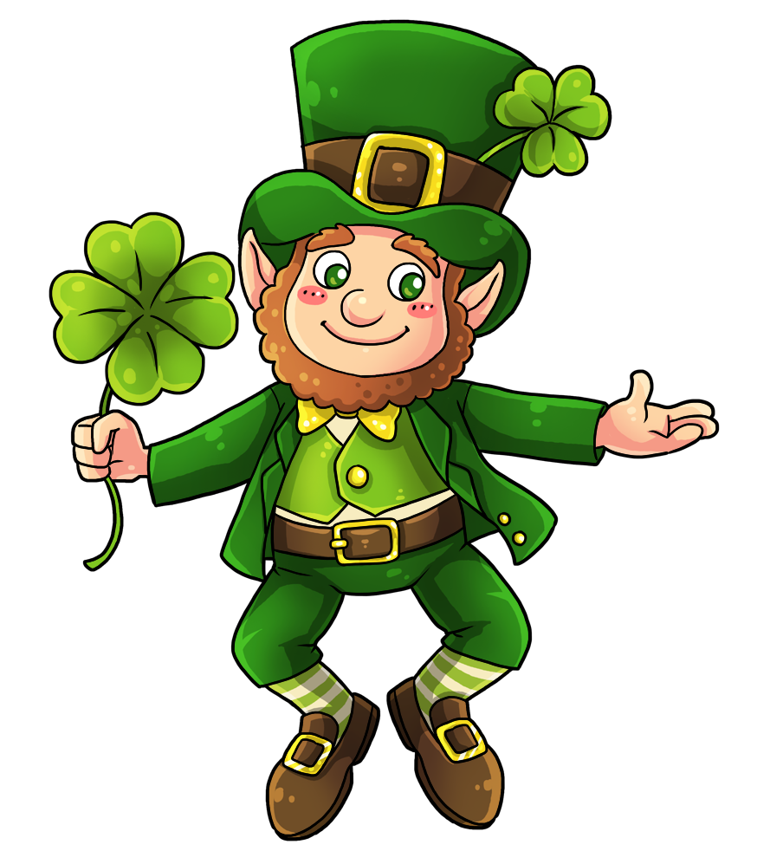


What’s The difference?
Can you find Lucky’s pot of gold hiding behind a Shamrock? Say the number sentence & difference then click it to see!
are
what
jump
two
come
look
here
said
with
have

Slide 2
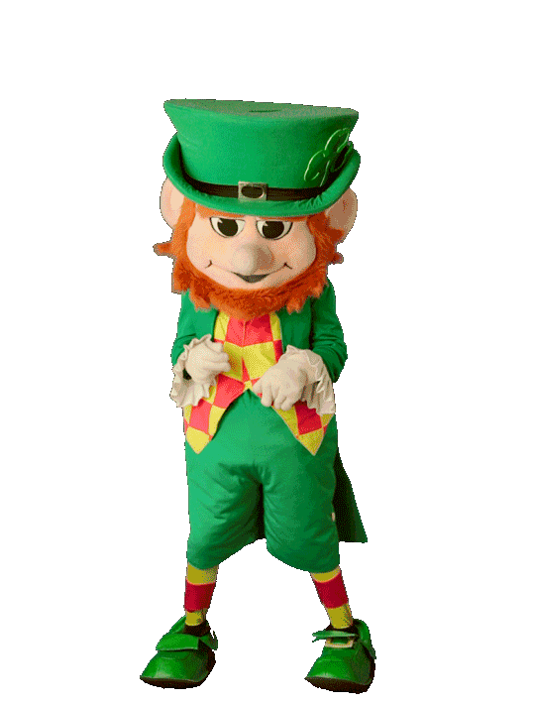

TRY AGAIN!!!
Go Back

Slide 3
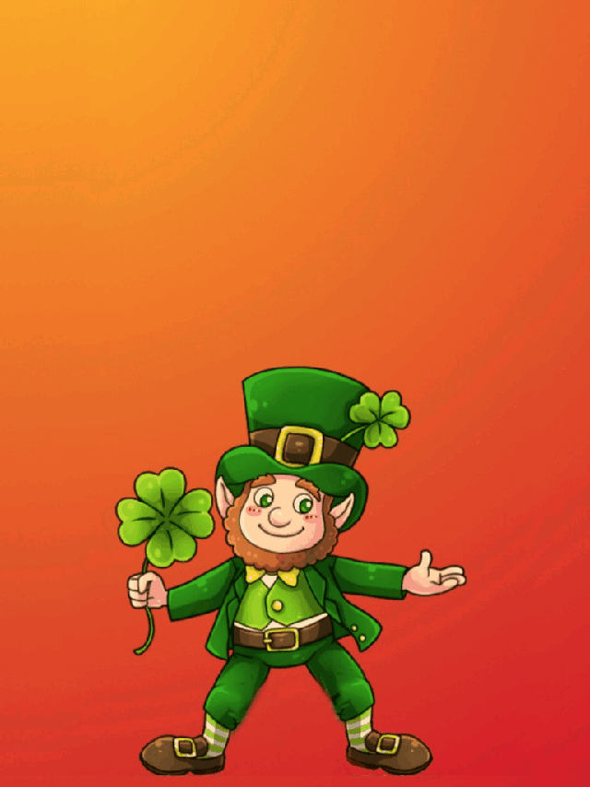

YOU FOUND Lucky’s gold!!!
Go Back

