Slide 1

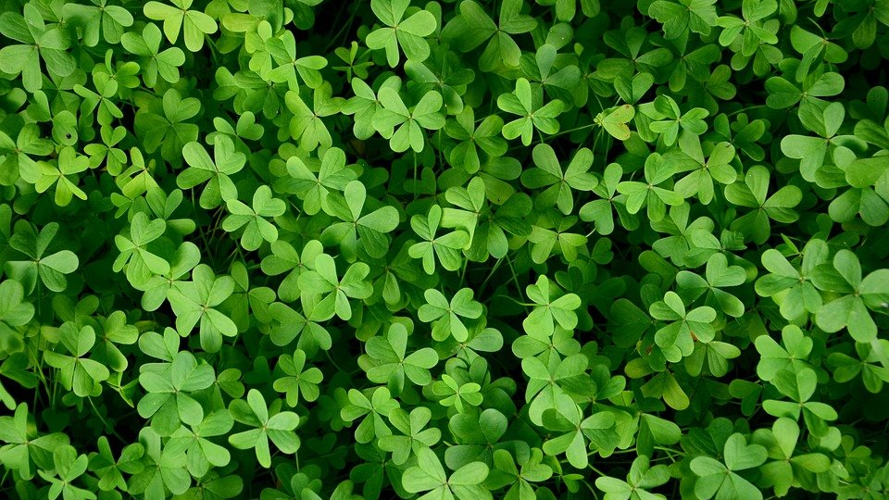

What’s The Sight word?
Can you find the leprechaun hiding behind a clover? Say the Sight Word then click it to see!
I
like
the
we
go
my
of
see
to
what
he
has
little
play
and

Slide 2

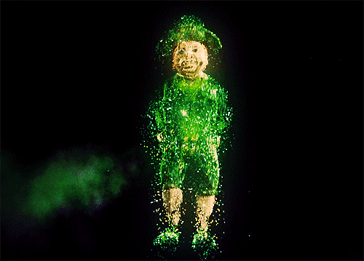

YOU FOUND HIM!!!
Go Back

Slide 3

Keep looking!!!
Go Back

