Slide 1



What’s The difference?
Can you find Lucky’s pot of gold hiding behind a Shamrock? Say the number sentence & difference then click it to see!
2-1
3-2
1-0
5-3
4-4
1-1
2-2
3-1
4-3
5-1

Slide 2
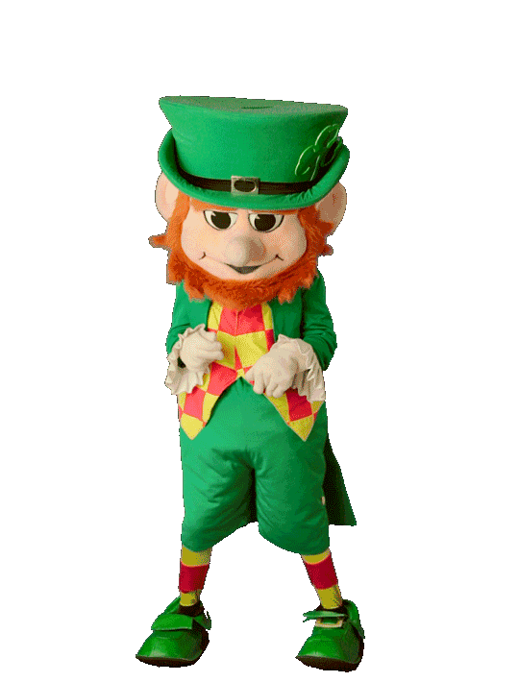

TRY AGAIN!!!
Go Back

Slide 3


YOU FOUND Lucky’s gold!!!
Go Back

