Slide 1


These classrooms are for personal and classroom use only. Please do not sell this classroom or claim it as your own even if you add, delete or rearrange the items included. You can however, make changes and share it with others.

Slide 2









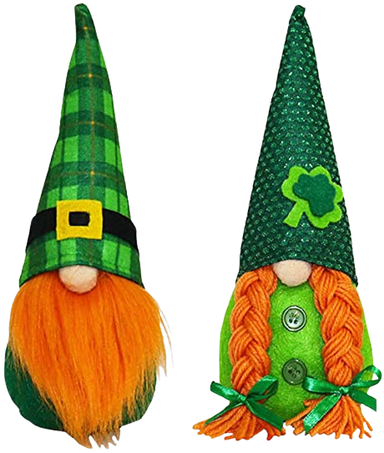

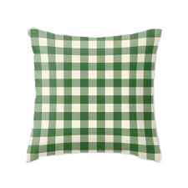


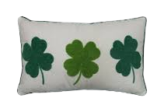






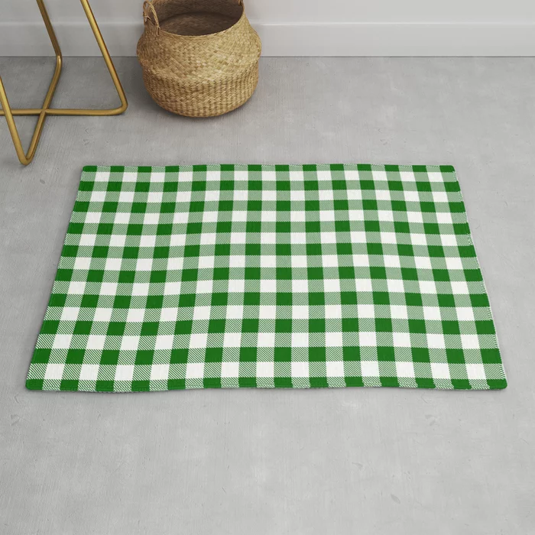

March 1
Did you know:
The word compote is French for “mixture.” A compote is a dessert originating in 17th century France. The French believed that fruit cooked in sugar syrup balanced the humidity’s effects on the body and led them to invent compotes.

Slide 3


March 2
Did you know:
This motivational and awareness day calls all children and youth in every community across the United States to celebrate reading. It encourages them to read where ever they are.

Slide 4


March 3
Did you know:
Genuine happiness takes effort. While we’re not individually responsible for others’ happiness, we do play a role in spreading joy and good cheer. One way to do that is to see happiness from another person’s perspective.

Slide 5


March 4
Did you know:
The military roots of the drum corps have evolved over time. It thrills us with an ability to perform delightful music and execute intricate routines with exact precision. Drill squads, marching bands, drum lines, and drum corps name but a few of the many styles of marching music.

Slide 6


March 7
Did you know:
Ferdinand Schumacher, a German immigrant, began the cereal revolution in 1854 with a hand oats grinder in the back room of a small store in Akron, Ohio. His German Mills American Oatmeal Company was the nation’s first commercial oatmeal manufacturer. In 1877, Schumacher adopted the Quaker symbol, the first registered trademark for a breakfast cereal.

Slide 7


March 8
Did you know:
In many parts of the world, women are less likely to own land, a business, or attend school. Education alone is a powerful tool leading to financial independence for women. Their children reap the rewards, often for generations to come. Additionally, when the women of a community prosper, so does the community. Educated women and girls are more likely to educate their offspring. They also have a better understanding of healthcare and understand their rights.

Slide 8
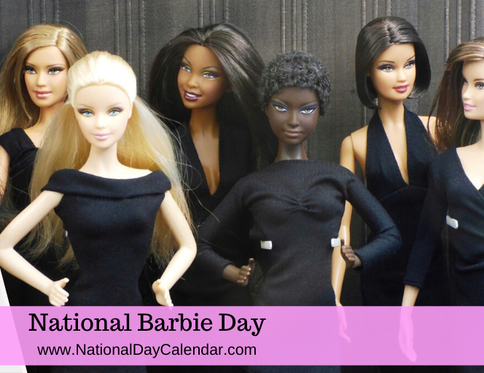
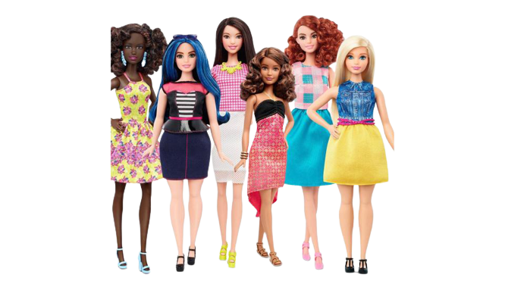
March 9
Did you know:
Over the years, Barbie evolved both in style and shape. In 2019, the Barbie brand honored pioneering women across several eras, as well. The modern Barbie offers positive role models in business, science, education, and more. Barbie continues to change, year after year, keeping up with the styles and the headlines.

Slide 9


March 10
Did you know:
Packing your lunch has benefits you may not expect. One of the immediate benefits is savings. Many home-prepared lunches cost less than ordering off the take-out menu or eating out. Another benefit of making your own lunch is controlling portion sizes and ingredients. By adding fruits, vegetables, and whole grains to your lunches, they will be healthier, too.

Slide 10


March 11
Did you know:
John Chapman was born on September 26, 1774, in Leominster, Massachusetts.Often shoeless, he traveled mostly by foot and sometimes by horseback or canoe. His appearance was nearly as noteworthy as his accomplishments, but so was his kindness. Farmers and frontier folk always found a place at the table if Johnny Appleseed came visiting.

Slide 11



March 14
Did you know:
Pi is the ratio between the circumference of a circle and its diameter. While the idea of pi has been known for nearly 4000 years, accurately calculating it has been something of slightly more recent mathematical development. in 1706, Welsh mathematician William Jones introduced the Greek letter π to represent the ratio of a circle’s circumference; pi.

Slide 12


March 15
Did you know:
Each day, over 500 million children, teens, and adults do not have a pair of shoes to wear. Despite the terrain and the climate, they walk barefoot everywhere. Their daily struggle is one we cannot begin to imagine. Living daily without protection on your feet can lead to a lifetime of problems including pain, injury, cuts, sores, infections, parasites.
Visit Soles4Souls to donate shoes.

Slide 13


March 16
Did you know:
In the wild, there are approximately only 1,864 (according to the World Wide Fund for Nature) and 100 living in zoos around the world. Their black and white coloring was designed for their natural habitat in the snowy mountains and temperate forests of southwest China.They eat mostly plants and do not hibernate in the winter like many other bears.

Slide 14


March 17
Did you know:
To “corn” something is simply to preserve it in a salty brine (the term corn refers to the coarse grains of salt used for curing).

Slide 15


March 18
Did you know:
The Sloppy Joe is one of America’s all-time favorite hot sandwiches. Its base ingredient is often ground beef. However, others use turkey and buffalo, too. The other elements give it its flavor, though. Onions, tomato sauce, brown sugar, cola or maple syrup to sweeten it and seasonings to spice it – and of course, any secret ingredient families may add over the years. All of it is served up on a hamburger bun or roll. And is it ever sloppy! Be sure to grab more than one napkin!

Slide 16


March 21
Did you know:
Common courtesy can be as simple as saying “please” and “thank you” when asking for and receiving a service, gift, or assistance. Kindness and courtesy do go a long way and are noticed by others even if you do not realize it.

Slide 17


March 22
Did you know:
Bavarian crepes are a delicious, very thin pancake-like dessert. They are typically made from wheat flour or buckwheat flour, then filled, rolled, and then often topped with a glaze, fruit, chocolate or whipped cream. In Bavaria, crepes are called palatschinke. While similar to a French crepe, the Bavarian crepe batter doesn’t need to rest before using.

Slide 18


March 23
Did you know:
National Puppy Day celebrates the unconditional love and affection puppies bring to our lives. The day also brings awareness to the need for care of and homes for orphaned pups as well as to educate people about the horrors of puppy mills across the country. Puppies are a big responsibility. Be sure to consider everything involved and adopt from a shelter.

Slide 19


March 24
Did you know:
In some countries, chocolate covered raisins are known as Raisinets. Raisinets produced the first and one of the most popular brands of the product. Currently made by Nestle, they are the third-largest selling candy in United States history.

Slide 20


March 28
Did you know:
Street fairs and food trucks have created a variety of recipes made to go on a stick that takes us from breakfast to after-party hunger with flavor combinations that sometimes make us wonder why we haven’t tried that before! Whether it is fresh and healthy or breaded and deep -fried, menu choices are broad and plentiful

Slide 21


March 29
Did you know:
The recipe for the chiffon cake was a closely guarded secret for years. In the 1920s, angel food cake was quite popular, but Henry Baker thought he could make a lighter, richer cake. The insurance salesman-turned-caterer tinkered with ingredients until 1927 when he came upon the perfect combination of ingredients and methods to produce the airy richness he was looking for.

Slide 22


March 30
Did you know:
Hymen Lipman received the first patent for attaching an eraser to the end of a pencil on this day in 1858. Before that time, pencils and erasers existed separately. Lipman combined the two making two tools much more convenient to use. The intuitive businessman also manufactured envelopes for his stationery shop and was the first to add adhesive to the flap of envelopes.

Slide 23


March 31
Did you know:
In 1903, Binney & Smith created the Crayola Division and produced colored wax crayons for children for the first time. Then in 1904, they presented their An-Du-Septic chalk at the Columbian Exposition in St. Louis winning a gold medal. The chalk was designed to be dustless at many teachers’ requests and was an immediate success.

