Slide 1

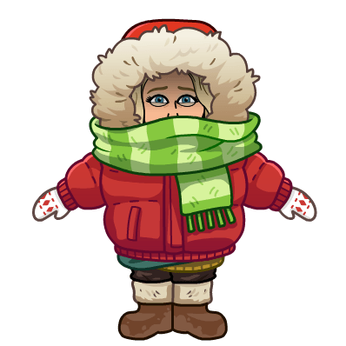

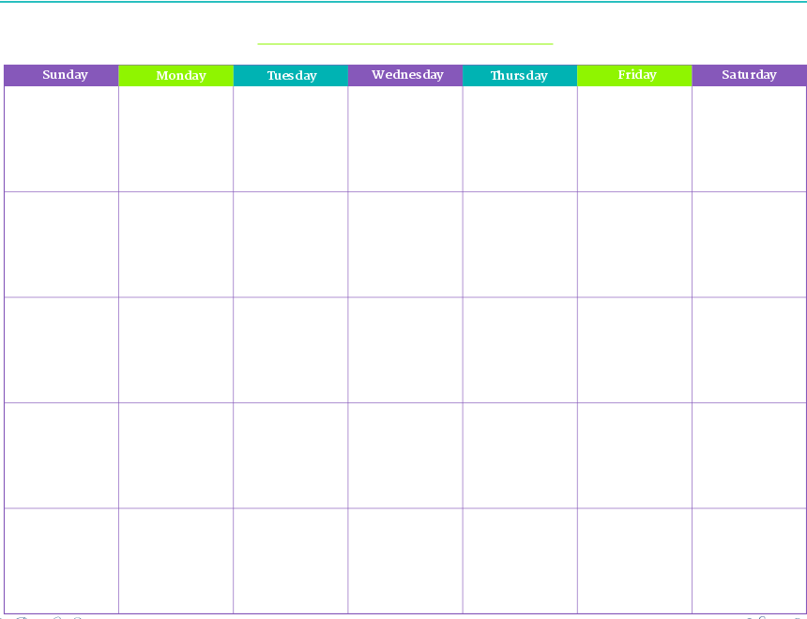


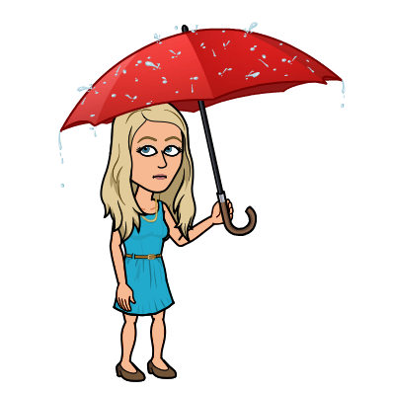










January
March
2021
February
Sunday
Monday
Tuesday
Wednesday
Thursday
Friday
Saturday
March
1
2
3
4
5
6
April
May
7
8
9
10
11
12
13
June
14
15
16
17
18
19
20
July
August
21
22
23
24
25
26
27
September
October
28
29
30
31
November
December

Slide 2
Weather
High Temperature
Tens | Ones
Quantity
Quantity
Low Temperature
Difference

Slide 3
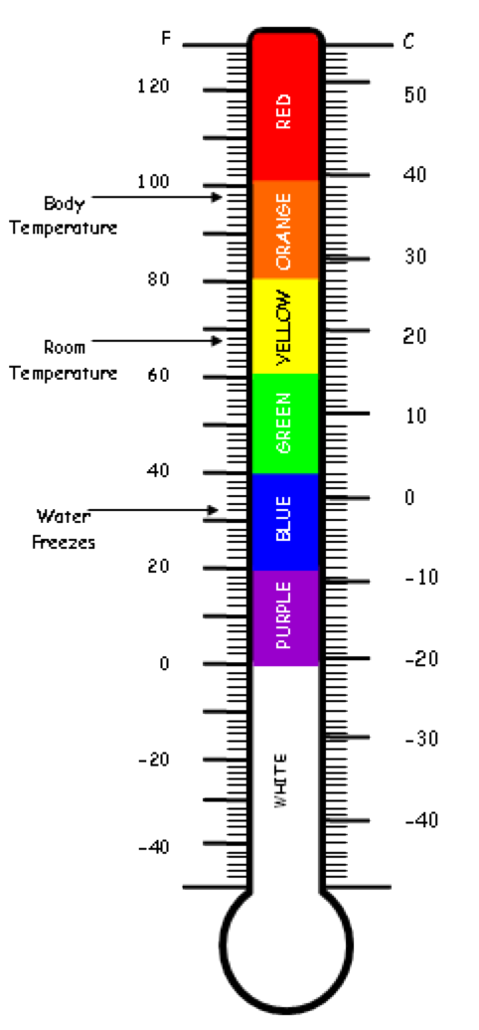

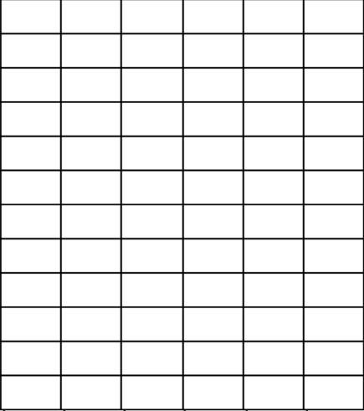
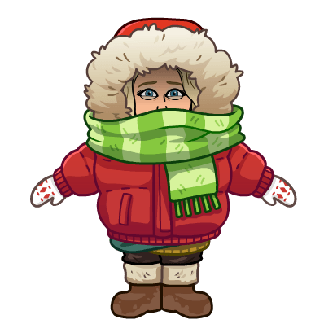

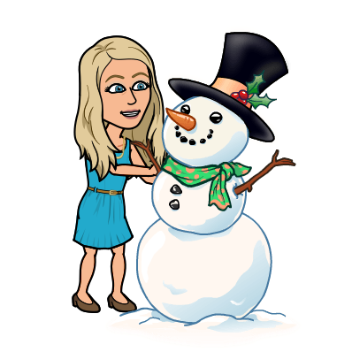
February High Temperatures

Slide 4

Days of School
Hundreds
Tens
Ones

Slide 5
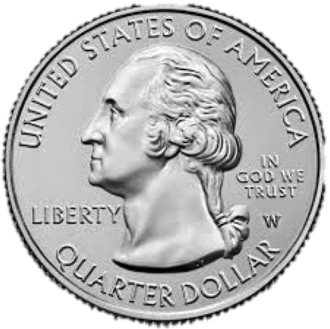
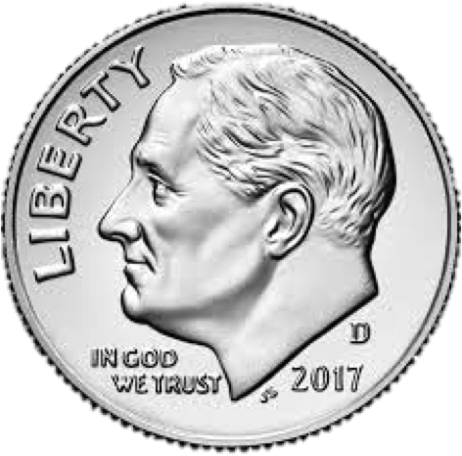
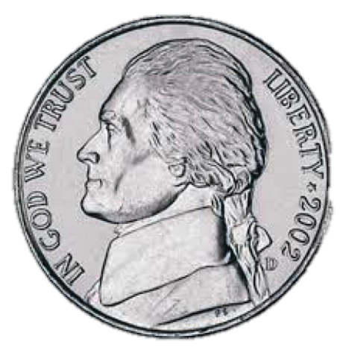

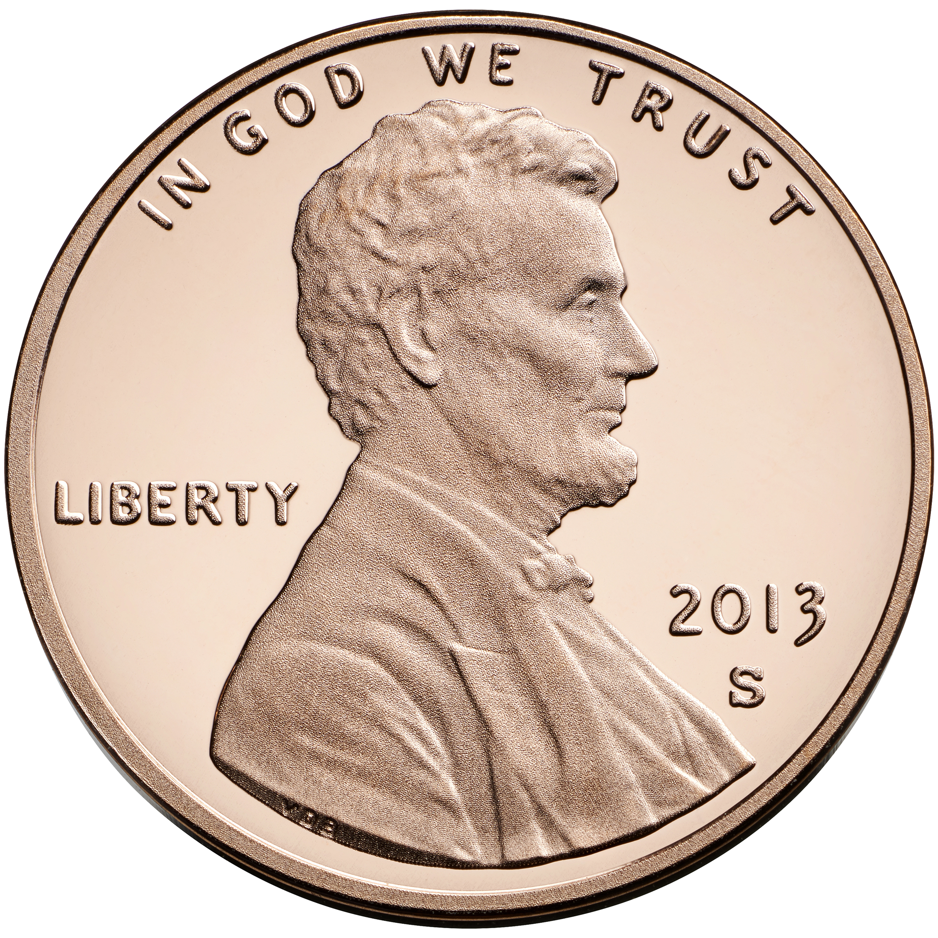
Number of the Day_____
Build the Number | Value of Each Digit | Expanded Form
Addition Number Model | Subtraction Number Model | Money

