Slide 1




Resource Links
This day in history
Epic Book Links
Sunday | Monday | Tuesday | Wednesday | Thursday | Friday | Saturday
 | 1 | 2 | 3 | 4 | 5 | 6
7 | 8 | 9 | 10 | 11 | 12 | 13
14 | 15 | 16 | 17 | 18 | 19 | 20
21 | 22 | 23 | 24 | 25 | 26 | 27
28 | 29 | 30 | 31
Youtube Links
Google Drive Folder

Slide 2


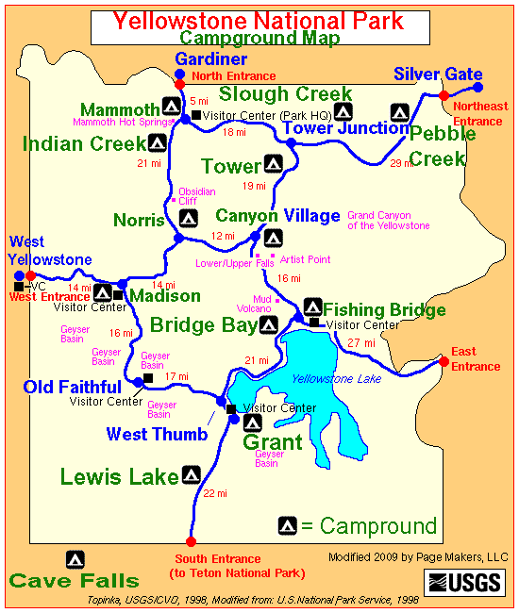
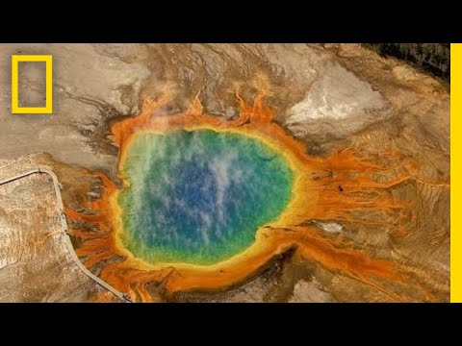

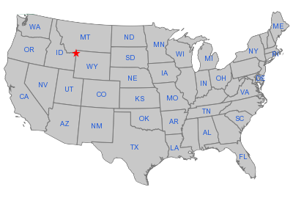



Yellowstone becomes the U.S.'s first national park. (1872)
Books

Slide 3
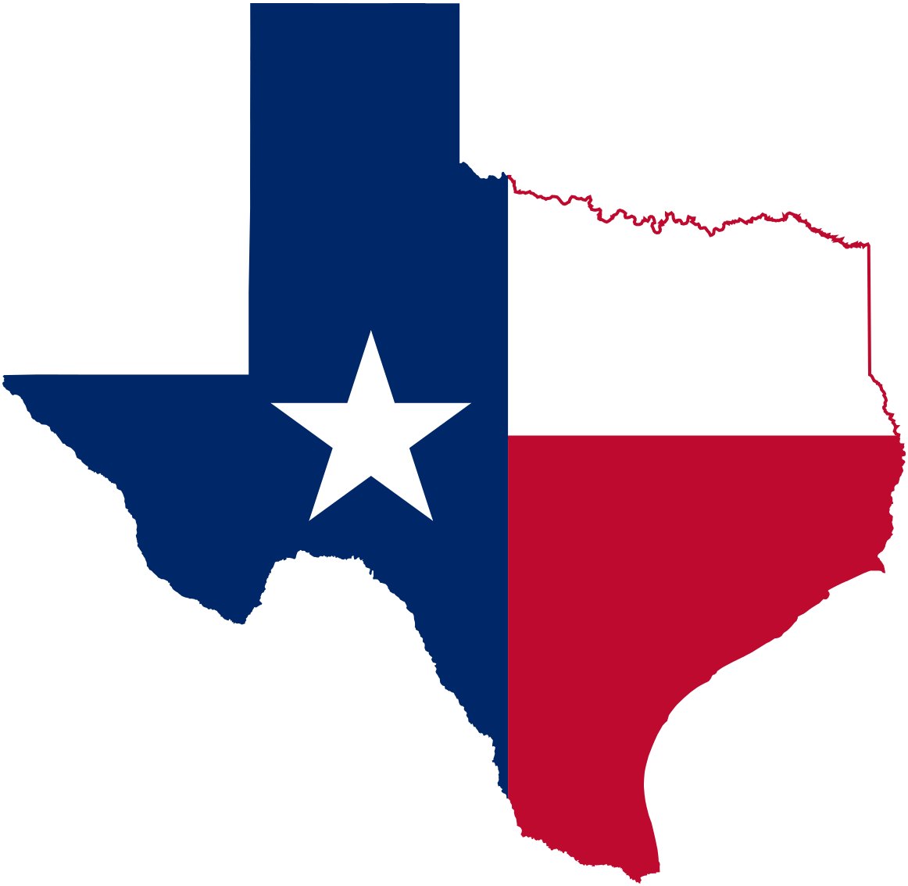
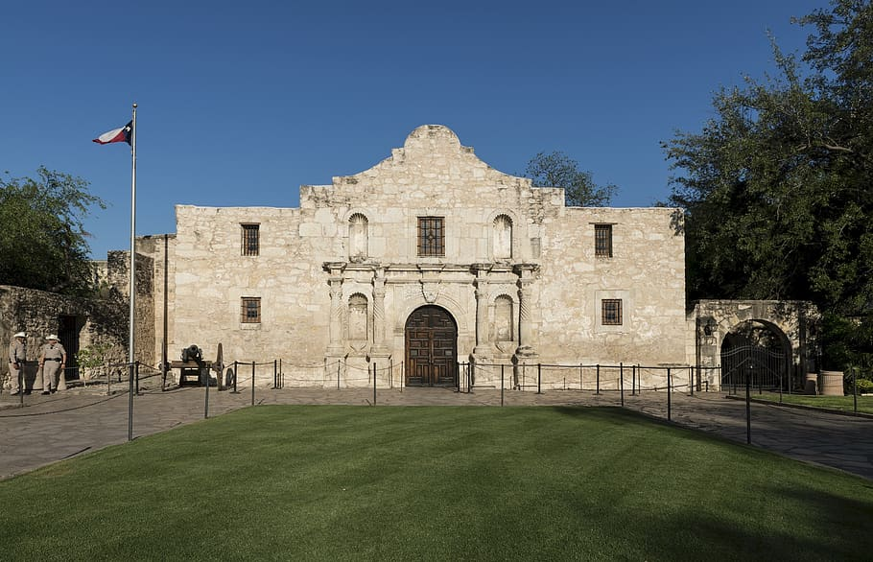
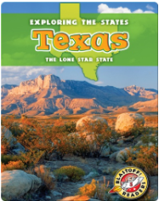

Texas declared its independence from Mexico (1836).
Books

Slide 4

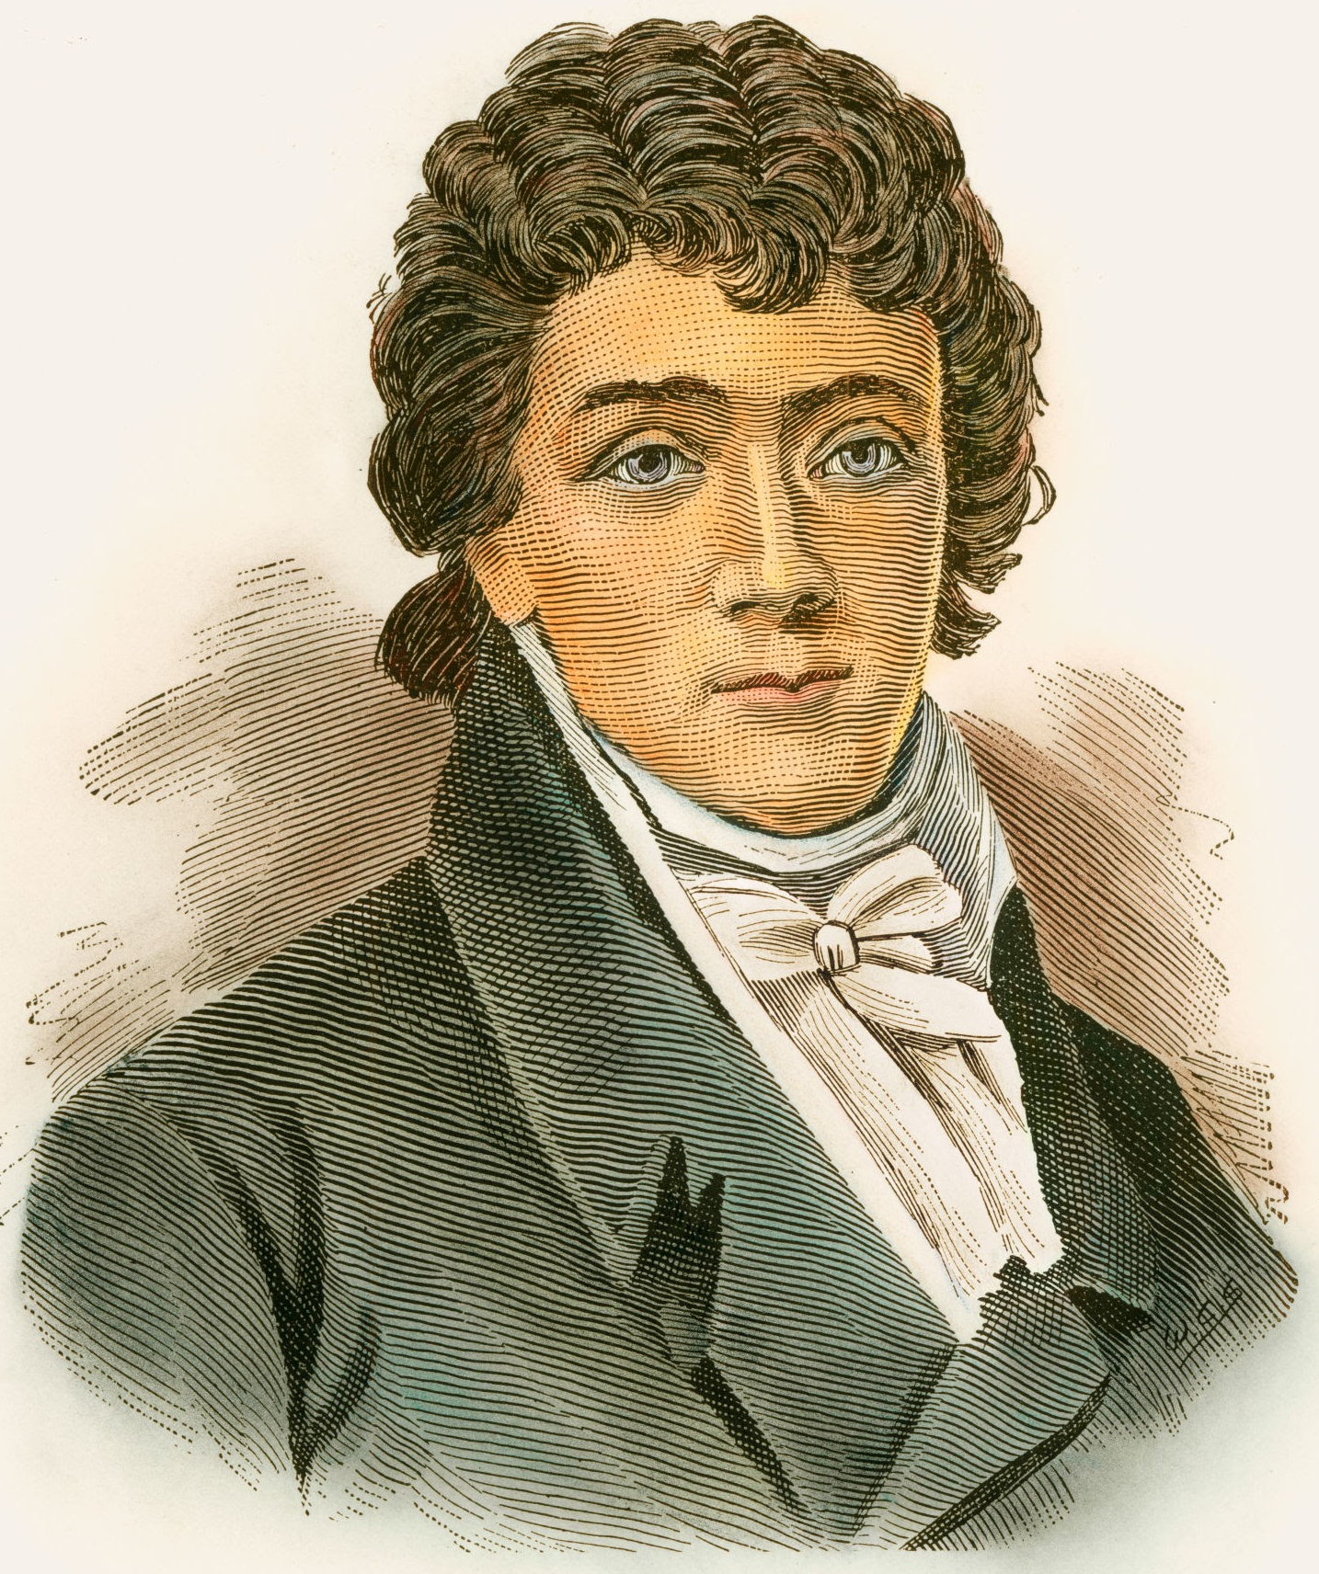



The Star Spangled Banner becomes the National Anthem (1931)
Books
Francis Scott Key

Slide 5
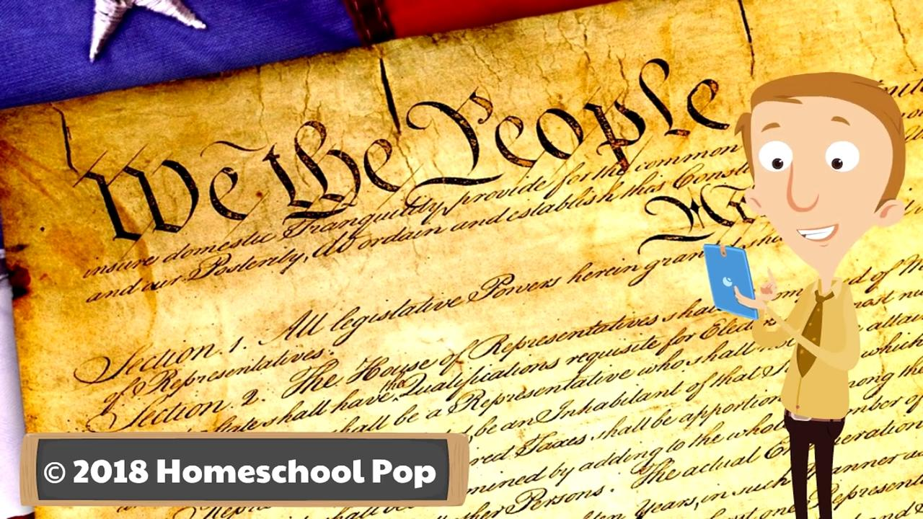
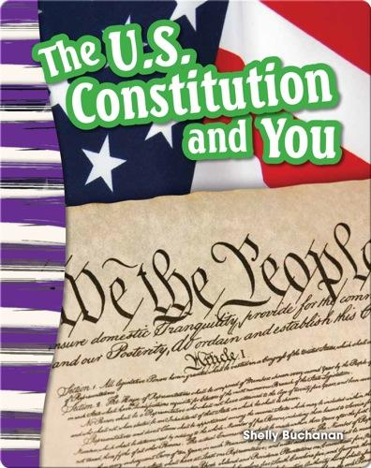
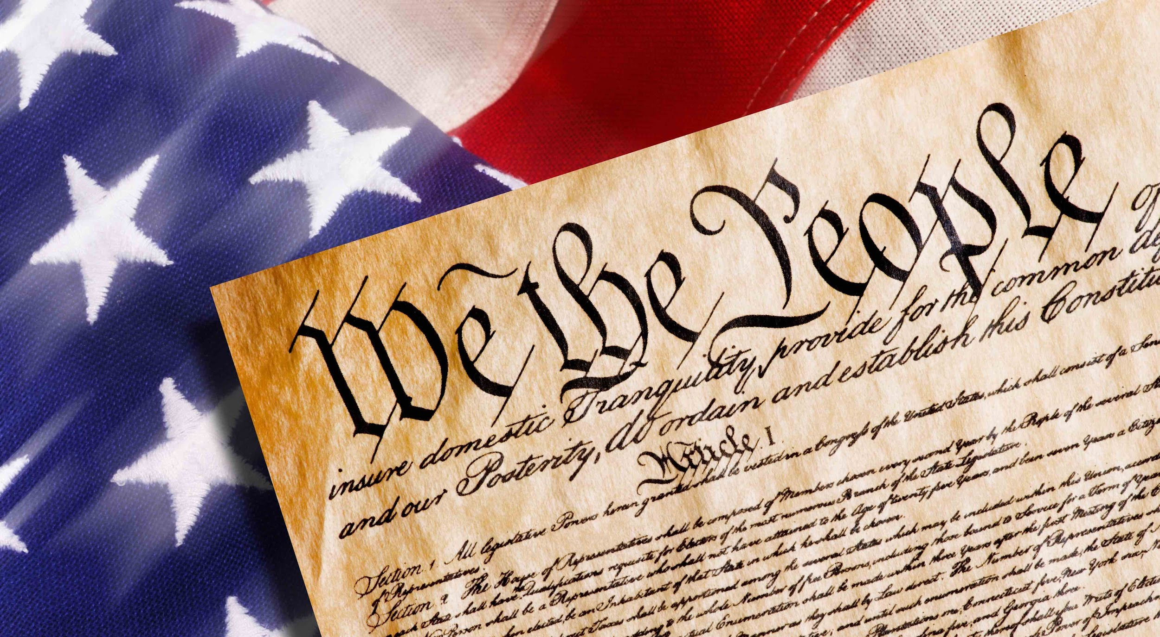
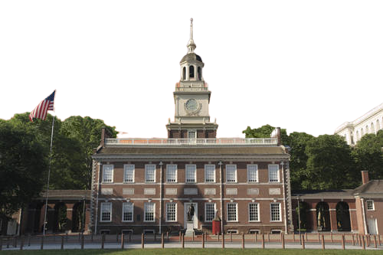

The Constitution of the United States of America goes into effect. (1789)
Books
Read and Listen to it
Tour me

Slide 6
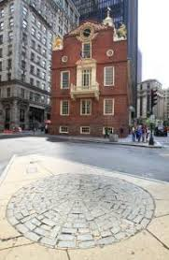
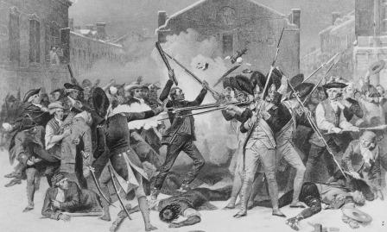


The Boston Massacre occurred. (1770)
Read and Listen to it
Tour me

Slide 7
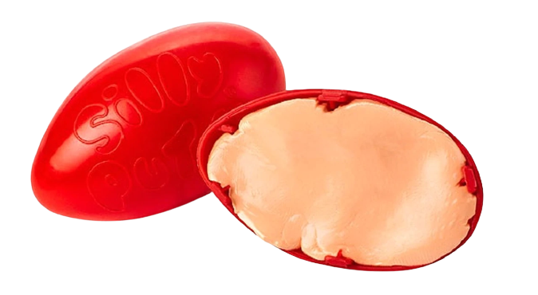


Silly putty is invented. (1950)
Watch the first commercial
15 Facts

Slide 8
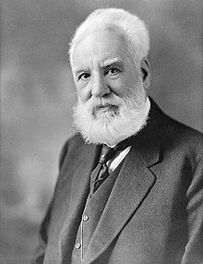
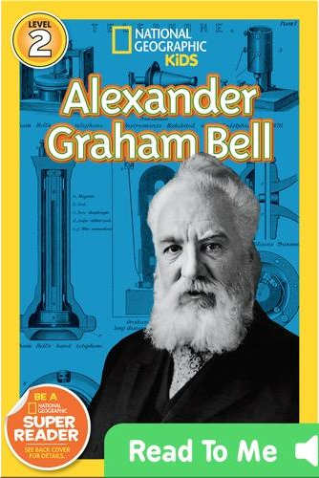
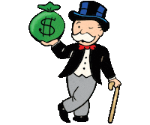
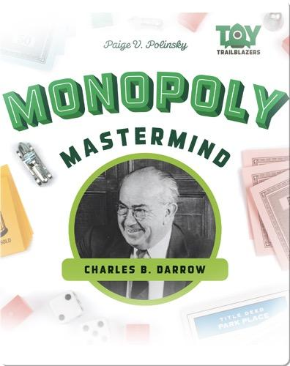

Alexander Graham Bell patents the Telephone. (1876)
Monopoly board game is invented (1933)
Books
Books

Slide 9

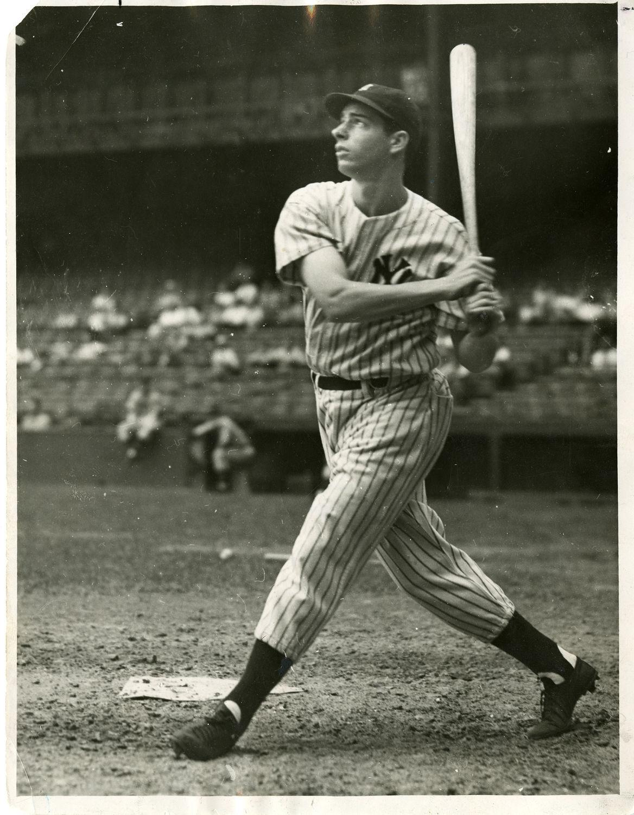
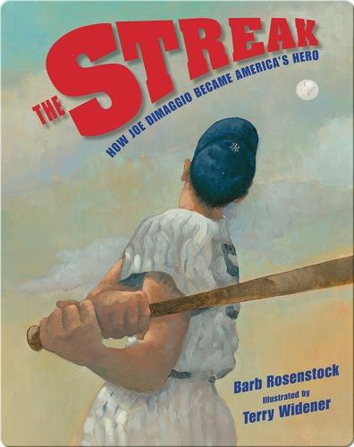


Baseball great Joe DiMaggio dies (1999)
Books
56 Fun Facts
Hall of Fame

Slide 10
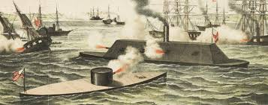
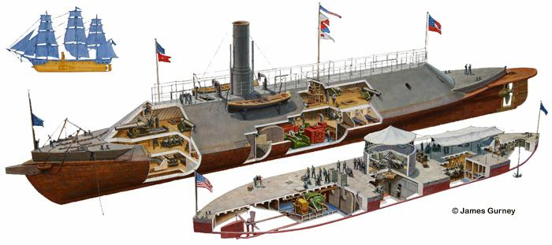

Ironclad ships the Monitor and the Merrimack battle in the Civil war.

Slide 11
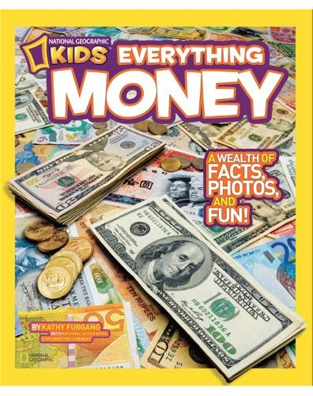
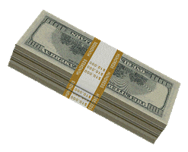

The U.S. government issues paper money for the first time. (1862)
Books
30 Fun Facts

Slide 12

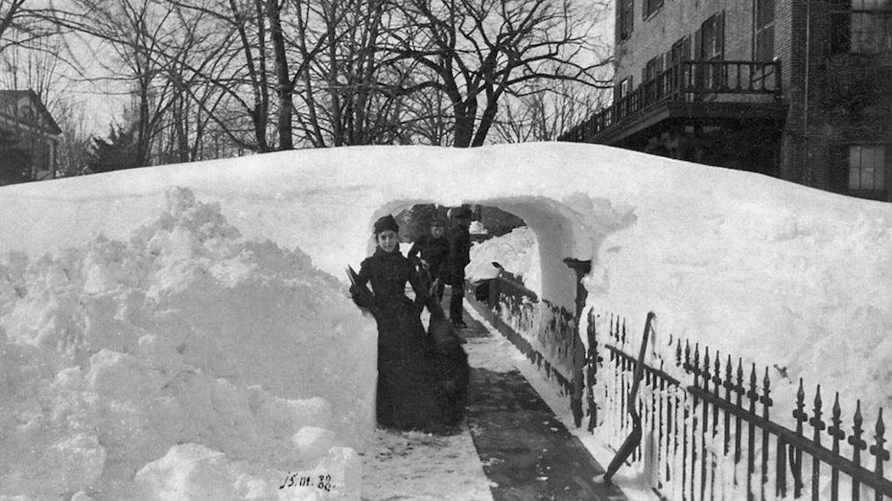
The most famous storm in American history begins.... the Blizzard of 1888. (1888)
Books

Slide 13

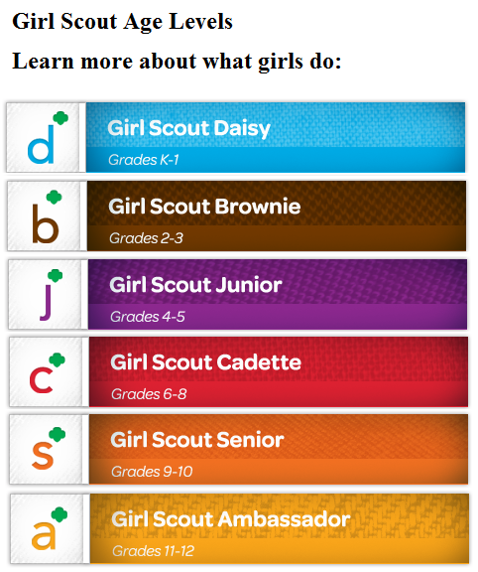
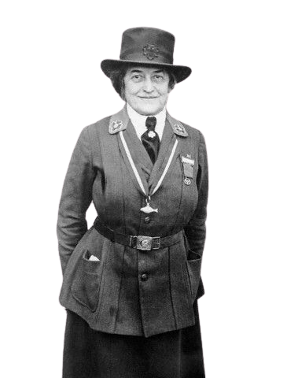

Girl Scouts were founded. (1912)
22 Fun Facts
Book
Juliette Gordon Low Bio

Slide 14

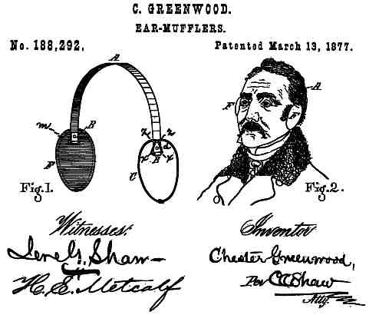
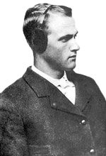
Greenwood patented earmuffs, originally called the "Champion Ear Protector". (1877)
Book
Chester Greenwood

Slide 15

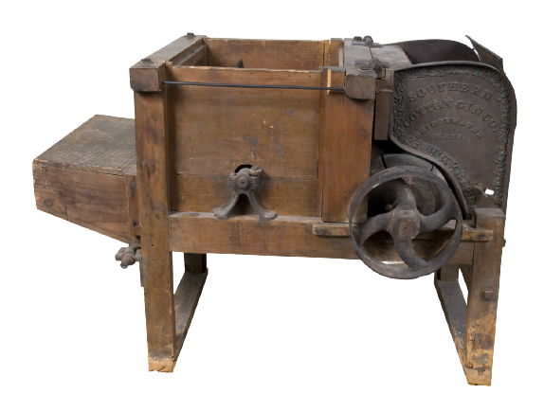
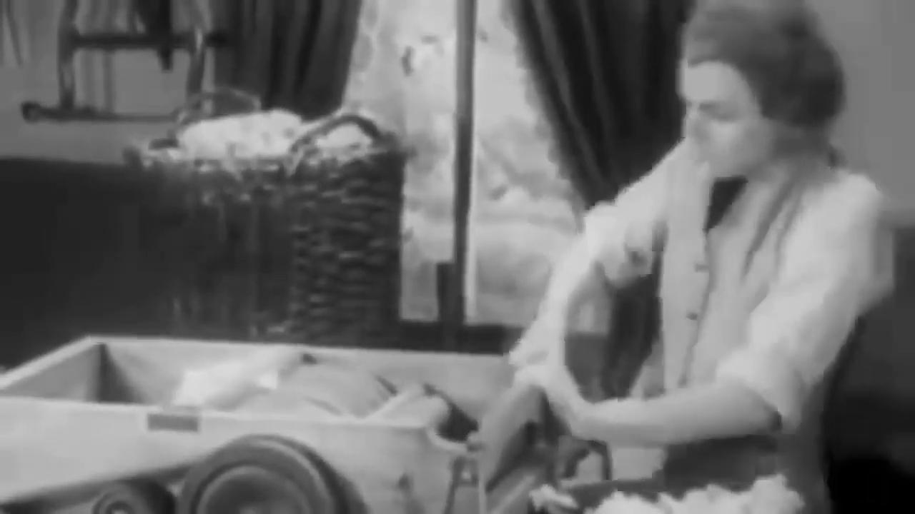
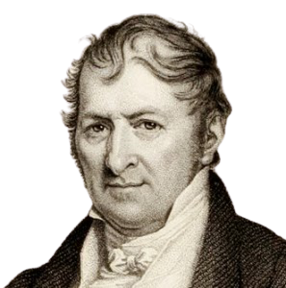
Eli Whitney patents the Cotton Gin (1794)
Books
How it Works
Eli Whitney Bio

Slide 16

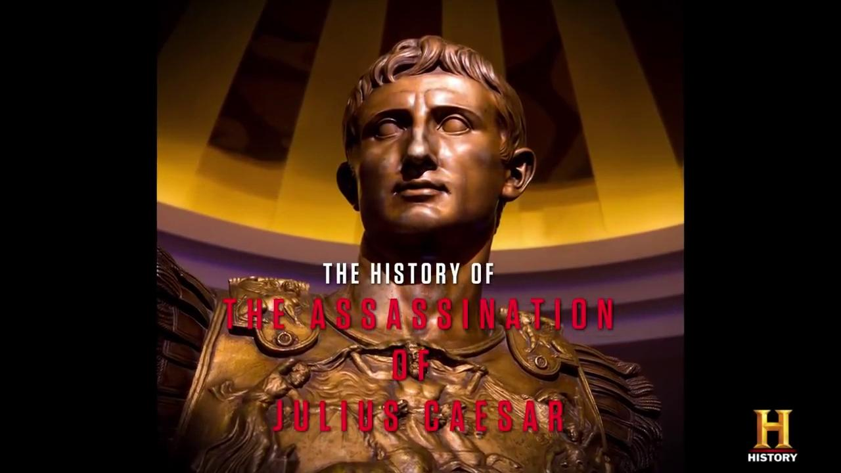
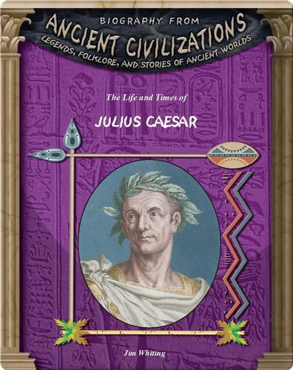
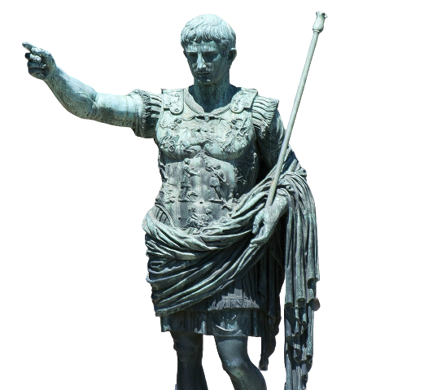
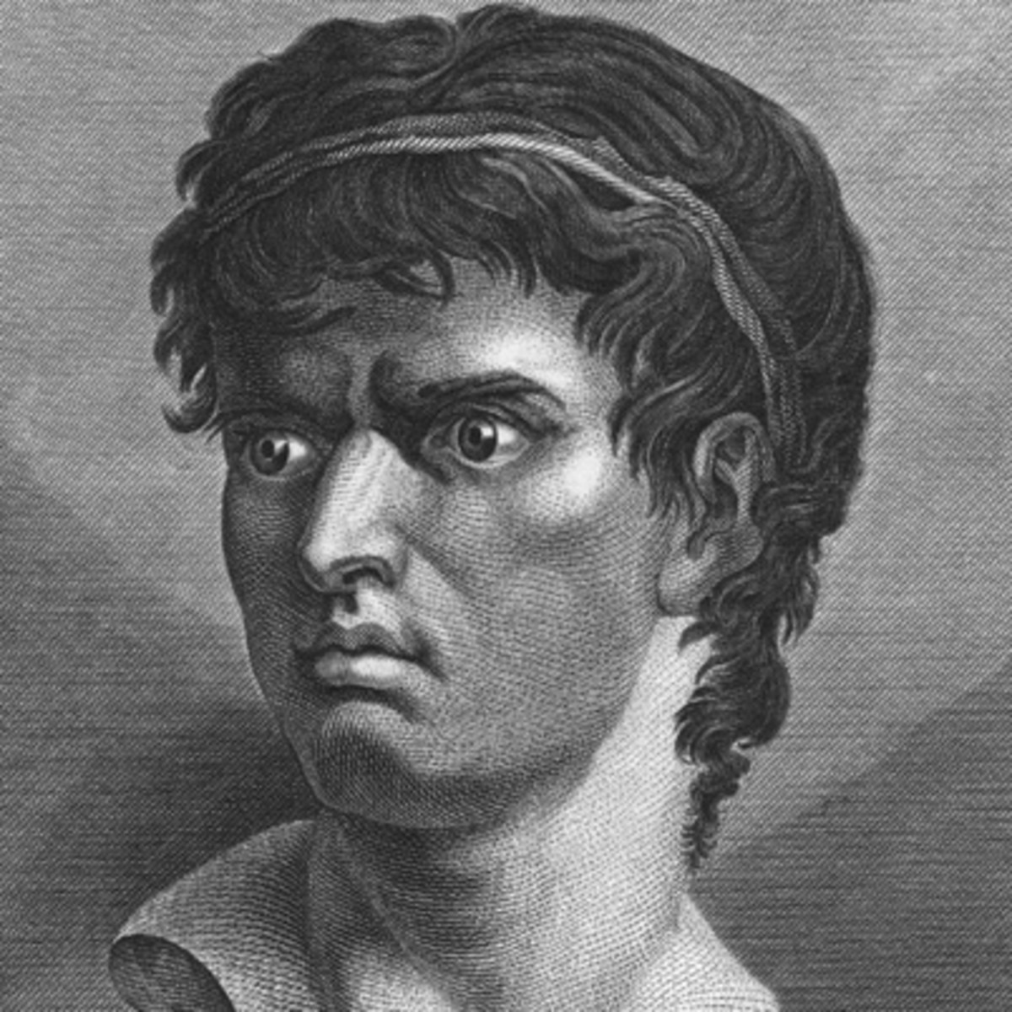
"The Ides of March" Julius Caesar is stabbed to death by Marcus Junius Brutus. (44 B.C.)
Marcus Brutus
Book
Julius Caesar

Slide 17


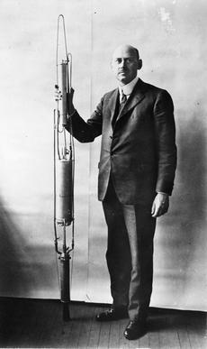
Professor Robert Goddard launches the first liquid fuel rocket. (1926)
Book
Robert Goddard

Slide 18
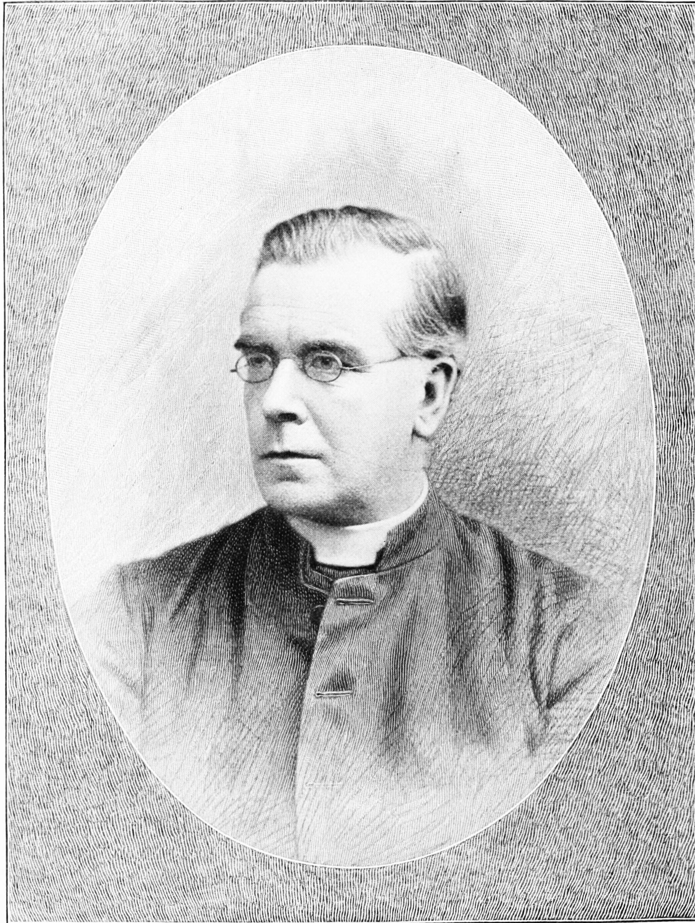
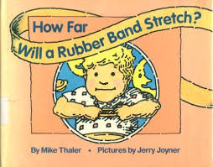
The rubber band was invented. (1845)
Book
Fun Facts

Slide 19
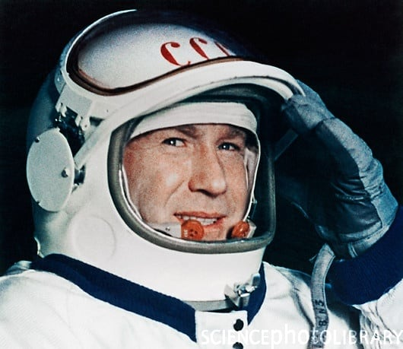
Soviet Union cosmonaut Aleksei Leonov becomes the first person to take a space walk. (1965)

Slide 20


Congress approves Daylight Savings Time. (1918)
Book

Slide 21

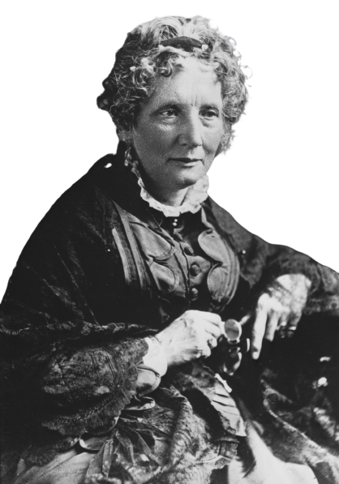
Harriet Beecher Stowe publishes the book Uncle Tom's Cabin . (1852)
Book
Harriet Beecher Stowe

Slide 22


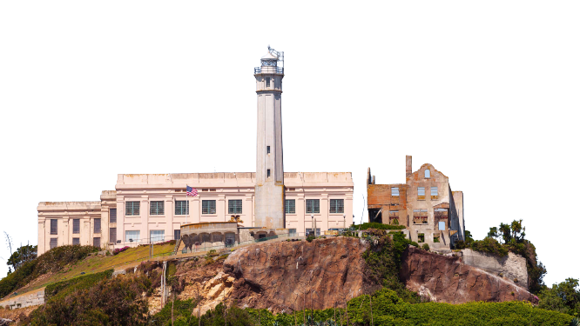
The infamous Alcatraz prison is closed. (1963)
Tour
Book
History

Slide 23

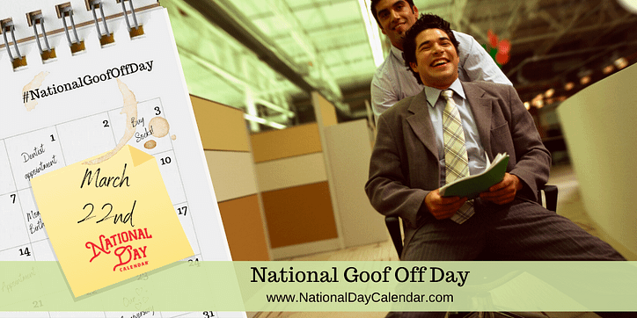
Sadly, nothing history happened on this day so we will celebrate with National Goof Off Day

Slide 24
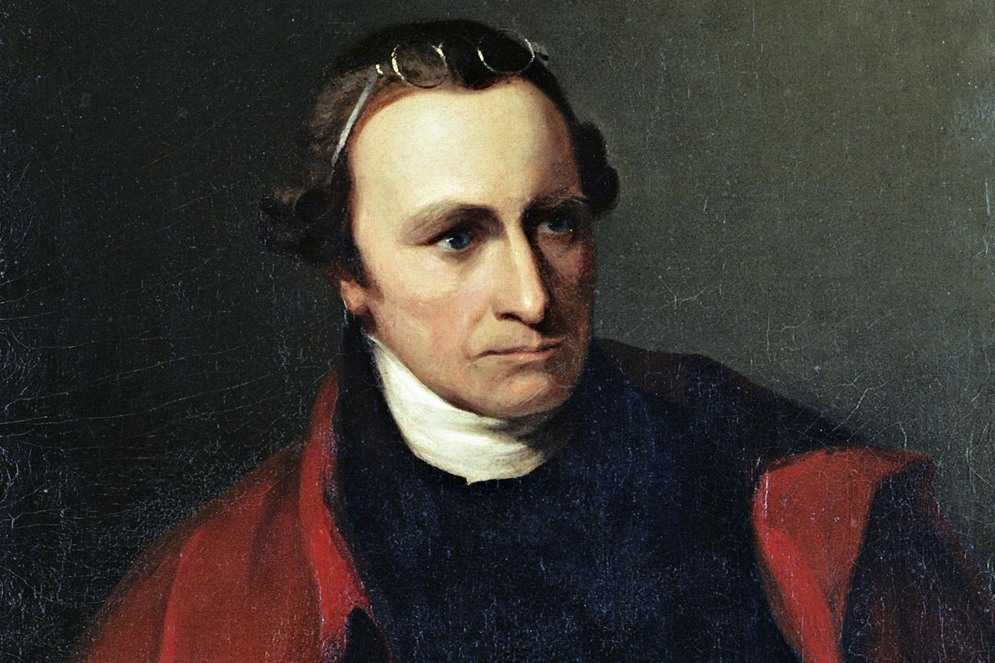

Patrick Henry declares "Give me liberty, or give me death!" (1775)
Books
Speech

Slide 25

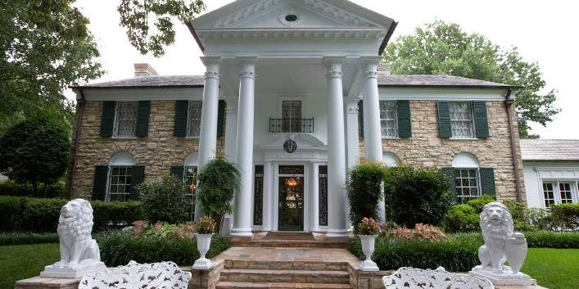
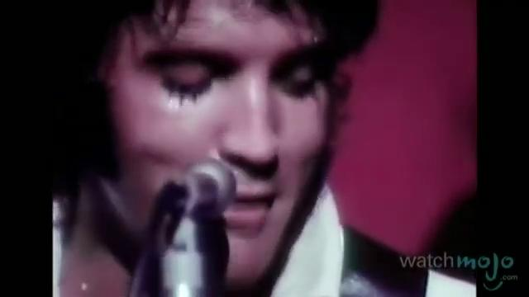
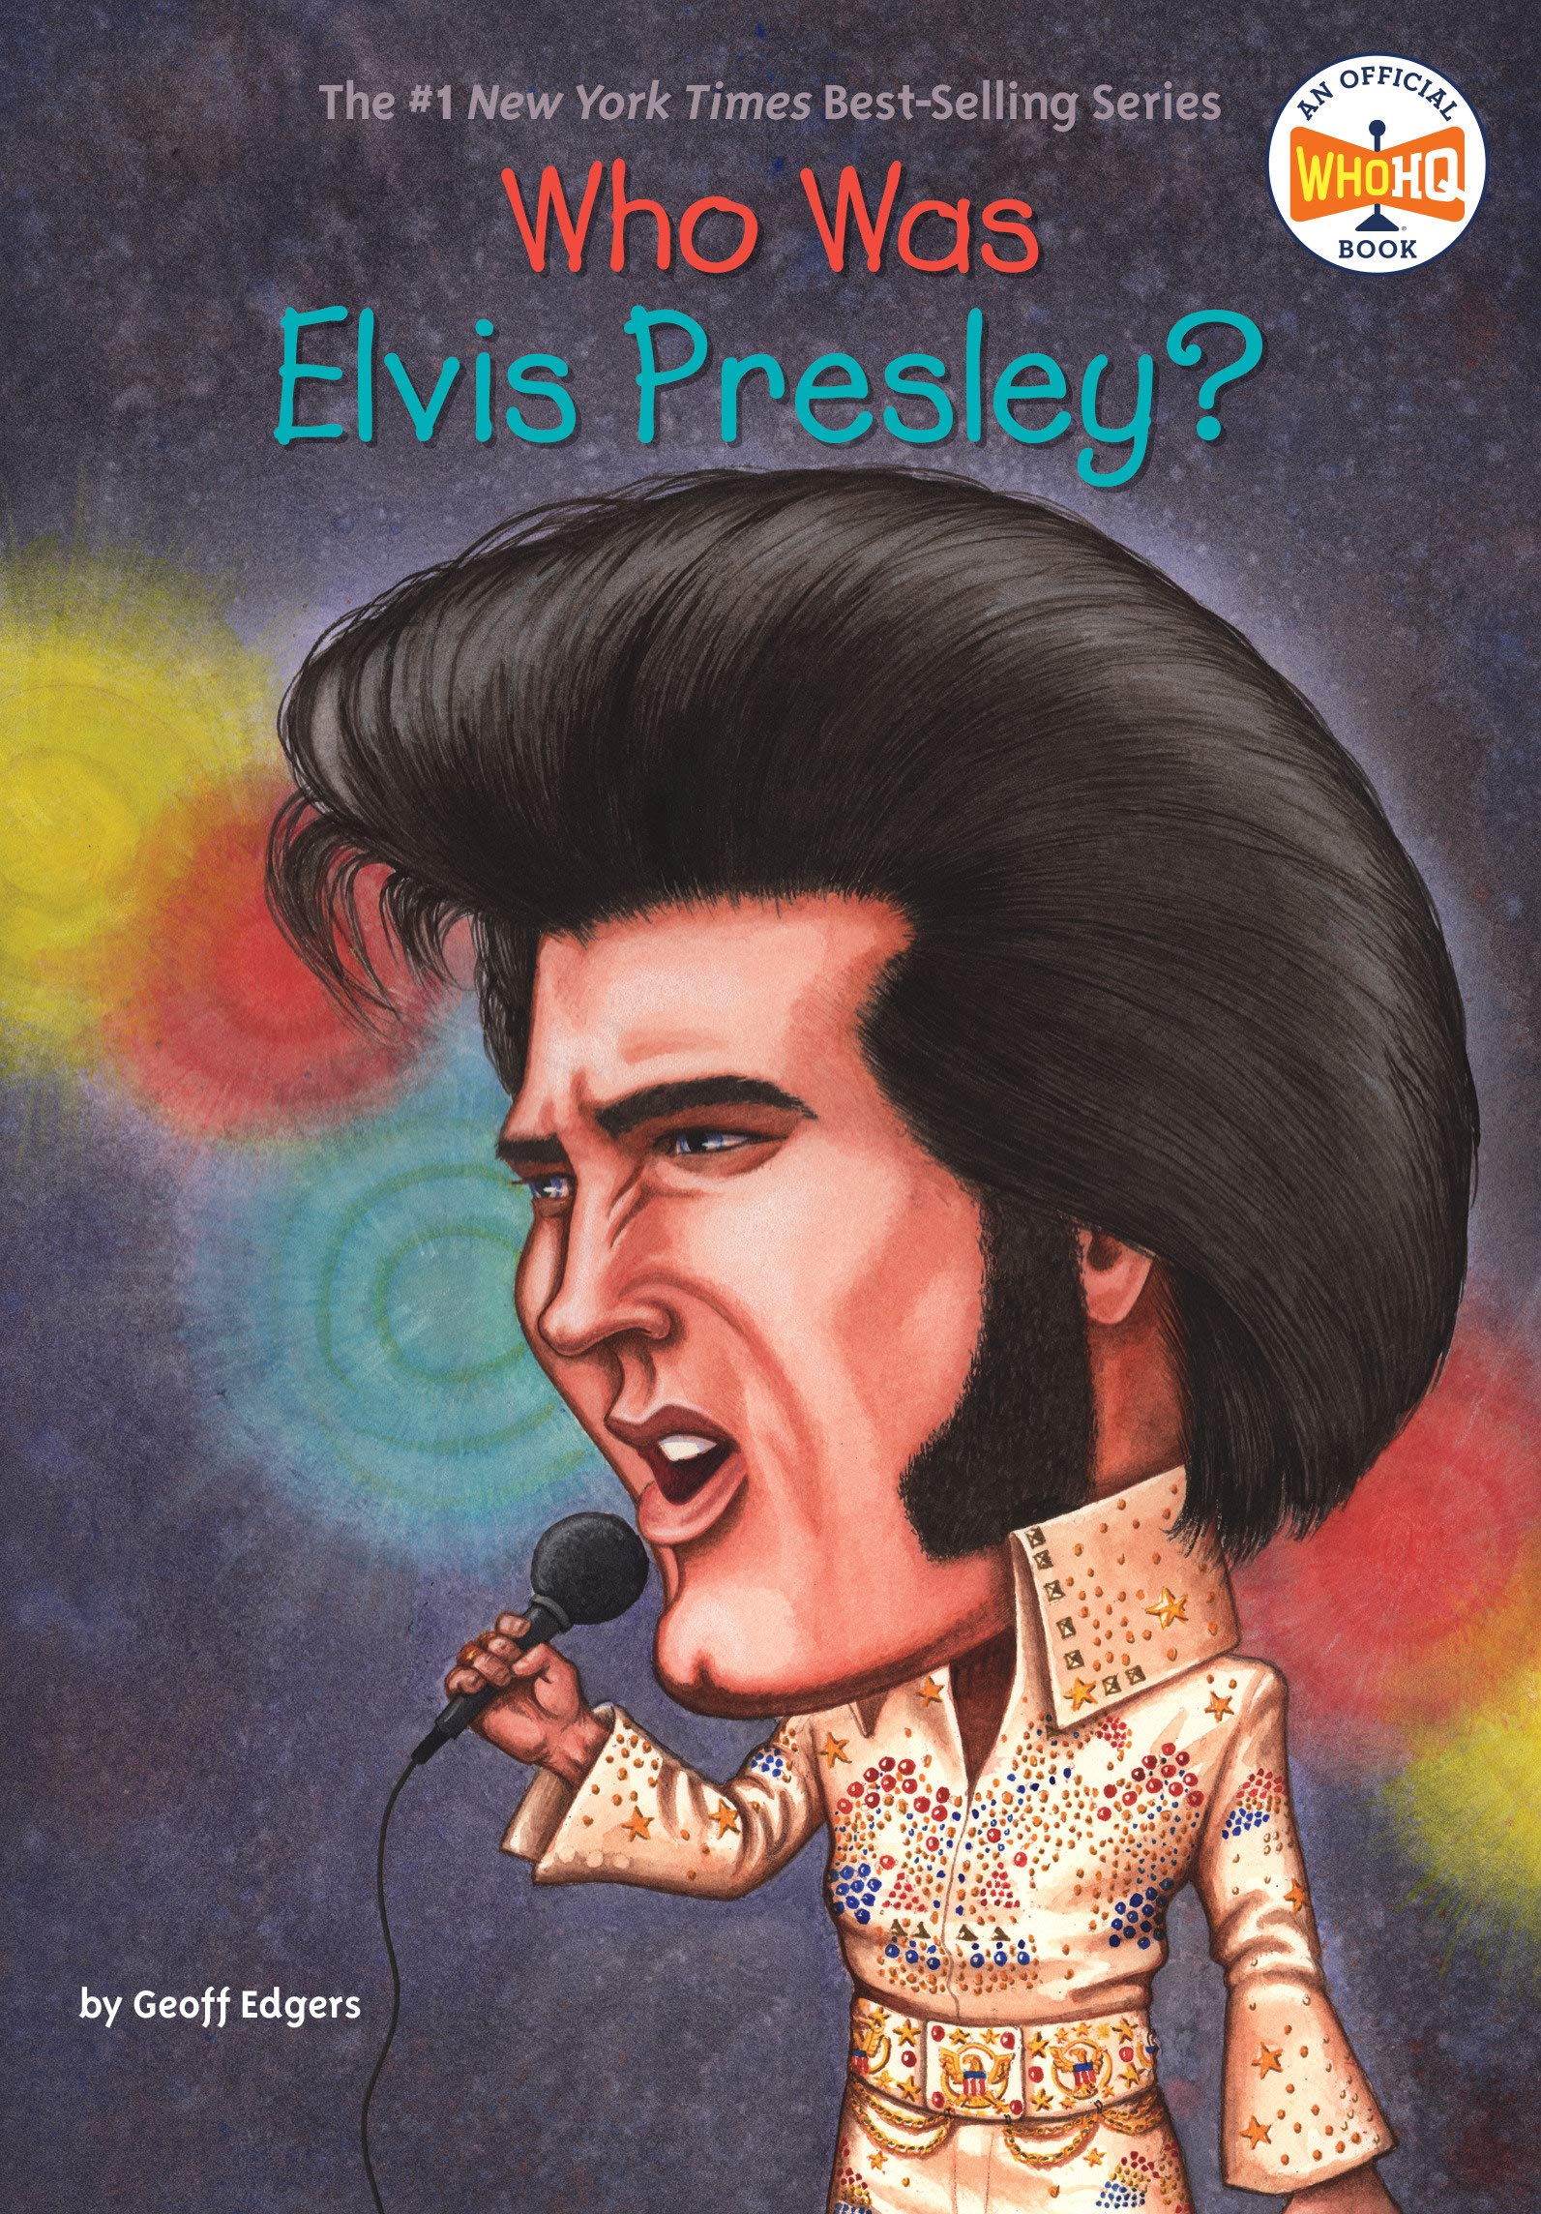
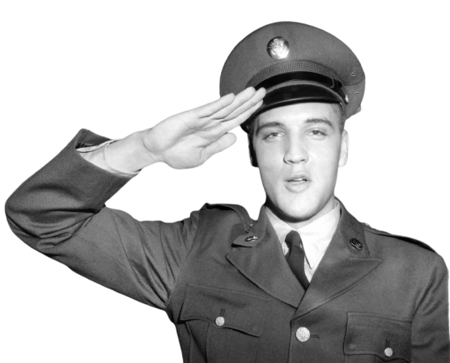
Elvis Presley joins the U.S. Army. (1958)
Graceland Tour
Book
Part 1
Part 2
Interview

Slide 26
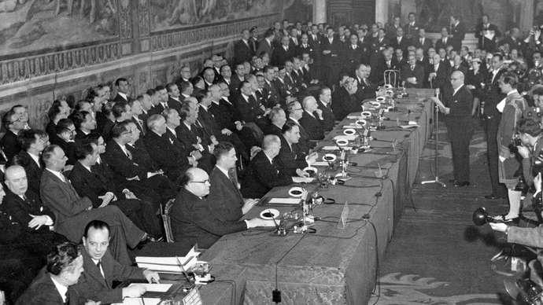
The European Economic Community (ECC) is established by the Treaty of Rome. (1957)
Signing of the Treaty in Rome

Slide 27




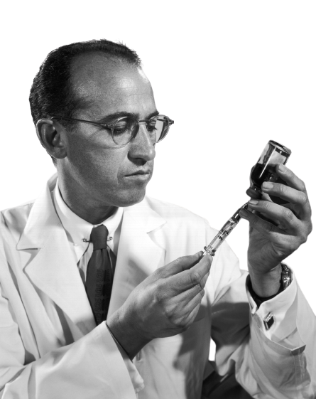


Ludwig von Beethoven dies in Vienna, Austria. (1827)
Dr. Jonas Salk invents a vaccine to fight polio.
Book
Book
Jonas Salk
Beethoven

Slide 28



The biggest earthquake ever recorded strikes Anchorage, Alaska. It measured 8.3 on the Richter scale. (1964)
Books
Charles Francis Richter

Slide 29

Nathaniel Briggs patents the washing machine. (1797)

Slide 30





Coca Cola is invented. (1886)
John Stith Pemberton
Books
Tour
commercial

Slide 31


The 15th amendment goes into effect, giving black men the right to vote. (1870)
Books

Slide 32




The Eiffel Tower opens in Paris, France (1889)
Books
360 Virtual Tour

