Slide 1






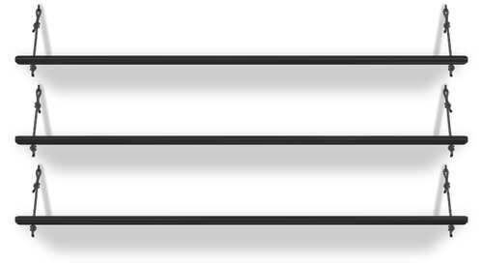


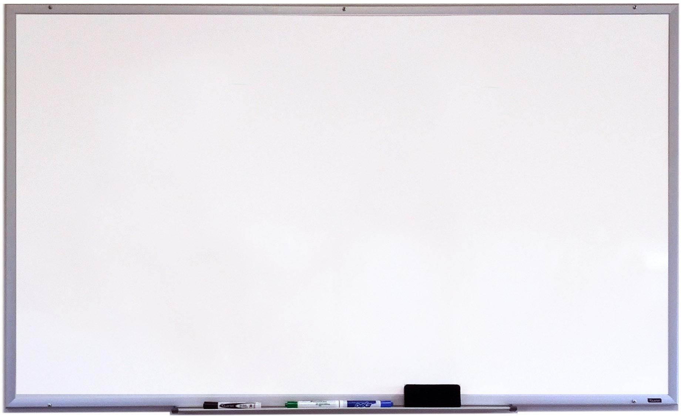












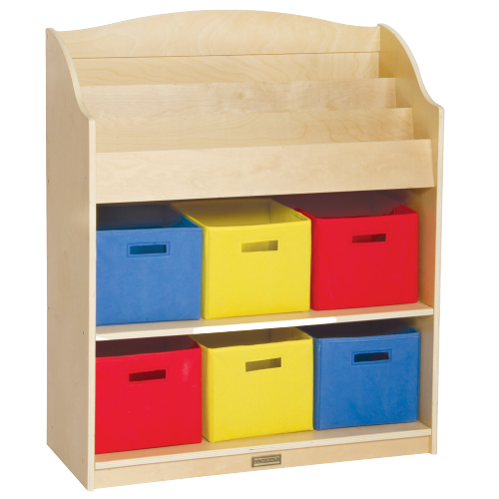








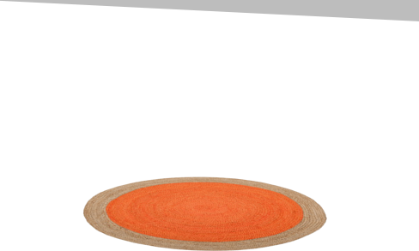

8:30-8:40 | Opening/SEL
8:40-9:00 | Writing
9:00-9:20 | ELA Lesson 2nd
9:20-9:50 | ELA Lesson 3rd
9:50-10:10 | Break - Recess
10:10-10:30 | Math Lesson 2nd
10:30-11:00 | Math Lesson 3rd
11:00-11:15 | Small Group 3rd
11:15-11:30 | Small Group 2nd
11:30-11:45 | SEL/Closing
11:45-12:10 | 2nd Science Zoom
12:10-1:00 | Break - Lunch
1:00-1:15 | Office Hours Q & A
1:15-1:30 | Office Hours Math
1:30-2:00 | Office Hours ELD/Writing
March 1, 2021
3-1-2021
Independent Must Dos
)
Do you have anything you’d like to share in the stream today?
2B
3B
2
3
Tell us about what you read today!
3rd

