Slide 1

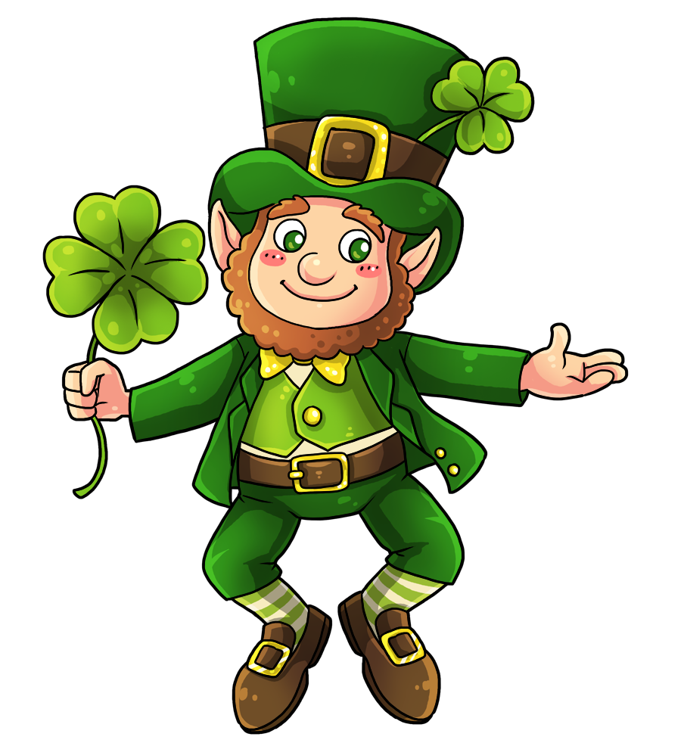
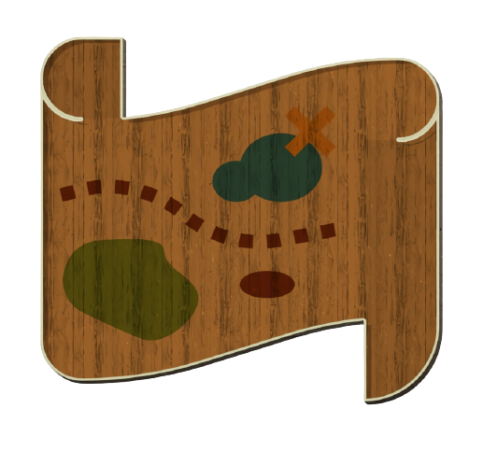
Start
Top’o the mornin’ to ye. I wonder if I could bother ye for a wee bit’o help.
Notes:
https://docs.google.com/presentation/d/1E_g37xI3dk_4u7s-1HQ3Y40nxHZ69D6JLwLEfRdJ7xA/copy?usp=sharing

Slide 2
Start 2
I lost me gold and I need your help to find it.

Slide 3
Start3
Just answer the questions correctly to help me find me gold. Click on me map to get started.

Slide 4
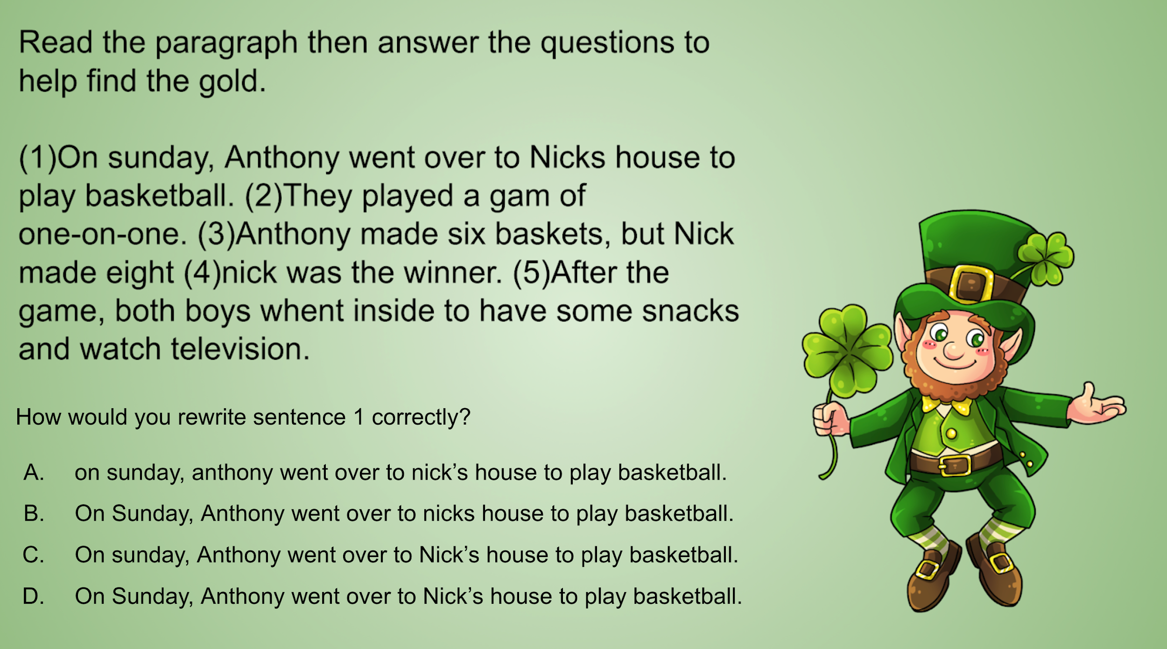
Question 1

Slide 5
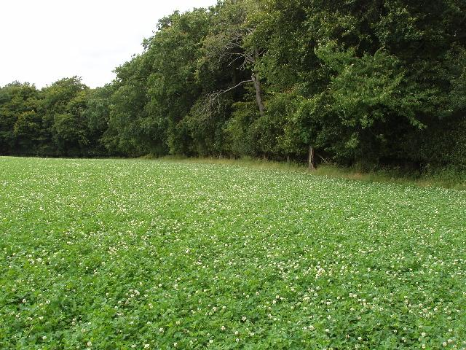


Yes 1
Aye, and a good job you’ve done! We found one of me gold bricks. Click on the gold to keep hunting for more.

Slide 6
Try again 1
Aye, wrong direction, I’m afraid. Me gold is still out there somewhere. Click on me shamrock to try again.

Slide 7
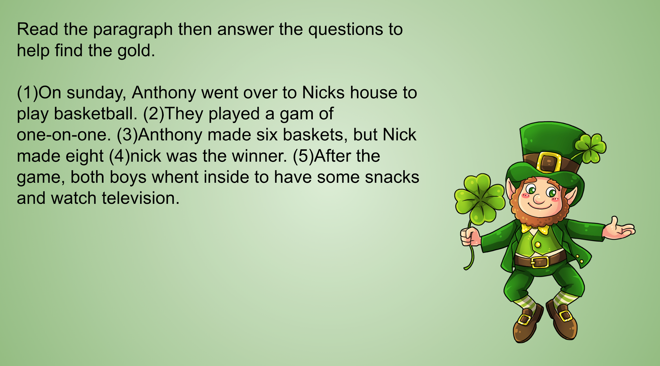
Question 2
How would you correctly rewrite sentence 2?
They played a gam of one-on-one?
They played a game of one-on-one
They played a game of one-on-one.
They played a game of One-on-one.

Slide 8
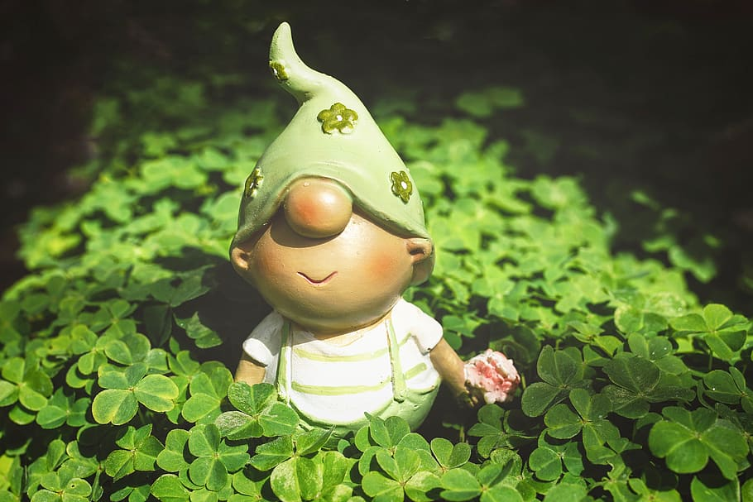
Try again 2
No gold here, friend. Click me gnome friend to try again.

Slide 9
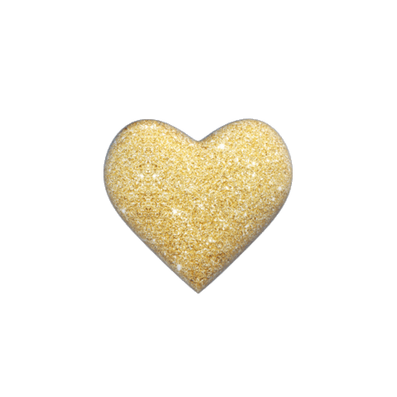
Correct 2
You found more of me gold! Click the heart to keep looking for more.

Slide 10
Question 3
How would you rewrite sentence 3 correctly?
Anthony made Six baskets, but Nick made ate.
Anthony made six baskets, but Nick made eight.
Anthony made six baskets but Nick made eight.
Anthony made six baskits but Nick made eight.

Slide 11
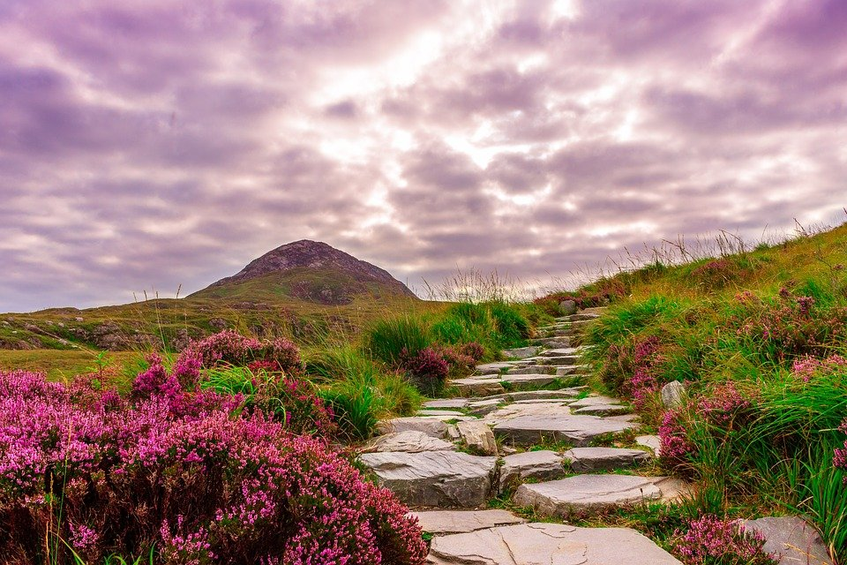
Try Again 3
No gold here, but we won’t give up. Click on me hat to keep looking.

Slide 12
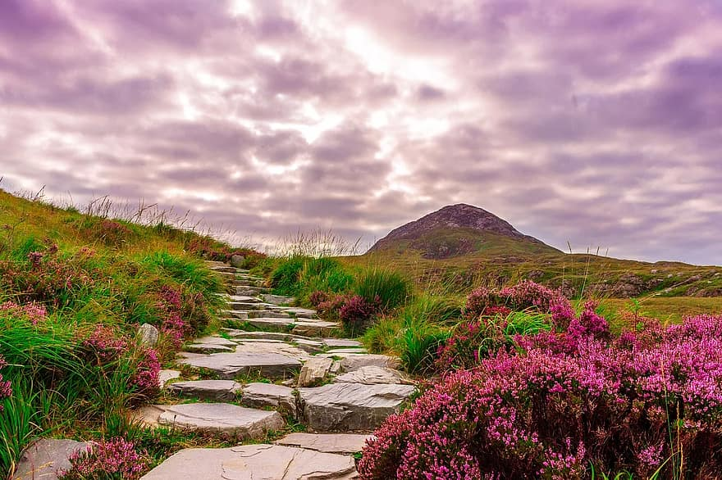

Correct 3
Aye, and a great job you’re doing! Ye’ve found more of me gold. Click the gold to help me find more.

Slide 13
Question 4
How would you rewrite sentence 4 correctly?
Nick was the winner.
nick was the winner.
Nick was the winner?
nick was the winner?

Slide 14



Try again 4
Aye, and there is a lot of gold here, but it’s not the right kind of gold. Click on the golden butterfly to keep trying.

Slide 15

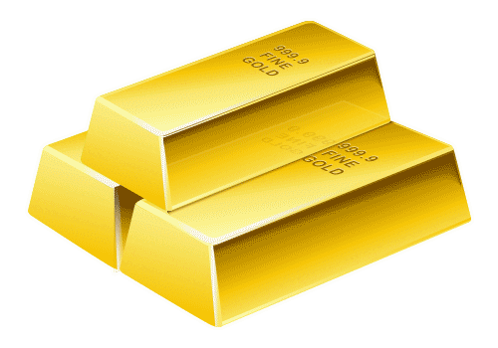
Correct 4
A sight for sore eyes, this is. Ye found more of me gold. Click on the gold bars to keep looking for more.

Slide 16
Question 5
How would you rewrite sentence 5 correctly?
After the game, both boys went inside to have some snacks and watch television.
After the game, both boys went inside to have some snack’s and watch television.
after the game,both boys went inside to have some snacks and watch television.
After the game, both boy’s went inside to have some snacks and watch television.

Slide 17
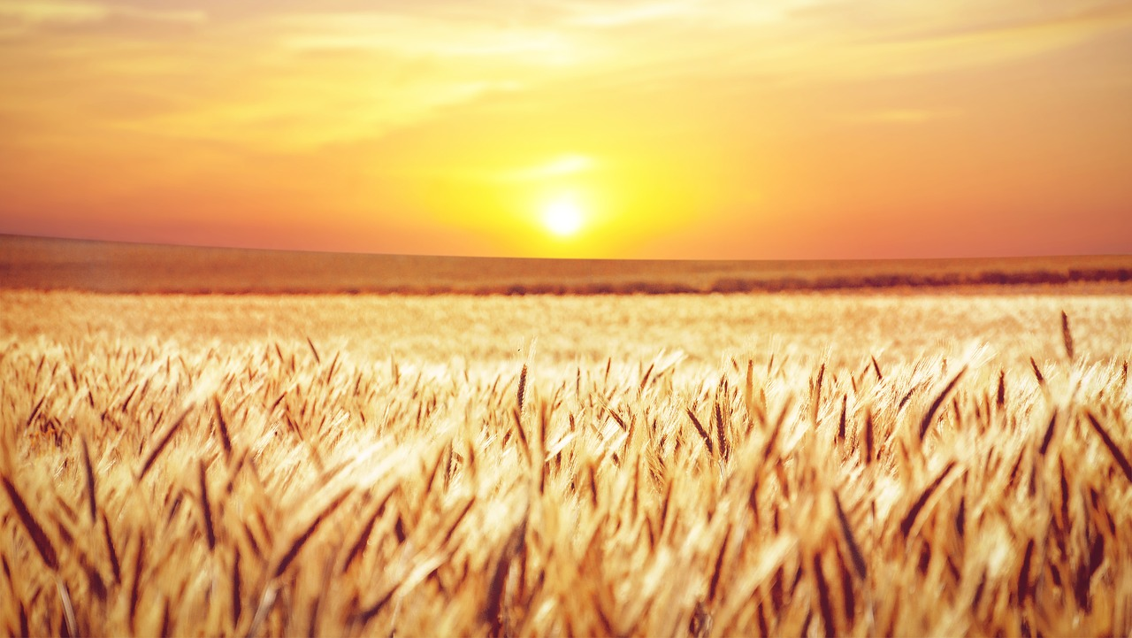

Try again 5
Aye, this is a golden land for sure, but my gold isn’t here. Click on the sun to keep looking.

Slide 18

Correct 5
Hooray! Ye found more of me gold. Click on the gold coin to keep looking for the rest.

Slide 19
Question 6
(1)Jim and Jane are brothr and sister. (2)They look alot alike, but they are very different. (3)Jim is quit and artistic. (4)Jane is outgoing and athletic (5)Sometimes they disagree about things, but most days they get along? (6)Jim and Jane are not just brother and sister, they are frends.
How would you rewrite sentence 1 correctly?
Jim and jane are brother and sister.
Jim and Jane are brothr and sistr.
Jim and Jane are brother and sister.
Jim and Jane are brother and sister

Slide 20

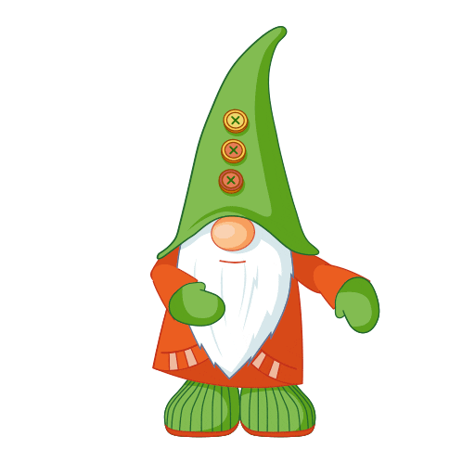
Try again 6
I’m still lookin’ for the rest of me gold, but it’s not here. Keep looking. Click on me gnome friend to try again.

Slide 21
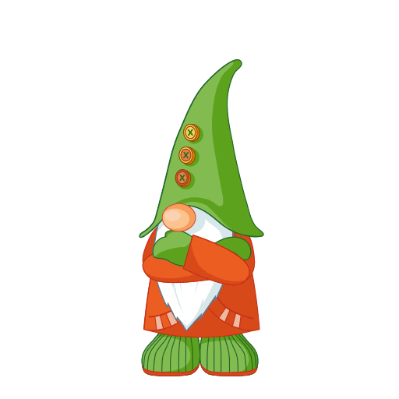

Correct 6
Howya! There’s more of me gold? Click on the gold to save it then pull your socks up and keep looking for the rest.

Slide 22
Question 7
(1)Jim and Jane are brothr and sister. (2)They look alot alike, but they are very different. (3)Jim is quit and artistic. (4)Jane is outgoing and athletic (5)Sometimes they disagree about things, but most days they get along? (6)Jim and Jane are not just brother and sister, they are frends.
How would you write sentence 2 correctly?
Thay look alot alike, but they are very different.
They look alot a like, but they are very different.
They look alot alike but they are very different.
They look a lot alike, but they are very different.

Slide 23
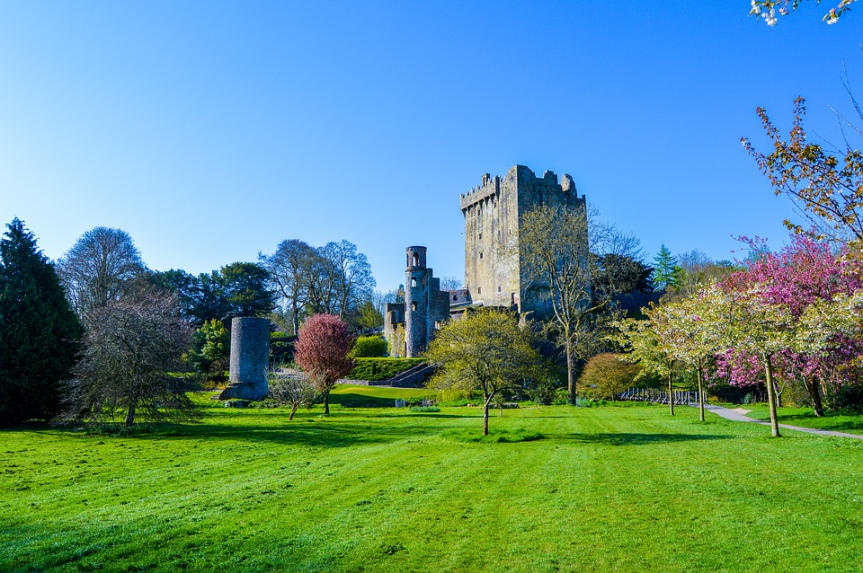
Try again 7
What a lovely castle you’ve found, but, alas, still no gold. Click on the castle to try again.

Slide 24
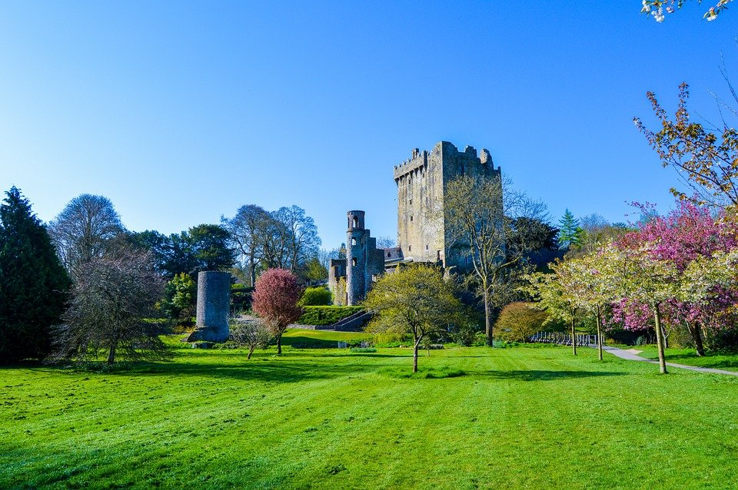

Correct 7

Slide 25
Question 8
(1)Jim and Jane are brothr and sister. (2)They look alot alike, but they are very different. (3)Jim is quit and artistic. (4)Jane is outgoing and athletic (5)Sometimes they disagree about things, but most days they get along? (6)Jim and Jane are not just brother and sister, they are frends.
How would you write sentence 3 correctly?
jim is quit and artistic.
Jim is quit and artistic.
jim is quiet and artistic
Jim is quiet and artistic.

Slide 26
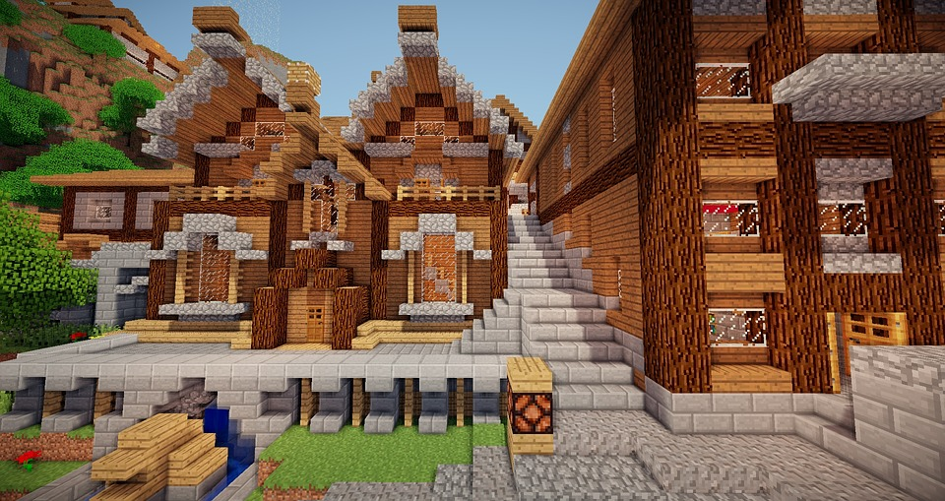

Try again 8
Lovely treasure, indeed. But it’s not me gold. Click on the diamond to go back and try again.

Slide 27
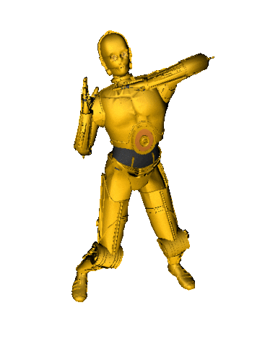
Correct 8
Don’t judge; it’s he’s gold. Click on C3PO to save the gold and go find more.

Slide 28
Question 9
(1)Jim and Jane are brothr and sister. (2)They look alot alike, but they are very different. (3)Jim is quit and artistic. (4)Jane is outgoing and athletic (5)Sometimes they disagree about things, but most days they get along? (6)Jim and Jane are not just brother and sister, they are frends.
How would you write sentence 4 correctly?
Jane is outgoing and athletick.
Jane is outgoing and athletic.
Jane is out going and athletic.
Jane is outgoing and Athletic.

Slide 29
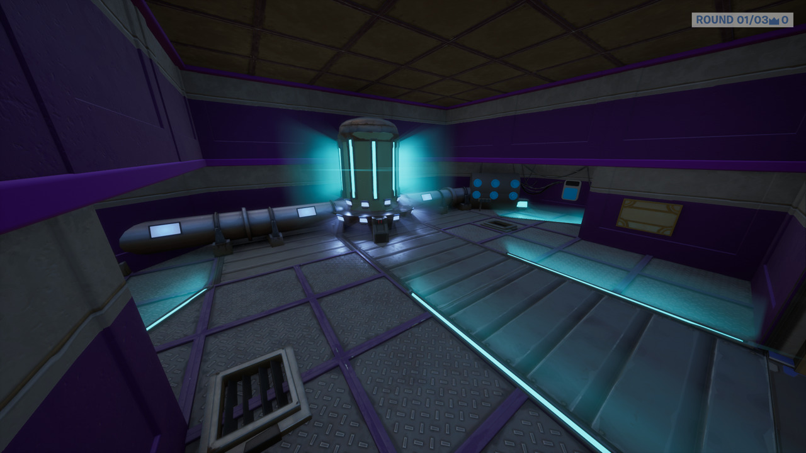

Try again 9
It’s a wee bit sus that my gold isn’t here, but we can keep looking. Click on the imposter to try again.

Slide 30
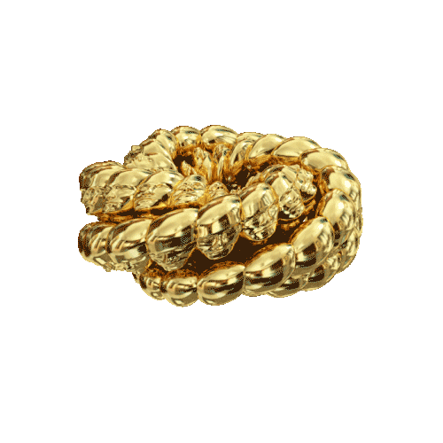
Correct 9
Aye, and sure there is no imposter here. Click on me gold to save it and find some more of me gold.

Slide 31
Question 10
(1)Jim and Jane are brothr and sister. (2)They look alot alike, but they are very different. (3)Jim is quit and artistic. (4)Jane is outgoing and athletic (5)Sometimes they disagree about things, but most days they get along? (6)Jim and Jane are not just brother and sister, they are frends.
How would you write sentence 5 correctly?
Sometimes they disagree about things, but most days they get along.
Sometimes they dis agree about things, but most days they get along.
Sometimes they disagree about things but most days they get along.
Sometimes they disagree about things but, most days they get along.

Slide 32
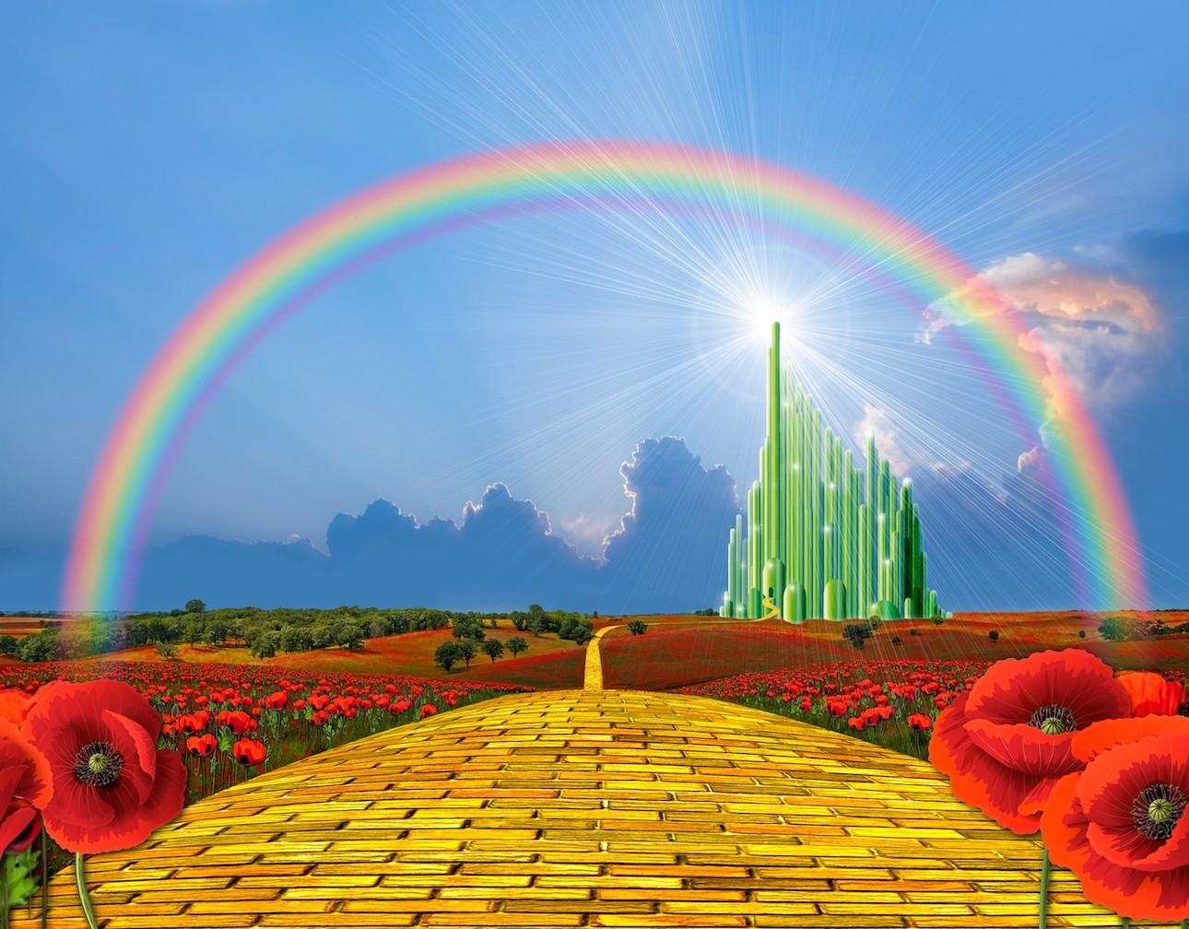
Try again 10
All this beautiful gold, but non of it’s is mine. Click on the emerald castle to try again.

Slide 33
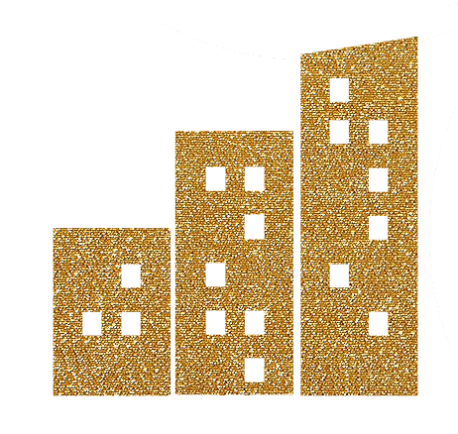
Correct 10
Aye, and there is more of me gold for sure. We almost have it all. Click on the gold buildinng to save it and find more.

Slide 34
Question 11
(1)Jim and Jane are brothr and sister. (2)They look alot alike, but they are very different. (3)Jim is quit and artistic. (4)Jane is outgoing and athletic (5)Sometimes they disagree about things, but most days they get along? (6)Jim and Jane are not just brother and sister, they are frends.
How would you correctly write sentence 6?
Jim and jane are not just brother and sister, they are friends.
Jim and Jane are not just brother and sister, they are friends.
Jim and Jane are not just brother and sister they are friends.
Jim and Jane are not just Brother and Sister, they are friends.

Slide 35
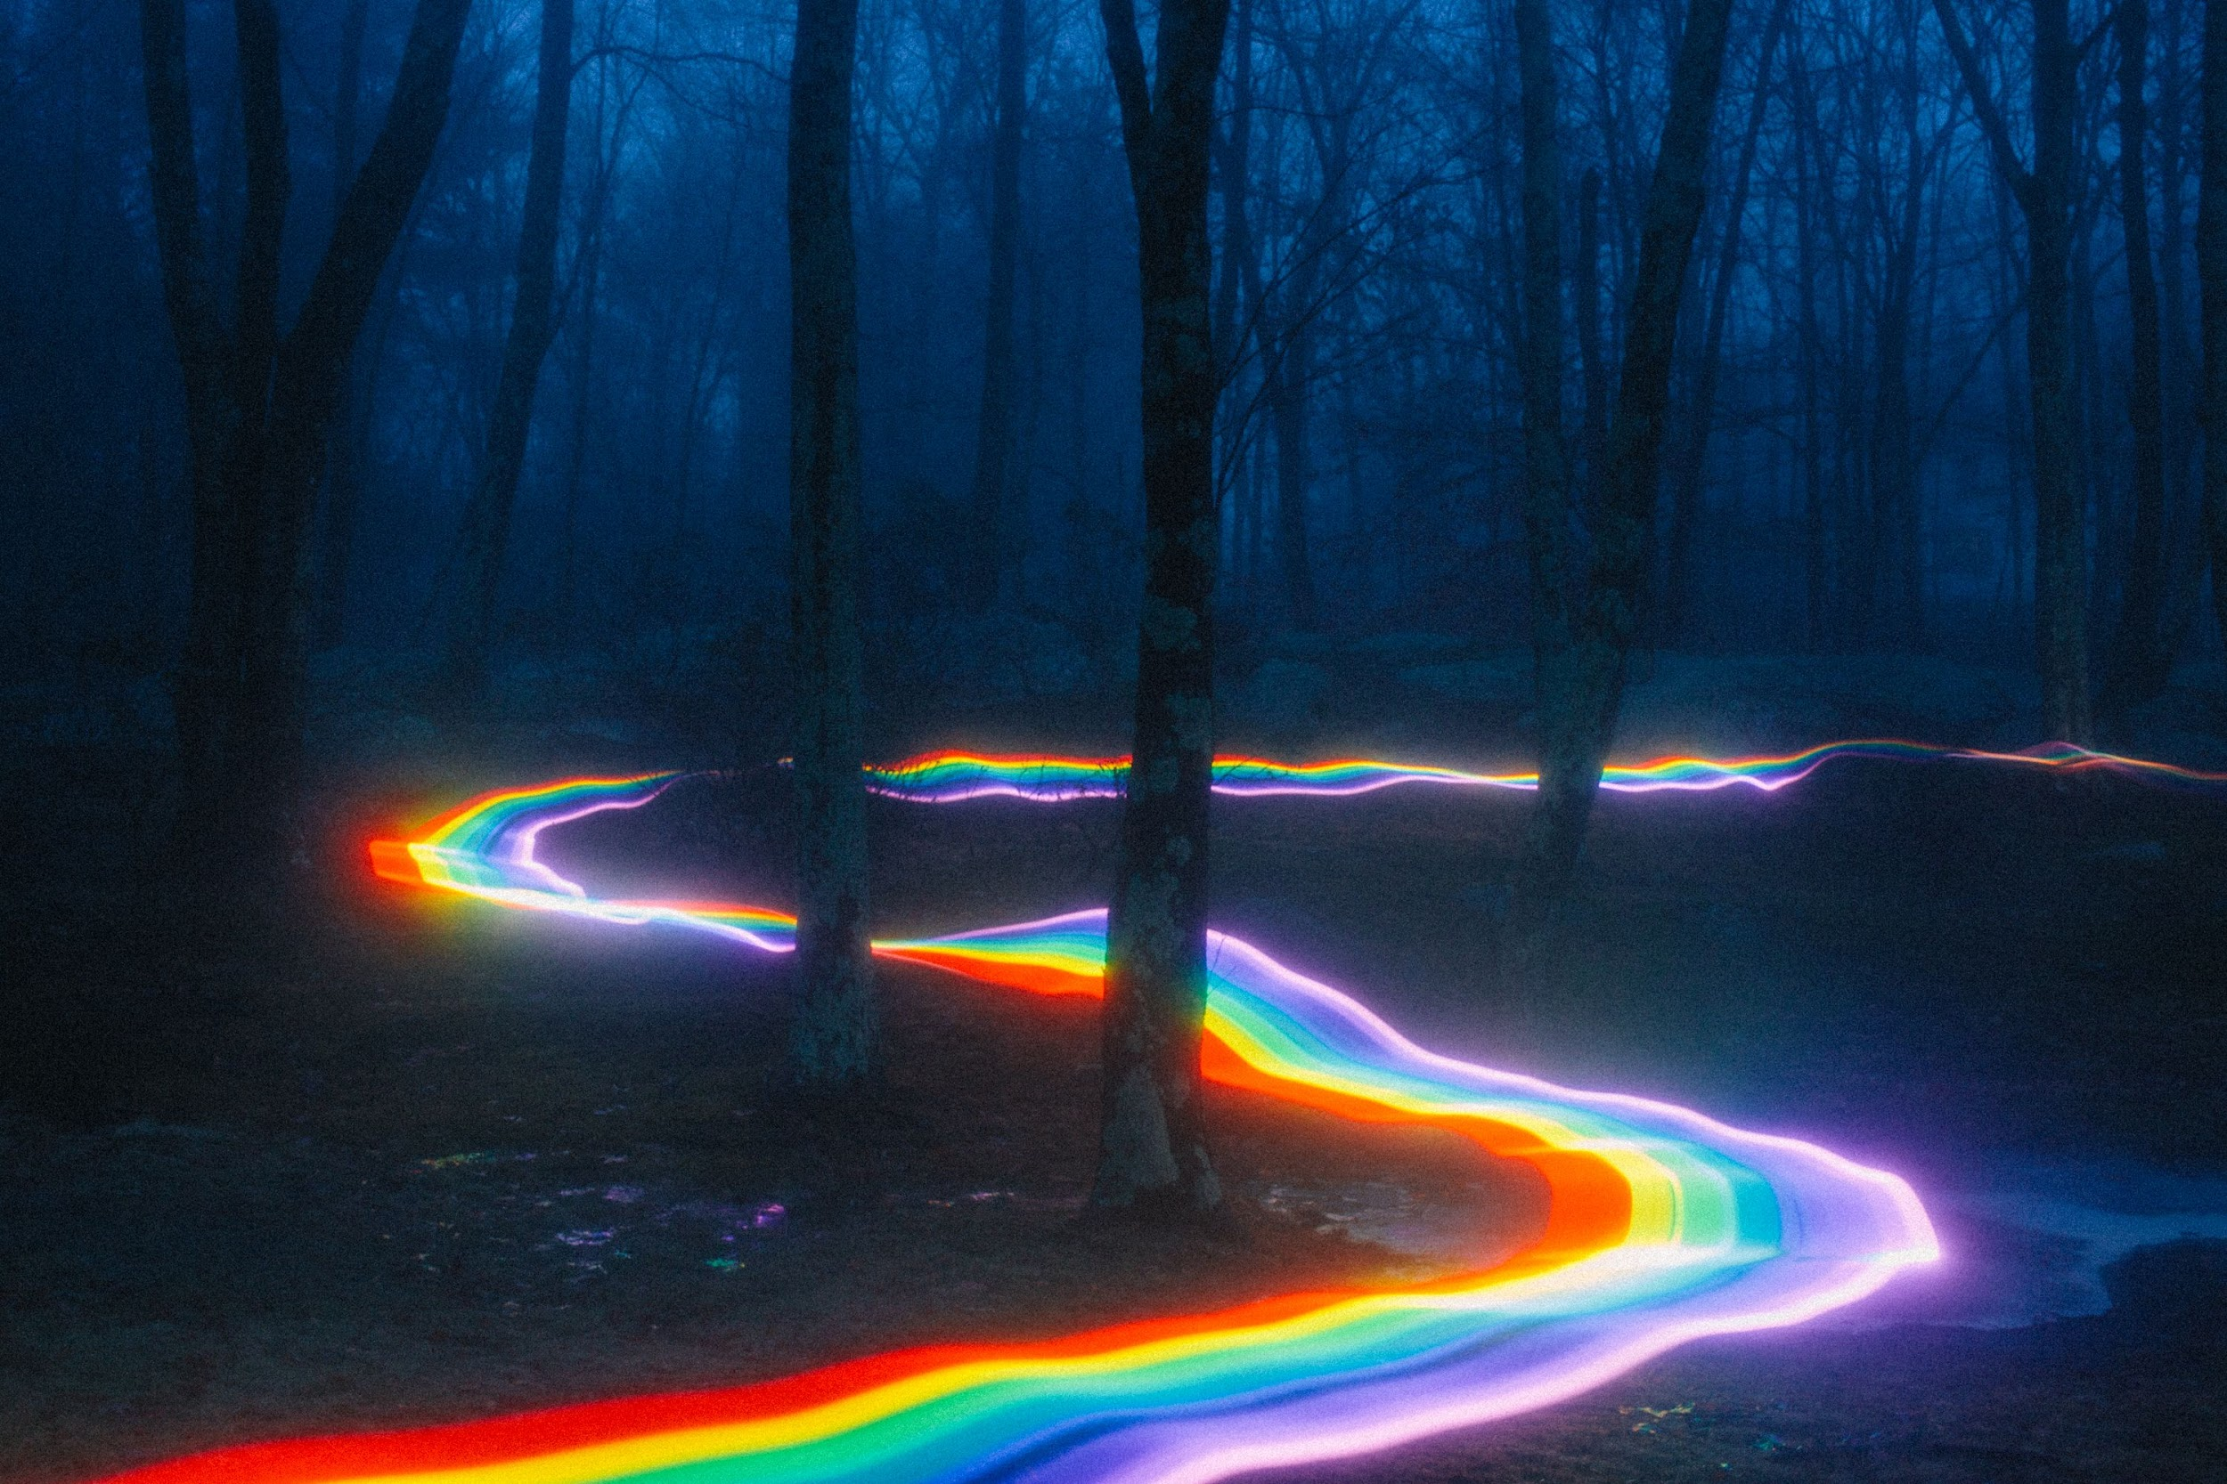

Try again 11
We’re on the right road, but no gold here. Click on the car to try again.

Slide 36
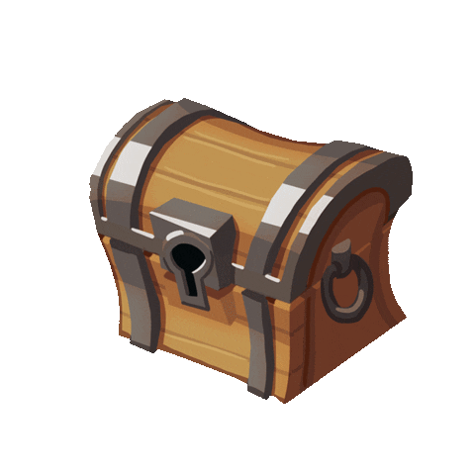
Correct 11
Aye, and ye’ve done it for sure! You found the rest o’ me gold, ye did! And for sure I thank ye! Click on the treasure chest to send it all home and see your reward.

Slide 37


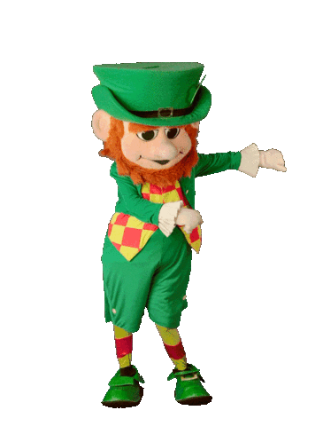
congratulations
Congratulations!

