Slide 1





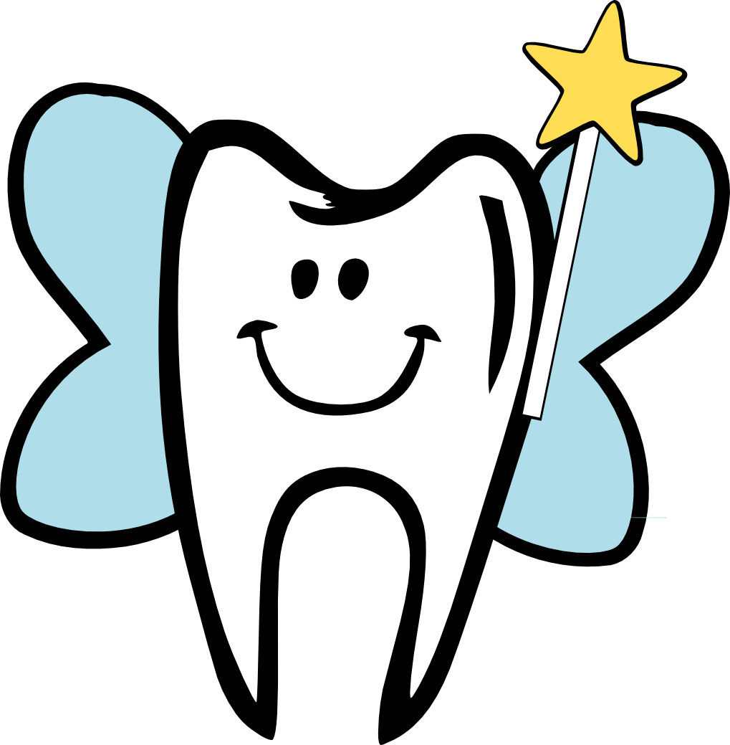
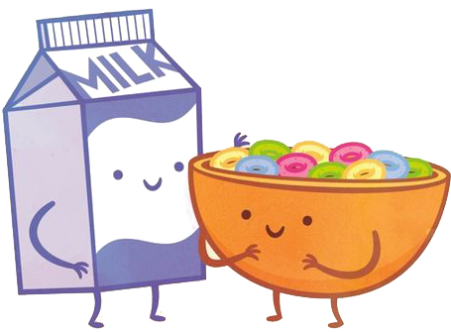

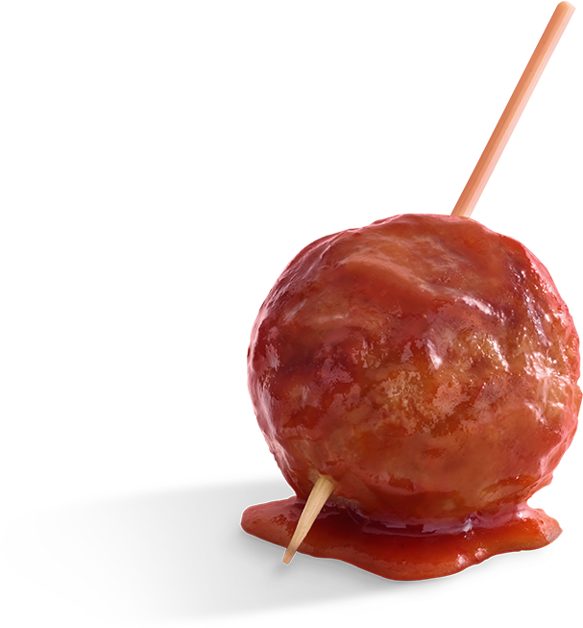

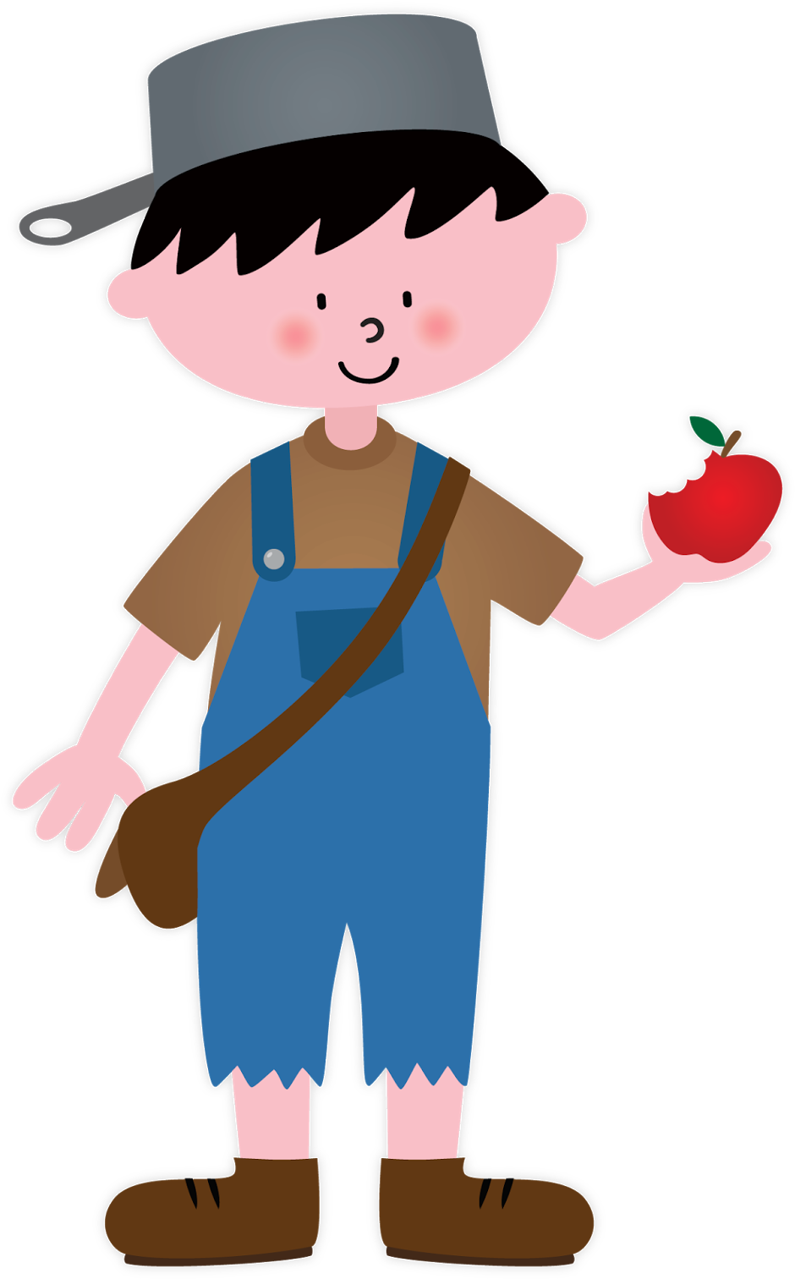
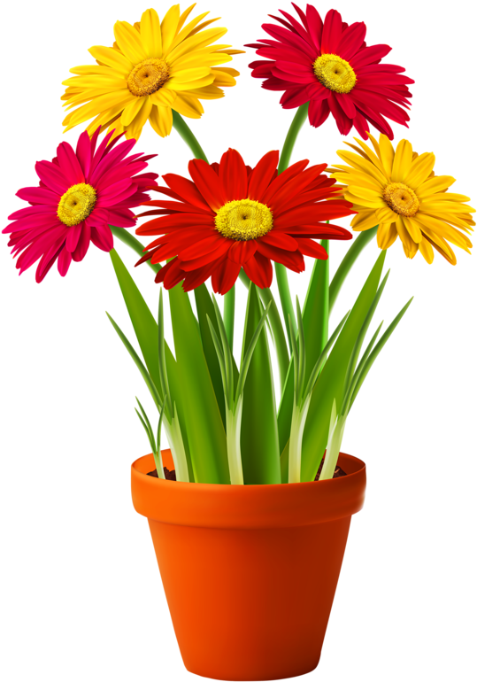

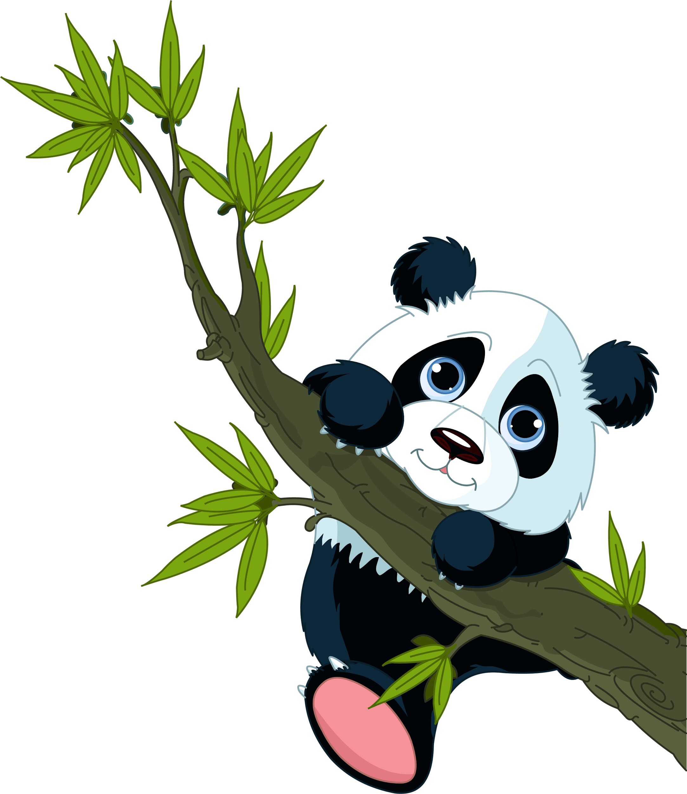
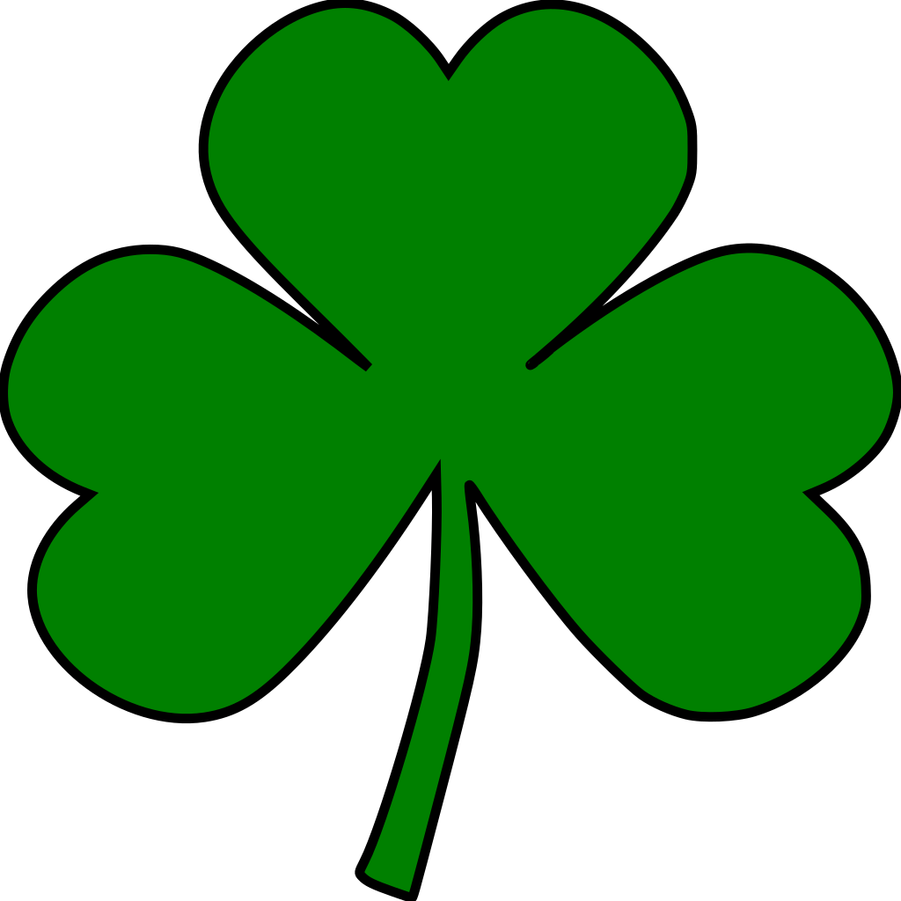
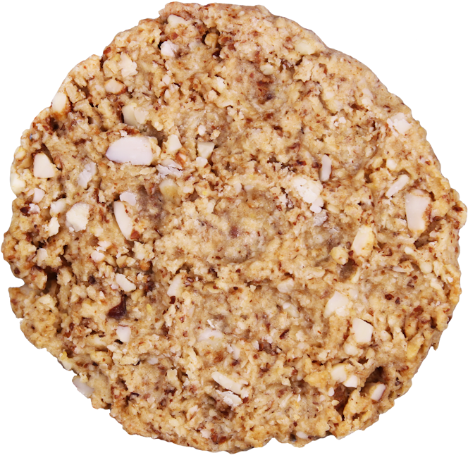

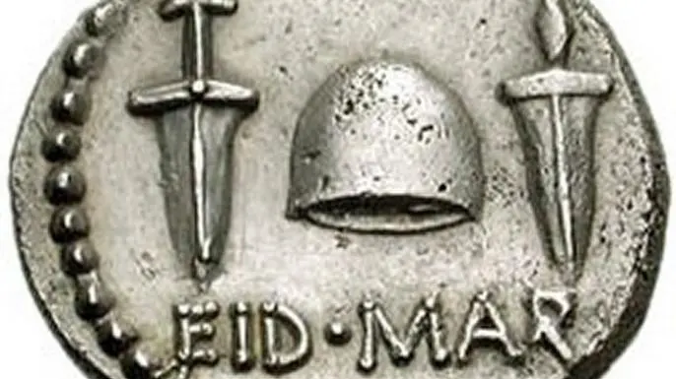




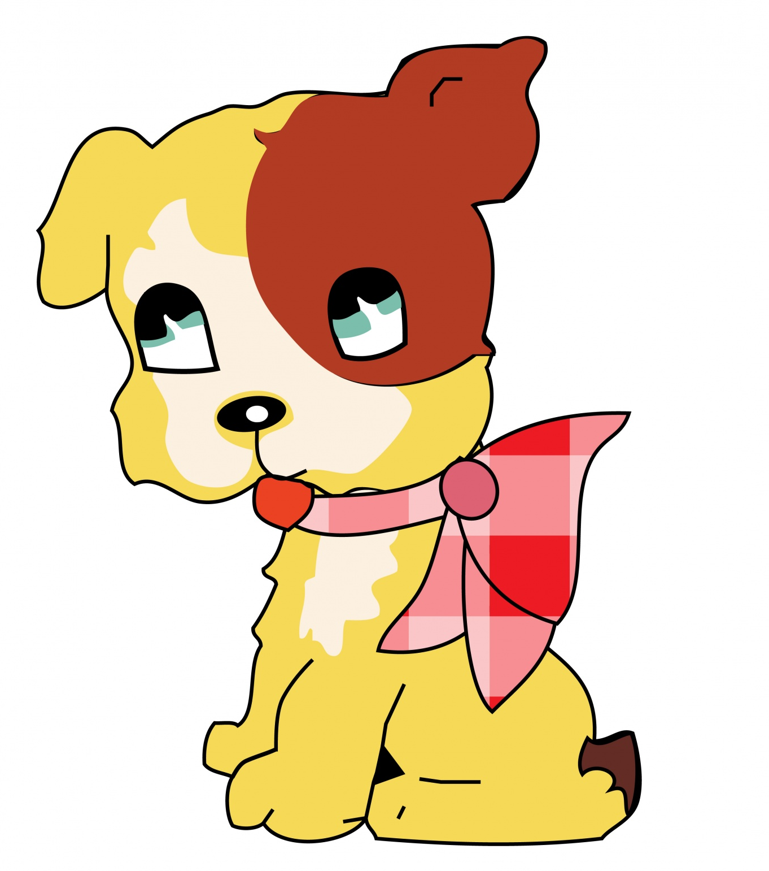
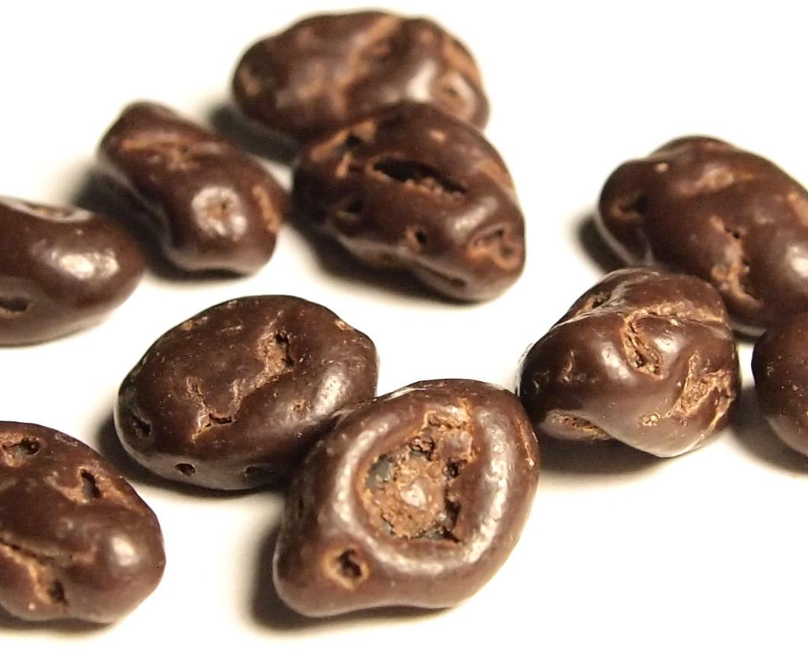
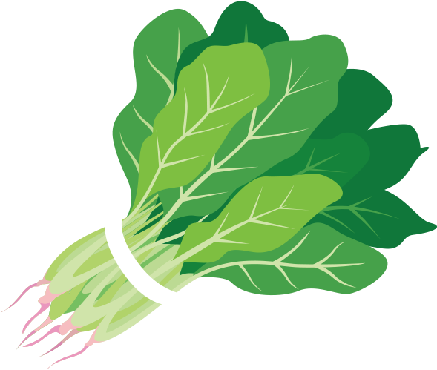
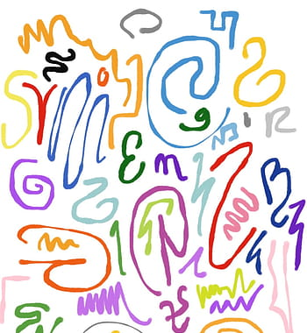
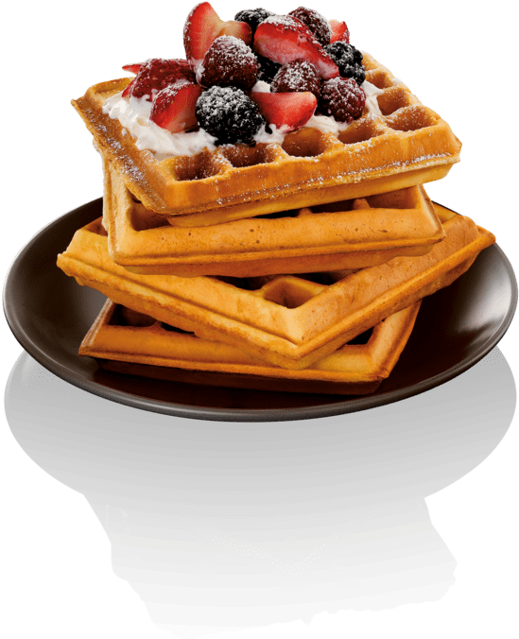




MARCH 2021
Sunday | Monday | Tuesday | Wednesday | Thursday | Friday | Saturday
 | 1 | 2 | 3 | 4 | 5 | 6
7 | 8 | 9 | 10 | 11 | 12 | 13
14 | 15 | 16 | 17 | 18 | 19 | 20
21 | 22 | 23 | 24 | 25 | 26 | 27
28 | 29 | 30 | 31
Fun Facts About Names Day
Dr. Seuss’s Birthday
World Wildlife Day
World Book Day
Reel Film Day
National Dentist’s Day
National Cereal Day
International Women’s Day
National Meatball Day
National Oreo Cookie Day
Johnny Appleseed Day
Plant a Flower Day
Genealogy Day
National Pi Day
The Ides of March
National Panda Day
St. Patrick’s Day
Oatmeal Cookie Day
Certified Nurses Day
First Day of Spring
World Poetry Day
World Water Day
National Puppy Day
Chocolate Covered Raisin Day
International Waffle Day
National Spinach Day
National Scribble Day
Barnum & Bailey Day
Niagara Falls Runs Dry Day
Talk A Walk in the Park Day
National Crayon Day

