Slide 1



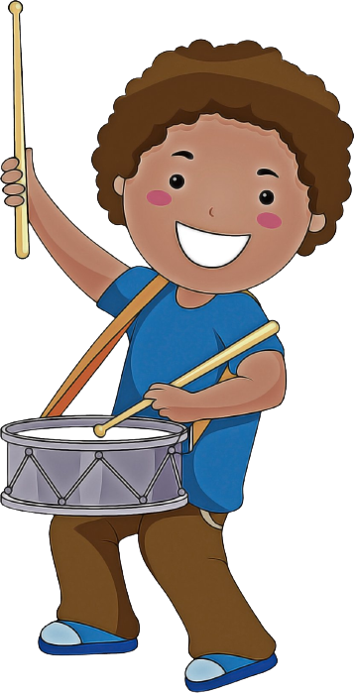
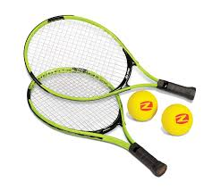
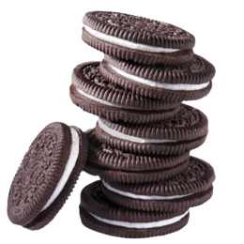
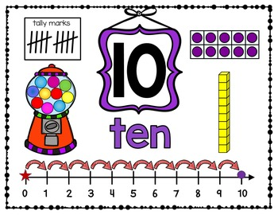
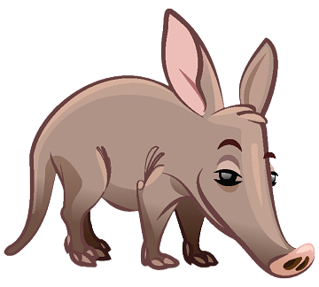
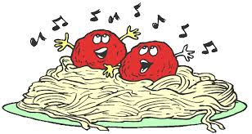


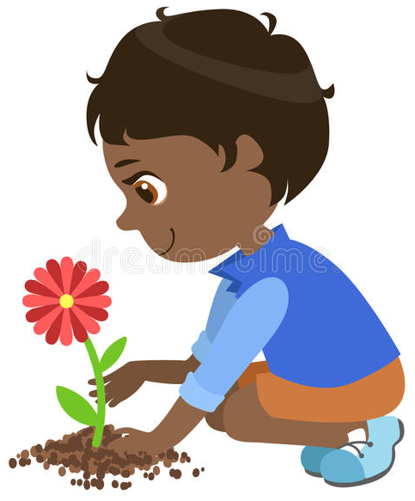




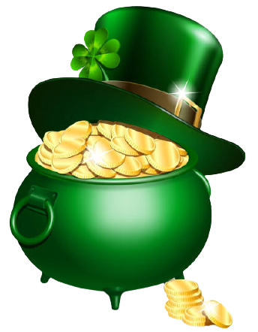

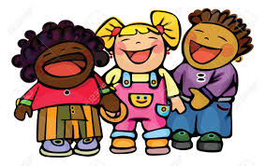


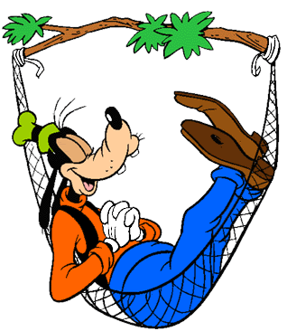
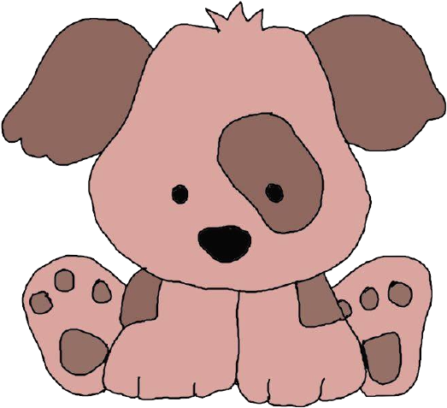
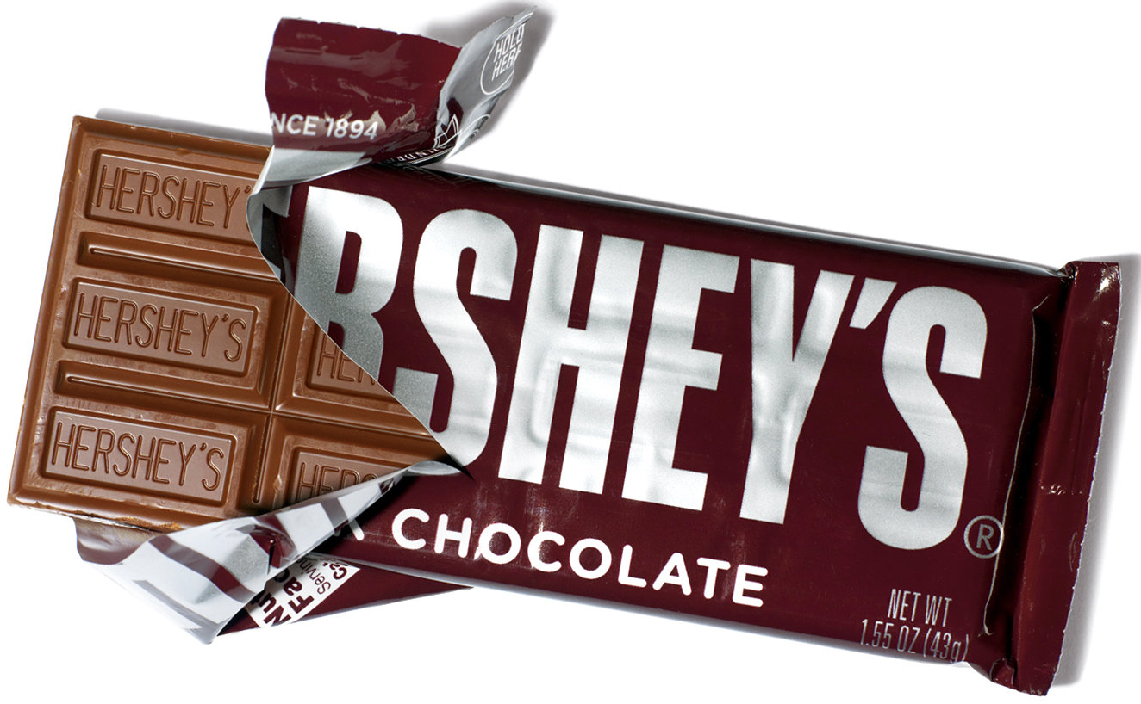
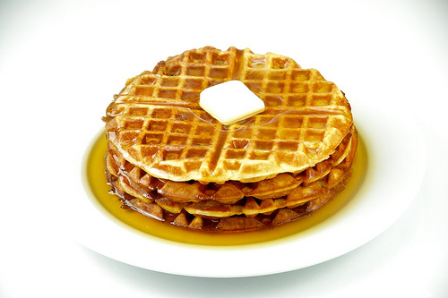


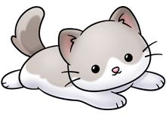

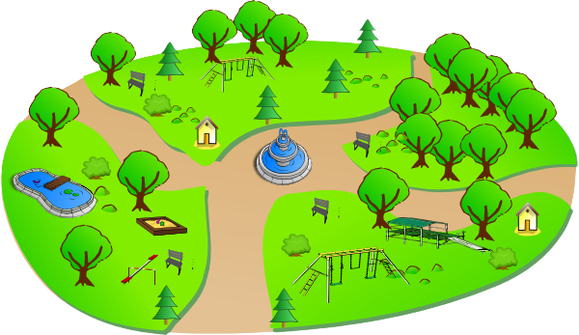

MARCH 2021
Sunday | Monday | Tuesday | Wednesday | Thursday | Friday | Saturday
 | 1 | 2 | 3 | 4 | 5 | 6
7 | 8 | 9 | 10 | 11 | 12 | 13
14 | 15 | 16 | 17 | 18 | 19 | 20
21 | 22 | 23 | 24 | 25 | 26 | 27
28 | 29 | 30 | 31
Share a Smile Day
Read Across America Day
World Wildlife Day
Marching Music Day
World Tennis Day
National Oreo Cookie Day
World Math Day
Celebrate National Aardvark Week
National Meatball Day
International Day of Awesomeness
Key Deer Awareness Day
Plant a Flower Day
National Earmuff Day
Celebrate Scientists Day
National Peanut Lovers Day
National Panda Day
St. Patrick’s Day
Absolutely Incredible Kid Day
Let’s Laugh Day
First Day of Spring
World Down Syndrome Day
National Goof Off Day
National Puppy Day
Celebrate American Chocolate Week
International Waffle Day
National Spinach Day
Passover Begins
Respect Your Cat Day
Piano Day
National Take a Walk in the Park Day
Manatee Appreciation Day

