Slide 1
























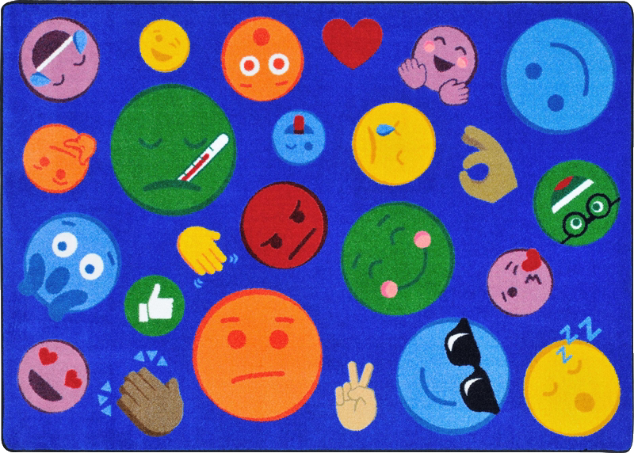
❄️WinterStorm❄️
My Emotions😀

