Slide 1
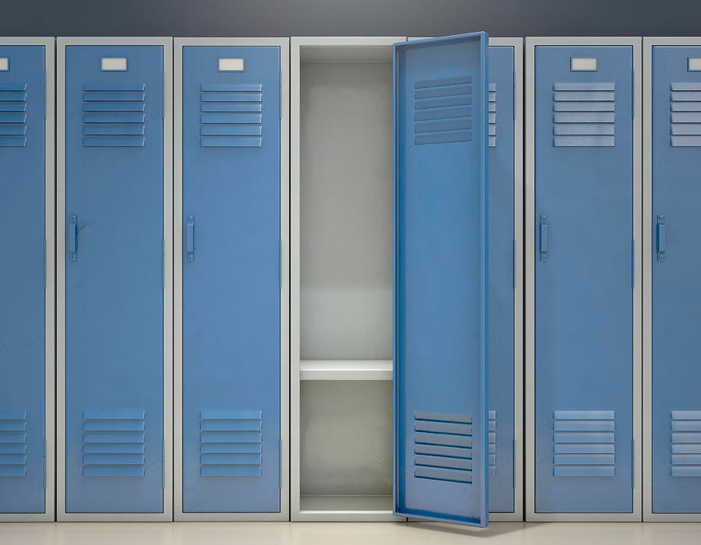

DESIGN
YOUR OWN
VIRTUAL
LOCKER
Design your virtual locker to help me get to know you better. Include at least 10 (or more!) things that tell about who you are.
Consider including some of the following:
pictures of family/friends/pets
your favorite book(s)
your favorite movie(s)
your favorite tv show(s)
your favorite music
what you like to do for fun
a future goal you have
your favorite sport and/or team
your favorite food
your favorite subject to learn about
a hobby you enjoy
a college you are interested in attending
a place you’d like to visit
something you did over the summer
be creative!
You can choose to present your locker to the class or write a short summary to tell me why you chose to include the things
you did.
Notes:
If you are interested in making a copy of this, please do so through my Digital Resource Library: https://www.goteachtheworld.com/digital-classroom-library
Thanks and happy teaching! :)

