Slide 1



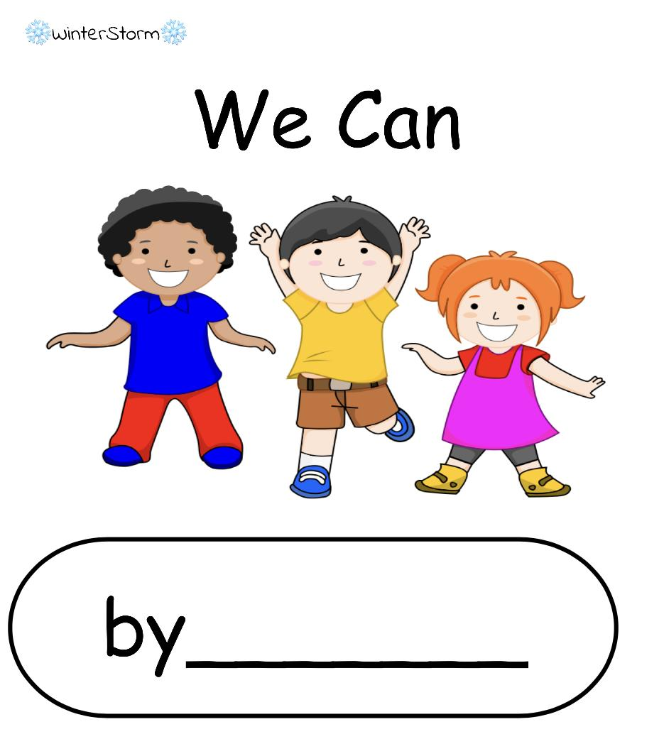
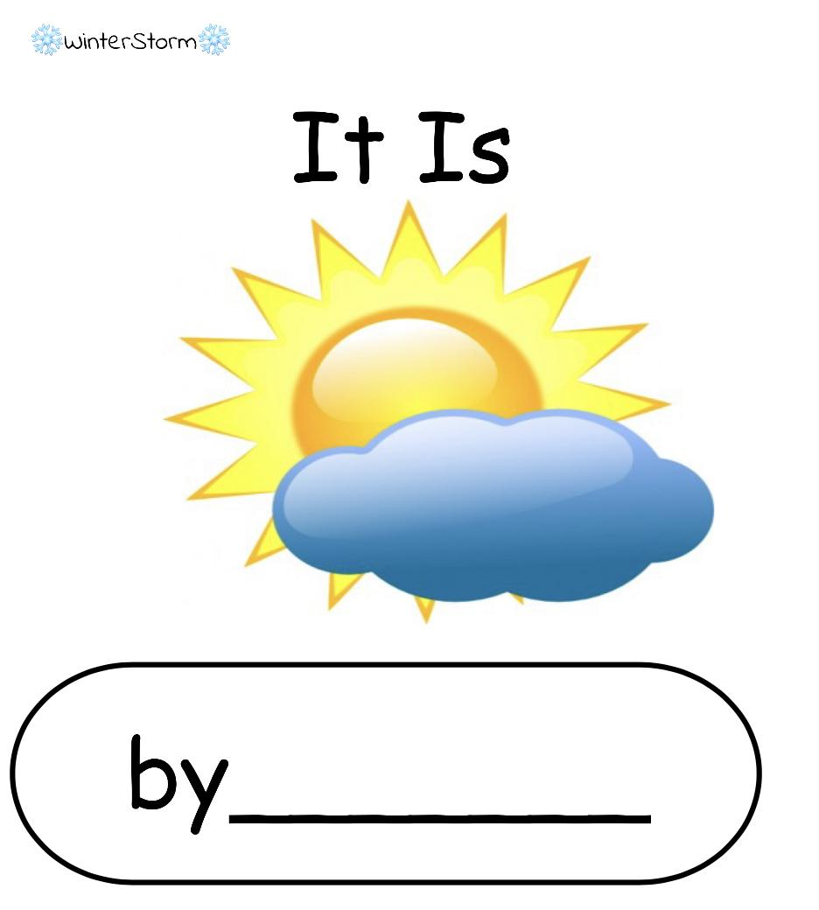
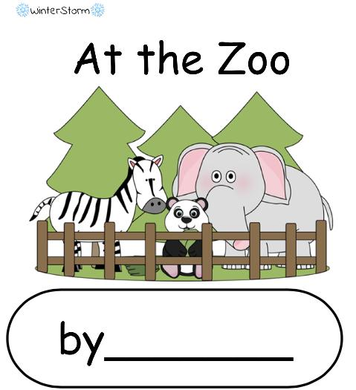
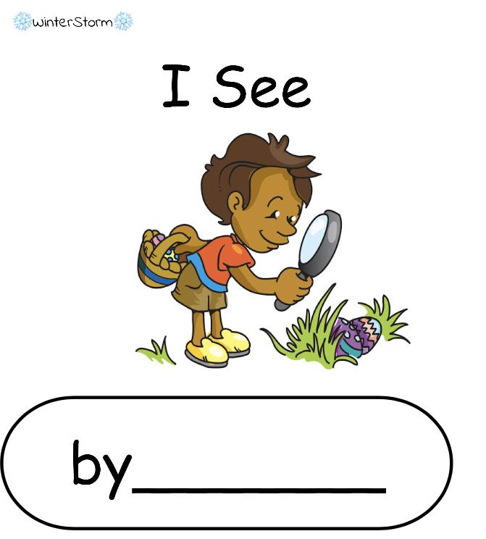
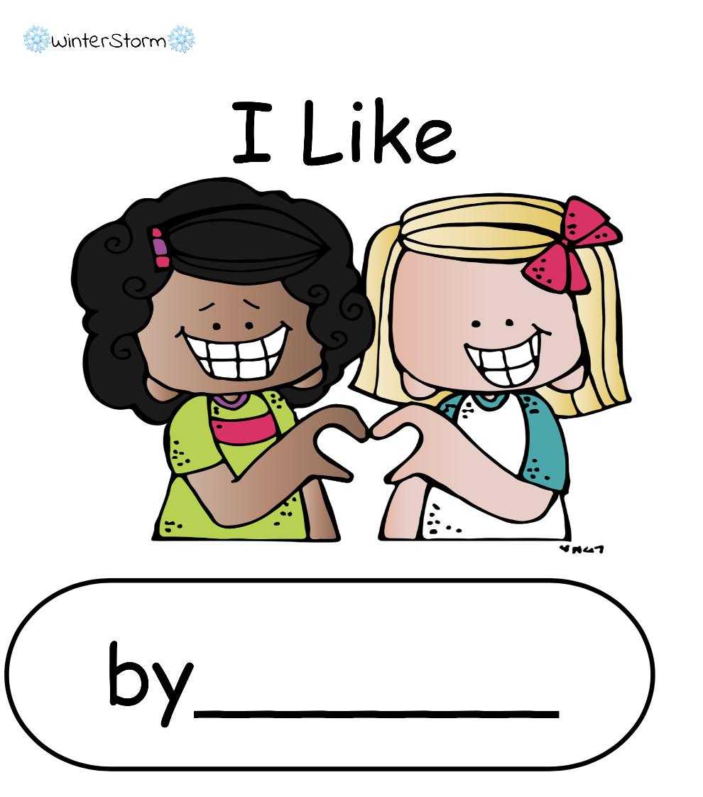
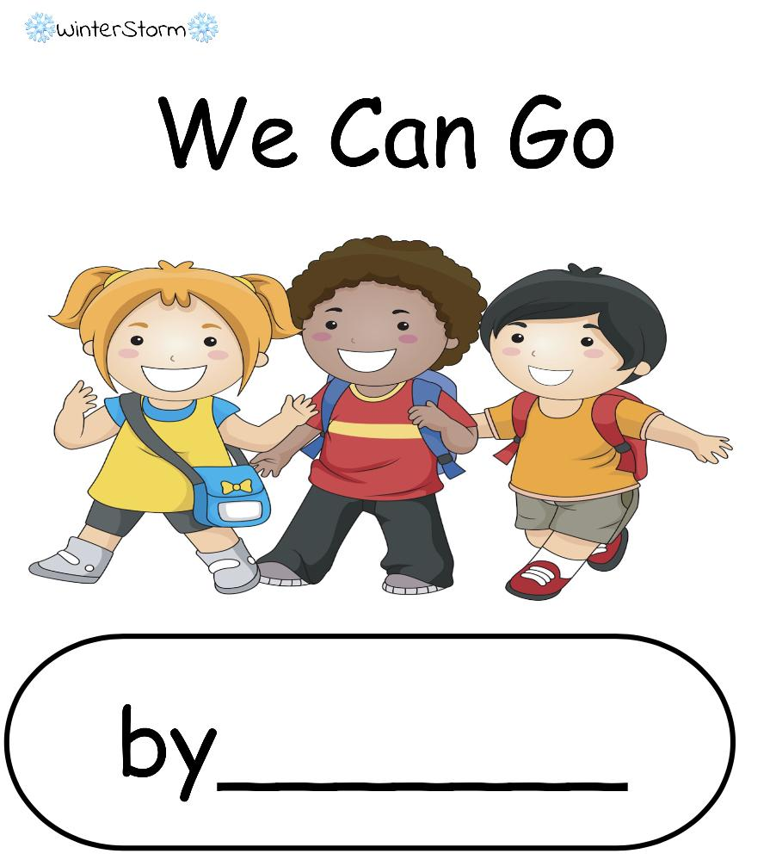

❄️WinterStorm❄️
Little Readers
Please do not edit this file unless you have made a copy. I have the link set to ‘force copy’ to allow others to use it.
Tap box and hit backspace/delete to remove once you’ve made your copy.
Thank you! - Winter

Slide 2
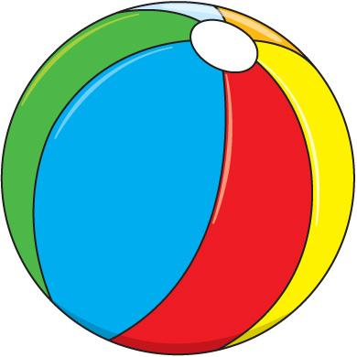

❄️WinterStorm❄️
I See
by_______
I see a ball.

Slide 3
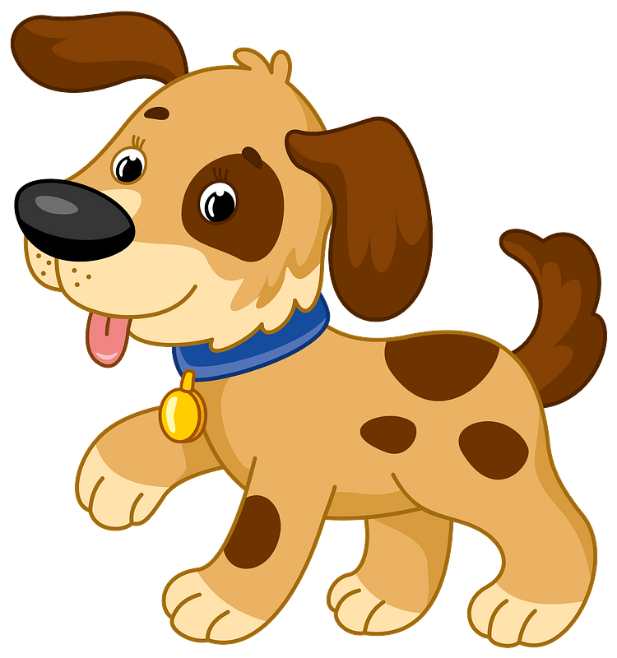
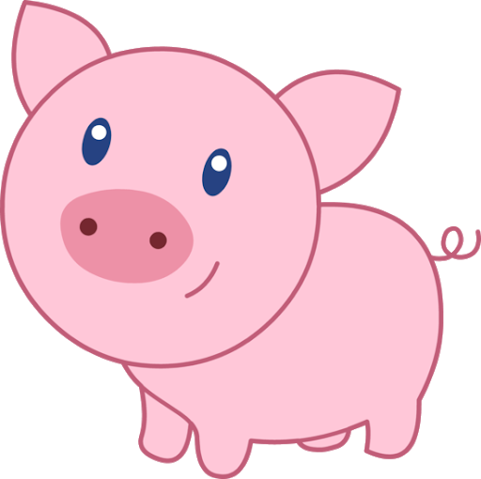
❄️WinterStorm❄️
I see a dog.
I see a pig.

Slide 4

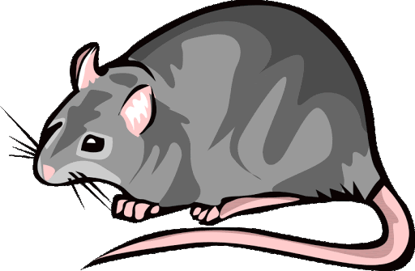
❄️WinterStorm❄️
I see a rat.
I see a bug .

Slide 5


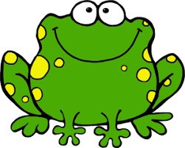
❄️WinterStorm❄️
I see a frog.
I see a house.

Slide 6
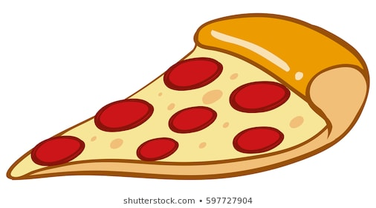

❄️WinterStorm❄️
I Like
by_______
I like pizza.

Slide 7

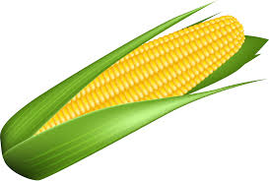
❄️WinterStorm❄️
I like apples.
I like corn.

Slide 8
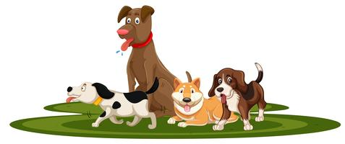

❄️WinterStorm❄️
I like dogs.
I like monkeys.
L

Slide 9
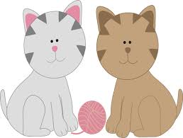
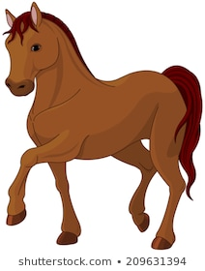
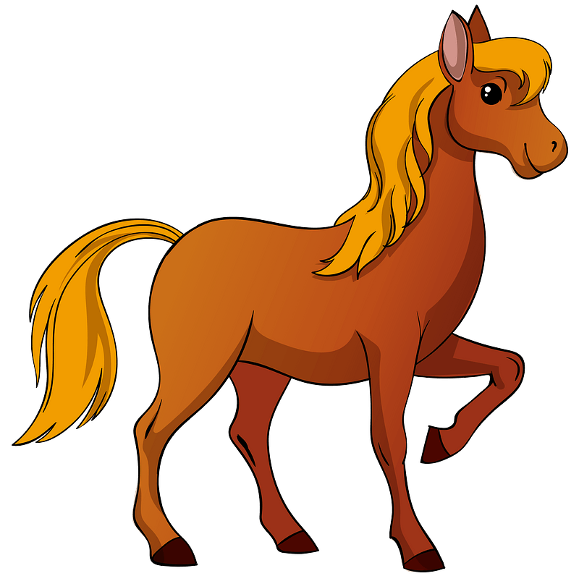
❄️WinterStorm❄️
I like cats.
I like horses.

Slide 10
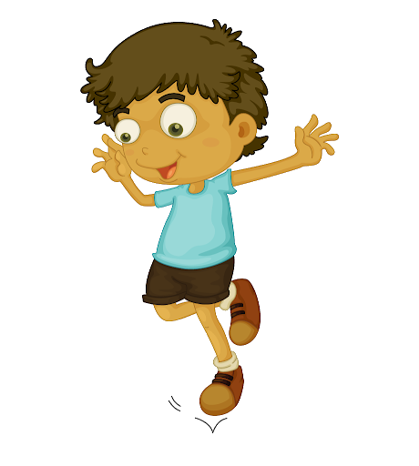
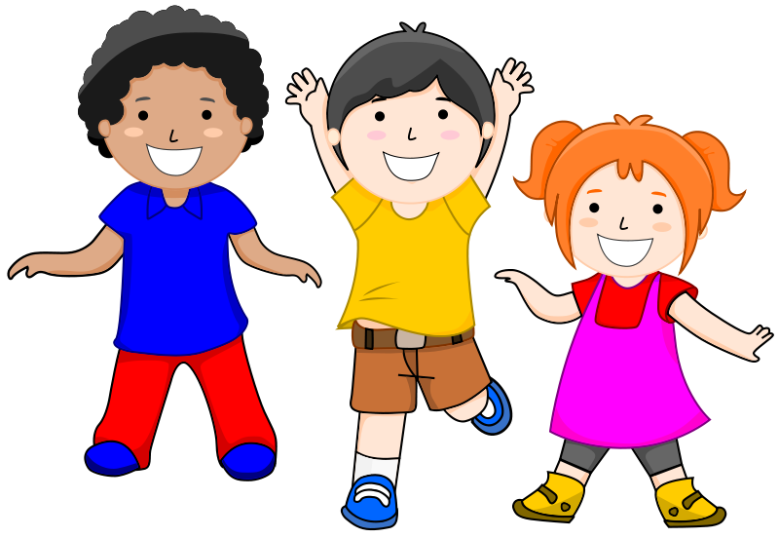
❄️WinterStorm❄️
We Can
by_______
We can hop.

Slide 11
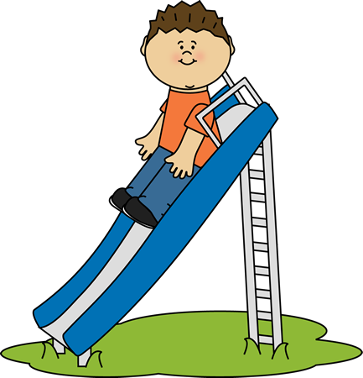
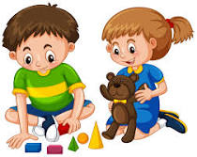
❄️WinterStorm❄️
We can play.
We can slide.

Slide 12


❄️WinterStorm❄️
We can read.
We can write.

Slide 13

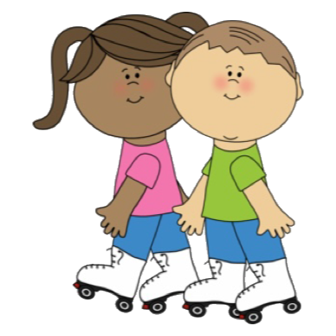
❄️WinterStorm❄️
We can skate.
We can eat pizza.

Slide 14


❄️WinterStorm❄️
It Is
by_______
It is sunny.

Slide 15


❄️WinterStorm❄️
It is stormy.
It is rainy.

Slide 16

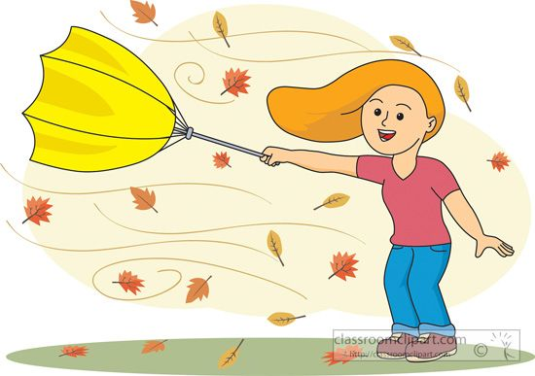
❄️WinterStorm❄️
It is windy.
It is snowy.

Slide 17
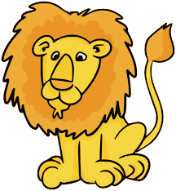
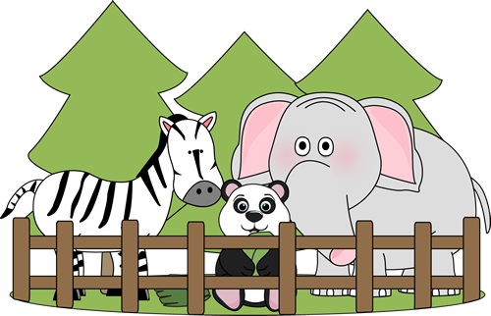
❄️WinterStorm❄️
At the Zoo
by_______
I see a lion at the zoo.

Slide 18


❄️WinterStorm❄️
I see a snake at the zoo.
I see a zebra at the zoo.

Slide 19

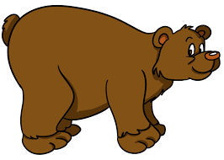
❄️WinterStorm❄️
I see a monkey at the zoo.
I see a bear at the zoo.

Slide 20
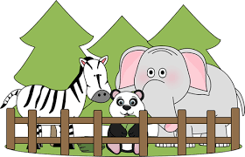

❄️WinterStorm❄️
We Can Go
by_______
We can go to the zoo.

Slide 21
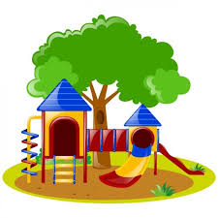
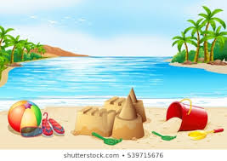
❄️WinterStorm❄️
We can go to the beach.
We can go to the park.

Slide 22
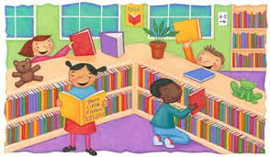

❄️WinterStorm❄️
We can go to the library.
We can go to the store.

Slide 23
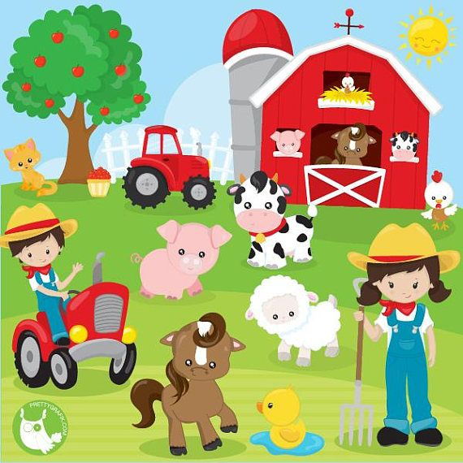
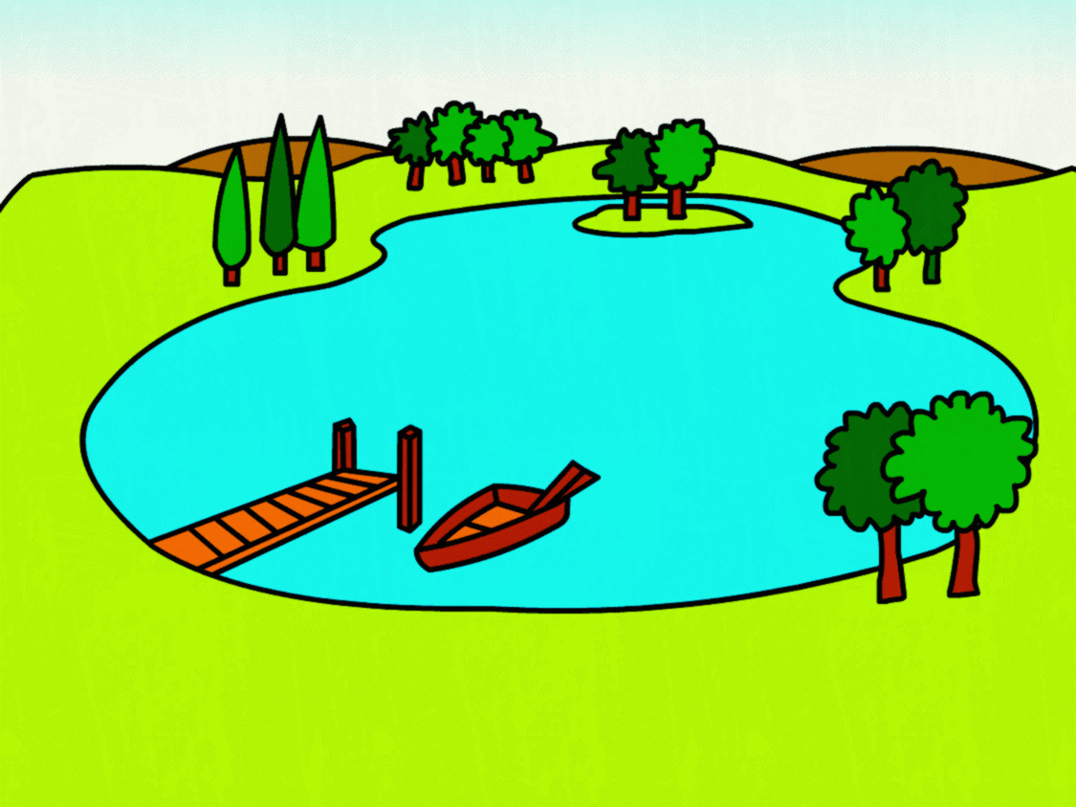
❄️WinterStorm❄️
We can go to the farm.
We can go to the lake.

