Slide 1
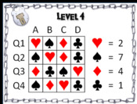
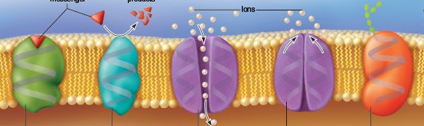
Q1. Lipid Tails
Q2. Marker Protein
Q3. Receptor Protein
Plasma Membrane
Digital Escape Room
Q4. Channel Proteins
A
B
C
D

