Slide 1



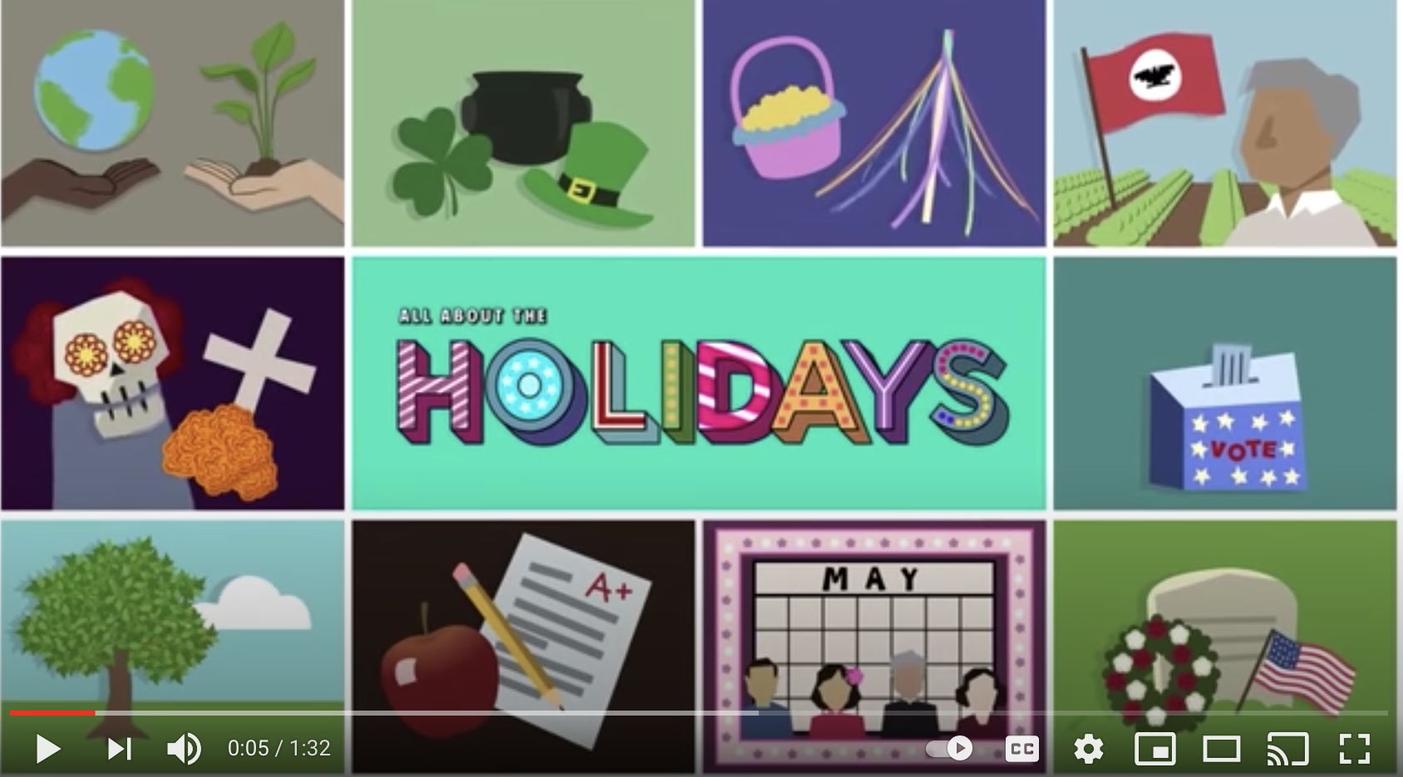




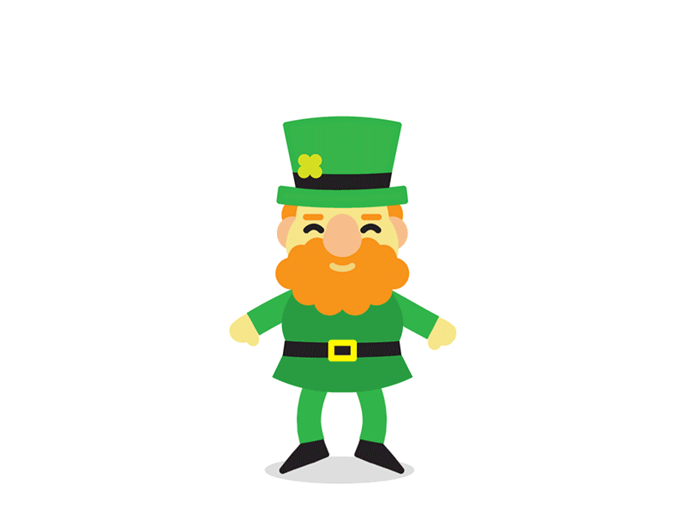









Let’s Celebrate St. Patrick’s Day
We celebrate St. Patrick’s Day on March 17th every year.

