Slide 1
Amplify CKLA
Classroom Setup K-2
DCSD 2024

Slide 2

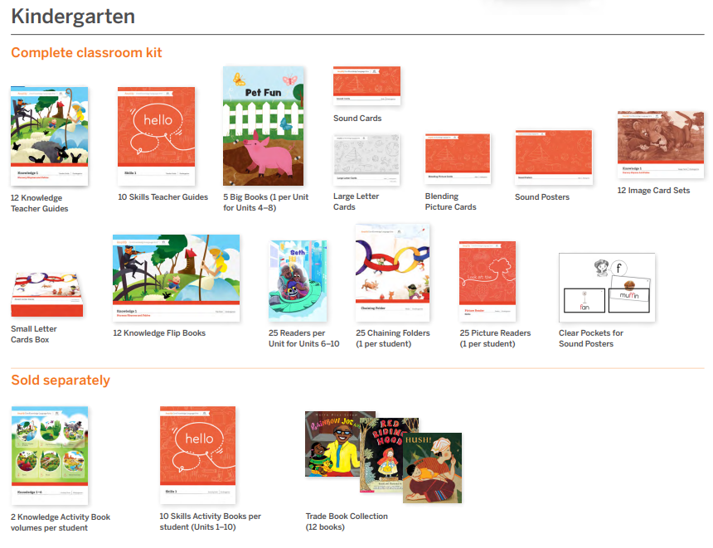
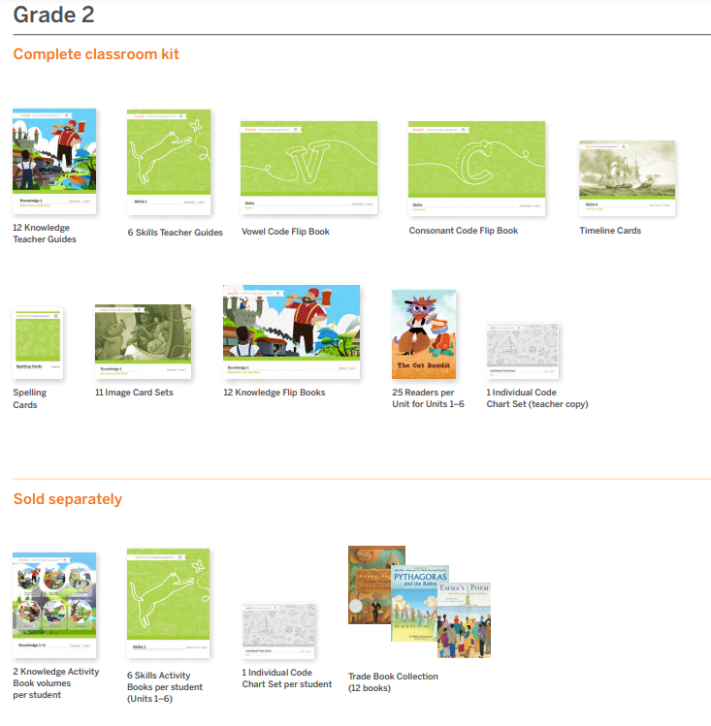
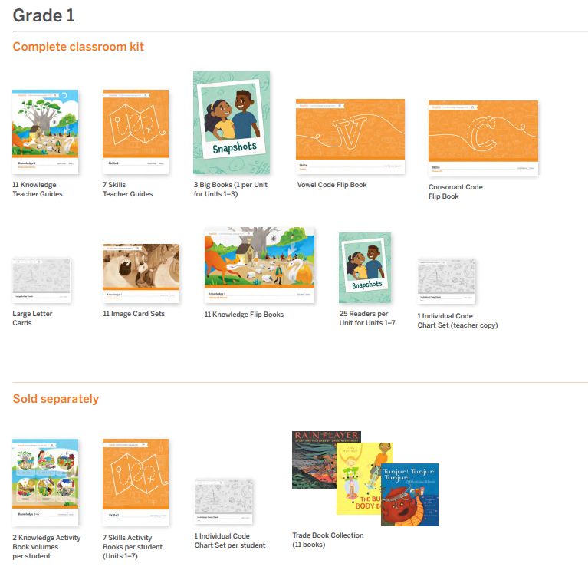
Materials
Kindergarten
Kindergarten Walkthrough Video
1st Grade
1st Grade Walkthrough Video
2nd Grade
2nd Grade Walkthrough Video

Slide 3
Kindergarten Components
Teacher Guides
  12 Knowledge
  10 Skills
Big Books/ Flip Books
  12 Knowledge
  5 Skills (Units 4-8)
Sound Posters
  Sound Cards
  Clear Pockets
Student Readers
  Picture Readers (set of 25)
  Readers Skills 6-10 (sets of 25)
Chaining Materials
  Small Letter Cards (box - class set)
  Chaining Folders (set of 25)
Blending Picture Cards and Image Cards
Large Letter Cards
12 Trade Books (1 per Knowledge Domain)
Student Activity Books (Consumable)
  10 Skills
  2 Knowledge

Slide 4
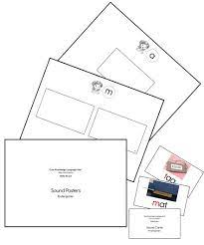
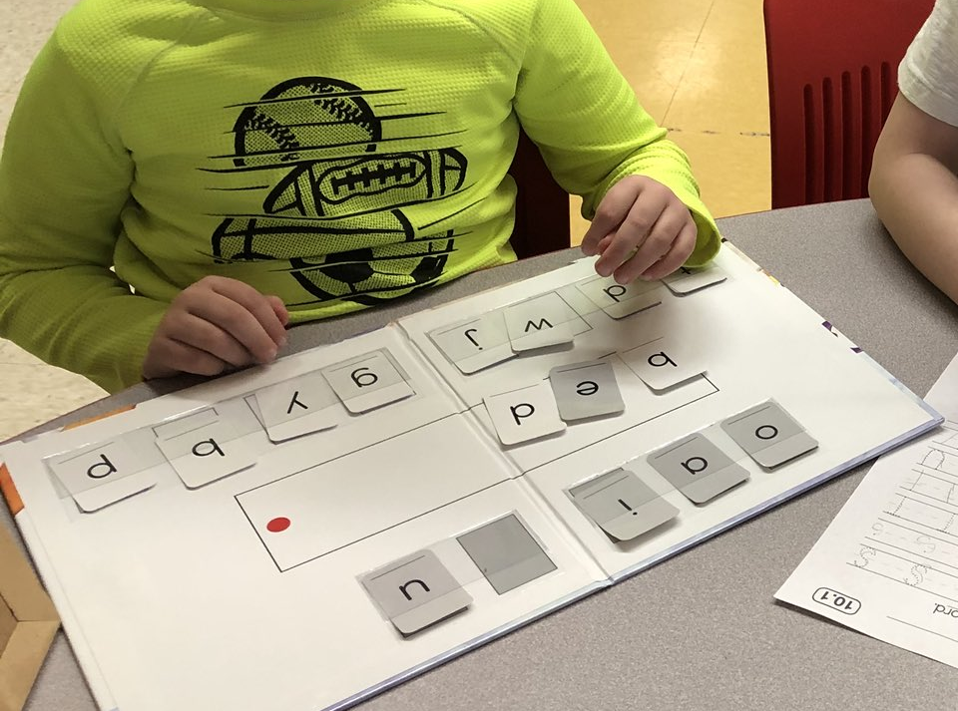
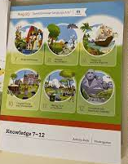
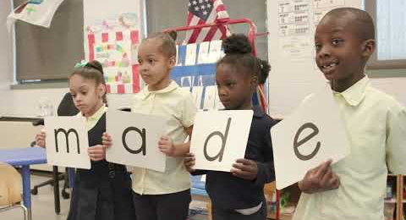
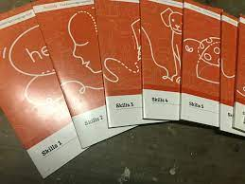
Kindergarten Components
Teacher Guides
  12 Knowledge
  10 Skills
Big Books/ Flip Books
  12 Knowledge
  5 Skills (Units 4-8)
Sound Posters
  Sound Cards
  Clear Pockets
Student Readers
  Picture Readers (set of 25)
  Readers Skills 6-10 (sets of 25)
Chaining Materials
  Small Letter Cards (box - class set)
  Chaining Folders (set of 25)
Blending Picture Cards and Image Cards
Large Letter Cards
12 Trade Books (1 per Knowledge Domain)
Student Activity Books (Consumable)
  10 Skills
  2 Knowledge

Slide 5
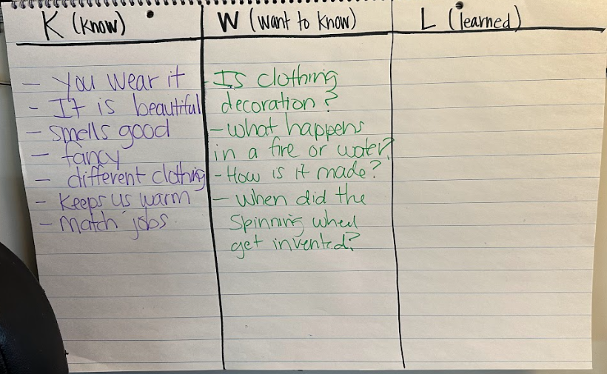
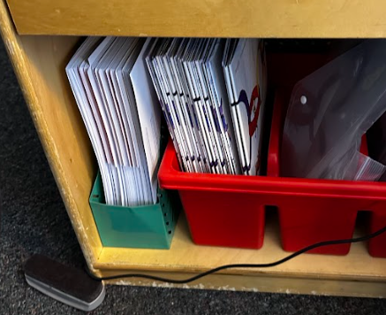
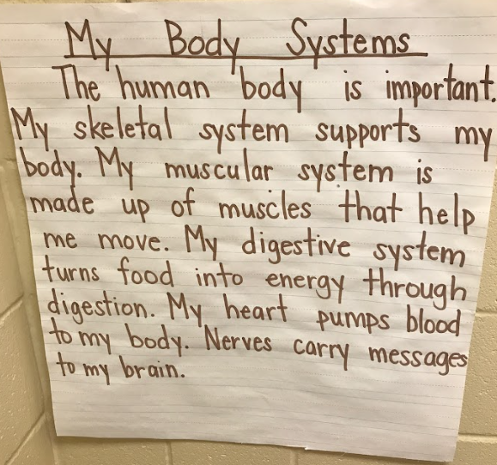
Kindergarten Classroom Setup and Organization
Need to Have:
Sound Wall - With Amplify CKLA Sound Posters
Tricky Word Board/ Chart
Knowledge Learning Board (Image Cards, Vocabulary)
Nice to Have:
Easel
Large Chart Paper
Small Baskets - for reader storage
Space to display shared writing and showcase learning
Think abouts:
Where will chaining folders, student readers, and student activity books be stored?

Slide 6
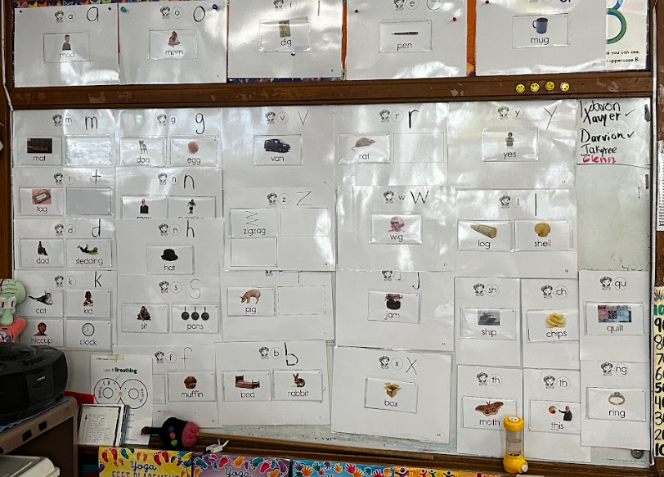
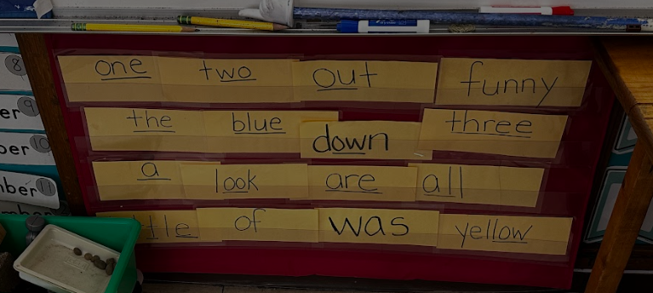
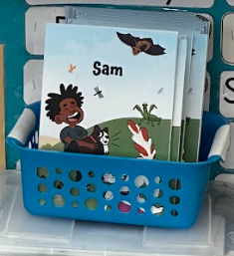
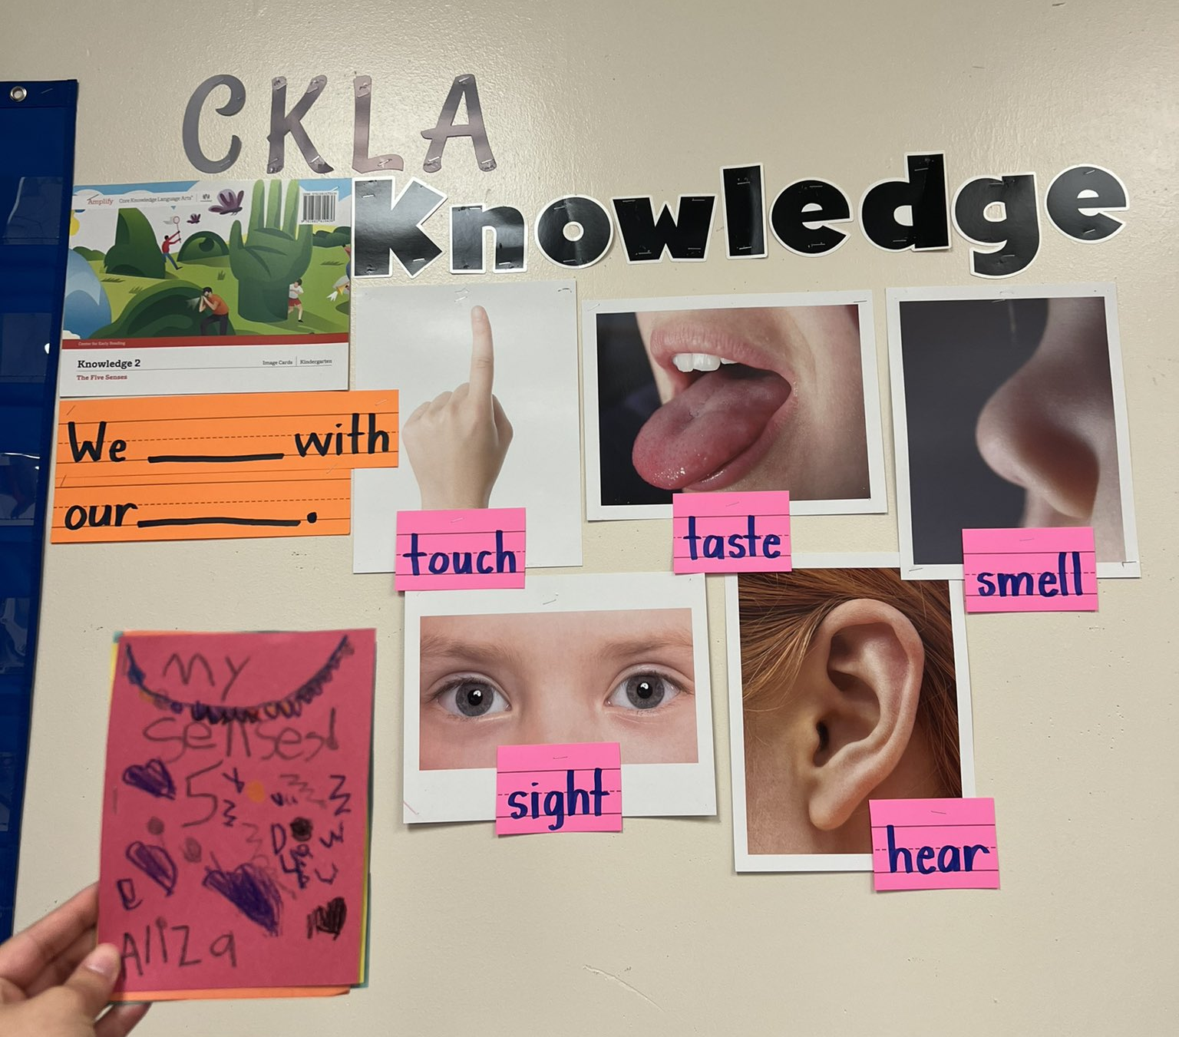
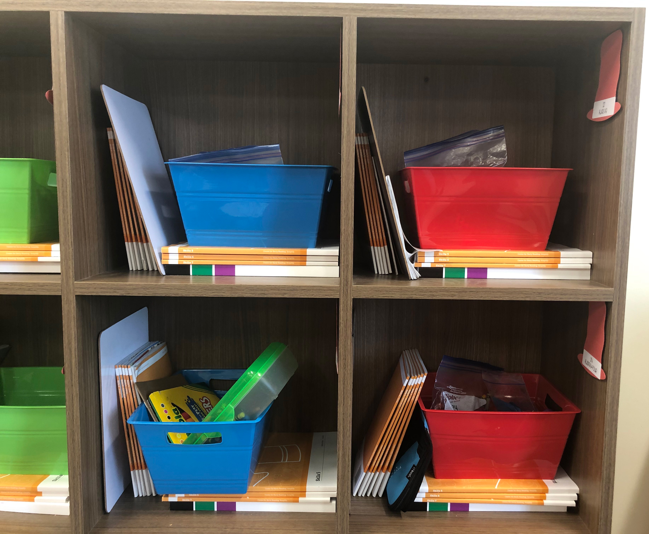
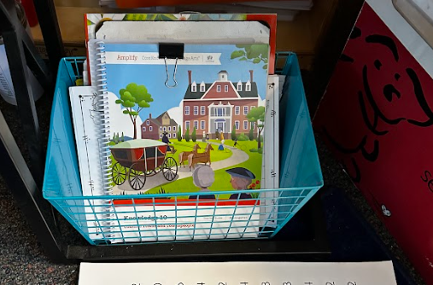
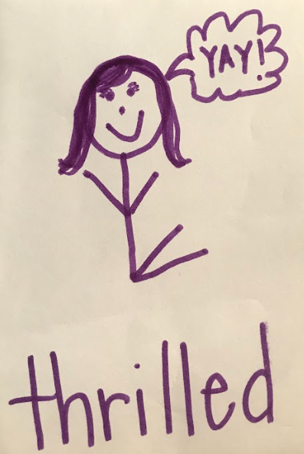
Kindergarten Classroom Setup and Organization
Tricky Word Board/ Chart
Storage
Sound Wall
Other Ideas
Knowledge Learning Board

Slide 7
First Grade Components
Teacher Guides
  11 Knowledge
  7 Skills
Big Books/ Flip Books
  11 Knowledge
  3 Skills (Units 1-3)
Spelling Cards
  Small Set
  Large Set (provided by DCSD)
Student Readers
  Readers Skills 1-7 (sets of 25)
Vowel and Consonant Code Flip Books
Image Cards (1 set per Knowledge Unit)
Large Letter Cards
11 Trade Books (1 per Knowledge Domain)
Student Activity Books (Consumable)
  7 Skills
  2 Knowledge
Individual Code Charts (Consumable)

Slide 8
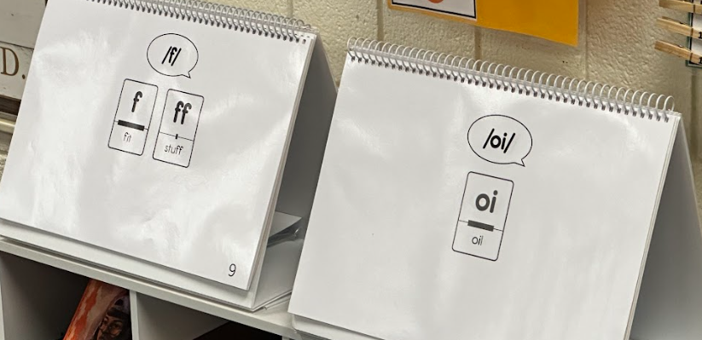
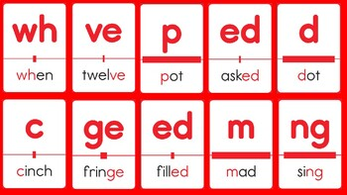
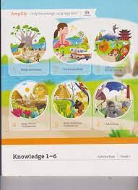

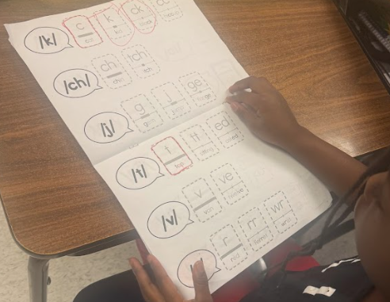
First Grade Components
Teacher Guides
  11 Knowledge
  7 Skills
Big Books/ Flip Books
  11 Knowledge
  3 Skills (Units 1-3)
Spelling Cards
  Small Set
  Large Set (provided by DCSD)
Student Readers
  Readers Skills 1-7 (sets of 25)
Vowel and Consonant Code Flip Books
Image Cards (1 set per Knowledge Unit)
Large Letter Cards
11 Trade Books (1 per Knowledge Domain)
Student Activity Books (Consumable)
  7 Skills
  2 Knowledge
Individual Code Charts (Consumable)

Slide 9
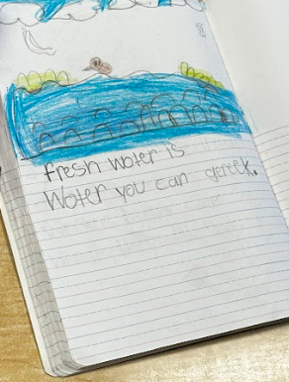
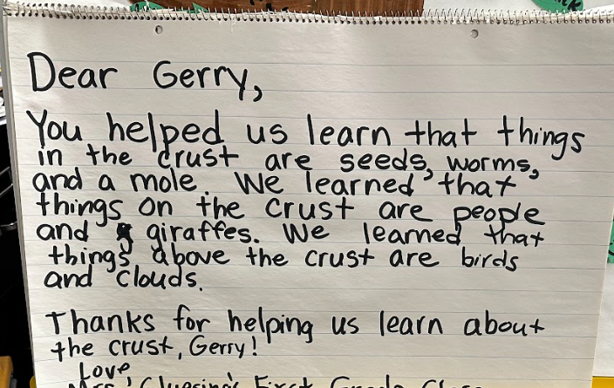
First Grade Classroom Setup and Organization
Need to Have:
Sound Wall - With Amplify CKLA Spelling Cards
Tricky Word Board/ Chart
Knowledge Learning Board (Image Cards, Vocabulary)
Pocket Chart - for chaining activities
Space for Spelling Trees - for the current units spelling trees
Nice to Have:
Easel
Large Chart Paper
Small Baskets - for reader storage
Space to display shared writing and showcase learning
Think abouts:
Where will student code charts, student readers, and student activity books be stored?

Slide 10
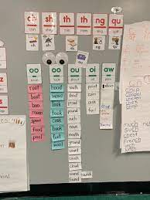
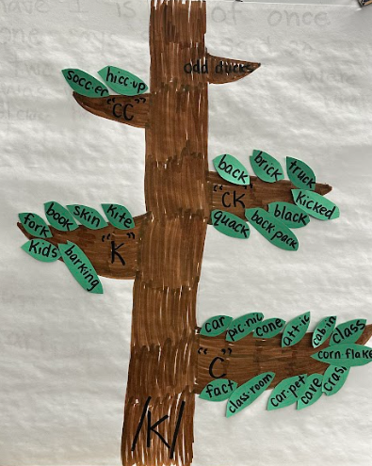
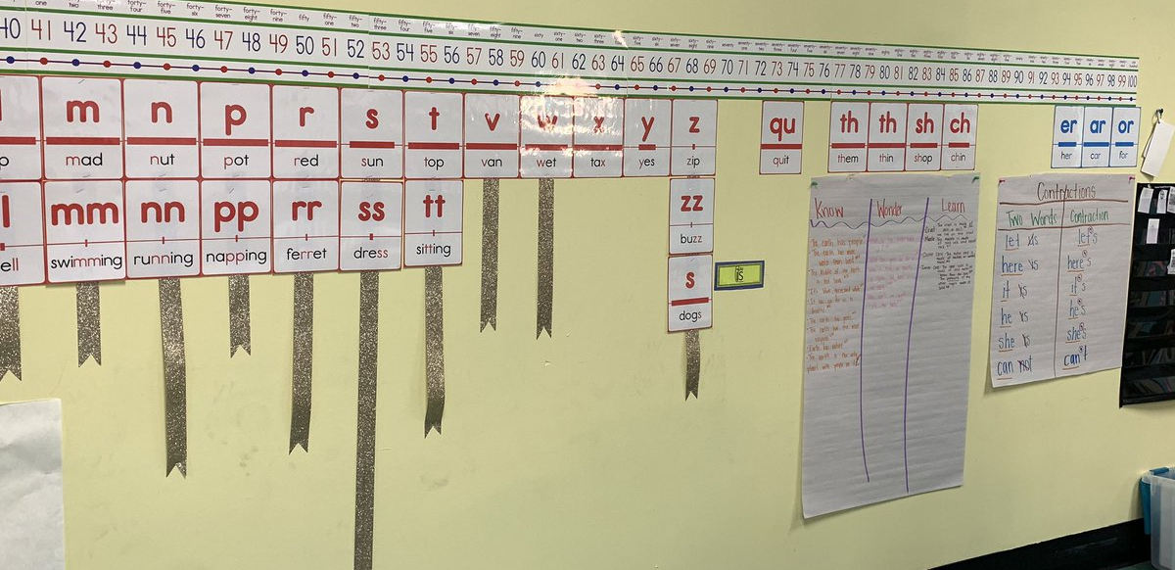
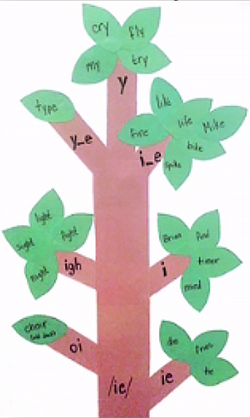
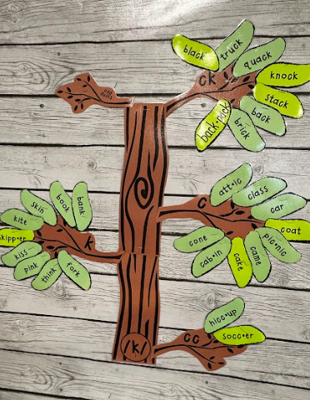
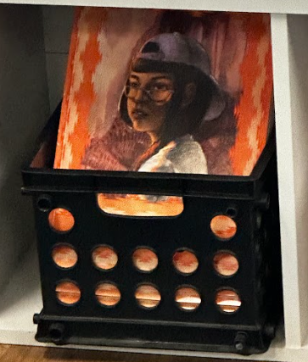
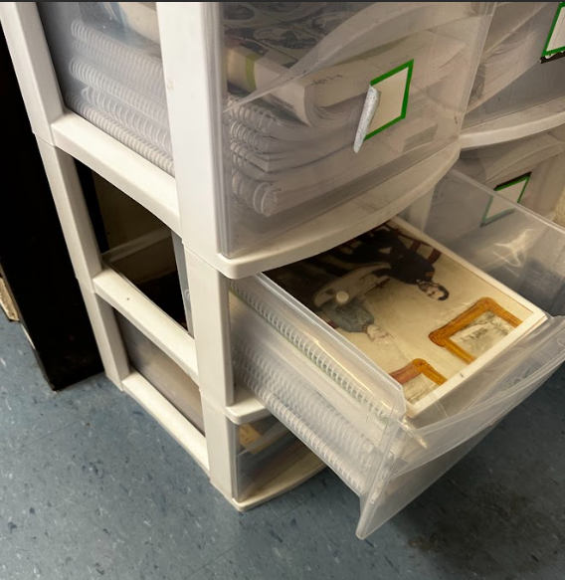
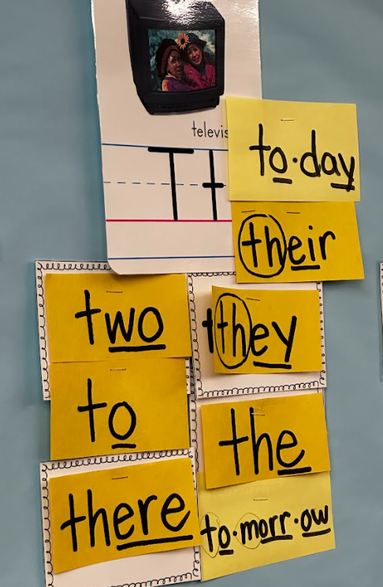
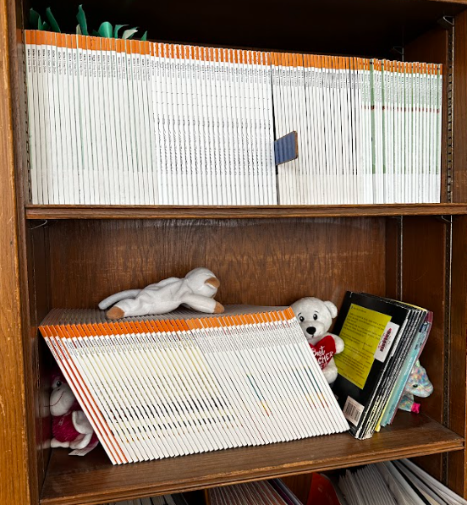
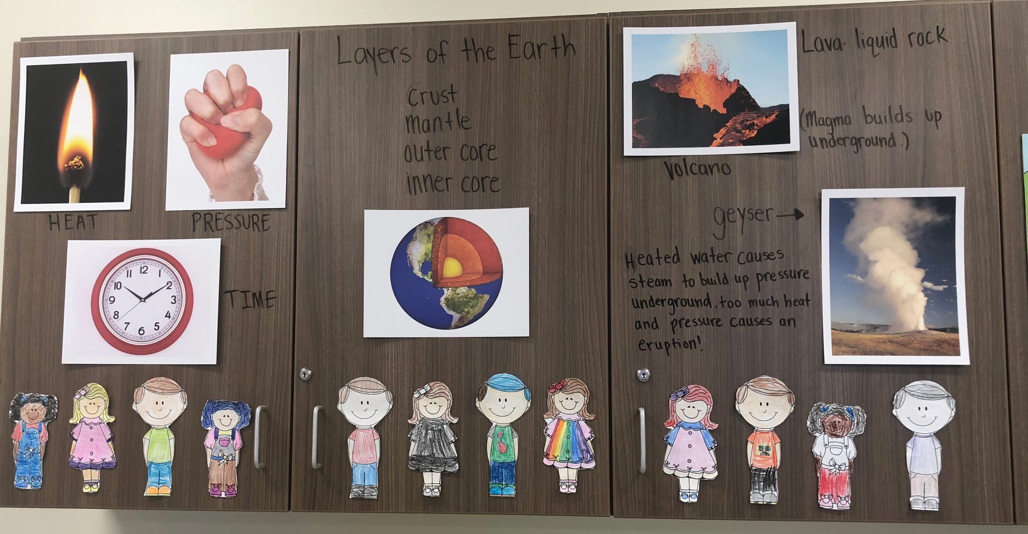
First Grade Classroom Setup and Organization
Spelling Trees
Sound Wall
Storage
Knowledge Learning Board
Other Ideas
Tricky Word Board/ Chart

Slide 11
Second Grade Components
Teacher Guides
  12 Knowledge
  6 Skills
Big Books/ Flip Books
  12 Knowledge
Spelling Cards
  Small Set
  Large Set (provided by DCSD)
Student Readers
  Readers Skills 1-6 (sets of 25)
Vowel and Consonant Code Flip Books
Image Cards (1 set per Knowledge Unit)
Timeline Cards
12 Trade Books (1 per Knowledge Domain)
Student Activity Books (Consumable)
  6 Skills
  2 Knowledge
Individual Code Charts (Consumable)

Slide 12
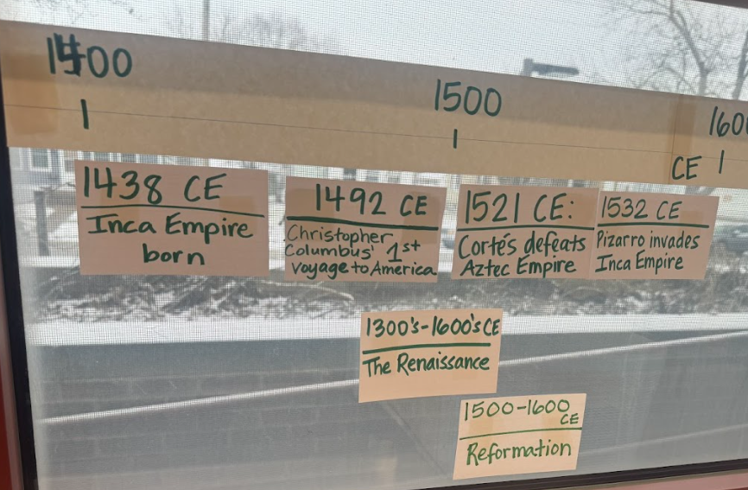
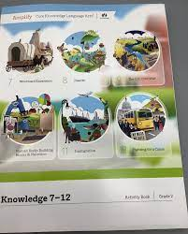
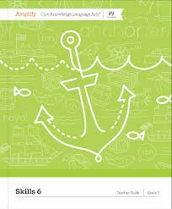
Second Grade Components
Teacher Guides
  12 Knowledge
  6 Skills
Big Books/ Flip Books
  12 Knowledge
Spelling Cards
  Small Set
  Large Set (provided by DCSD)
Student Readers
  Readers Skills 1-6 (sets of 25)
Vowel and Consonant Code Flip Books
Image Cards (1 set per Knowledge Unit)
Timeline Cards
12 Trade Books (1 per Knowledge Domain)
Student Activity Books (Consumable)
  6 Skills
  2 Knowledge
Individual Code Charts (Consumable)

Slide 13
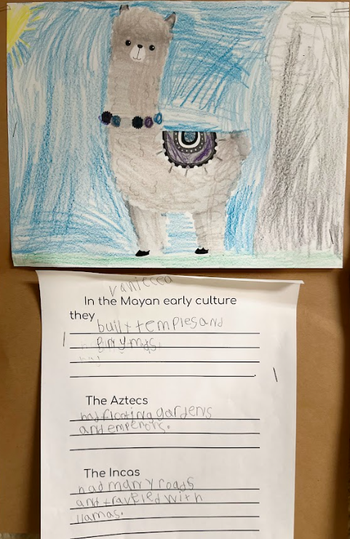
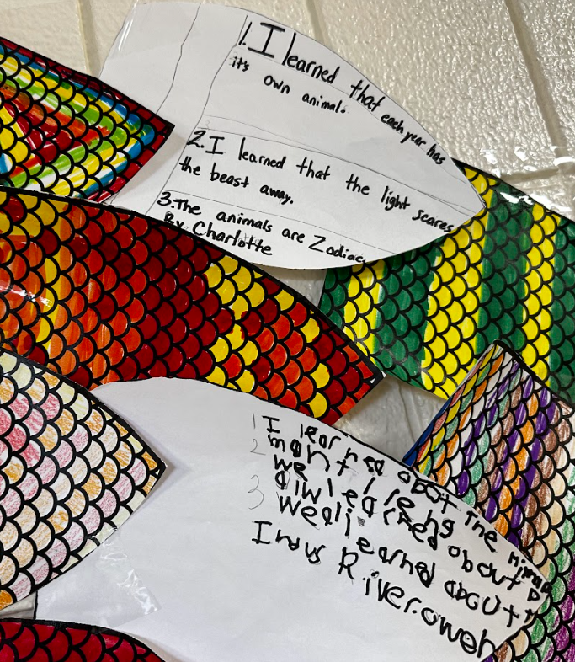
Second Grade Classroom Setup and Organization
Need to Have:
Sound Wall - With Amplify CKLA Spelling Cards
Tricky Word Board/ Chart
Knowledge Learning Board (Image Cards, Vocabulary)
Space for Spelling Trees - for the current units spelling trees
Nice to Have:
Easel
Large Chart Paper
Small Baskets - for reader storage
Timeline - to document learning time periods from knowledge
Space to display shared writing and showcase learning
Think abouts:
Where will student code charts, student readers, and student activity books be stored?

Slide 14
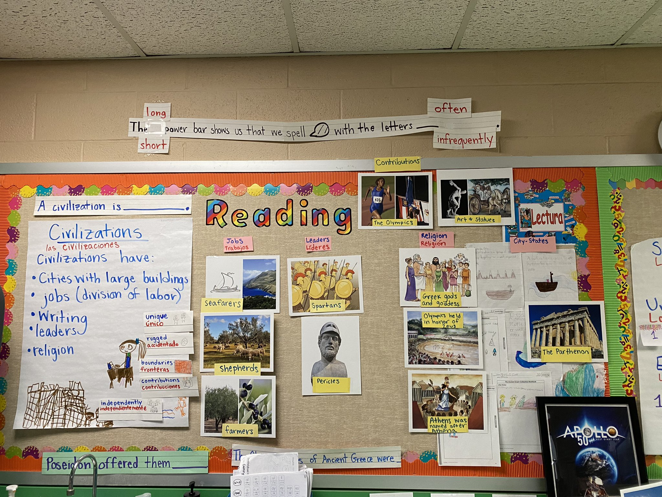
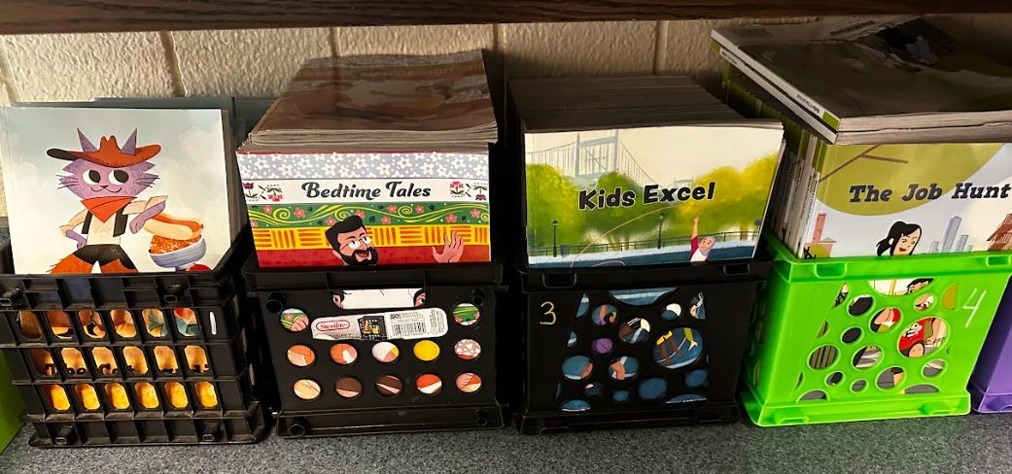
Second Grade Classroom Setup and Organization
Spelling Trees
Sound Wall
Storage
Knowledge Learning Board
Other Ideas
Tricky Word Board/ Chart

Slide 15
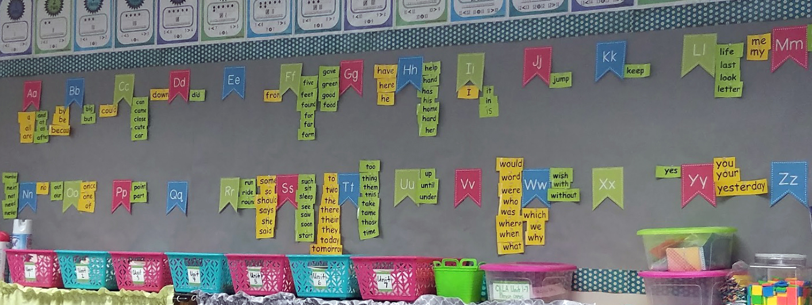
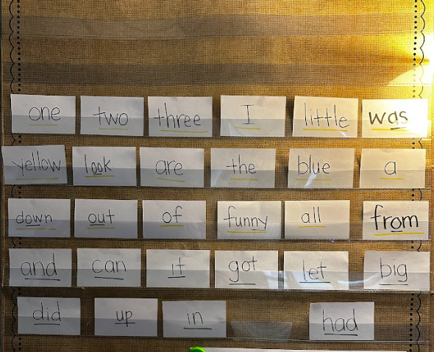
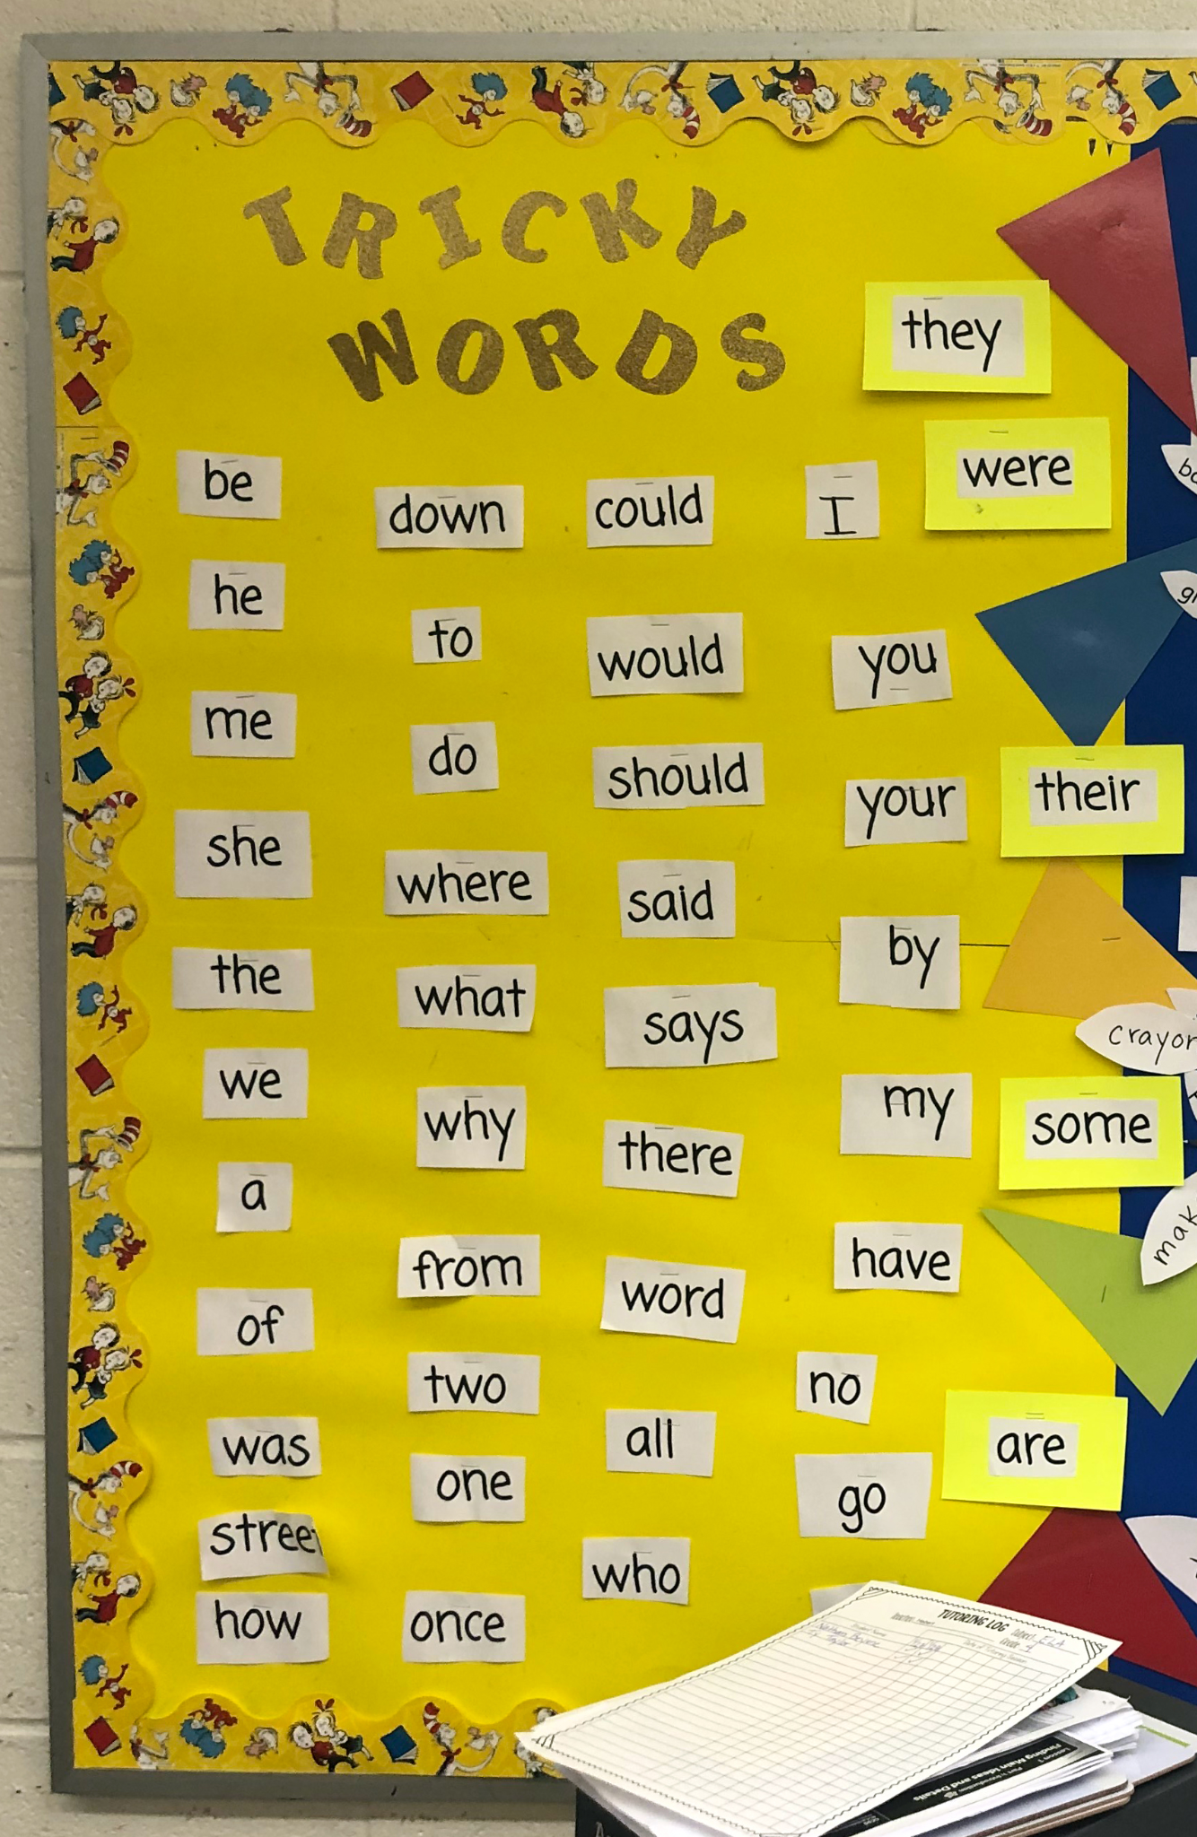
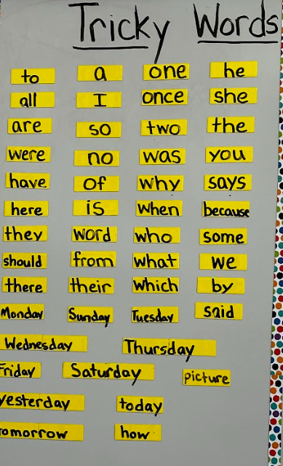
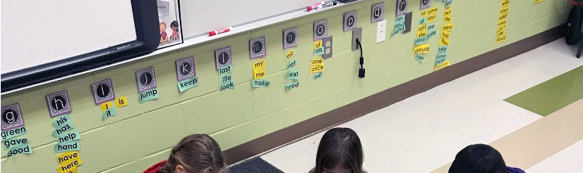
Other Ideas - Tricky Words
GK Tricky Words
G1 Tricky Words
G2 Tricky Words

Slide 16
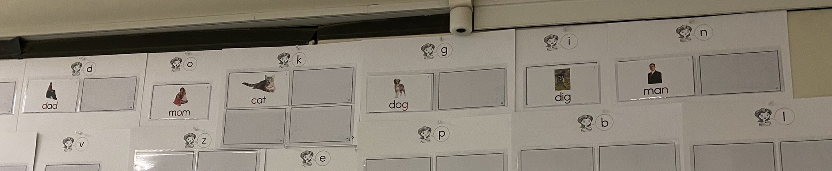
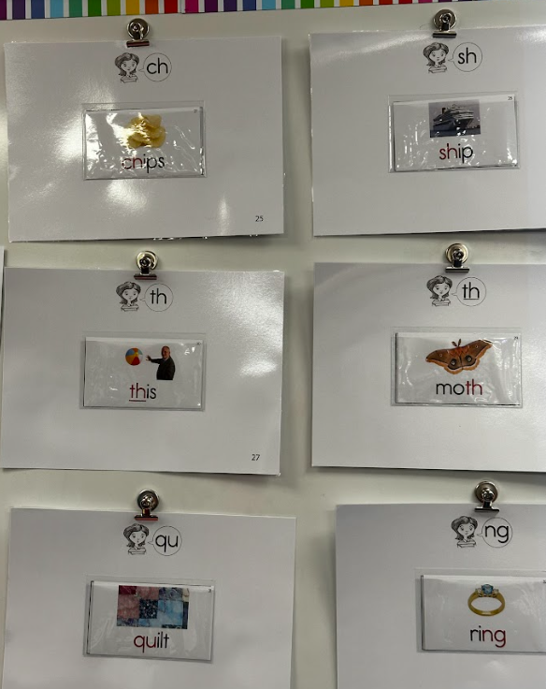
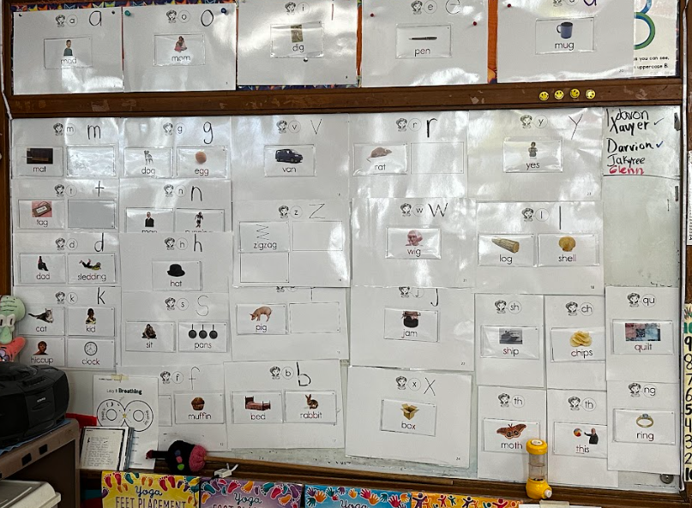
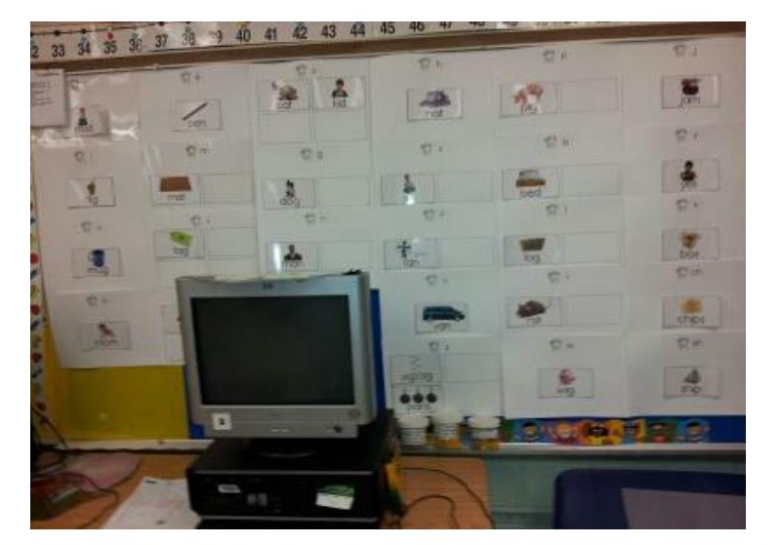
Other Ideas - Sound Wall (Kindergarten)

Slide 17







Other Ideas - Spelling Trees
G1 Spelling Trees
G2 Spelling Trees

Slide 18




Other Ideas - Sound Wall (1st/2nd)

Slide 19





Other Ideas - Knowledge Boards

Slide 20

Other Ideas - Timeline

