Slide 1













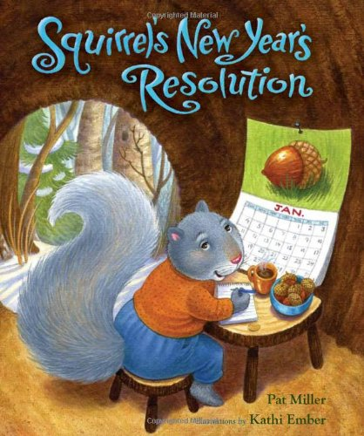





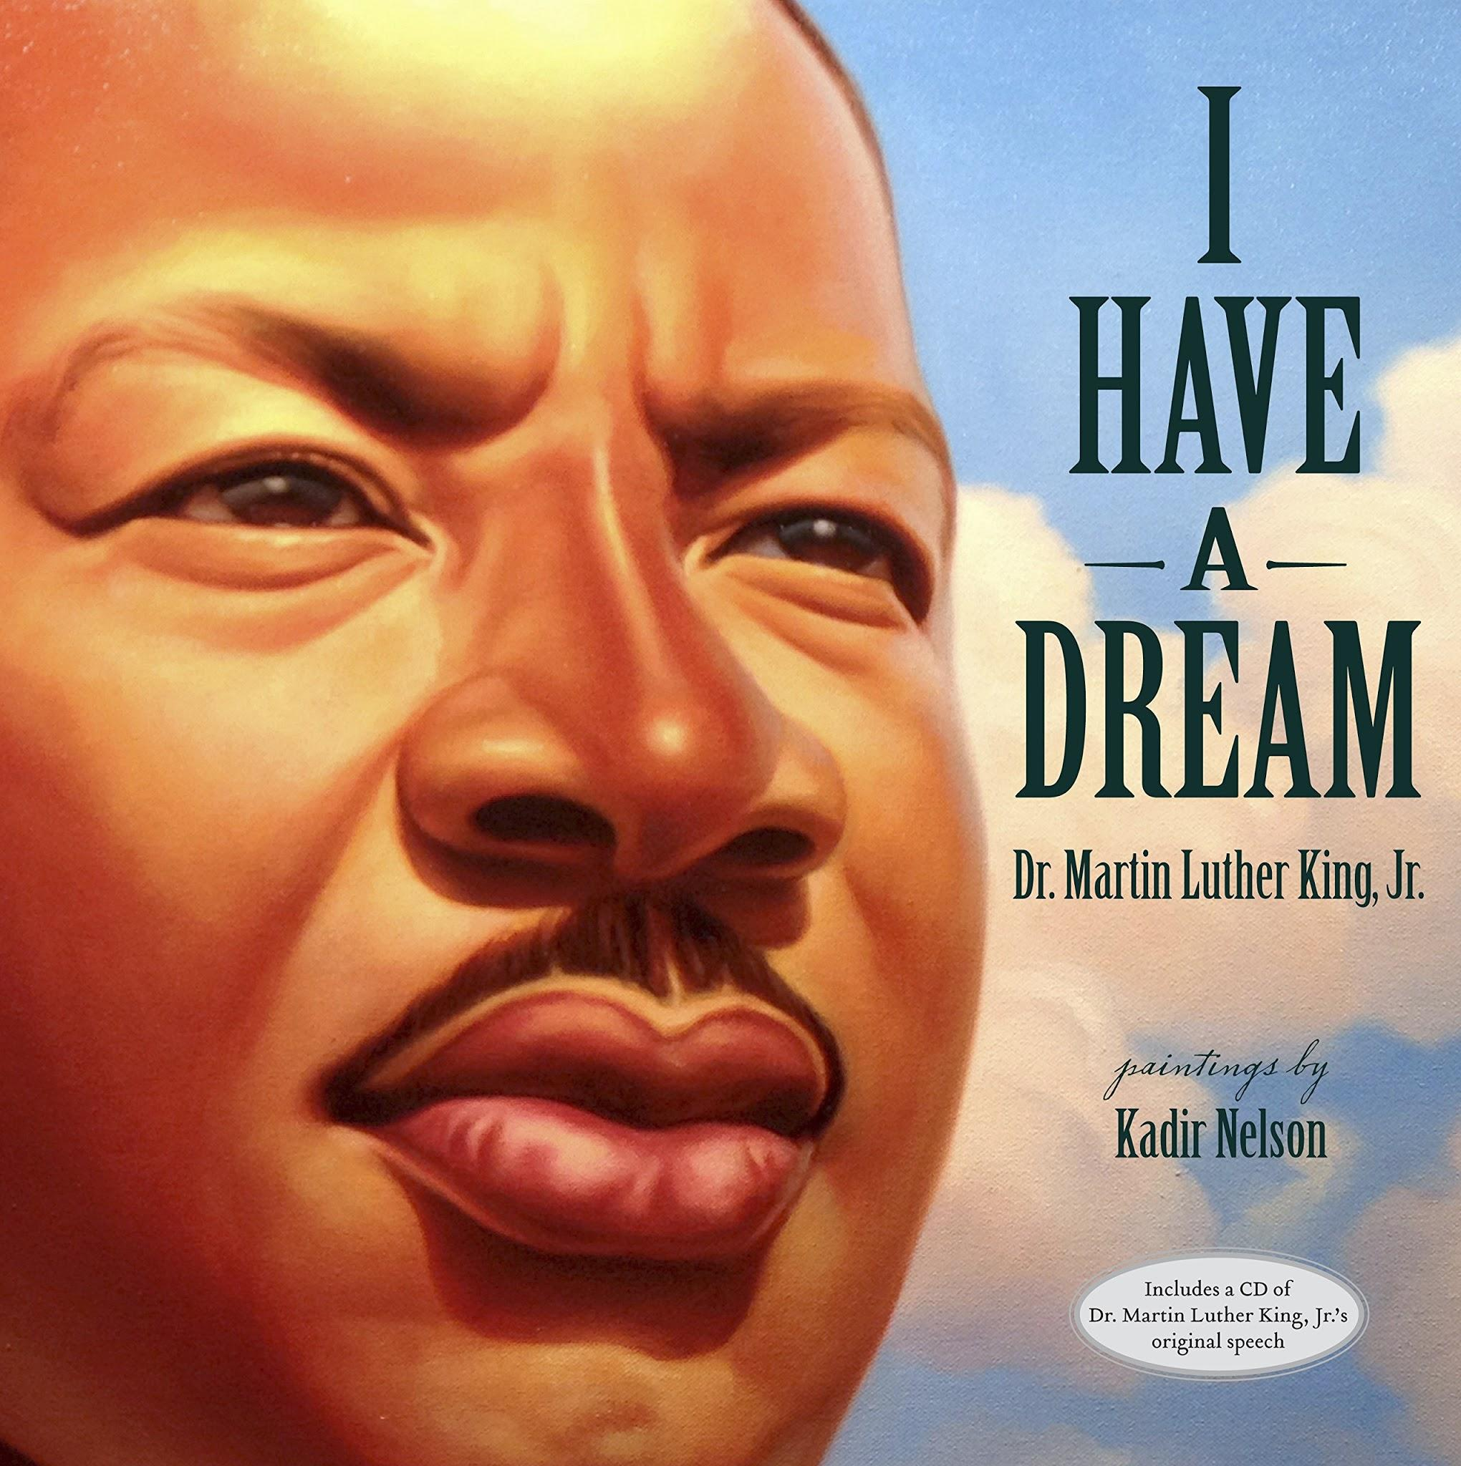



Winter Books
January Virtual Library
Read about New Years Traditions, Martin Luther King Jr., and Winter Fun
New Year’s Books
MLKJ
Books

