Slide 1















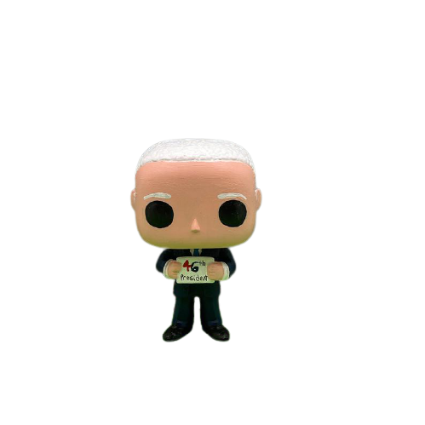

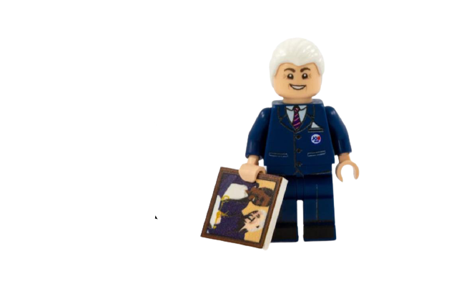
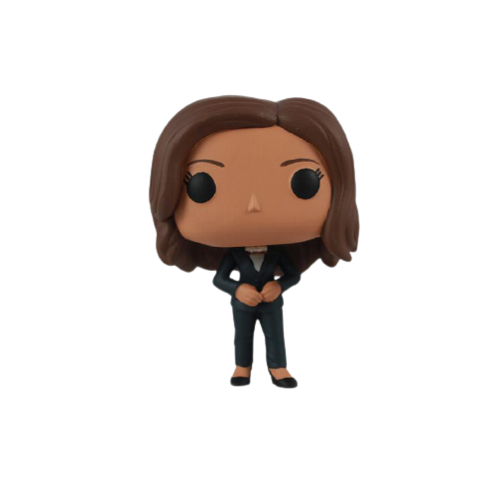
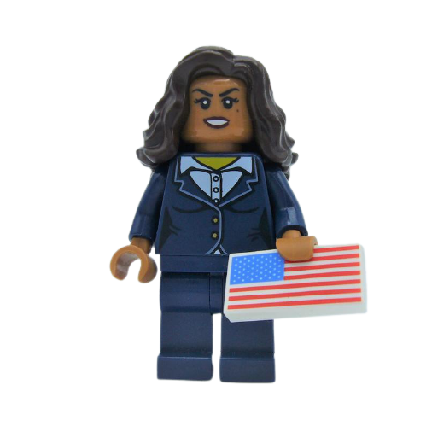


“While I may be the first woman in this office, I will not be the last…” - Kamala Harris
Inauguration

Slide 2

Looking for more libraries?
Check out my linktree....
https://linktr.ee/missrachelsf
Buy Me A Coffee ☕️
Vemno

