Slide 1
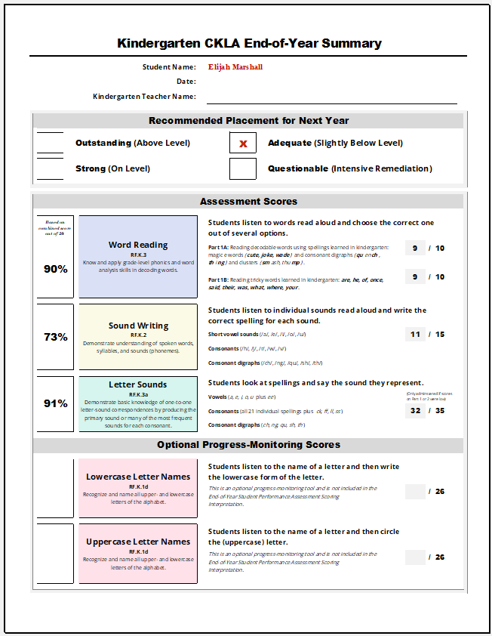
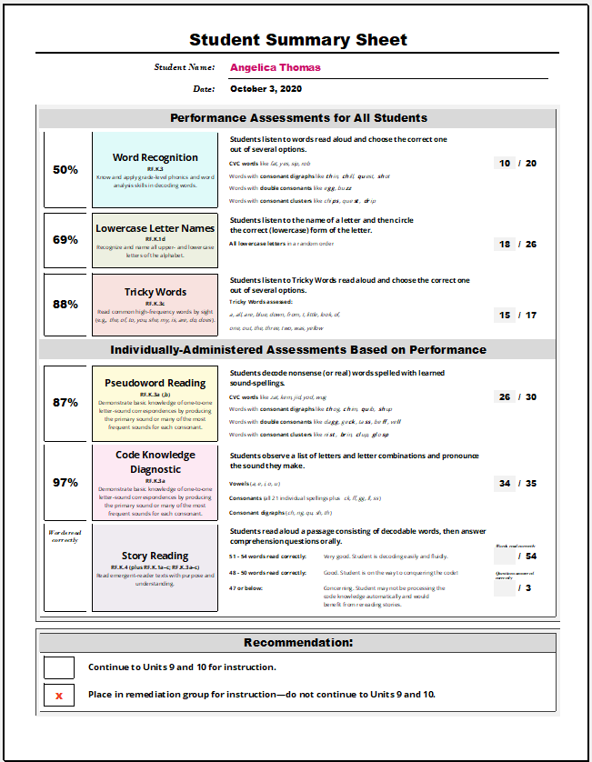
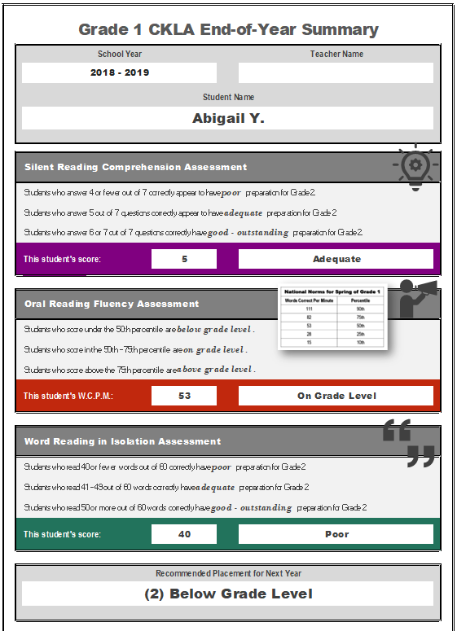

Slide 2
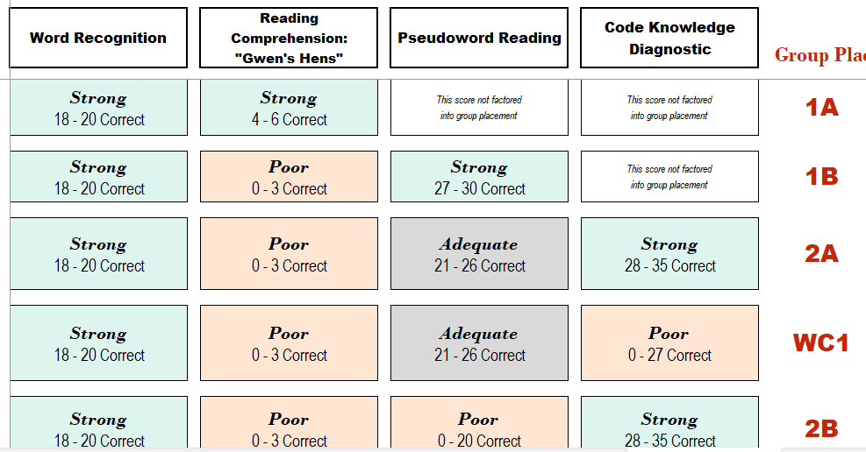
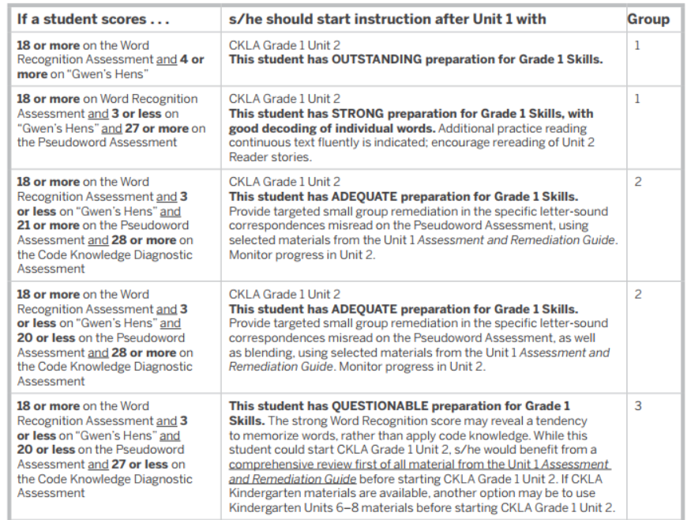
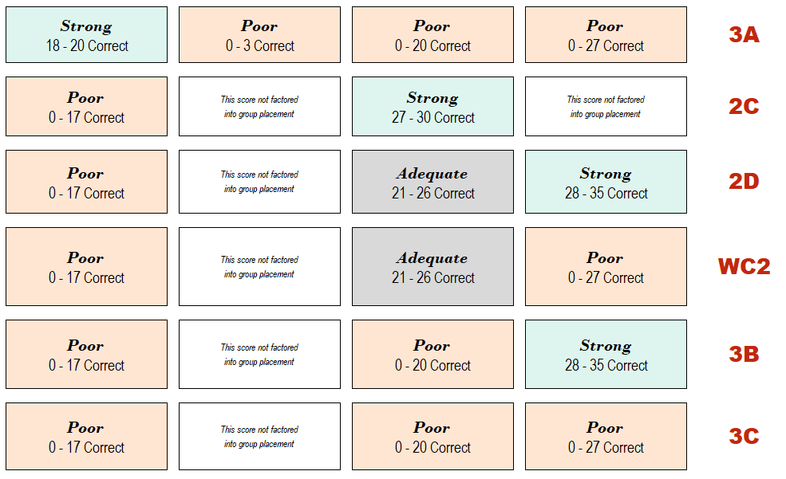
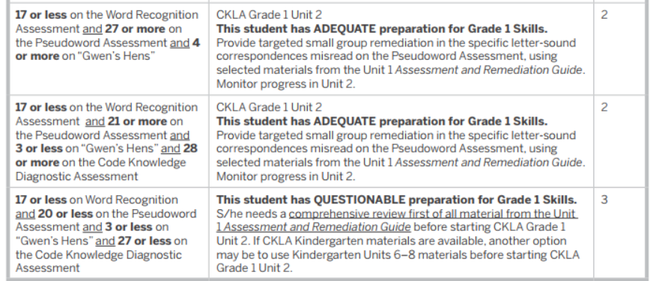

Slide 3
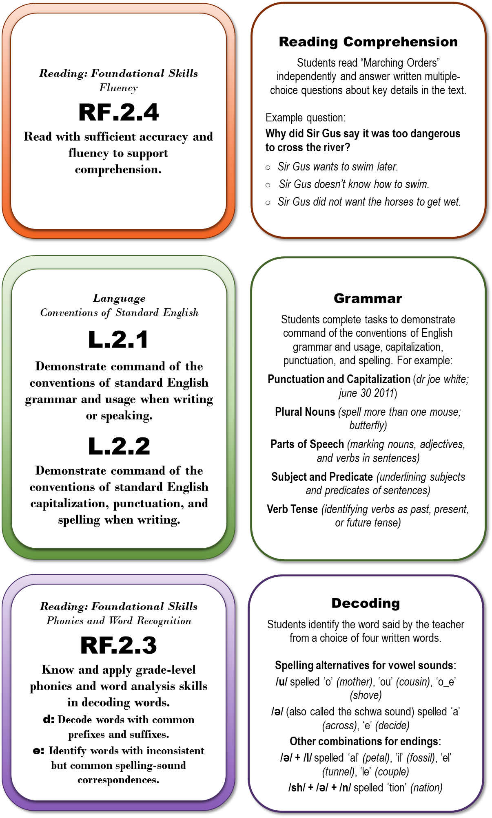

Slide 4
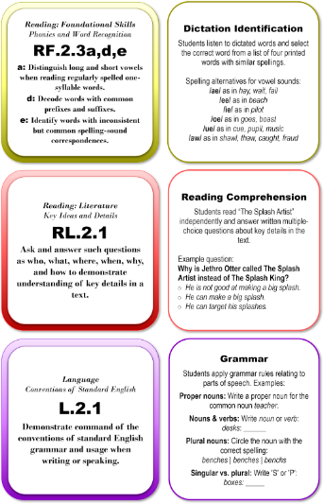
Size of Google Sheets Student Report images

Slide 5
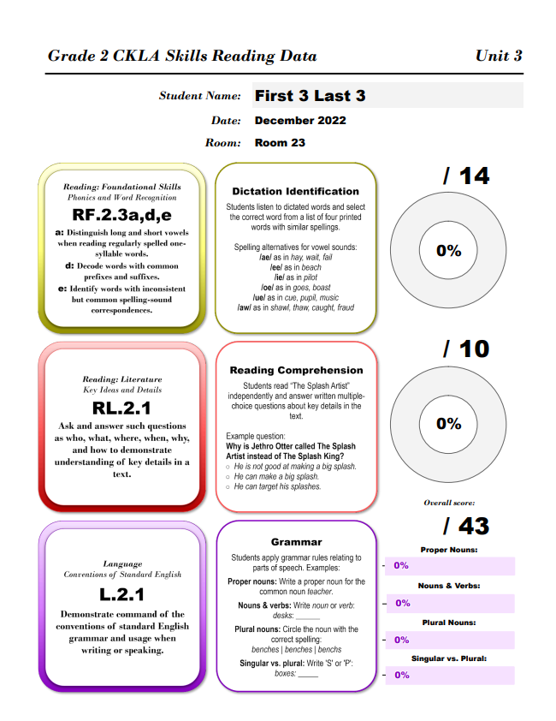
Entire Student Report size

Slide 6
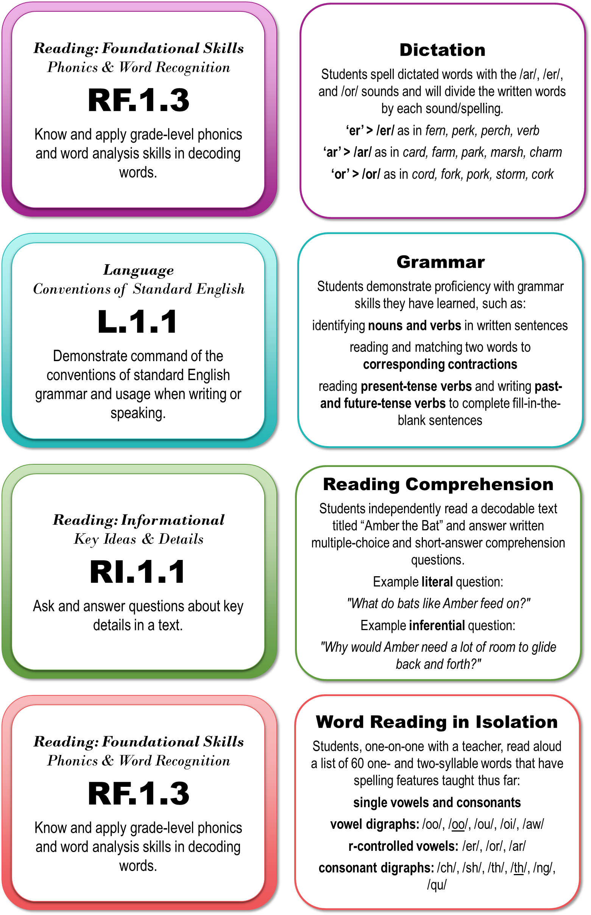
Reading: Foundational Skills
Phonics & Word Recognition
RF.1.3
Know and apply grade-level phonics and word analysis skills in decoding words.
Dictation
Students spell dictated words with the /ar/, /er/, and /or/ sounds and will divide the written words by each sound/spelling.
‘er’ > /er/ as in fern, perk, perch, verb
‘ar’ > /ar/ as in card, farm, park, marsh, charm
‘or’ > /or/ as in cord, fork, pork, storm, cork
Language
Conventions of Standard English
L.1.1
Demonstrate command of the conventions of standard English grammar and usage when writing or speaking.
Grammar
Students demonstrate proficiency with grammar skills they have learned, such as:
identifying nouns and verbs in written sentences
reading and matching two words to corresponding contractions
reading present-tense verbs and writing past- and future-tense verbs to complete fill-in-the-blank sentences
Reading: Informational
Key Ideas & Details
RI.1.1
Ask and answer questions about key details in a text.
Reading Comprehension
Students independently read a decodable text titled “Amber the Bat” and answer written multiple-choice and short-answer comprehension questions.
Example literal question:
"What do bats like Amber feed on?"
Example inferential question:
"Why would Amber need a lot of room to glide back and forth?"
Reading: Foundational Skills
Phonics & Word Recognition
RF.1.3
Know and apply grade-level phonics and word analysis skills in decoding words.
Word Reading in Isolation
Students, one-on-one with a teacher, read aloud a list of 60 one- and two-syllable words that have spelling features taught thus far:
single vowels and consonants
vowel digraphs: /oo/, /oo/, /ou/, /oi/, /aw/
r-controlled vowels: /er/, /or/, /ar/
consonant digraphs: /ch/, /sh/, /th/, /th/, /ng/, /qu/

Slide 7
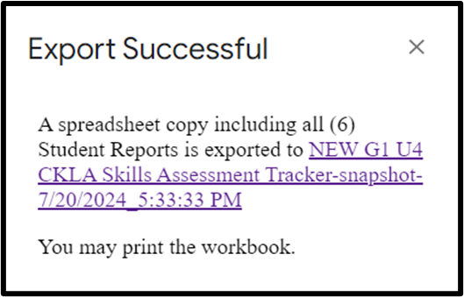
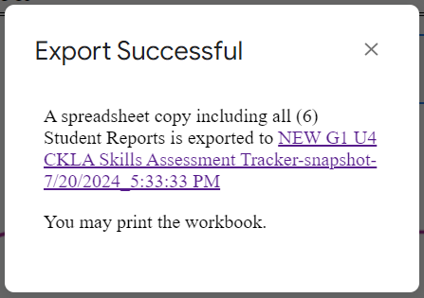
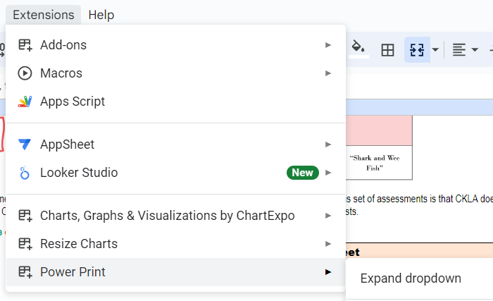
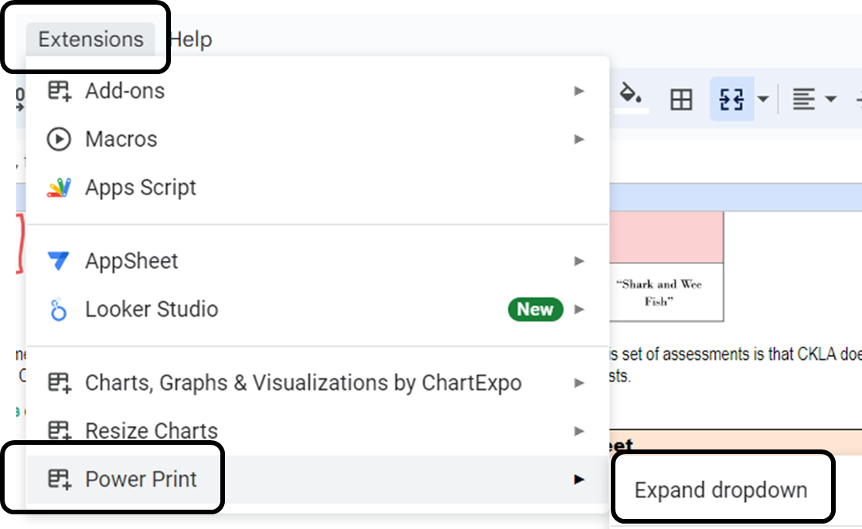
PowerPrint

Slide 8
