Slide 1


You will be writing directions on How to Catch a Leprechaun!
Notes:
https://linktr.ee/Mrs.Gonzalez 🍵

Slide 2
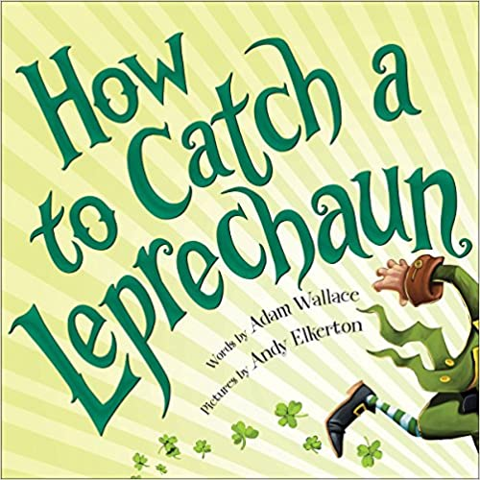
How do feel about leprechauns? What would you do if you found one? Let’s read the book How to Catch a Leprechaun written by Adam Wallace.
Notes:
https://linktr.ee/Mrs.Gonzalez 🍵

Slide 3

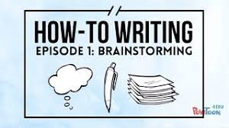
Notes:
https://linktr.ee/Mrs.Gonzalez 🍵

Slide 4

Imagine you found your way to the end of a rainbow.. What would you do to catch a leprechaun and have him take you to his pot of gold?
I will write directions on how to catch a leprechaun!
Notes:
https://linktr.ee/Mrs.Gonzalez 🍵

Slide 5

s.
How would you catch a leprechaun?
Let’s brainstorm!
Notes:
https://linktr.ee/Mrs.Gonzalez 🍵

Slide 6
First,
Then
Last,
Notes:
https://linktr.ee/Mrs.Gonzalez 🍵

Slide 7

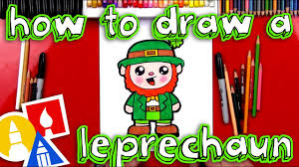
Click on the drawing video and draw a detailed picture of you catching a leprechaun!
Notes:
https://linktr.ee/Mrs.Gonzalez 🍵

