Slide 1





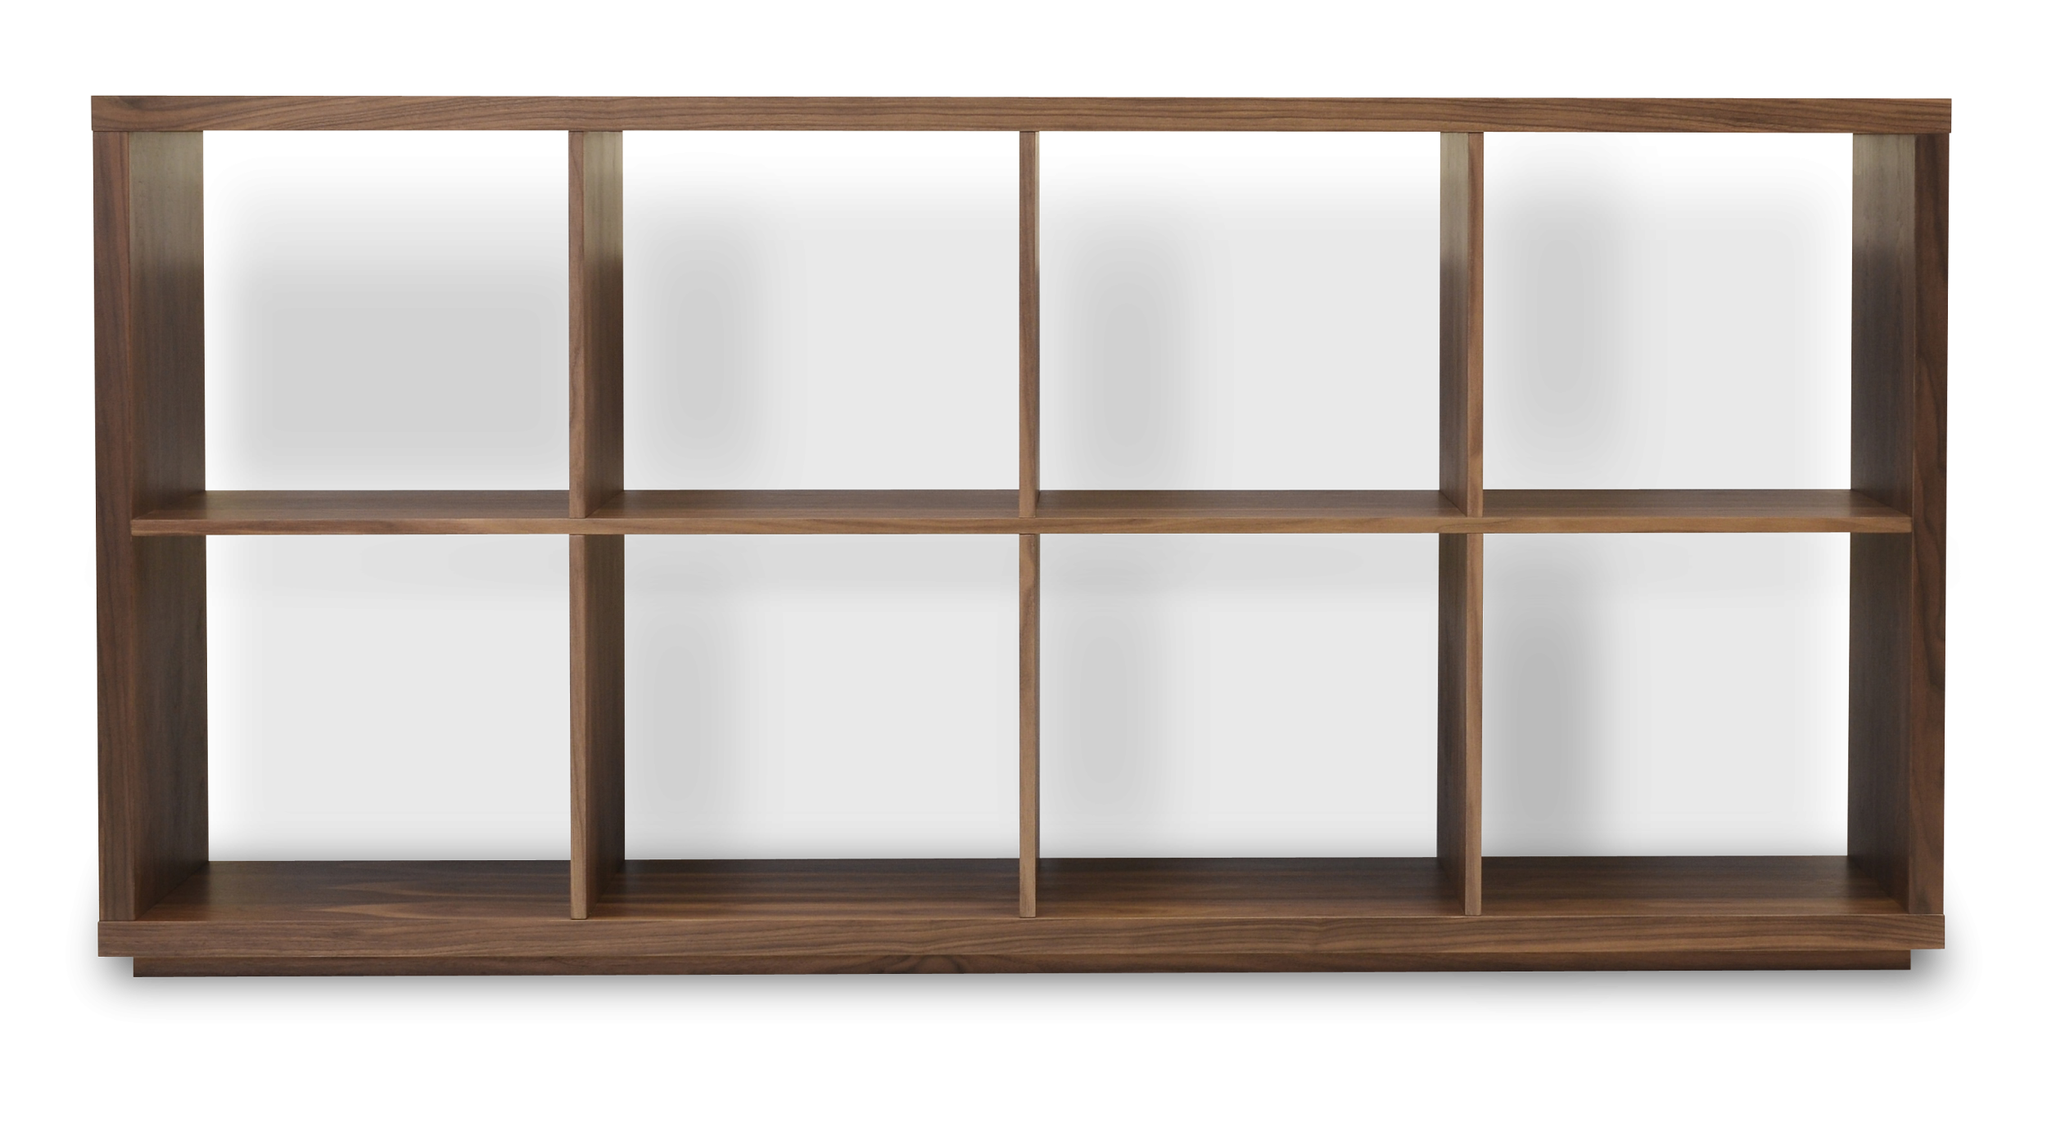
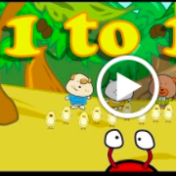
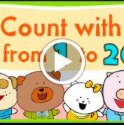


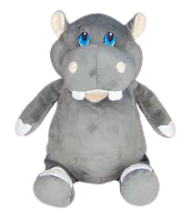
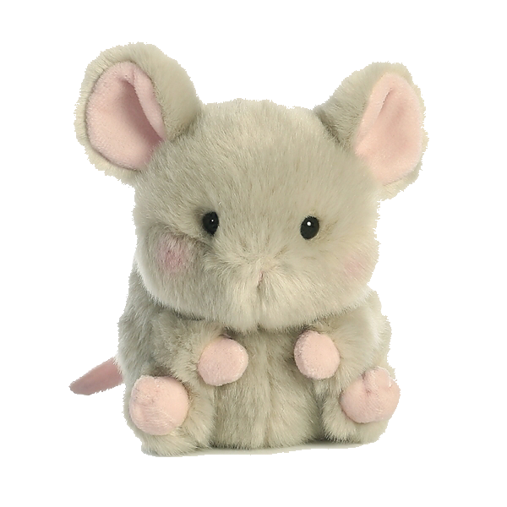
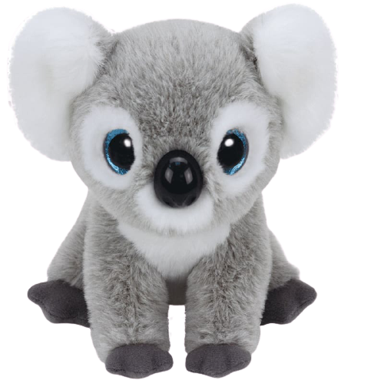
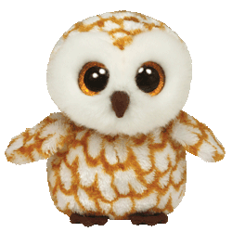
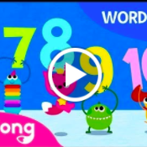



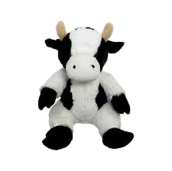
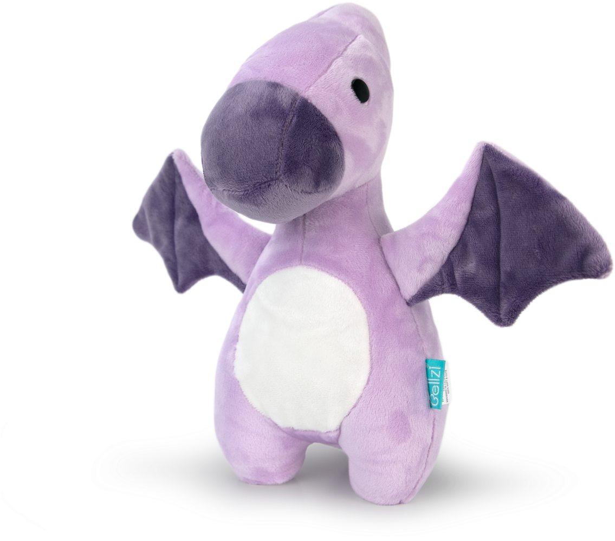
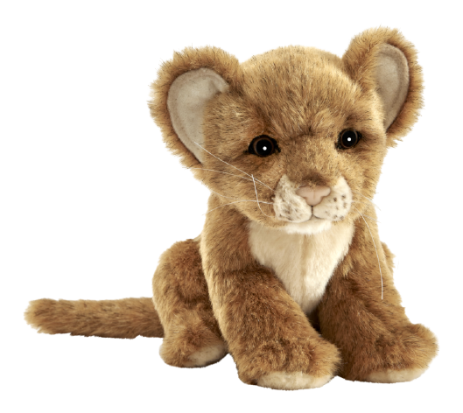
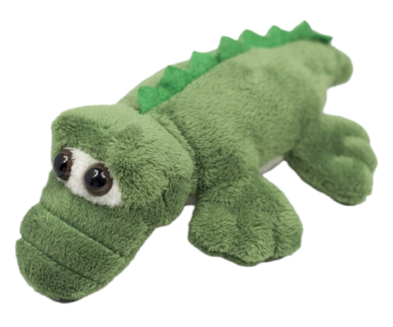

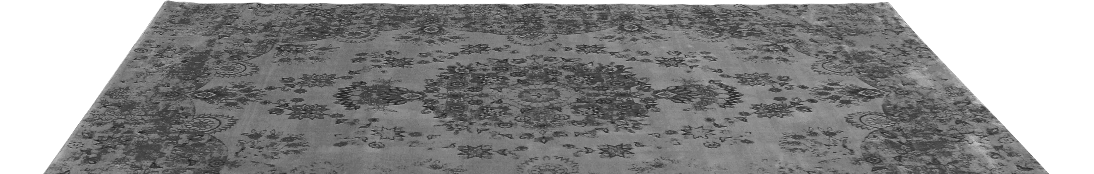

1-10
11-20
Notes:
Bitmoji search “pointing” and then right click on bitmoji select rotate and flip horizontally

Slide 2

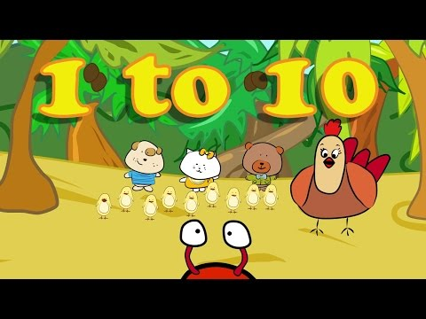

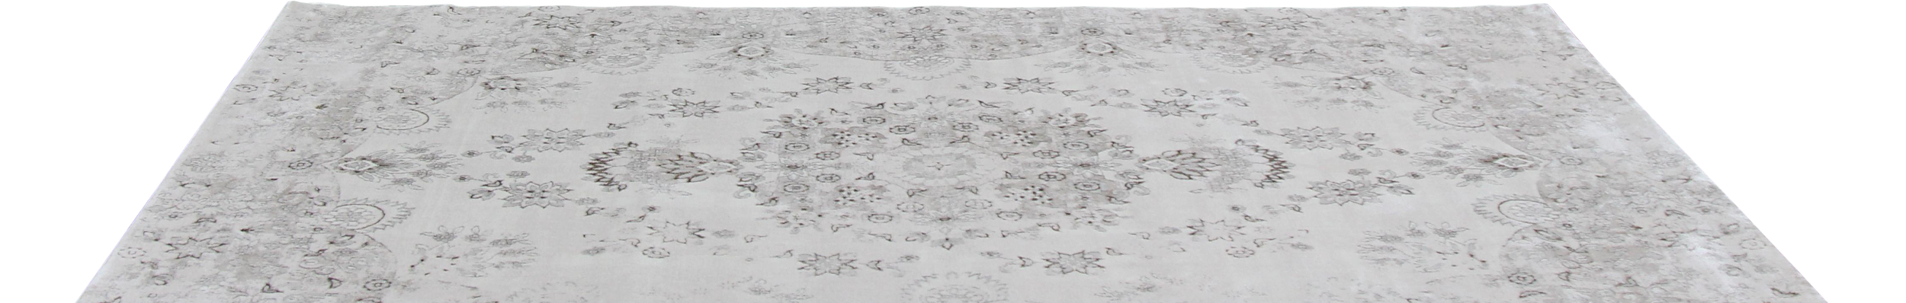
HOME
Notes:
Bitmoji search “pointing”

Slide 3
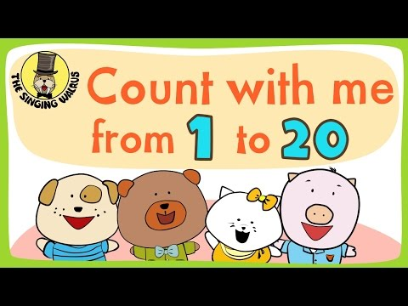

HOME
Notes:
Bitmoji search “pointing”

Slide 4

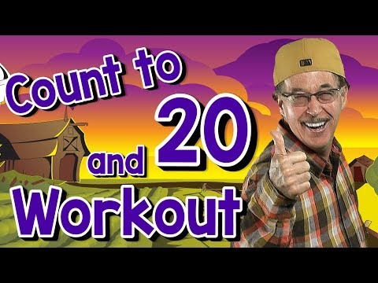
HOME
Notes:
Bitmoji search “workout”

Slide 5


HOME
Notes:
Bitmoji search space

Slide 6
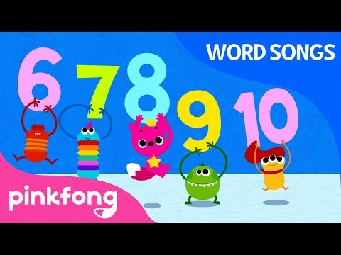

HOME
Notes:
Bitmoji search reading

Slide 7

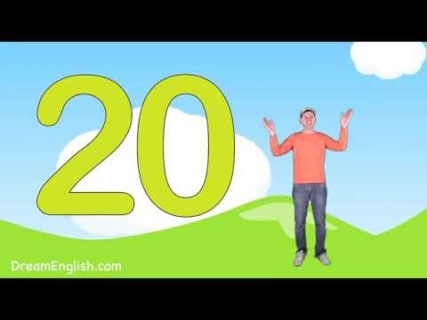
HOME
Notes:
Bitmoji search “pose” and then right click on bitmoji select rotate and flip horizontally

Slide 8
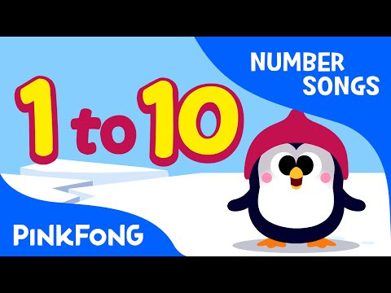

HOME
Notes:
Bitmoji search cold

Slide 9


HOME
Notes:
Bitmoji search fruit

Slide 10











1-10 Room
HOME

Slide 11






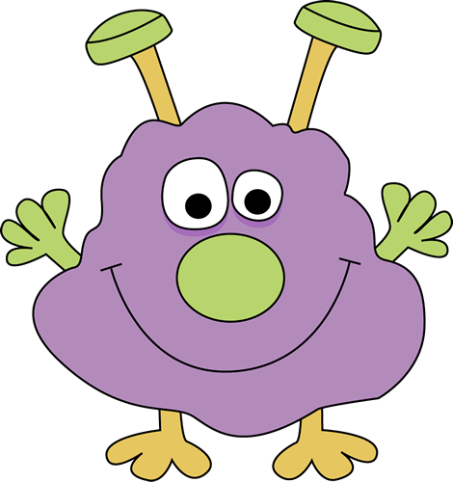


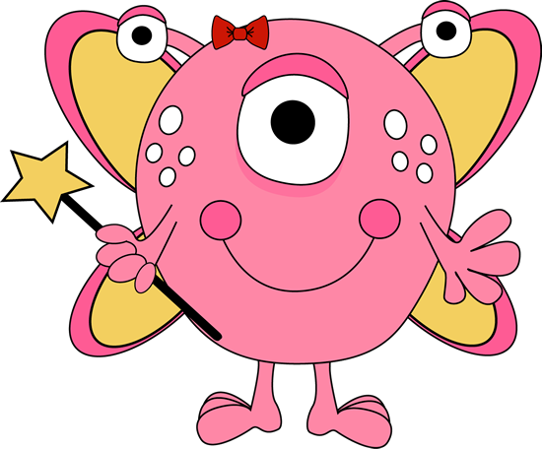
11-20 Room
HOME

Slide 12

I
4
2

Slide 13


Try Again

Slide 14
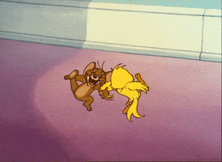
Great Job

Slide 15
Great Job

Slide 16
5
2
3

Slide 17
Try Again

Slide 18
6
3
4

Slide 19
Try Again

Slide 20
4
2
6

Slide 21
Try Again

Slide 22
4
5
2

Slide 23
Try Again

Slide 24
7
3
6

Slide 25
Try Again

Slide 26
8
7
2

Slide 27
Try Again

Slide 28
8
9
6

Slide 29
Try Again

Slide 30
8
9
6

Slide 31
Try Again

Slide 32
8
5
I0

Slide 33
Try Again

Slide 34
8
II
I0

Slide 35
Try Again

Slide 36
I2
7
6

Slide 37
Try Again

Slide 38
I0
II
I3

Slide 39
Try Again

Slide 40
I2
I4
I6

Slide 41
Try Again

Slide 42
I2
I7
I5

Slide 43
Try Again

Slide 44
I6
II
I5

Slide 45
Try Again

Slide 46
II
I7
I3

Slide 47
Try Again

Slide 48
I8
I5
I3

Slide 49
Try Again

Slide 50
II
I6
I9

Slide 51
Try Again

Slide 52
I8
20
I4

Slide 53
Try Again

