Slide 1

H
High Knees- for 30 seconds

Slide 2

A
Arm circles- for 30 seconds

Slide 3

L
Leg lifts- 10 on each leg

Slide 4
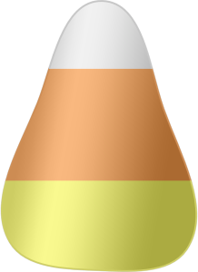
L
Leg lunges- 20 while rotating legs

Slide 5

o
One arm plank- 30 seconds on each side

Slide 6

W
Windmills- 10 times to each foot

Slide 7

E
Elbow to knee- 10 to each knee

Slide 8
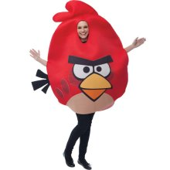
E
Elbow circles- 10 times each direction

Slide 9

n
Nose to knee- hold for 20 Seconds

