Slide 1







If you found my work useful, please consider donating. Thank you!
@Calliehamilton6

Slide 2
ST. PATRICK’S DAY GUESS THAT ZOOM!

Slide 3


Take out your whiteboards!
You will have 20 seconds on each slide to write or draw what you think the zoomed photo is!

Slide 4

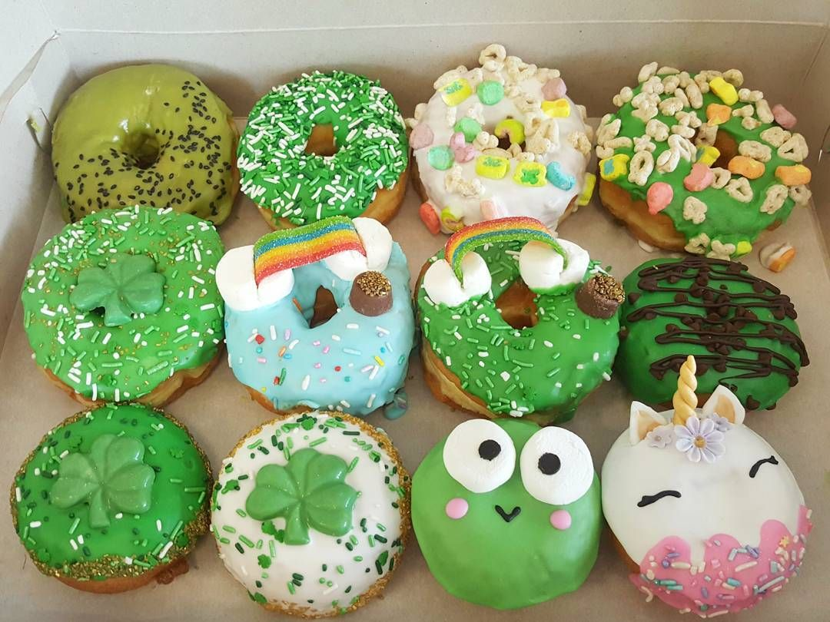


Slide 6


Slide 8


Slide 10


Slide 12


Slide 14


Slide 16
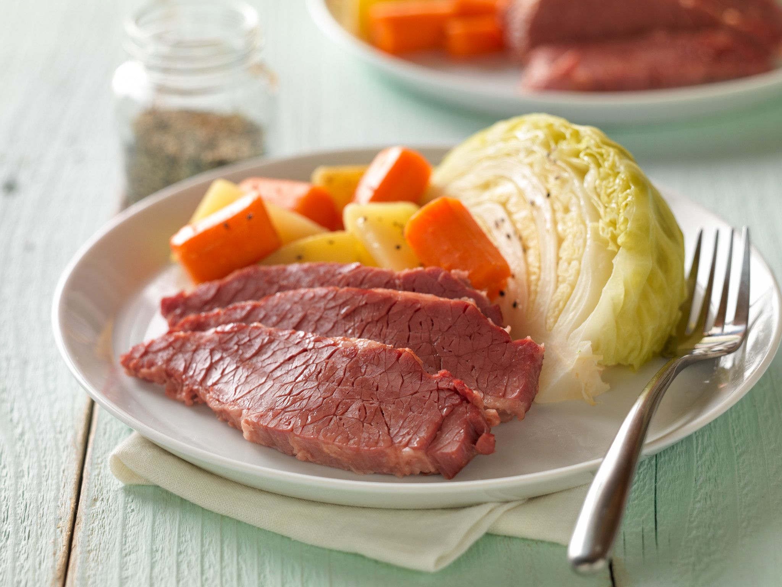

Slide 18


Slide 20


Slide 22


Slide 24


Slide 26


Slide 28


Slide 30


