Slide 1
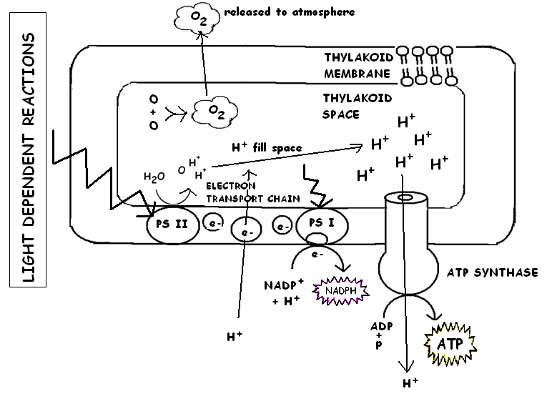
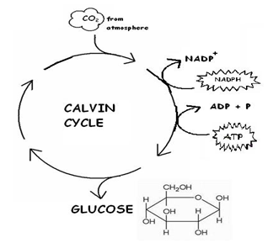
Photo - Synthesis
Light Dependent Reactions
Takes place in:
What happens?
Light Independent Reactions
Also called:
Takes place in:
What happens?
Thylakoid membranes
Calvin Cycle
Stroma
11
Light
Energy
RuBP
Light excites chlorophyll, splits H₂O, produces ATP & NADPH
CO₂ is fixed in carbohydrate using energy from light reactions

Slide 3
Cell Respiration
Glycolysis
Where:
What happens:
Energy:
Uses:
Produces:
ANAEROBIC – NO O₂:
Fermentation:
Citric Acid or Krebs Cycle
Where:
AEROBIC RESPIRATION
Energy:
Electron
Carriers
Oxidative Phosphorylation
Where:
Electron Transport Chain (ETC)
Energy:
Final electron acceptor:
Cytoplasm
Mitochondrial matrix
Inner membrane
Pyruvate
Pyruvate
Glucose splits
Oxidized to
2 Acetyl CoA
2 ATP
Citric Acid
4 ATP
2 NADH
e- H⁺
CO₂ &
NADH
Series of reactions
2 CO₂
Alcohol (yeast)
Glucose → pyruvate →
Alcohol+ 2CO₂ + 2ATP + 2 NAD+
e- H⁺
ATP
2 ATP
e- + H⁺
Electron
carriers
e- H⁺
32 ATP total
Lactic acid (muscle cells)
Glucose → pyruvate →
Lactic acid + 2ATP + 2 NAD+
ATP Synthase
2 NADH
from pyruvate oxidation
6 NADH
from Krebs
2 FADH₂
Oxygen of H₂O
H₂O
28 ATP

