Slide 1

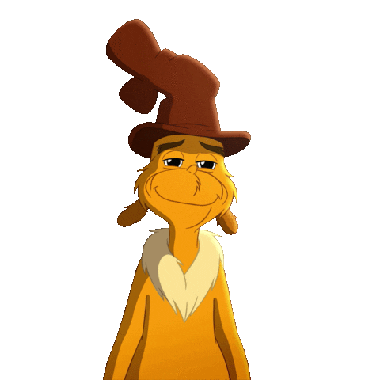
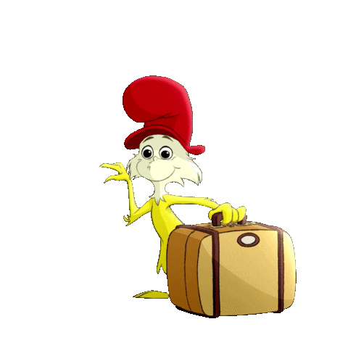
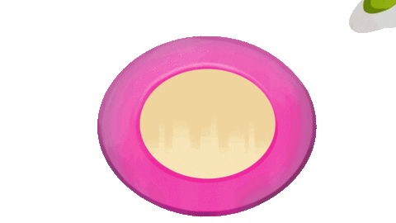
Green Eggs
and Ham
By: Dr. Seuss

Slide 2
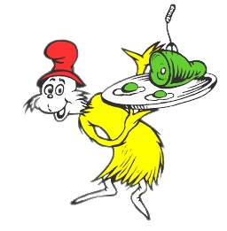
I am Sam - Sam I Am…
And I need your help with a plan.
I am going to check your brain
To see the information
you retain.

Slide 3

Today, we will take some time
I will read and you will rhyme.
I will read a story part,
And you will say the rhyme by heart!

Slide 4
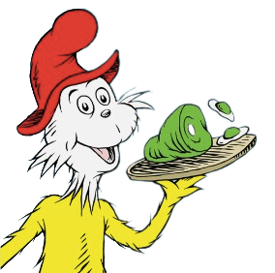
I am Sam.
Sam I ____.
am

Slide 5
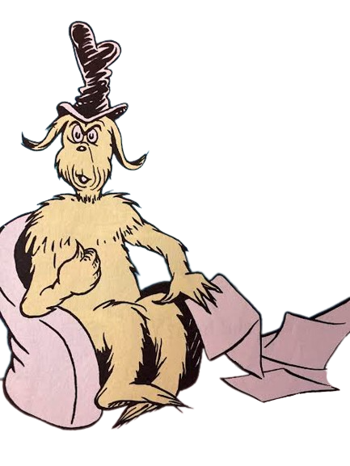

That Sam -I -Am!
That Sam- I -Am!
I do not like that
Sam -I - _____!
am

Slide 6
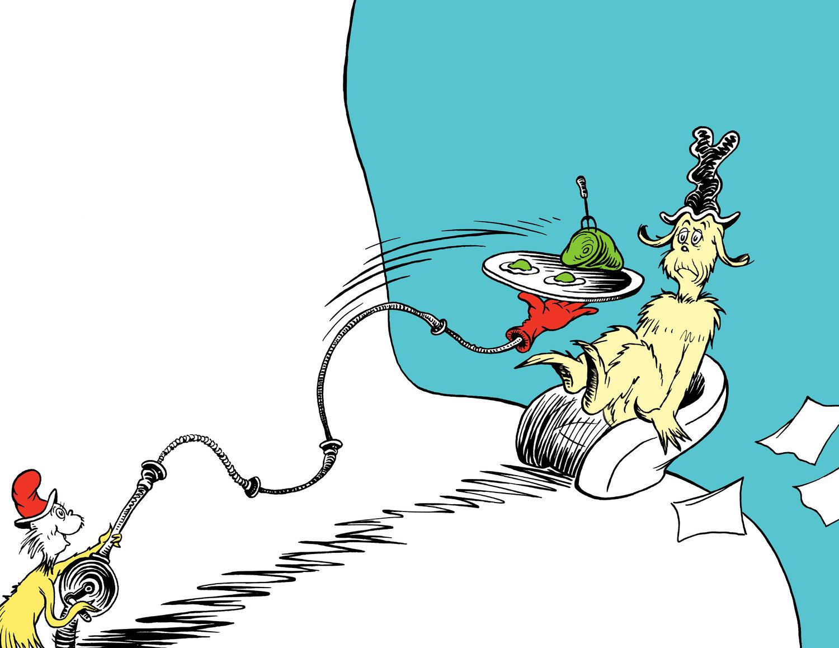
Do you like
green eggs and ________ ?
ham
jam
ham
spam

Slide 7
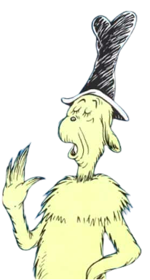
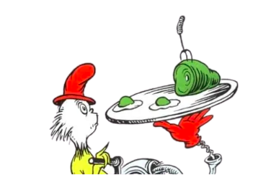
I do not like them,
Sam - I- am.
I do not like
green eggs and ham.

Slide 8

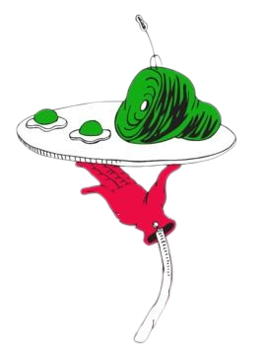
Would you like them here or there?
here
there

Slide 9
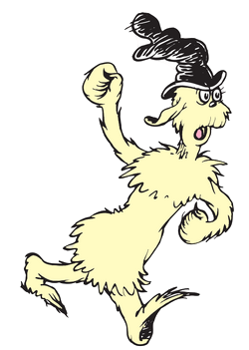
I would not like them
here or there,
I would not like them
________________!
anywhere
in a chair
in my hair
anywhere

Slide 10

I do not like
green eggs and ham.
I do not like them
Sam - I - am!

Slide 11
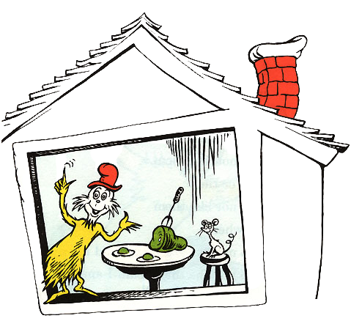
Would you like them in a house?
Would you like them with a
_____________?
mouse
spouse
blouse
mouse

Slide 12
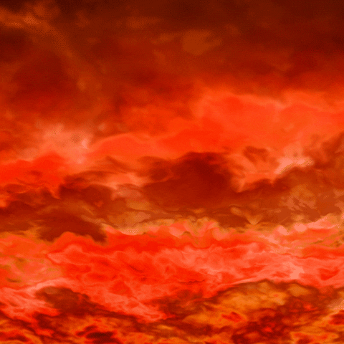
I do not like them in a house.
I do not like them with a mouse.
I do not like them here or there.
I do not like them anywhere.
I do not like green eggs and ham.
I do not like them, Sam- I- am!

Slide 13
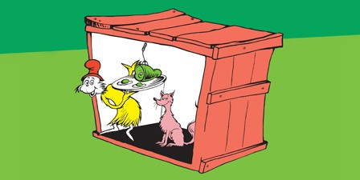
Would you eat them in a
_____?
box
box
rock
sock
Would you eat them with a fox?

Slide 14

Not in a box.
Not with a _______.
Not in a __________.
Not with a mouse.
I would not eat them here or _______.
I would not eat them anywhere!
I would not eat green eggs and _____.
I do not like them, Sam-I-am!
fox
house
there
ham

Slide 15
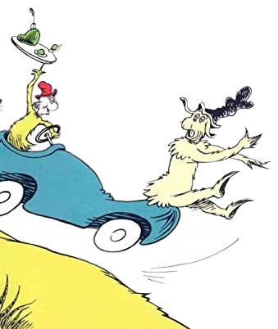
Would you? Could you?
In a car?
Eat them! Eat them!
Here they _______.
are
I would not, could not,
in a car.

Slide 16
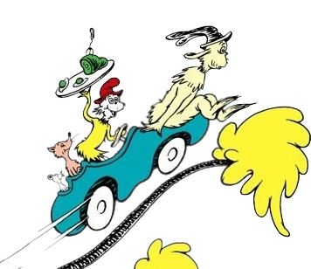
You may like them.
You will see.
You may like them
In a ___________!
tree
sea
tree
flea

Slide 17
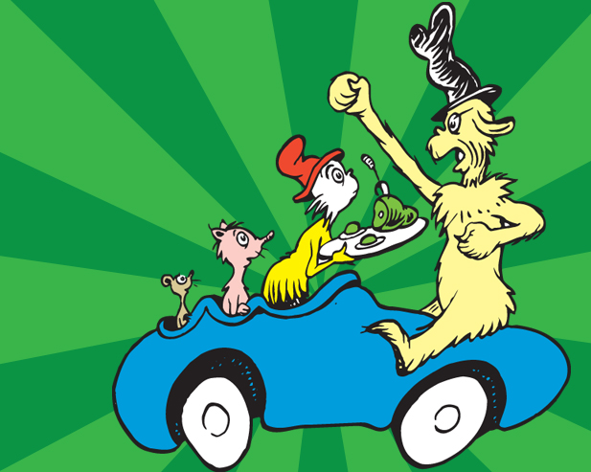
I would not, could not in a tree.
Not in a car.
You let me _____.
be
see
be
free

Slide 18

I do like them in a box.
I do not like them with a fox.
I do not like them in a house.
I do not like them with a mouse.
I do not like them here or there.
I do not like them anywhere.
I do not like green eggs and ham.
I do not like them, Sam-I-am!

Slide 19
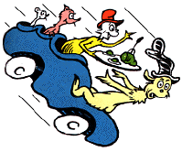
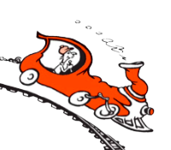
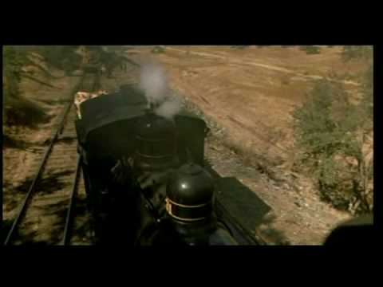
A train! A train!
Could you, would you,
on a train?

Slide 20

Not in a train! Not in a tree!
Not in a car! Sam! Let me _______!
I would not, could not in a ______.
I could not, would not, with a fox.
I will not eat them with a mouse.
I will not eat them in a ____________.
I will not eat them here or there.
I will not eat them _________________!
I do not like green eggs and ham.
I do not like them Sam- I - _______.
be
box
house
anywhere
am

Slide 21
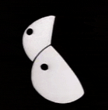

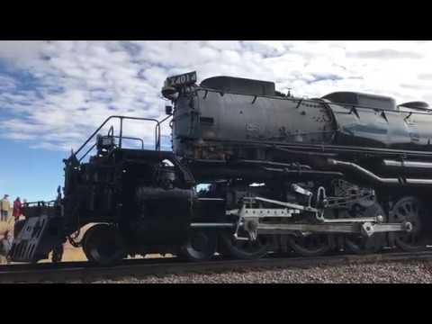
Say!
In the dark?
Here in the dark!
Would you, could you, in the dark?
I would not, could not, in the dark.

Slide 22



Would you, could you
In the rain?

Slide 23
I would not, could not in the rain.
Not in the dark. Not on a __________.
Not in a car. Not in a tree.
I do not like them, Sam, you _______.
Not in a house. Not in a box.
Not with a mouse. Not with a ________.
I will not eat them here or__________.
I do not like them anywhere.
train
see
fox
there

Slide 24

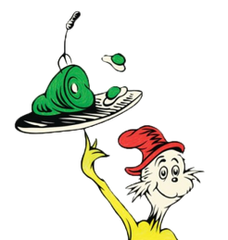
You do not like green eggs and ham?
I do not like them Sam - I - am?

Slide 25
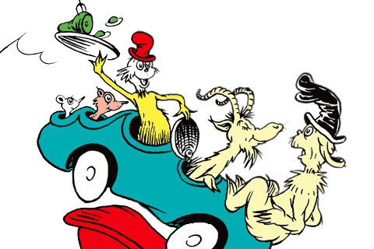
Would you, could you with a goat?
I would not, could not with a goat.

Slide 26
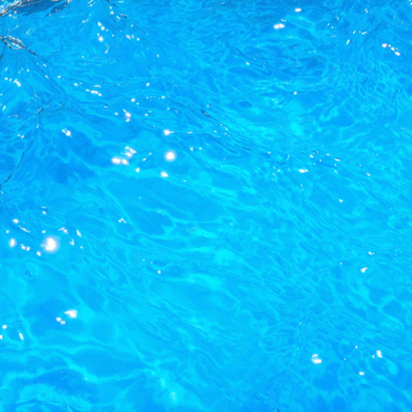
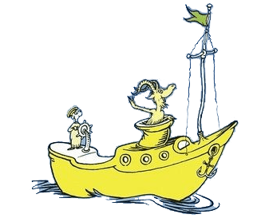
Would you, could you, on a boat?

Slide 27
I could not, would not, on a boat.
I will not, will not, with a _________.
I will not eat them in the ___________.
I will not eat them on a train.
Not in the dark! Not in a tree!
Not in a car! You let me __________.
I do not like them in a box.
I do not like them with a _________.
goat
rain
be
fox

Slide 28
I will not eat them in a house.
I do not like them with a ____________.
I do not like them here or there.
I do not like them ___________________.
mouse
anywhere

Slide 29
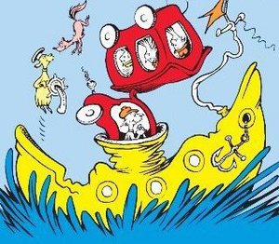


Slide 30
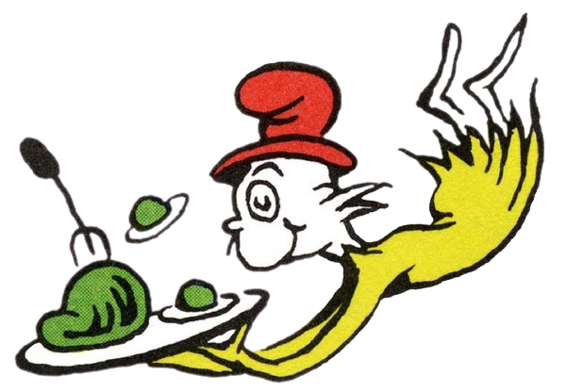
I do not like them Sam - I-am!

Slide 31
You do not like them.
So you say.
Try them! Try them!
And you __________.
may
may
play
day

Slide 32
Sam!
If you will let me be,
I will try them.
You will ________.
see

Slide 33
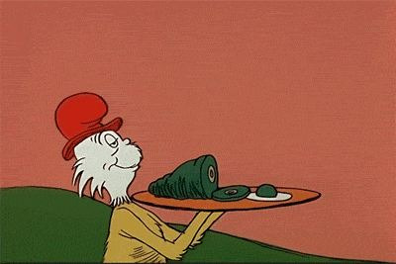

Slide 34

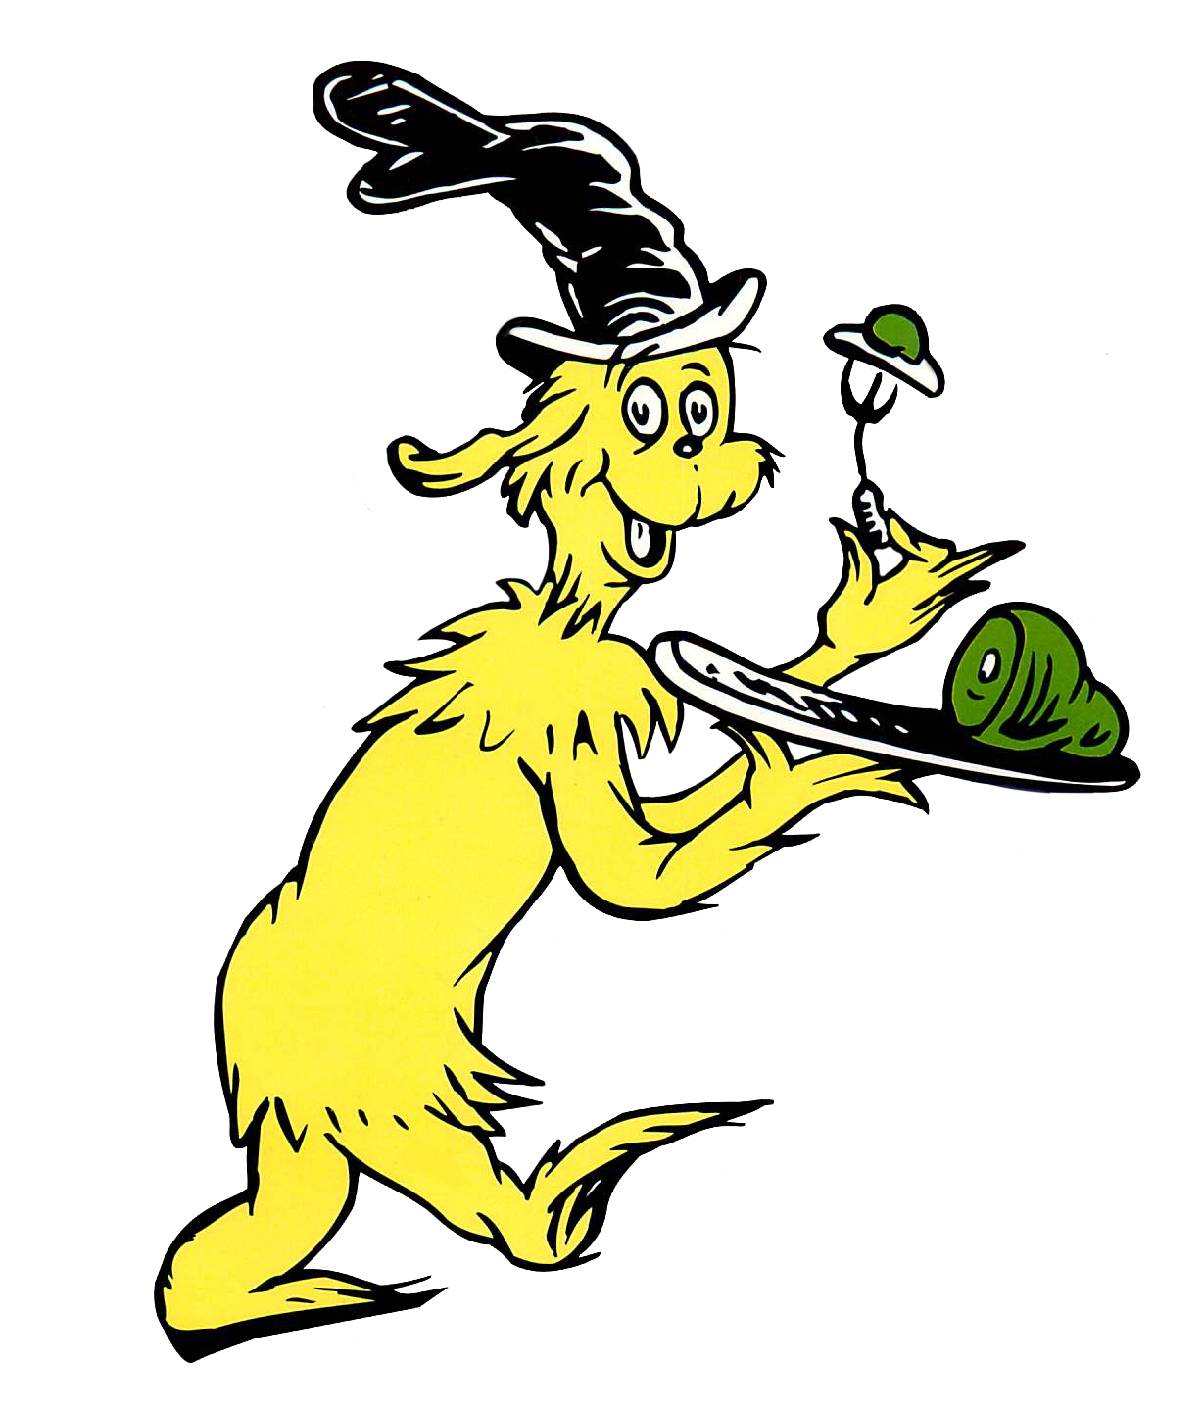
Say!
I like green eggs and ham!
I do! I like them, Sam-I-am!
And I would eat them in a boat.
And I would eat them with a
_________________.
goat

Slide 35
And I will eat them in the rain.
And in the dark. And on a
_____________.
And in a car. And in a tree.
They are so good, so good,
you ___________.
train
see

Slide 36

So I will eat them in a box.
And I will eat them with a _______.
And I will eat them in a _________.
And I will eat them with a mouse.
And I will eat them here and there.
Say! I will eat them ______________.
fox
house
anywhere

Slide 37

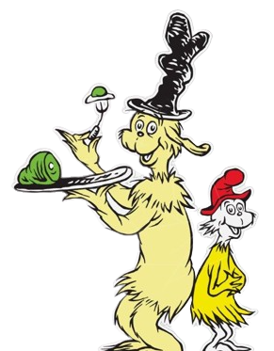
I do so like
Green eggs and _________ !
Thank you!
Thank you!
Sam- I- am!
ham

Slide 38


