Slide 1
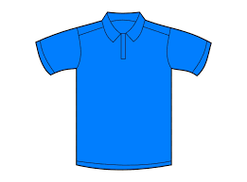
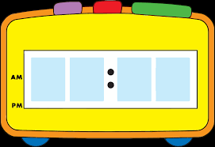






Google Meet Expectations
-Be on time for all classes and follow your schedule.
-Check your technology and log on a few minutes early.
-Check your email before you start your first class and multiple times during the day.
-Dress in school appropriate clothes for all your classes
-Check your surroundings
1
2
3
8 15
-Remember to mute yourself when joining your class.
-Focus, Pay attention and be an active participant.
-Use your computer where there is proper lighting.
-Chat responsibly. No side conversations on chatbox
-Use the chatbox if you have a question.
4
5
6

