Slide 1





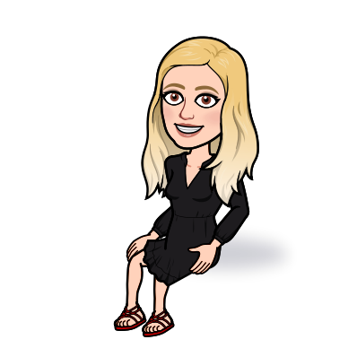











Dates for the Week
PRIMARY

Slide 2
Dates for the Week
SECONDARY

Slide 3




Dates for the Week
ARTICULATION

Slide 4



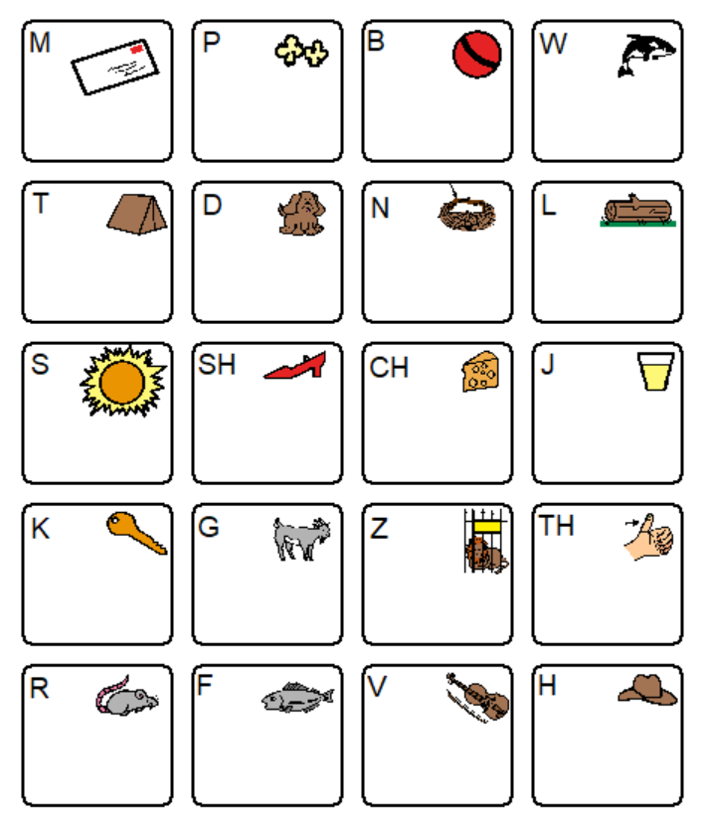















W
E
L
C
M
E
Welcome to Speech
Click on a mouth for a short video of how to make that sound!
NEXT

Slide 5

W
E
L
C
M
E
Click on the picture. Look for your sound and click on the initial position PDF. Now it is time to practice some words!
NEXT

Slide 6



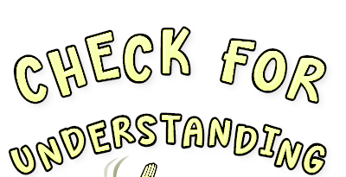


W
E
L
C
M
E
Do you understand what you are working on?
Click here to find out!

