Slide 1

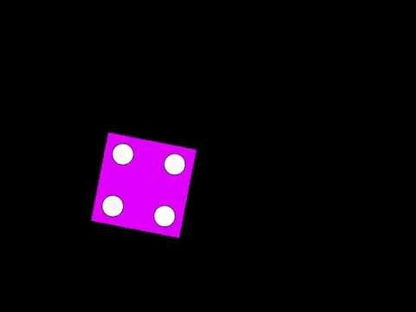

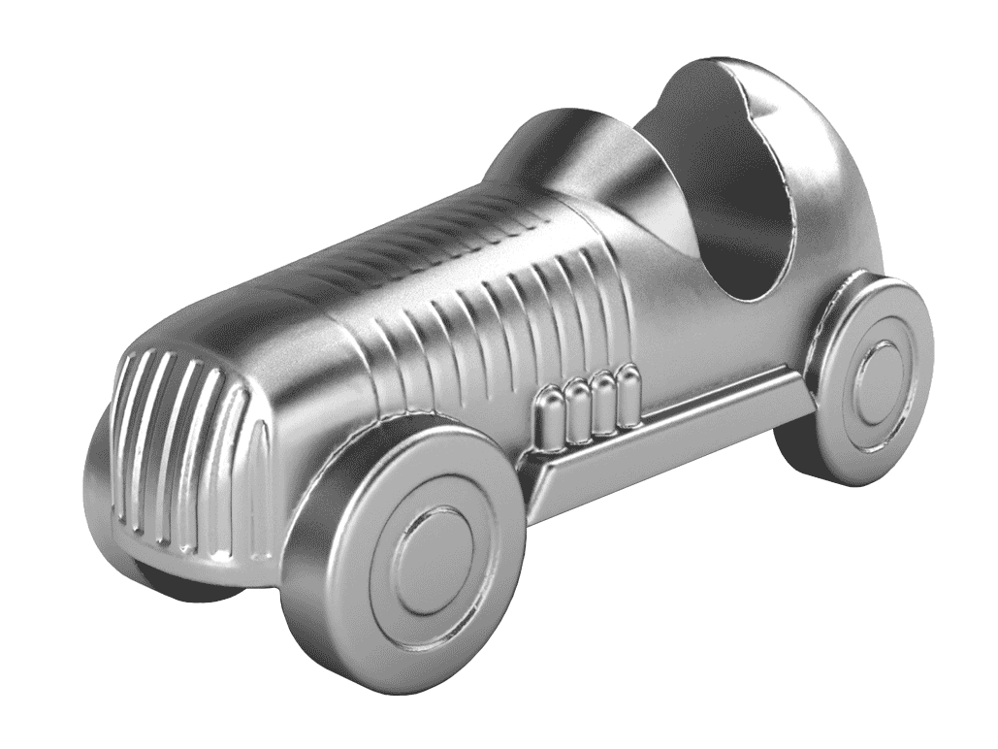
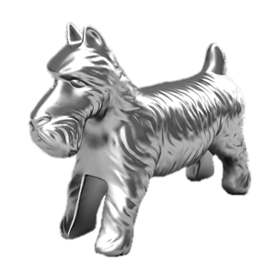
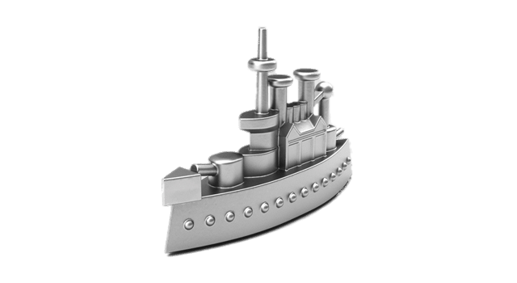
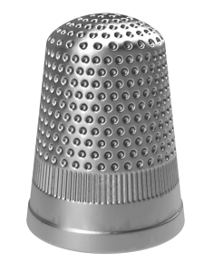
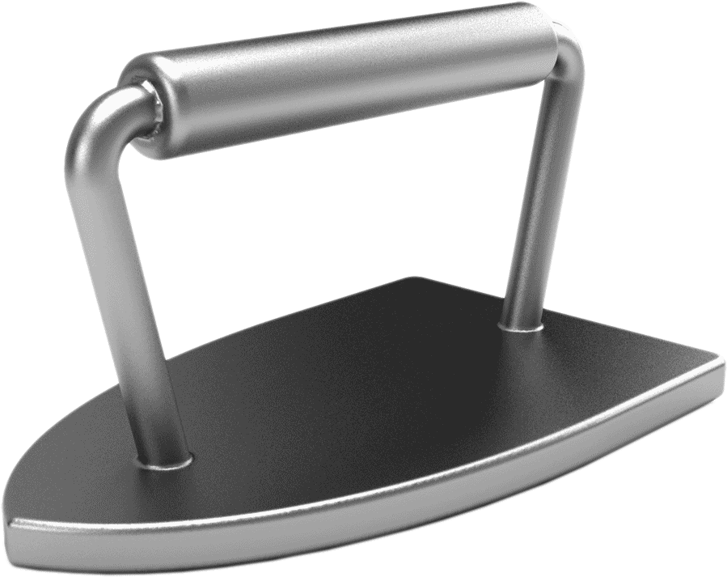
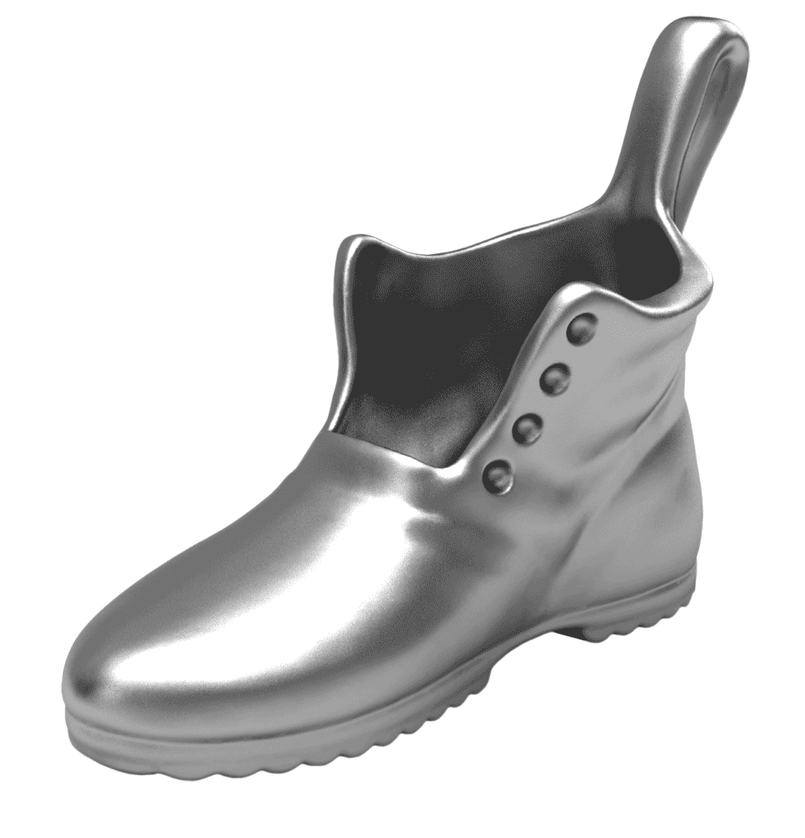
Follow the Color Brick Road
Tap to roll the die in the middle. Tap again to stop. Move that many spaces
RED:
10 arm circles PURPLE:
8 torso twists YELLOW:
12 arm pumps GREEN:
10 freestyle strokes
ORANGE:
10 backstroke
BLUE:
Skip 1 lap
Pick
Your
Playing
Piece

