Slide 1
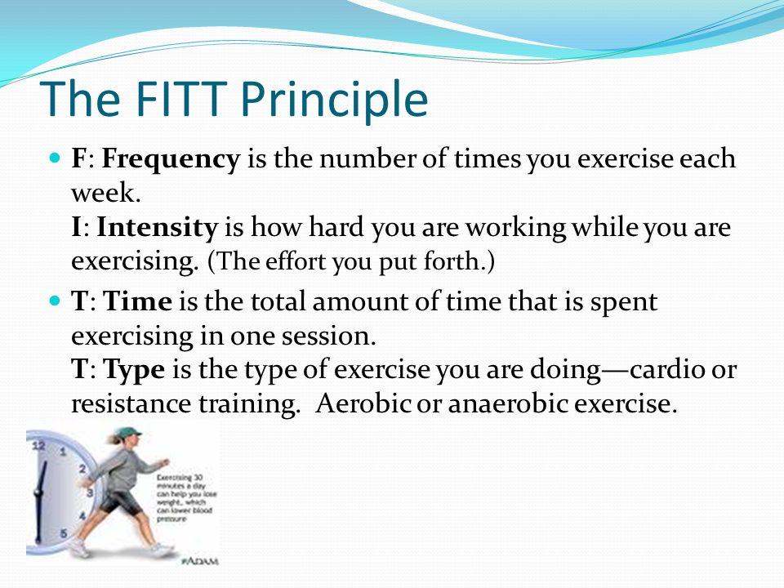
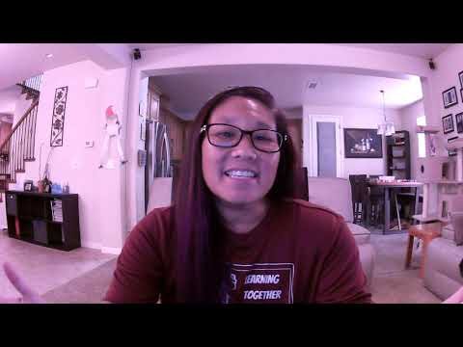

Slide 2
How do you decide the frequency - that’s easy….how many days a week do you do activity?
How do you decide the intensity - there are several ways (how hard you are breathing, how you feel, how much you are sweating, and how fast your heart is beating. Your heart rate is the only objective way to determine it (meaning it is not your opinion, but more of a fact)
How do you determine the time - this is easy, too. It is simply how many minutes you exercised in that day
How do you determine the type - this one can be more difficult. Sometimes an activity could fit two different categories.

Slide 3
Heart Rate
The number of times your heart beats in 1 minute
Also called your “pulse”
It is lower at rest and higher when you are moving
It is DIFFERENT than your blood pressure! Your heart rate is simply the number of times your heart beats in 1 minute. Your blood pressure is the pressure against the walls of your blood vessels when it beats. A high heart rate can be ok, but a high blood pressure is not.
It can tell you about your health

Slide 4
Heart Rate (continued…..)
RESTING HEART RATE
Your heart rate when you are at rest and not doing any moving. A true resting heart rate should be taken when you first get up or after you have been laying down, not moving for several minutes. It is different for all people, but is generally around 100 or lower

Slide 5
Heart Rate (continued….)
MAXIMUM HEART RATE
The maximum number of times your heart can beat in one minute. Everyone is different, but for most people it really should not be higher than 225.

Slide 6
Heart Rate (continued….)
RECOVERY HEART RATE
when you are done exercising immediately take your heart rate. Wait 1 minute and take your heart rate again. It should have decreased by about 20-30 beats per minute….more is GREAT. Less CAN mean you have health issues, especially if it is less than 7!

Slide 7
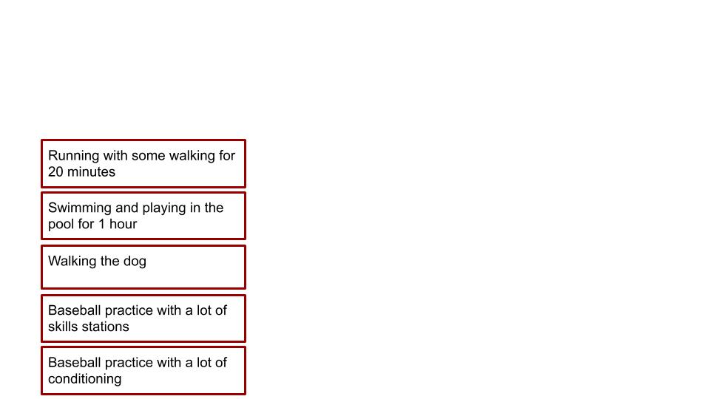
DIRECTIONS:
Label each exercise below as Low or high INTENSITY. Be careful not to delete the text box. IF you do, just go to the top and click “insert”, choose text box, click on the screen where you want it, use arrows to resize it

Slide 8
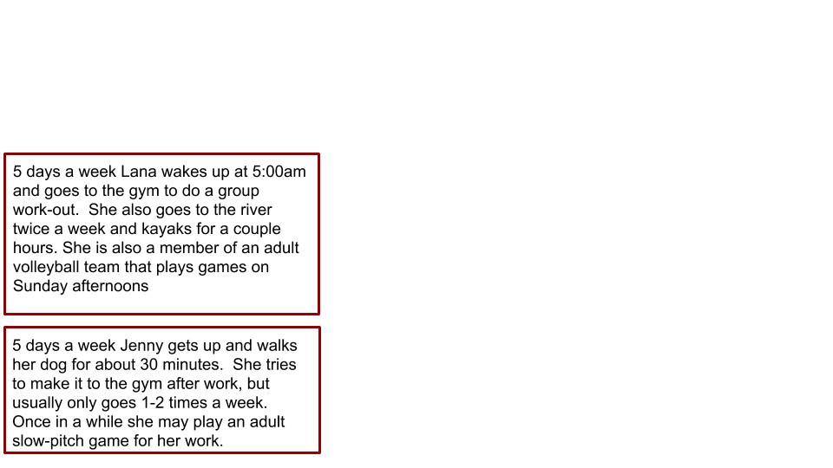
Read each exercise scenario below and then comment on each in terms of the FITT principles. Make sure you talk about frequency, intensity, time, and type

Slide 9
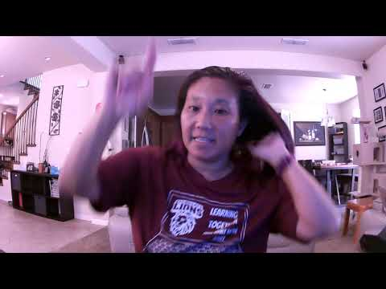

Slide 10
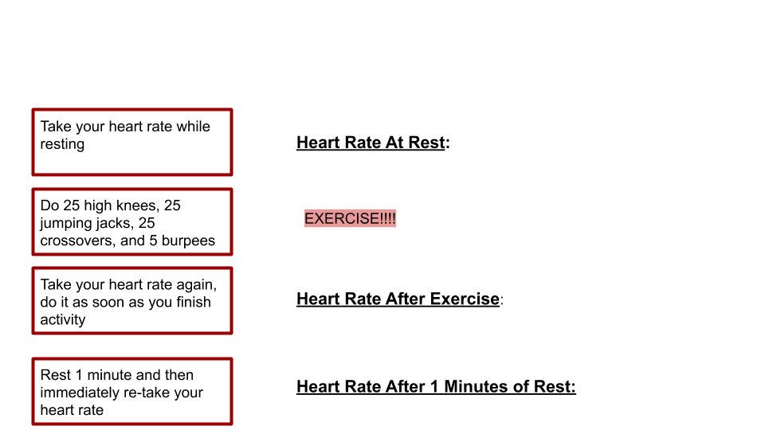
Directions: Follow the directions and input the data!

