Slide 1
Station 1: Read class syllabus
Pick up a copy of the class syllabus
Read the ENTIRE THING. No skipping around. There’s important stuff in there!
  Highlight things you want to remember for later
Your first homework assignment is for you and your parent/guardian to sign the signature page and return it, stating that you understand the rules and regulations of the Biology classroom.

Slide 2
Station 2: Asking Questions
Examine the image in front of you for one minute
Add three questions the image makes you think of to the chart paper.
Using a sticky note, write the number your favorite question (does not have to be your own), and put it on the second piece of chart paper

Slide 3
Station 3: Read the safety contract
My #1 Goal is to send you home safe.
My #2 Goal is to send you home smarter.
Rather obviously, you have a hand in your own safety. I require adherence to all safety rules in class. Read the safety contract.
  The biggie: YOU MAY NOT EAT IN CLASS.
Your second homework assignment is to sign the laboratory safety contract.

Slide 4
Station 4: Developing and Using Models
Using the paper at the station, create a model to represent your class schedule at T-STEM Academy at East High School
Leave it at the station with your name on the back
On someone else’s model, use a sticky note to suggest one change they can make to enhance their model

Slide 5
Station 5: Get absent buddies
Find TWO people with whom you want to be absent buddies, and trade contact info with them. Make sure you are buddies with someone who is in different extracurricular activities than you.
Program them into your phone!
What’s an absent buddy do?
  You text them BEFORE you are absent, ask them to pick up extra handouts, take awesome notes, and listen for any details about homework
  You meet up AFTER you are absent to get those handouts and to talk about what you missed in class.
Why do you need two?
  Just in case one of them is absent the same day as you. It happens. ☺

Slide 6
Station 6: Planning and Carrying Out Investigations
Choose one of the envelopes of protocols at this station
On the sheet of paper with the corresponding label, write the order you think the protocol goes in (use the numbers on the slips of paper)

Slide 7
Station 7: Meet your teacher!
Pick up and fill out the student survey.
Give it to your teacher and introduce yourself.
Ask your teacher one question that you would like to know the answer to.

Slide 8
Station 8: Analyzing and Interpreting Data
Examine the data on the sheet at this station
On a sticky note, write a conclusion that you can come to using this data
Add your sticky note to the chart paper

Slide 9
Station 9: Classroom Norms
Science class is a place to share ideas, and debate about data and evidence.
In order for this to be a safe place for these class discussions, we need to respect one another as peers
On a sticky note, please share one classroom norm you would like our class to have
  *The norms must be school appropriate and cannot violate SCS, T-STEM, or Syllabus policy
Place the sticky note on the chart paper

Slide 10
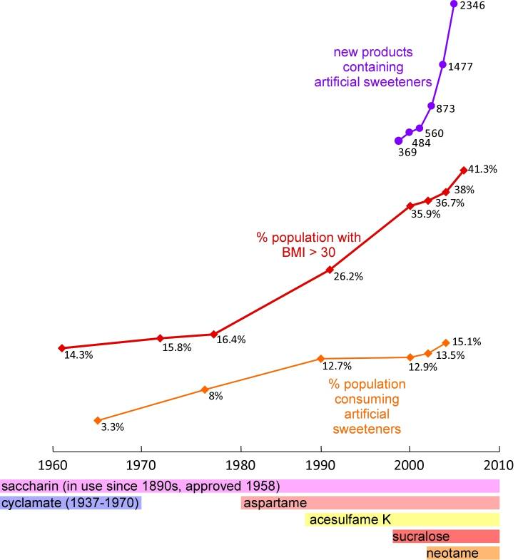
Station 10: Engaging in an Argument from Evidence
We will be using the CER method throughout the year in this class. CER stands for Claim-Evidence-Reason.
  A CER Infographic is included at the station
Using the CER table at this station, create a Claim-Evidence-Reason argument to answer the question “What effect do artificial sweeteners have on obesity?” using the data

Slide 11
Station 11: SMART Goals
Using the sheet at the station, create one SMART Goal for Quarter 1 of this class specifically
Analyze your goal using the SMART Goal Analysis chart
Finalize your goal and hand it in to the inbox for your class by Friday. This is your third homework assignment.

Slide 12
Station 12: Textbook
Grab a textbook for your class from the stack
Put your name in the textbook in sharpie, with the year and book condition
Bring the book to your teacher, to write the number in the log book
Sign the log book

