Slide 1


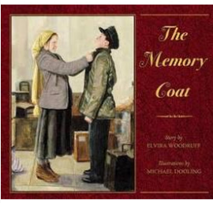










Notes:
SS.4.1 – Compares life in the past to life today.
SSC.4.3 – Explains how culture influences the way people modify and adapt to their enviornments.

Slide 2













Notes:
SS.4.1 – Compares life in the past to life today.
SSC.4.3 – Explains how culture influences the way people modify and adapt to their enviornments.

