Slide 1
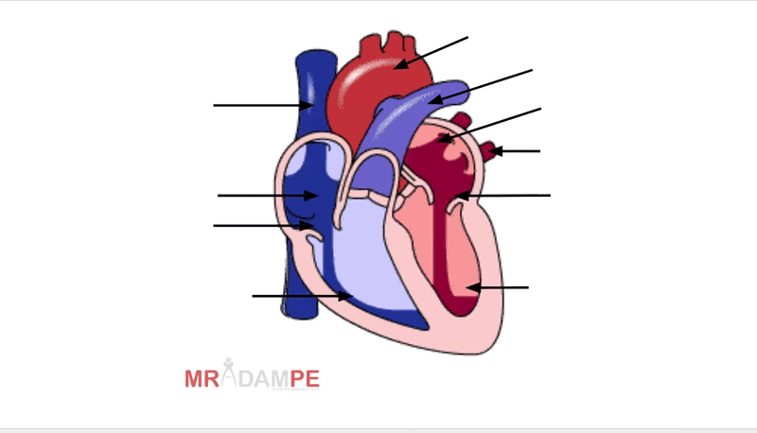










Drag the labels to the correct part of the heart

Slide 2
GLOs
Recognizes that when you move fast, your heart beats faster and you breathe faster. S3.E3.K
Identifies the heart as a muscle that grows stronger with exercise, play, and physical activity. S3.E3.1
Defines resting heart rate and describes its relationship to aerobic fitness and the Borg Rating of Perceived Exertion (RPE) Scale. S3.M13.6

