Slide 1


Read Across America Week

Slide 2








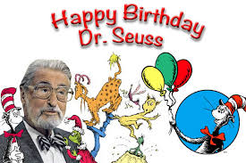







Slide 3



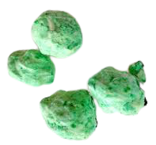
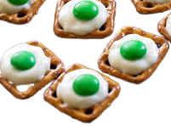

In honor of Green Eggs and Ham, wear GREEN!
Monday’s Spirit Day - Wear Green
Science Experiment
Tasty Treat

Slide 4



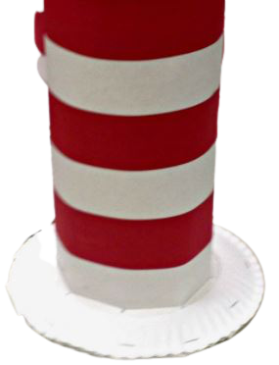
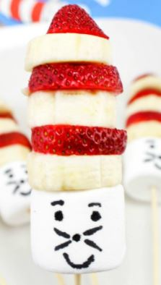

Tuesday’s Spirit Day - Wear a Hat
In honor of The Cat in the Hat, wear your FAVORITE HAT!
Getting Crafty
Tasty Treat

Slide 5




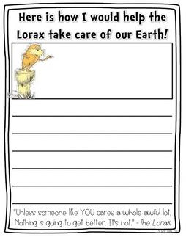
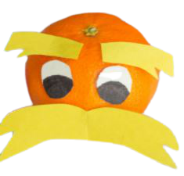
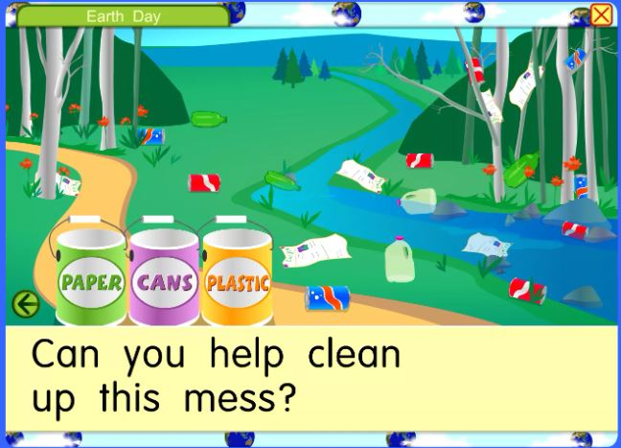
In honor of the Lorax, wear a MUSTACHE!
Wednesday’s Spirit Day - Wear a Mustache
Tasty Treat
Write it Out

Slide 6

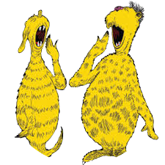



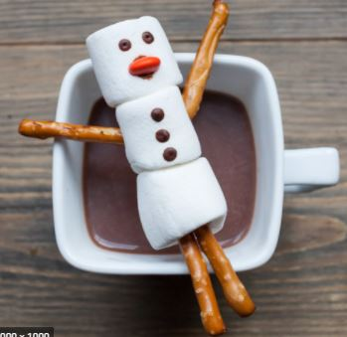
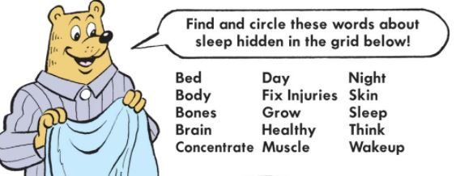
Thursday’s Spirit Day - Wear Pajamas
In honor of The Sleep Book, wear your PAJAMAS!
Getting Crafty
Tasty Treat

Slide 7
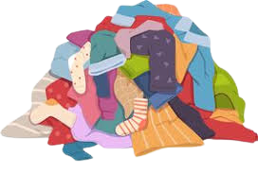
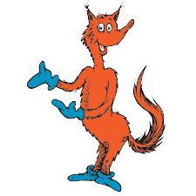
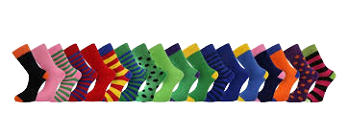

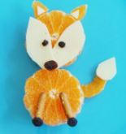

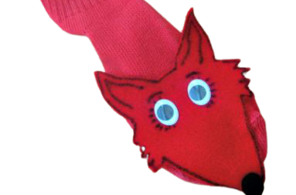
In honor of Fox in Socks, wear your FAVORITE SOCKS!
Friday’s Spirit Day - Wear Fun Socks
Getting Crafty
Tasty Treat

