Slide 1

































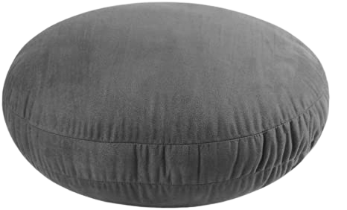
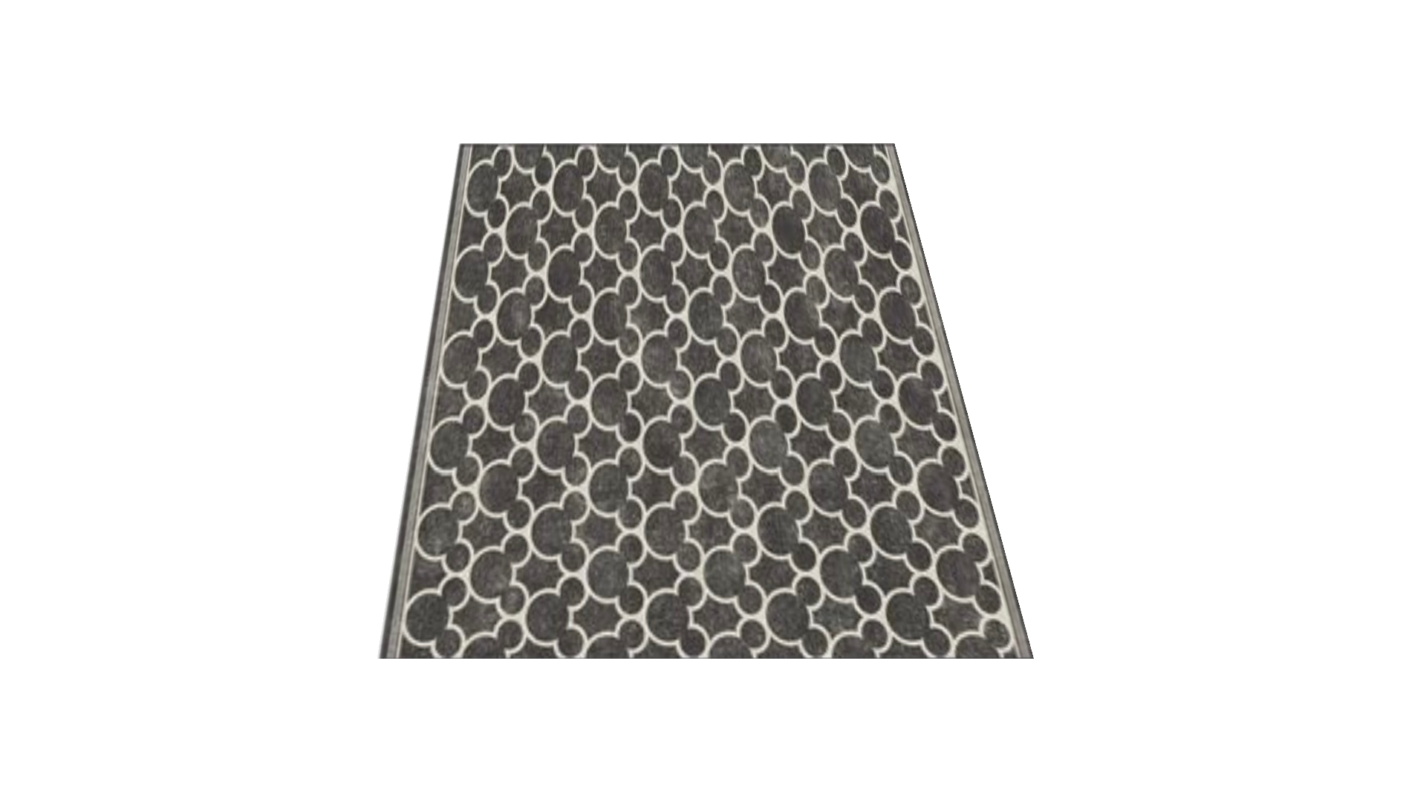
Notes:
Not to be sold, whether modified or as-is. These slides are for personal, non-commercial, use by classroom teachers.
Created by Pamela Bradley.

