Slide 1

Dr. Seuss Biography
Read Across America

Slide 2
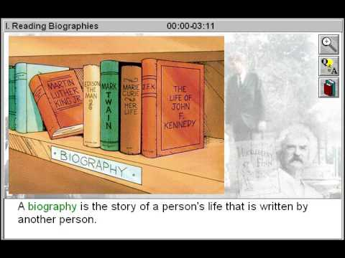

Slide 3


Slide 4
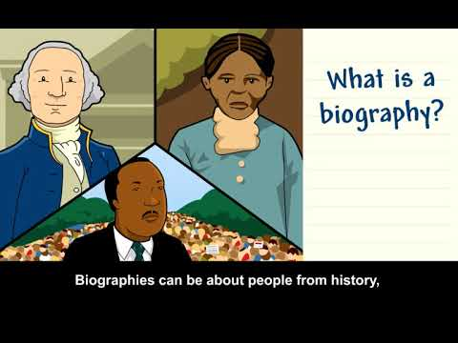

Slide 5


Slide 6
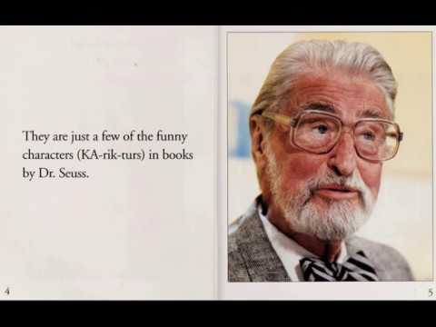

Slide 7
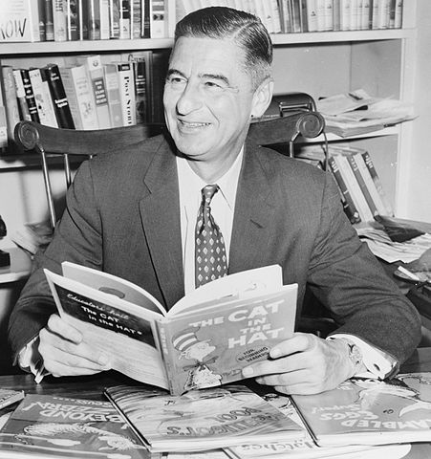
Fill in the graphic organizer after listening to the biography.

Slide 8
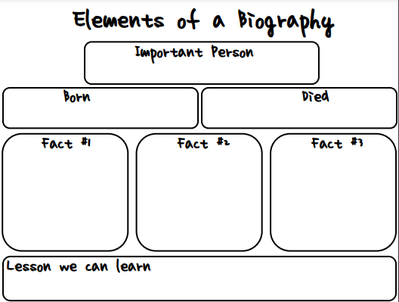
________ 1904
September 24,1991

Slide 9


Slide 10
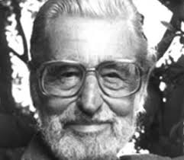
Here are a few of his books we have not read.
Compare the two types of books, his biography - nonfiction and his works - fiction, at the end.

Slide 11


Slide 12
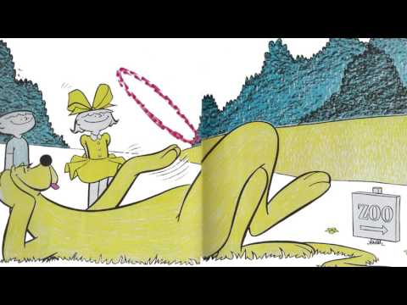

Slide 13


Slide 14


Slide 15


Slide 16
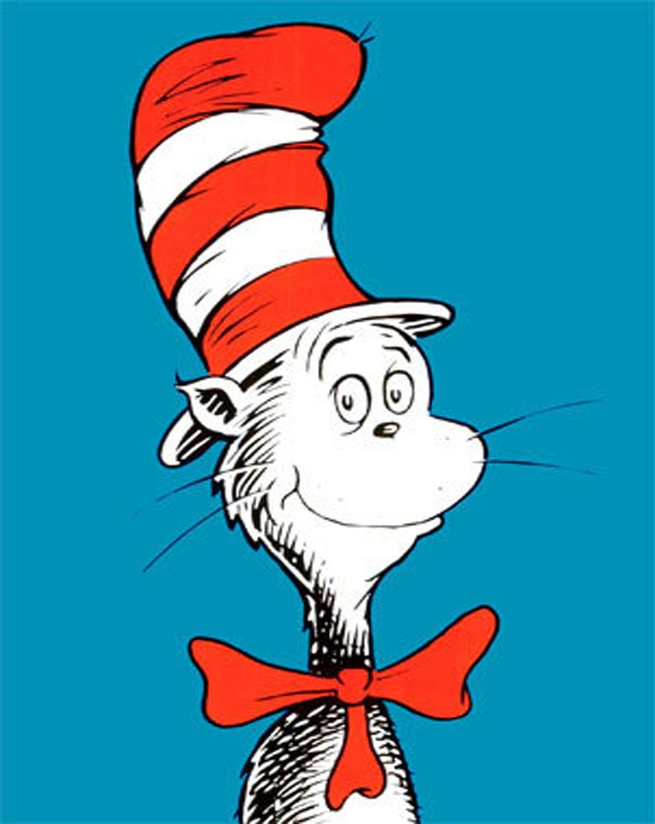
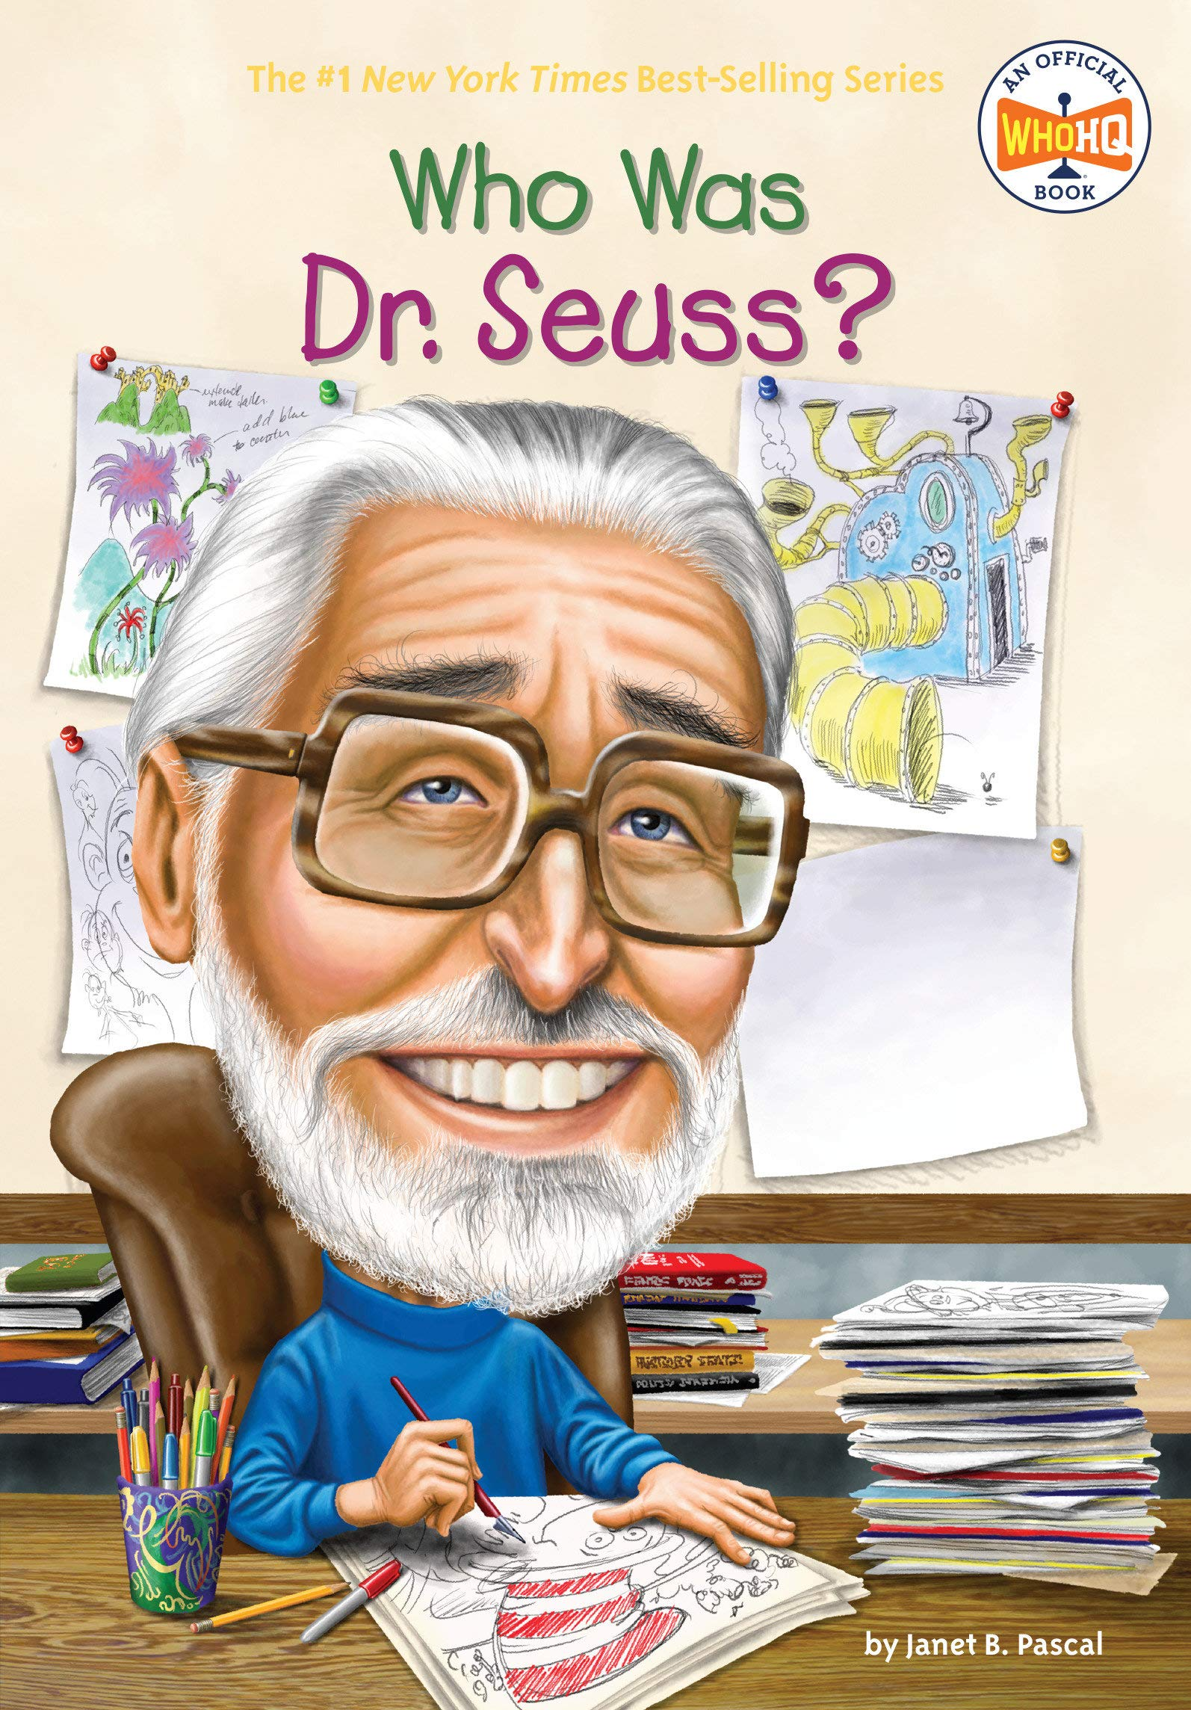
COMPARE AND CONTRAST
Fiction
Non Fiction
Both
GIVES FACTS
MADE UP PEOPLE
LITERATURE
MAKE BELIEVE STORY
BOOK GENRES
REAL PEOPLE

