Slide 1


Tic Tac Toe
To play the game share the link (make sure they have access to edit it) in the Zoom chat and then assign two kids per break out room. The room they go in is the slide they will play on.

Slide 2


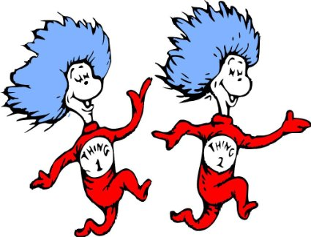

Slide 3



Slide 4



Slide 5



Slide 6



Slide 7



Slide 8



Slide 9



Slide 10



Slide 11



