Slide 1
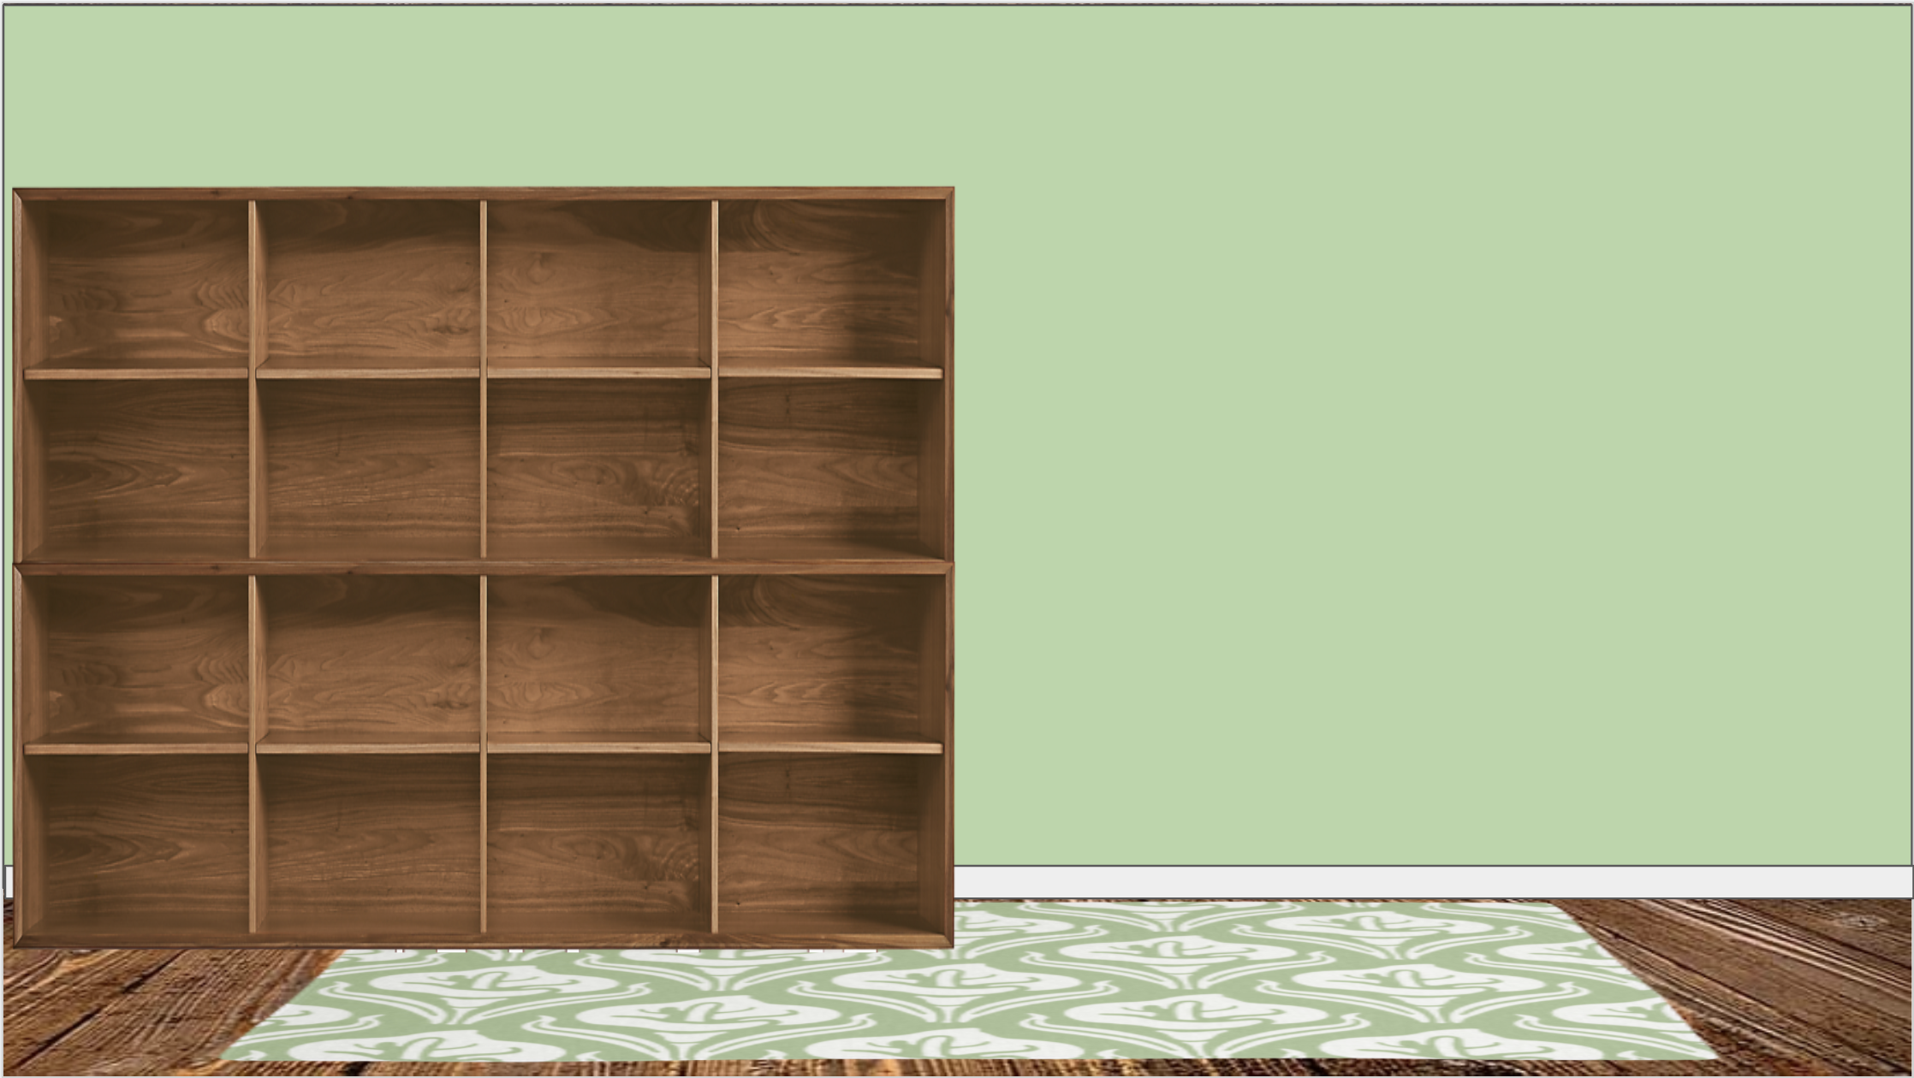

















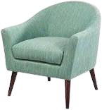




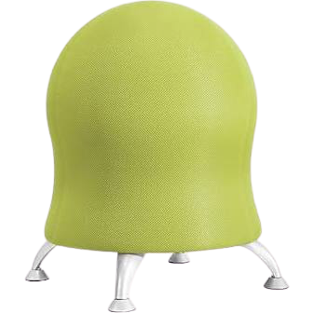

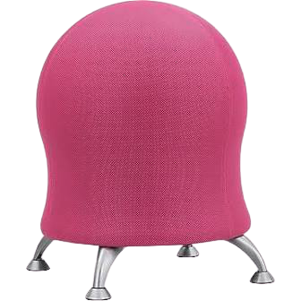
Notes:
This room was created with minimal furnishings and accessories as to not overstimulate students with special needs. The colors are calming and the room is simplistic for ease of use :) https://docs.google.com/presentation/d/e/2PACX-1vQFDNWxi3RODQ4_VUFvLUMnzTf59KNHnTgT8WRbkWwFZF_DAnjpI3v8mYsfJv5pG7PreUcnVbE7cPeO/pub?start=false&loop=false&delayms=00000

